Slide 1
Writing Linear Equations 2 Section 8.1

Slide 2
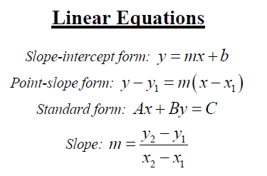
Review of formulas covered in Chapter 3:

Slide 3
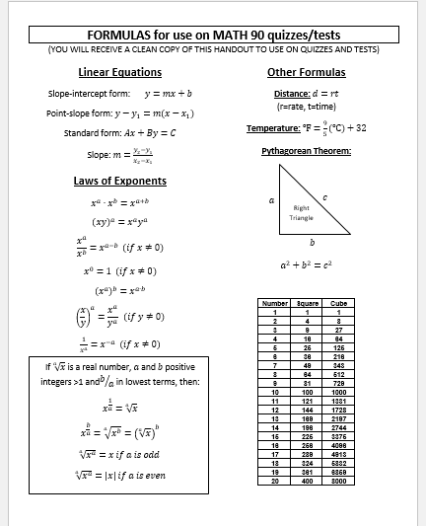
Note: You can use a printed copy of the sheet containing formulas on quizzes/tests. (You can view/print a copy of the formula sheet online by clicking on the “Formula sheet” menu button.)
Keep a copy of this sheet in your notebook to use while you do your homework assignments and practice quizzes/tests so you know which ones will be available to you on the sheet and where to find them.

Slide 4
Last session we applied the point-slope formula to problems in which we were given the slope and one point on the line.
Today we’ll be applying the point-slope formula to problems with different sets of information:
Example: What if we’re given TWO POINTS on the line?
Find the equation of the line through (-4,0) and (6,-1). Write the equation in standard form.
First find the slope.

Slide 5
Example (cont.)
Now substitute the slope and either one of the points into the point-slope formula.
(This would give
but we need standard form.)
For standard form, clear fractions by multiplying both sides by 10.
(use distributive property)
(add x to both sides)

Slide 6
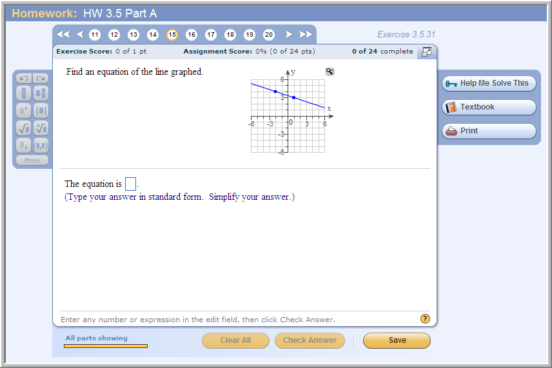
Problem from today’s homework:
Answer in slope-intercept form:
y = -1/3x +10/3
Answer in standard form:
x + 3y = 10

Slide 7
Quick review: parallel and perpendicular lines
Nonvertical parallel lines have identical slopes.
Nonvertical perpendicular lines have slopes that are negative reciprocals of each other.
Remember: If you rewrite linear equations into slope-intercept form (i.e. solve for y), you can easily determine the slope.

Slide 8
Example
Find an equation of a line that contains the point (3,-5) and is perpendicular to the line 3x + 2y = 7. Write the equation in slope-intercept form.
First, we need to find the slope of the given line.
2y = -3x + 7 (subtract 3x from both sides)
(divide both sides by 2)
Since perpendicular lines have slopes that are negative reciprocals of each other, we use the slope of 2/3 for our new equation, together with the given point (3,-5).

Slide 9
Example (cont.)
(multiply by 3 to clear fractions)
(use distributive property)
(subtract 15 from both sides)
(simplify)
(divide both sides by 3)

Slide 10
Example:
Find an equation of a line that contains the point (-2,4) and is parallel to the line x + 3y = 6. Write the equation in standard form.
First, we need to find the slope of the given line.
3y = -x + 6 (subtract x from both sides)
y = x + 2 (divide both sides by 3)
Since parallel lines have the same slope, we use the slope of for our new equation, together with the given point.

Slide 11
Example (cont.)
(multiply by 3 to clear fractions)
(use distributive property)
(add x to both sides) (Why? Because they want it in STANDARD form)
(add 12 to both sides)
What would this look like in slope-intercept form?

Slide 12
Example:
Find the equation of the line parallel to y = -4, passing through the point (0,-3).
The line y = -4 is a horizontal line (slope = 0).
If the new line is parallel to this horizontal line y = -4, then it must also be a horizontal line.
So we use the y-coordinate of our point to find that the equation of the line is y = -3.
NOTE: Sketching a quick graph of the line y = -4 and the point (0,-3) can help you visualize the situation and make sure you are solving the problem correctly.

Slide 13
Example
Find the equation of the line perpendicular to x = 7, passing through the point (-5,0).
The line x = 7 is a vertical line.
If the new line is perpendicular to the vertical line x = 7, then it must be a horizontal line.
So we use the y-coordinate of our point to find that the equation of the line is y = 0.
Again: Sketching a quick graph of the line x = 7 and the point (-5,0) can help you visualize the situation and make sure you are solving the problem correctly.

Slide 14
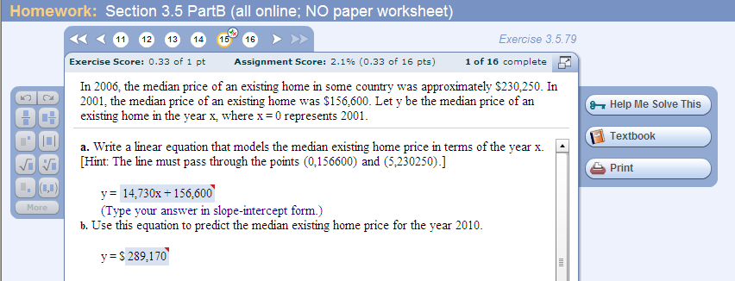
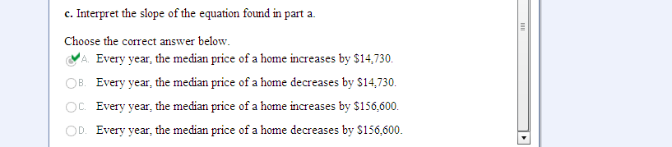
Application problems that involve figuring out the equation of a line:

