Slide 1
Review for Test 1

Slide 2
If at any time you are unable to access assignments from the PearsonMyLab web site:
You can still get to your homework assignments and practice tests and quizzes during this time by using the following login site:
http://www.mathxl.com/mmllogin.htm
MAKE SURE YOU HAVE THIS WEBSITE ADDED TO YOUR “FAVORITES” LIST,
AND KNOW HOW TO USE IT TO ACCESS HOMEWORK AND PRACTICE TESTS!

Slide 3
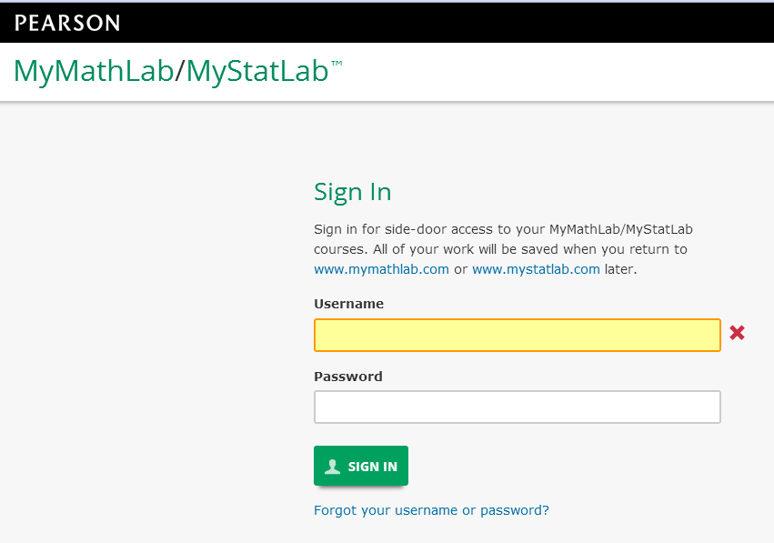
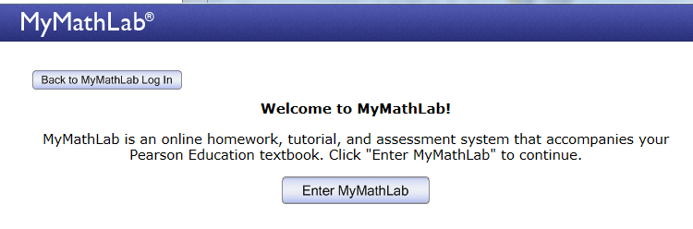
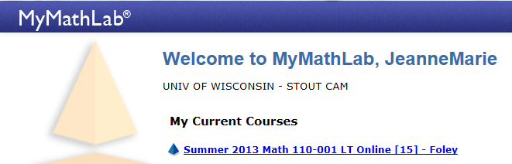
http://www.mathxl.com/mmllogin.htm

Slide 4
REMINDERS:
You can use your laptop on the test, but no other devices (cell phones, iPads, headphones, calculators, etc.) or notes are allowed.
You will have access to the online calculator within both Practice Test 1 and Test 1.
If you will need formulas for any test problems, they will be given to you within the problem, on the whiteboard, or on a printed formulas sheet.
Any attempt to use notes or unauthorized devices or other students’ help will result in a zero score being assigned to your test. If it happens again, you’ll get an F for the course and an academic misconduct citation in your permanent record.

Slide 5
Test 1 is worth 100 points. It covers: Chapter 1 (Operations on real numbers) Chapter 2 (Linear equations/inequalities)

Slide 6
To study for the test:
1). Take Practice Test 1 as many times as you want. (Remember, your best score on the practice test DOES count 10 points toward your course grade. A 100% score gives you 10 points, 50% gives you 5 points, and not taking it at all gives you 0 out of the 10 points.)
2). Review the homework . (Review homework by using the “Gradebook” function, not the “Assignments” button.)
3). Review your QUIZZES using the Gradebook
Using the online gradebook: Click “Review” to view any completed quiz/test (including practice versions) or HW assignments. The online help buttons (like “Help Me Solve This” )will be available when reviewing a submitted quiz or test.
4). Review your notes and/or the online lecture slides (from the Lecture Slides link on your MyMathLab course home page)

Slide 7
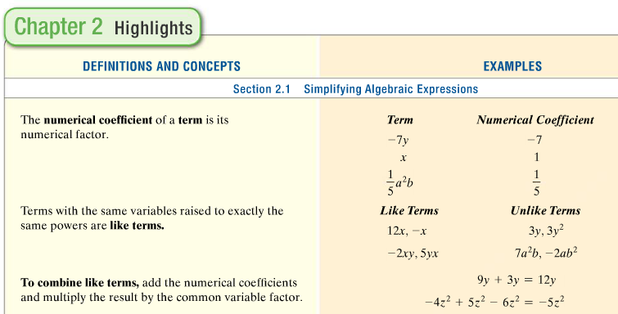
Another good study aid: “Chapter Highlights” pages in textbook (online or hardcopy):

Slide 8
Practice Test Tips:
There is no password needed for the practice test.
There are 20 questions on the practice test, the same number of questions as on the real test.
The time limit on the practice test is 75 minutes, but the time limit on the real test is only 55 minutes.
Each time you take the practice test you will get a different set of questions, so taking it at least twice will help you review more of the topics and problems that might appear on the test.
If you need a calculator for any problems, use the online calculator in your laptop browser. That is the only calculator you will be able to use on the test.

Slide 9
More Test Tips:
If you finish the test early, use the extra time to check your work.
This means you should get in the habit of showing work for each practice test problem in your notebook, and practice checking answers before submitting your practice test. Make sure you know the steps for checking answers to “solve equations” problems!
You DON’T have to finish a practice test all on one session. On the PRACTICE test, you can do part of it, then close it (DON’T submit the unfinished quiz, just close the window and leave the page) and come back later to finish it without losing any time off your clock.
When you REVIEW submitted tests, the online help buttons like “help me solve this” will become visible for each question.

Slide 10
Why you should take advantage of the opportunity to take the practice test multiple times:
Practice Test Tries | Average Test Score | Grade | number of students
0 | 61 | F | 9
1 | 68 | C- | 6
2 | 76 | C+ | 13
3 | 89 | A- | 7

Slide 11
Practice Test 1
is your only assignment for the weekend
It is worth 10 points.

