Slide 1
Review for Test 2

Slide 2
REMINDER: If at any time you are unable to access assignments from the PearsonMyLab web site:
You can still get to your homework assignments and practice tests and quizzes during this time by using the following login site:
http://www.mathxl.com/mmllogin.htm
MAKE SURE YOU HAVE THIS WEBSITE ADDED TO YOUR “FAVORITES” LIST,
AND KNOW HOW TO USE IT TO ACCESS HOMEWORK AND PRACTICE TESTS!

Slide 3
REMINDERS:
You can use your laptop on the test, but no other devices (cell phones, iPads, headphones, calculators, etc.) or notes are allowed.
You will have access to the online calculator within both Practice Test 2 and Test 2.
You may use a clean copy of the Math 90 formula sheet to use during this test.
Any attempt to use notes or unauthorized devices or other students’ help will result in a zero score being assigned to your test. If it happens again, you’ll get an F for the course and an academic misconduct citation in your permanent record.

Slide 4
Test 2 has 100 points and covers: Chapter 3 (Graphing/writing linear equations and functions) Chapter 4 (Systems of linear equations) Remember: Some of this test will also cover material from Unit 1, so make sure you review your Test 1.

Slide 5
To study for tomorrow’s test:
Take Practice Test 2.
It’s required assignment, worth 10 points and due tomorrow class time.
You can take it as many times as you want.
Each time you take it, you’ll get a different set of questions (not just same ones with different numbers), so taking it at least 2 or 3 times will give you a wider variety of practice problems to try.
Use your yellow formula sheet as you take the practice test.
Review your weekly quizzes using the Gradebook function.
Review your Test 1. (Remember, there will be material from Unit 1 that was covered on Test 1 on Test 2.)

Slide 6
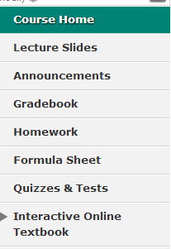
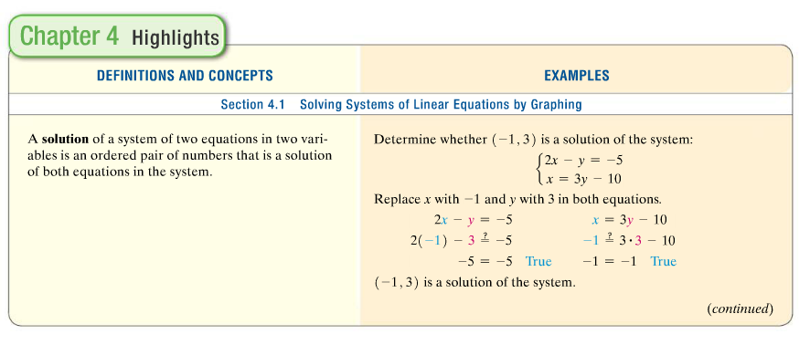
Another good study aid: “Chapter Highlights” pages in textbook:

Slide 7
Practice Test Tips:
There is no password needed for the practice test.
There are 20 questions on the real test.
The time limit on the practice test is 65 minutes, but the time limit on the real (in-class) test is only 60 minutes.
Each time you take the practice test you will get a different set of questions, so taking it at least twice will help you review more of the topics and problems that might appear on the test.

Slide 8
More Practice Test Tips:
Practice showing work for the real test by showing work for each practice test problem in your notebook, and practice checking answers before submitting your practice test.
Make sure you know the steps for checking answers to “solve systems of equations” problems!
You DON’T have to finish a practice test all on one session. On the PRACTICE test, you can do part of it, then close it (DON’T submit the unfinished quiz, just close the window and leave the page) and come back later to finish it without losing any time off your clock.
When you REVIEW submitted tests, the online help buttons like “help me solve this” will become visible for each question.

