Slide 1

Sample Gateway problems
.with complete solutions showing all the steps you should be showing on your worksheet.
Notes:
Math TLC (Math 010 and Math 110) Work To Show On Gateway Problems

Slide 2
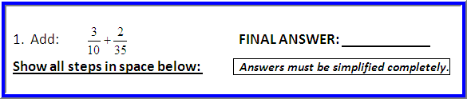
Full Solution to Sample Problem #1:
5
14
Here is the work we expect to see on your worksheet:
10 = 2∙5 and 35 = 5∙7, so 3 + 2 = 3 + 2 , and LCD = 2∙5∙7
10 35 2∙5 5∙7
3 + 2 = 3∙7 + 2 ∙2 = 21 + 4 = 25 = 5∙5 = 5∙5 = 5 = 5 2∙5 5∙7 2∙5∙7 5∙7∙2 2∙5∙7 2∙5∙7 2∙5∙7 2∙5∙7 2∙5∙7 2∙7 14
/
/
Notes:
Math TLC (Math 010 and Math 110) How to Solve Gateway Problems

Slide 3
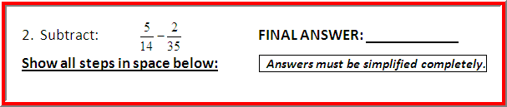
Full Solution to Sample Problem #2:
3 .
10
Here is the work we expect to see on your worksheet:
14 = 2∙7 and 35 = 5∙7, so 5 - 2 = 5 - 2 , and LCD = 2∙5∙7
14 35 2∙7 5∙7
5 - 2 = 5∙5 - 2 ∙2 = 25 - 4 = 21 = 3∙7 = 3∙7 = 3 = 3 2∙7 5∙7 2∙7∙5 5∙7∙2 2∙5∙7 2∙5∙7 2∙5∙7 2∙5∙7 2∙5∙7 2∙5 10
/
/
Notes:
Math TLC (Math 010 and Math 110) How to Solve Gateway Problems

Slide 4
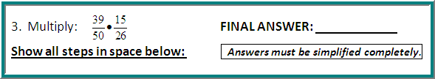
Full Solution to Sample Problem #3:
9 .
20
Here is the work we expect to see on your worksheet:
39 • 15 = 3∙13 • 3∙5 = 3∙13 • 3∙5 = 3∙3 = 9 .
50 26 2∙5∙5 2∙13 2∙5∙5 2∙13 2∙5∙2 20
/ /
/ /
Notes:
Math TLC (Math 010 and Math 110) How to Solve Gateway Problems

Slide 5

Full Solution to Sample Problem #5:
30 .
7
9 .
20
Here is the work we expect to see on your worksheet:
45 ÷ 21 = 45 • 26 = 3∙3∙5 • 2∙13 = 3∙3∙5 • 2∙13
13 26 13 21 13 3∙7 13 3∙7
.
= 3∙5∙2 = 30
1∙7 7
/ /
/ /
Notes:
Math TLC (Math 010 and Math 110) How to Solve Gateway Problems

Slide 6
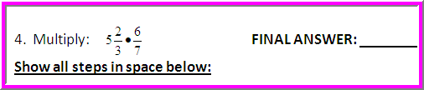

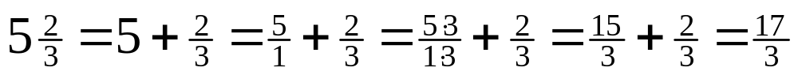
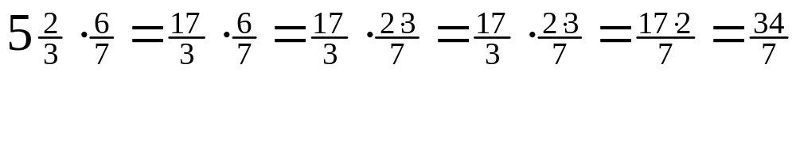
Full Solution to Sample Problem #4:
Here is the work we expect to see on your worksheet:
/
/
Notes:
Math TLC (Math 010 and Math 110) How to Solve Gateway Problems

Slide 7
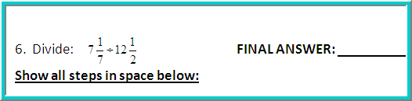
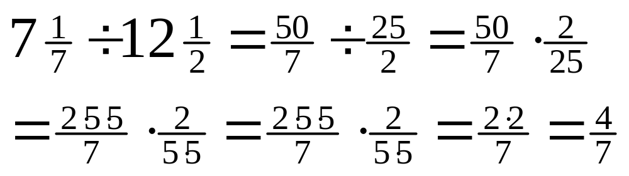
Full Solution to Sample Problem #6:
Here is the work we expect to see on your worksheet:
/ /
/ /
Notes:
Math TLC (Math 010 and Math 110) How to Solve Gateway Problems

Slide 8
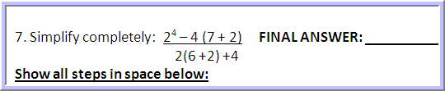

Full Solution to Sample Problem #7:
Here is the work we expect to see on your worksheet:
2⁴ – 4(7 + 2) = 2⁴ – 4(9) = 16 – 4(9) = 16 – 36 = -20 = -1 = -1
2(6+2) + 4 2(8) + 4 16 + 4 20 20 1
Notes:
Math TLC (Math 010 and Math 110) How to Solve Gateway Problems

Slide 9


Full Solution to Sample Problem #8:
Here is the work we expect to see on your worksheet:
3[17 + 5(-3 + 6) - 10] = 3[17 + 5(3) - 10] =
3[17 + 15 - 10] = 3[32 - 10] = 3[22] = 66
Notes:
Math TLC (Math 010 and Math 110) How to Solve Gateway Problems

