Slide 1
Section 10.3
Simplifying Radical Expressions

Slide 2
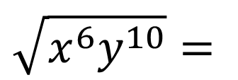
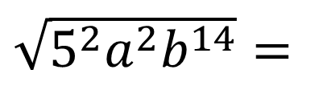
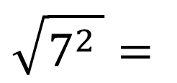
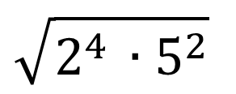
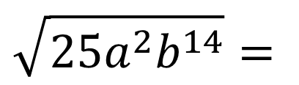
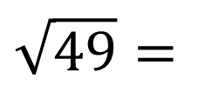
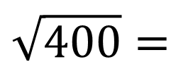

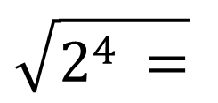
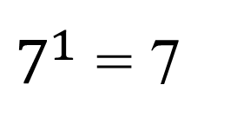

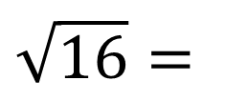


Recall these square root problems from Section 10.1:
Examples:
$$\sqrt{49}=$$
$$\sqrt{7^{2 }}=$$
(7²)^{½} =
$7^{1}$ = 7
$$\sqrt{16}=$$
$$\sqrt{2^{4 }=}$$
$$2^{2}=4$$
$$\sqrt{400}=$$
$$\sqrt{2^{4 }{∙5}^{2}}$$
$$=2^{2}∙5=20$$
$$\sqrt{x^{6}y^{10}}=$$
$$x^{3}y^{5}$$
$$\sqrt{25a^{2}b^{14}}=$$
$\sqrt{5^{2}a^{2}b^{14}}=$
$$5ab^{7}$$

Slide 3


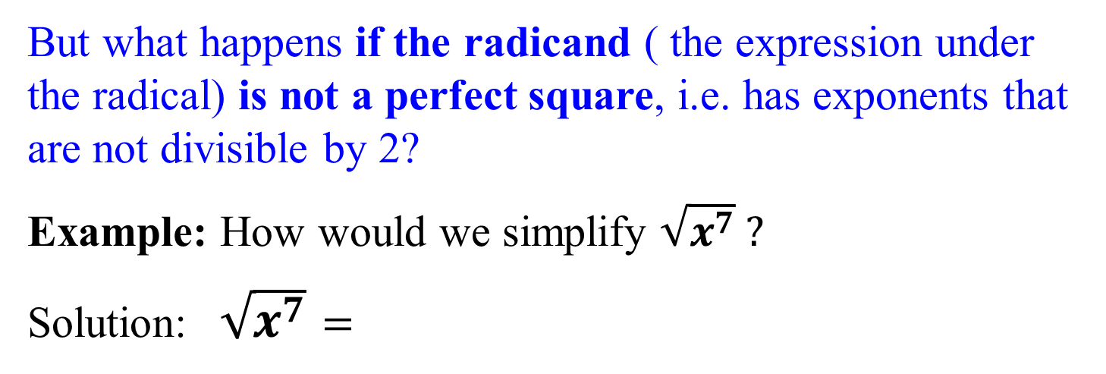

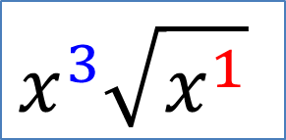

What we did in the previous examples was essentially to divide the exponent of each base by 2, which is index of the radical for square roots.
But what happens if the radicand ( the expression under the radical) is not a perfect square, i.e. has exponents that are not divisible by 2?
Example: How would we simplify $\sqrt{x^{7}} ?$
Solution:$\sqrt{x^{7}}$ $=$
$$x^{7/2}=$$
$$x^{3½}=$$
$$x^{3}x^{½}=$$
$x^{3}\sqrt{x}$
Think of this as dividing the exponent 7 by the index 2
Two goes into seven 3 times with a remainder of 1
$$x^{3}\sqrt{x^{1}}$$

Slide 4

Example
Simplify
First, break down 12 into its prime factors:
12 = 4∙3 = 2∙2∙3 = 2²∙3¹
This gives
Now divide the exponents by 2 (square root, so the index is 2). Answer:

Slide 5
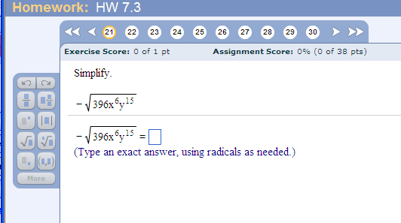
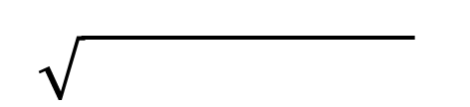
Problem from today’s homework:
Final Answer:
-
2²3²11¹x⁶y¹⁵
Start by breaking down 396: 396
(use your calculator, and start by dividing by 2) 2 198
2 99
9 11
3 3
So 396 = 2²3²11¹

Slide 6


If we have a radical with an index of 3 or higher, we can use the same process to simplify the radical.
Example: How would we simplify $\sqrt[3]{x^{7}} ?$
Solution:
$\sqrt[ 3]{x^{7}}=$
Divide the exponent 7 by the index 3
Three goes into seven 2 times with a remainder of 1
$$x^{2} \sqrt[3]{x^{1}}$$

Slide 7
Example
Simplify
Answer:

Slide 8
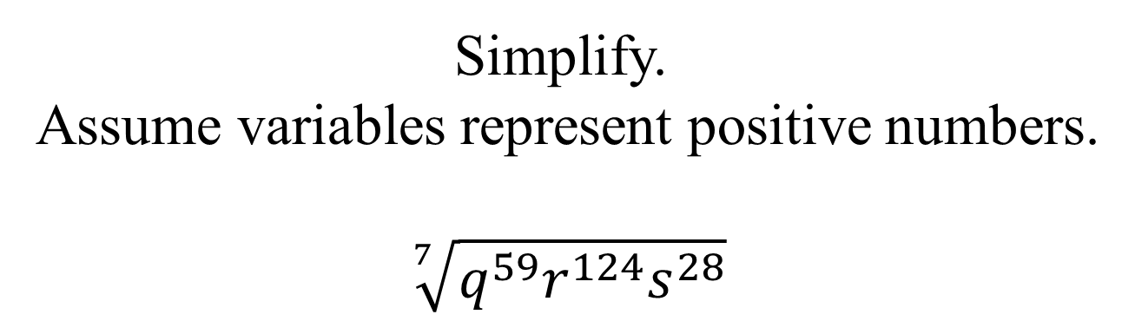
Problem from today’s homework:
Simplify.
Assume variables represent positive numbers.
$$\sqrt[7]{q^{59}r^{124}s^{28}}$$

Slide 9
Product and Quotient Rules for Radicals:
If and are real numbers, then
Product Rule:
Why is this condition important?
Quotient Rule:
Because division by zero gives an undefined quotient.
No, because square roots of negative numbers
are not real numbers.

Slide 10
Example
Simplify the following radical expressions.
(Assume x and y are ≥ 0)
(Assume a > 0 and b ≠ 0)

Slide 11
Example
Use the quotient rule to divide, then simplify if possible:
Answer:

Slide 12
In previous chapters, we’ve discussed the concept of “like” terms.
These are terms with the same variables raised to the same powers.
They can be combined through addition and subtraction.
Example: (x² + 5x – 1) + (6x² - 3x + 4) =
7x² + 2x + 3
Similarly, we can work with the concept of “like” radicals to combine radicals with the same radicand.

Slide 13
Like radicals are radicals with the same index and the same radicand.
Like radicals can also be combined with addition or subtraction by using the distributive property.

Slide 14
Example
Can not simplify (different indices)
Can not simplify (different radicands)

Slide 15
Always simplify radicals FIRST to determine whether there are like radicals to be combined.

Slide 16
Example
Simplify the following radical expression.

