Slide 1
Section 7.2
Operations on Rational Expressions

Slide 2
In the previous lesson, we showed that we can simplify ratios of polynomials (rational expressions) in the same way that we simplify ratios of integers (fractions).
The process in both cases involves completely factoring the numerator and denominator, and then canceling any factors that appear in both.
We can also perform the operations of multiplication, division, addition and subtraction on rational expressions using the same methods we did back at the start of the semester with fractions.

Slide 3
Steps in multiplying two or more rational expressions:
Factor all numerators and denominators
Cancel any common factors between all numerators and all denominators
Simplify the remaining ratio by multiplying out any terms that remain, if necessary.
IMPORTANT: Always factor and cancel first, THEN multiply what’s left.

Slide 4
Example
Multiply:

Slide 5
Example
Multiply the following rational expressions.
STOP HERE!!!!
Nothing else cancels…

Slide 6
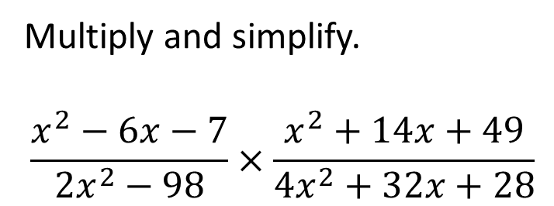
Problem from today’s homework:
Multiply and simplify.
$$\frac{x^{2}−6x−7}{2x^{2}−98}×\frac{x^{2}+14x+49}{4x^{2}+32x+28}$$
1
8

Slide 7
Example
Multiply the following rational expressions.
Solution: Factor each polynomial completely,
then cancel all factors that appear on both the top
and the bottom.
NOTE: A problem similar to this one appeared Test 4 and the final last semester…

Slide 8
When dividing rational expressions, first change the division into a multiplication problem, where you use the reciprocal of the divisor as the second part of the product.
Then treat it as a multiplication problem (factor, multiply, simplify).

Slide 9
Example
Divide the following rational expression.

Slide 10
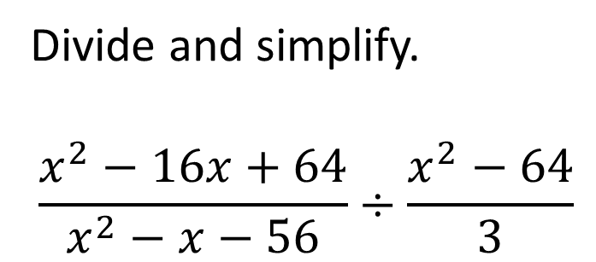
Problem from today’s homework:
Divide and simplify.
$$\frac{x^{2}−16x+64}{x^{2}−x−56}÷\frac{x^{2}−64}{3}$$
3 .
(x + 7)(x + 8)

Slide 11
Rational expressions can be also be added or subtracted in the same way as fractions:
If the denominators are already the same, we can just add or subtract the numerator polynomials and put the result over the common denominator polynomial
Then we check to see if the answer can be simplified, by seeing if we can factor the numerator polynomial, then cancelling any common factors.

Slide 12
Example
Subtract the following rational expressions.

Slide 13
As with adding rational numbers (fractions), to add or subtract rational expressions with unlike denominators, you have to change them to equivalent forms that have the same denominator (a common denominator).
This involves finding the least common denominator of the two original rational expressions, which is just like the process of finding the LCD of two numbers.
We won’t be covering this topic in Math 90, although it will be covered in Math 120 and used in subsequent courses.
If you’re interested in exploring these ideas, explanations and examples can be found in sections 7.3 and 7.4 of the online textbook.

