Slide 1
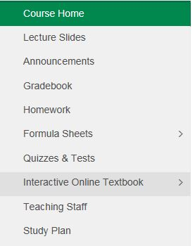
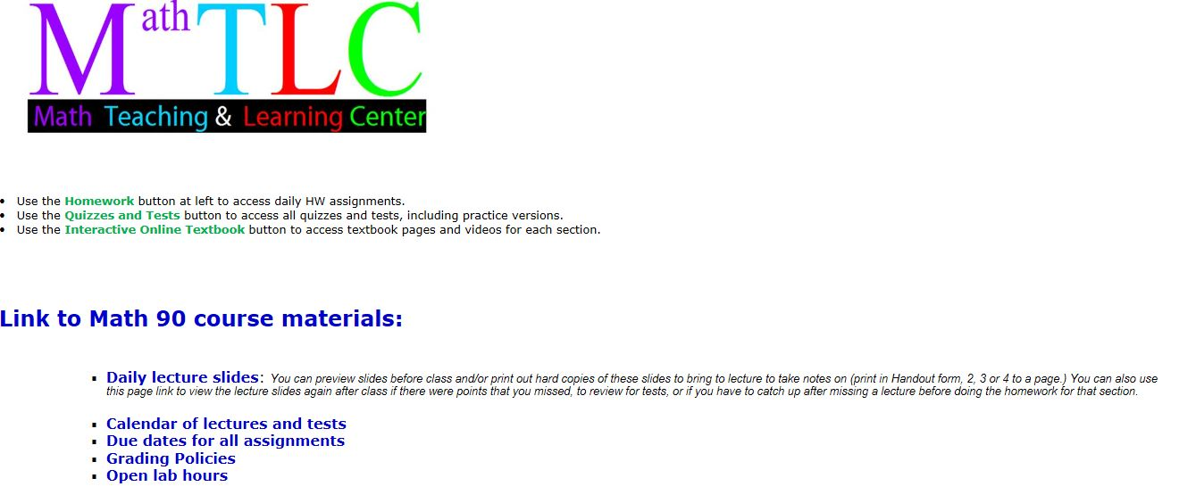
Lecture slides also available from this menu button
Practice Gateway Test is accessible from this menu button

Slide 2
Other study aids available for each day’s lecture topic:
Additional video lectures by the textbook author are available online for each book section we cover in class.
An on-line version of the textbook is also provided for each section, with interactive practice problems and video clips.
Both of these can be accessed from the “Interactive Online Textbook” menu button by clicking on the Chapter and Section for that day.

Slide 4
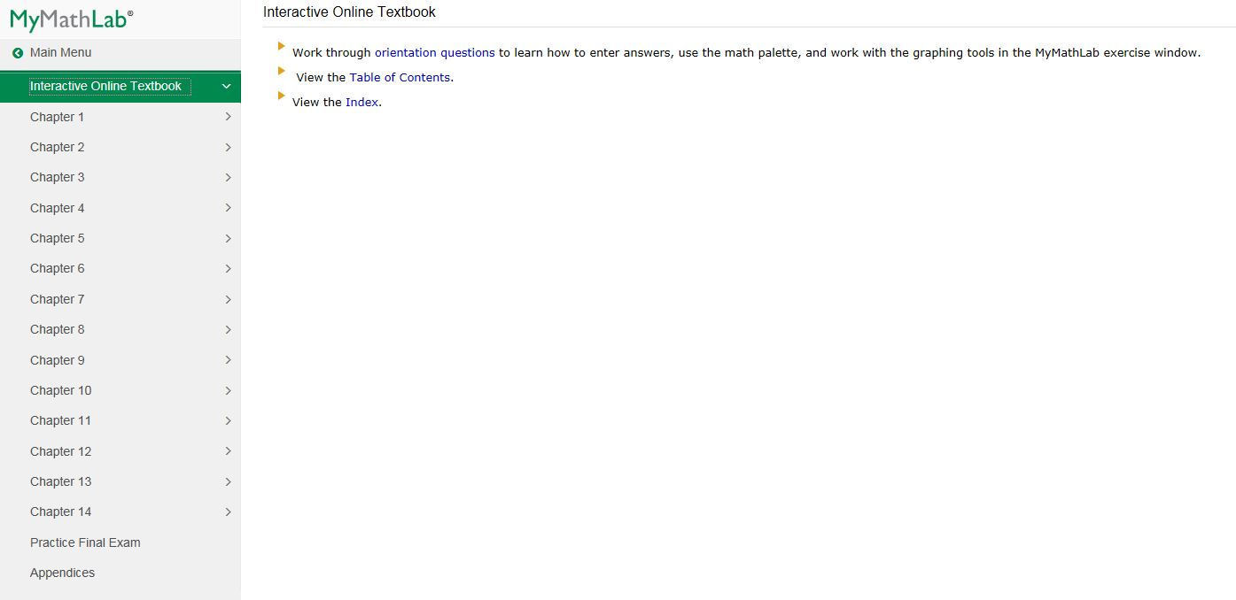

Slide 5
Section 1.3 Prime numbers and fractions
Factoring a number means writing it as a product of two or more prime number factors.
A prime number is a natural number (other than 1) whose only factors are 1 and itself.
The first few prime numbers are:
2, 3, 5, 7, 11, 13, 17, 19, 23, 29
(It will help you on the Homework & Quizzes if you learn these by heart!)
Question: Why isn’t 6 a prime number?
Answer: Because it can be written as 2 times 3 (or 2·3)
Why isn’t 8 a prime number? 9? 10? 12?

Slide 6
Question:
What’s the next prime number after 29?
Check 30: Can you divide 30 by anything other than 1 and 30?
Yes, so it’s NOT prime.
(Numbers that are not prime are called composite numbers.)
Check 31: Try dividing it by all of the prime numbers up to half of 31. If none of them work, then 31 is prime.
Can you divide 31 by 2? NO By 3? NO By 5? NO
By 7? By 11? By 13? By 17?
( 17 is a little more than half of 31, and none of the primes up through 17 divide into 31, so we conclude that 31 is a prime number.)

Slide 7
Back to factoring numbers:
Factor the number 44 into a product of primes.
Solution:
First, think of some number that divides into 44.
How about 2?
Then write 44 as 2·22. (Because 44÷2 = 22)
2 is prime, but 22 can be factored further, into 2·11
So 2·22 = 2·2·11 (NOTE: We could also write this as 2²·11)
These are now all prime numbers, so we’re done.
(Always arrange the numbers in order from smallest to largest in your final answer).

Slide 8
Another example:
Factor the number 150 into a product of primes.
Solution:
First, think of some number that divides into 150.
How about 10?
Then write 150 as 10·15. (Because 150÷10 = 15)
Both of these can be factored further:
10·15 = 2·5·3·5
These are now all prime numbers, so we’re done, except for arranging the numbers in order from smallest to largest.
Final answer: 2·3·5·5 (or 2·3·5²)

Slide 9
Recall that a fraction is a quotient of two numbers.
(“quotient” means you’re dividing the top number by the bottom number)
The numerator is the top number.
The denominator is the bottom number.
Simplifying fractions (reducing to lowest terms) involves factoring numerator and denominator into prime numbers and then canceling any primes that appear on both top and bottom.

Slide 10
Example
Simplify the following fractions.
Since there are no common factors, the original fraction is already simplified.

Slide 11
Basic strategy for multiplying and dividing fractions:
These kinds of problems DO NOT require finding a common denominator. They can be most easily done by factoring both the numerator (top number) and denominator of both fractions into a product of prime numbers, and then canceling any common factors (numbers that appear on both the top and the bottom).

Slide 12
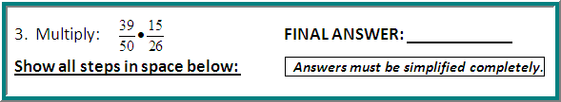
Sample Problem: Multiplying fractions
Step 1: Factor both the numerators and denominators into
prime factors, then write each fraction in factored form:
First fraction: 39= 3∙13 and 50 = 2∙5∙5
Second fraction: 15= 3∙5 and 26 = 2∙13
So you can write 39 • 15 as 3∙13 • 3∙5 .
50 26 2∙5∙5 2∙13

Slide 13
Sample Problem: Multiplying fractions (continued)
Step 2: Now just cancel any common factors that appear in both numerator and denominator. Once you multiply out any remaining factors, the result is your simplified answer.
3∙13 • 3∙5 = 3∙3 = 9 .
2∙5∙5 2∙13 2∙5∙2 20
/ /
/ /
NOTE: It is much easier to factor first and then cancel, rather than multiplying out the numerators and denominators and then trying to simplify the answer (especially if you aren’t using a calculator!) If you multiplied first, you’d have gotten
585, which would be nasty to simplify by hand…
1300

Slide 14

Sample Problem: Dividing fractions
Step 1: Multiply the first fraction by the 45 ÷ 21 = 45 • 26
reciprocal of the second fraction. 13 26 13 21
(i.e. flip the second fraction upside down and change ÷ to • .)
Step 2: Factor both the numerators and denominators into
prime factors, then write each fraction in factored form:
First fraction: 45 = 3∙3∙5 and 13 = 13 (prime)
Second fraction: 26 = 2∙13 and 21 = 3∙7
So you can write 45 • 26 as 3∙3∙5 • 2∙13 .
13 21 13 3∙7

Slide 15
Sample Problem: Dividing fractions (continued)
Step 3: Now just cancel any common factors that appear in both numerator and denominator. Once you multiply out any remaining factors, the result is your simplified answer.
3∙3∙5 • 2∙13 = 3∙5∙2 = 30
13 3∙7 7 7
/ /
/ /
NOTE: Once again, it is much easier to factor first and then cancel, rather than multiplying out the numerators and denominators and then trying to simplify the answer (especially if you aren’t using a calculator!) If you multiplied first, you’d have gotten 1170 , which would be pretty hard to simplify by hand.
273

Slide 16
NOTE: Gateway problems 4 & 6 and several of today’s homework problems using mixed numbers all start with the same step.
A mixed fraction (mixed number) consists of an integer part and a fraction part.
We want to covert the mixed number into an improper fraction (one with the numerator larger than the denominator). This is done by multiplying the integer part by the denominator of the fraction part, then adding that product to the numerator of the fraction and putting that sum over the original denominator.

Slide 17
Converting a Mixed Number
Into an Improper Fraction:
Example: Convert the mixed number into
an improper fraction:
Solution: First, note that
Then:

Slide 18
Converting a Mixed Number Into an Improper Fraction Another way to look at it:
To convert 5 ¼:
Multiply the denominator of the fraction part (4) by the whole number part (5) 5 ∙ 4 = 20
Add the numerator of the fraction part (1) to this result: 1 + 20 = 21
Write this number over the denominator of the original fraction : ANSWER: 21/4

Slide 19
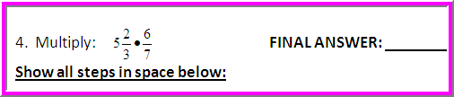
Sample Gateway Problem #4: Multiplying mixed numbers
Step 1: Convert the mixed number into
an improper fraction: (Note that )
.
So becomes , which we can then solve the same
way we did our fraction multiplication problems.

Slide 20
Sample Problem #4 (continued)
Step 2: Factor both the numerators and denominators into
prime factors, then write each fraction in factored form:
First fraction: 17 and 3 are both prime
Second fraction: 6 = 2∙3 and 7 is prime
So you can write 17 ∙ 6 as 17 ∙ 2∙3 .
3 7 3 7
Step 3: Now just cancel any common factors that appear in both
numerator and denominator. Once you multiply out any remaining
factors, the result is your simplified answer.
/
/
17 ∙ 2∙3 = 17∙2 = 34 .
3 7 7 7

Slide 21
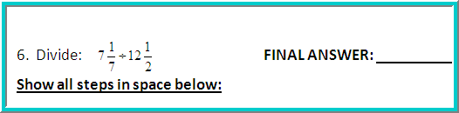
Sample Gateway Problem #6: Dividing with mixed numbers
Step 1: Convert the mixed numbers into improper fractions:
Now we can rewrite the problem as:
Then convert from division
to multiplication by using the
reciprocal of the second fraction:

Slide 22
Sample Problem #6 (continued)
Step 2: Factor both the numerators and denominators into
prime factors, then write each fraction in factored form:
First fraction: 50 = 2∙5∙5 and 7 is prime
Second fraction: 2 is prime and 25 = 5∙5
So you can write 50 • 2 as 2∙5∙5 • 2 .
7 25 7 5∙5
Step 3: Now just cancel any common factors that appear in
Both numerator and denominator. Once you multiply out any
remaining factors, the result is your simplified answer.
2∙5∙5 • 2 = 2∙2 = 4
7 5∙5 7 7
/ /
/ /

Slide 23
IMPORTANT: Even if you get a problem wrong on each of your three tries, you can still go back and do it again by clicking “similar exercise” at the bottom of the exercise box. You can do this nine times, for a total of 30 tries (3 tries at each of 10 different problems). You should always work to get 100% on each assignment!

