Slide 1
Comment on HW 2.2/2.3: Types of outcomes when solving linear equations in one variable:
1. One solution (nonzero). (most problems in HW 5)
Example: 2x + 4 = 4(x + 3)
Answer: x = -4
2. One solution (zero).
Example: 2x + 4 = 4(x + 1)
Answer: x = 0
3. Solution = “All real numbers”.
Example: 2x + 4 = 2(x + 2)
Answer: All real numbers. (Type in “R” on computer.)
4. No solutions. Example: 2x + 4 = 2(x + 3)
Answer: No solution (“N” on computer.)

Slide 2
Section 2.4 Introduction to Problem Solving

Slide 3
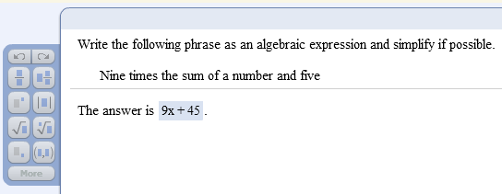
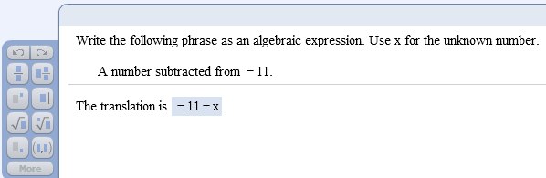
Translating words into algebraic expressions: Examples from the homework due today:

Slide 4
General strategy for problem solving:
Understand the problem
Read and reread the problem
Choose a variable to represent the unknown
Construct a drawing, whenever possible
Translate the problem into an equation
Solve the equation
Interpret the result
Check solution
State your conclusion

Slide 5
Example 1:
The product of twice a number and three is the same as the difference of five times the number and ¾. Find the number.
Understand
Read and reread the problem.
If we let x = the unknown number, then
“twice a number” translates to 2x,
“the product of twice a number and three” translates to 2x · 3,
“five times the number” translates to 5x, and
“the difference of five times the number and ¾” translates to 5x - ¾.

Slide 6
Example (cont.)
Translate
The product of
the difference of
is the same as
twice a number
5 times the number
and 3
and ¾
2x
·
3
=
5x
–
¾

Slide 7
Example (cont.)
Solve
2x · 3 = 5x – ¾
6x = 5x – ¾ (simplify left side)
6x + (-5x) = 5x + (-5x) – ¾ (add –5x to both sides)
x = - ¾ (simplify both sides)
Now CHECK your answer:
Left side: 2x·3= (2·-3/4)·3 = -6/4·3 = -3/2·3= -9/2
Right side: 5x-3/4 = 5·-3/4 – 3/4 = -15/4 – 3/4 = -18/4 = -9/2 
(You can perform this check quickly by using your online calculator in the homework or quiz window.)

Slide 8
Sample problem from today’s homework:
Five times the difference of a number and 4 is the same as 4 increased by five
times the number plus four times the number. Find the number.

Slide 9
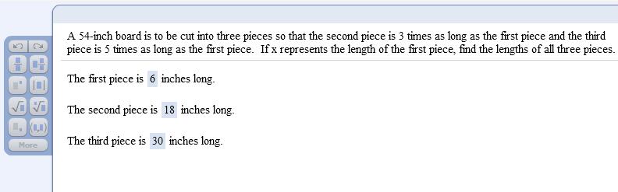
Sample problem from today’s homework:

Slide 10
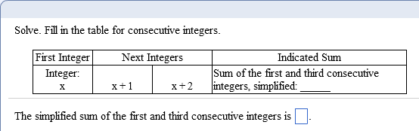
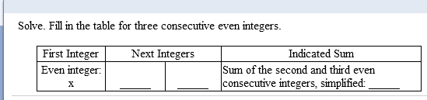
Consecutive integer problems
2x + 2
x + 2
x + 4
2x + 6

Slide 11
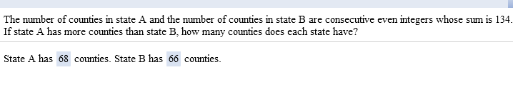
Sample problem from today’s homework:

Slide 12
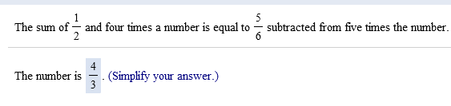
Sample problem from today’s homework:

