Slide 1
GPU Schedulers: How Fair is Fair Enough?
Tyler Sorensen, Hugues Evrard, Alastair Donaldson Imperial College London, UK CONCUR
Sept. 2018

Slide 2


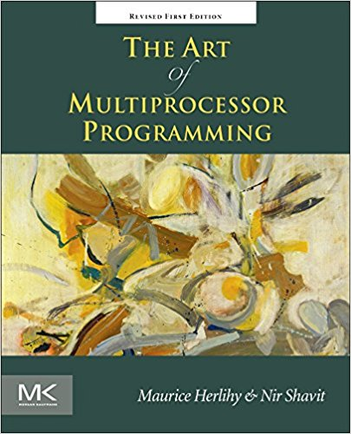


Overview
AMD Radeon R9 fury 4096 processing units
GPUs are parallel devices
GPUs have a concurrent execution model
“classic shared memory concurrency” on GPUs?
kernels executed by millions of threads

Slide 3
Overview
AMD Radeon R9 fury 4096 processing units
GPUs are parallel devices
GPUs have a concurrent execution model
“classic shared memory concurrency” on GPUs?
kernels executed by millions of threads

Slide 4
Overview
AMD Radeon R9 fury 4096 processing units
GPUs are parallel devices
GPUs have a concurrent execution model
“classic shared memory concurrency” on GPUs?
kernels executed by millions of threads

Slide 5

Overview
We’re scientists: let’s experiment!
First experiment - barrier
T0
T1
T2
T3
……
barrier
……

Slide 6
Overview
We’re scientists: let’s experiment!
First experiment - barrier
T0
T1
T2
T3
AMD Radeon R9 fury
……
barrier
Barrier with 64 threads:
……

Slide 7
Overview
We’re scientists: let’s experiment!
First experiment - barrier
T0
T1
T2
T3
AMD Radeon R9 fury
……
barrier
Barrier with 64 threads:
HANGS
……

Slide 8


Overview
We’re scientists: let’s experiment!
Second experiment - lock
T0
T1
lock
Critical section
lock
unlock
Critical section
unlock

Slide 9
Overview
We’re scientists: let’s experiment!
Second experiment - lock
T0
T1
AMD Radeon R9 fury
lock
Critical section
lock
unlock
Lock with 64 threads contending:
Critical section
unlock

Slide 10
Overview
We’re scientists: let’s experiment!
Second experiment - lock
T0
T1
AMD Radeon R9 fury
lock
Critical section
lock
unlock
Lock with 64 threads contending:
Critical section
WORKS
unlock

Slide 11
Overview
We’re scientists: let’s experiment!
third experiment - small barrier
T0
T1
T2
T3
……
barrier
……

Slide 12

Overview
We’re scientists: let’s experiment!
third experiment - small barrier
T0
T1
T2
T3
……
barrier
……

Slide 13
Overview
We’re scientists: let’s experiment!
third experiment - small barrier
T0
T1
T2
barrier

Slide 14
Overview
We’re scientists: let’s experiment!
third experiment - small barrier
T0
T1
T2
AMD Radeon R9 fury
barrier
Barrier with 64 32 threads:

Slide 15
Overview
We’re scientists: let’s experiment!
third experiment - small barrier
T0
T1
T2
AMD Radeon R9 fury
barrier
Barrier with 64 32 threads:
WORKS

Slide 16

Overview
Experimental results:
Experiment | Observation
Barrier | Hangs
Lock | Works
Small barrier | Works

Slide 17
Overview
Experimental results:
Experiment | Observation
Barrier | Hangs
Lock | Works
Small barrier | Works
Can we formally reason about these results?

Slide 18
Overview
Obstruction Free
Lock Free
???
Wait Free
Non-blocking
Blocking

Slide 19
Overview
Experiment | Observation
Barrier | Hangs
Lock | Works
Small barrier | Works
Obstruction Free
Lock Free
???
Wait Free
Non-blocking
Blocking

Slide 20
Contributions
Define a parameterized formula for semi-fair schedulers
Instantiate formula for several GPU schedulers
Analyse common blocking idioms under each scheduler

Slide 21
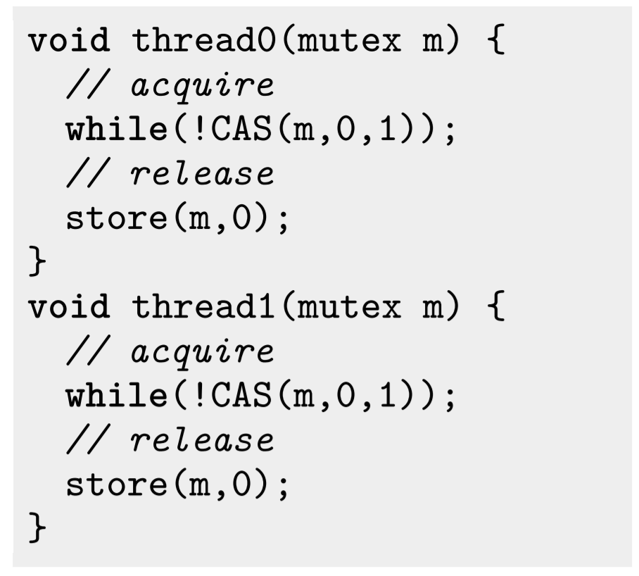
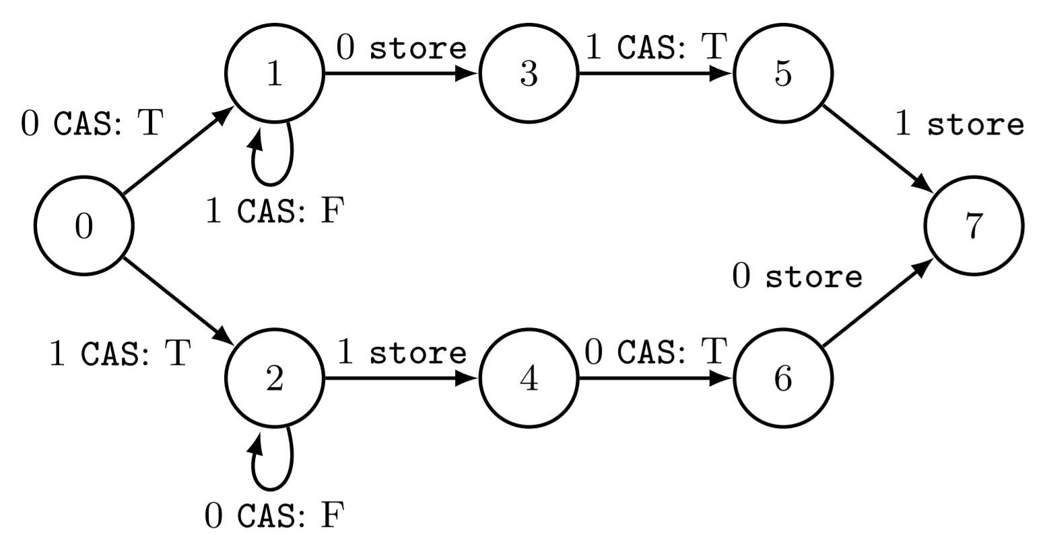
Formal Schedulers

Slide 22
Formal Schedulers
(0→1)

Slide 23
Formal Schedulers
(0→1) (1→3)

Slide 24
Formal Schedulers
(0→1) (1→3) (3→5)

Slide 25
Formal Schedulers
(0→1) (1→3) (3→5) (5→7)

Slide 26
Formal Schedulers

Slide 27
Formal Schedulers
(0→2)

Slide 28
Formal Schedulers
(0→2) (2→2)

Slide 29
Formal Schedulers
(0→2) (2→2) (2→2)

Slide 30
Formal Schedulers
(0→2) (2→2) (2→2) (2→2)

Slide 31
Formal Schedulers
(0→2) (2→2)^{ω}

Slide 32
Formal Schedulers
Problematic Paths
(0→2) (2→2)^{ω}
(0→1) (1→1)^{ω}

Slide 33
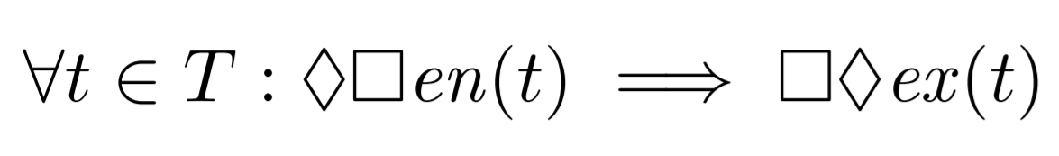
Formal Schedulers
Problematic Paths
(0→2) (2→2)^{ω}
(0→1) (1→1)^{ω}
Weak Fairness

Slide 34
Formal Schedulers
Problematic Paths
(0→2) (2→2)^{ω}
(0→1) (1→1)^{ω}
Weak Fairness

Slide 35
Formal Schedulers
Problematic Paths
(0→2) (2→2)^{ω}
(0→1) (1→1)^{ω}
Fairness

Slide 36
Formal Schedulers
Experiment | Observation | No Fairness | Fairness
Barrier | Hangs | Can hang | Works
Lock | Works | Can hang | Works
Small barrier | Works | Can hang | Works
Fairness

Slide 37
Formal Schedulers
Experiment | Observation | No Fairness | Fairness
Barrier | Hangs | Can hang | Works
Lock | Works | Can hang | Works
Small barrier | Works | Can hang | Works
We want something
in between!
Fairness

Slide 38
Semi-fair Schedulers

Slide 39
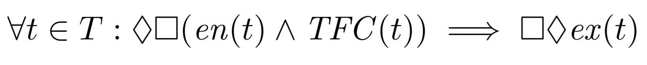
Semi-fair Schedulers

Slide 40
Semi-fair Schedulers
The Thread Fairness Criterion (TFC) is a per-thread predicate that can enable fairness for individual threads

Slide 41
Semi-fair Schedulers
Experiment | Observation | No Fairness | Fairness
Barrier | Hangs | Can hang | Works
Lock | Works | Can hang | Works
Small barrier | Works | Can hang | Works

Slide 42
Semi-fair Schedulers
TFC(t) = False
Experiment | Observation | No Fairness | Fairness
Barrier | Hangs | Can hang | Works
Lock | Works | Can hang | Works
Small barrier | Works | Can hang | Works

Slide 43
Semi-fair Schedulers
TFC(t) = False
TFC(t) = True
Experiment | Observation | No Fairness | Fairness
Barrier | Hangs | Can hang | Works
Lock | Works | Can hang | Works
Small barrier | Works | Can hang | Works

Slide 44
Semi-fair Schedulers
Our first GPU scheduler:

Slide 45
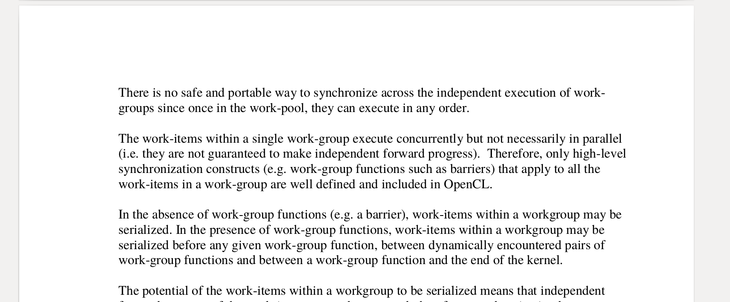
Semi-fair Schedulers
Our first GPU scheduler:
Page 29 of OpenCL Standard

Slide 46
Semi-fair Schedulers
Our first GPU scheduler:
Page 29 of OpenCL Standard

Slide 47
Semi-fair Schedulers
Our first GPU scheduler:
Page 29 of OpenCL Standard
TFC_{OpenCL}(t) = False

Slide 48
Now for something more interesting….

Slide 49
Occupancy Bound Execution (OBE)
Persistent thread execution (Gupta et. al, InPar 2012) and
Occupancy bound execution (Sorensen et. al, OOPSLA 2016)

Slide 50
Occupancy Bound Execution
Program with 5 threads
t4
t3
t2
t1
t0
thread queue
CU
CU
CU
GPU with 3 compute units

Slide 51
Occupancy Bound Execution
Program with 5 threads
t4
t3
t2
t1
t0
thread queue
CU
CU
CU
GPU with 3 compute units

Slide 52
Occupancy Bound Execution
Program with 5 threads
t4
t3
thread queue
t0
t1
t2
CU
CU
CU
GPU with 3 compute units

Slide 53
Occupancy Bound Execution
Program with 5 threads
t4
t3
thread queue
t0
t1
CU
CU
CU
t2
GPU with 3 compute units
finished threads

Slide 54
Occupancy Bound Execution
Program with 5 threads
t4
thread queue
t0
t1
t3
CU
CU
CU
t2
GPU with 3 compute units
finished threads

Slide 55
Occupancy Bound Execution
Program with 5 threads
t4
thread queue
t1
t3
CU
CU
CU
t2
t0
GPU with 3 compute units
finished threads

Slide 56
Occupancy Bound Execution
Program with 5 threads
thread queue
t4
t1
t3
CU
CU
CU
t2
t0
GPU with 3 compute units
finished threads

Slide 57
Occupancy Bound Execution
Program with 5 threads
thread queue
Finished!
CU
CU
CU
t2
t0
t4
t1
t3
GPU with 3 compute units
finished threads

Slide 58
Occupancy Bound Execution
Once a thread starts executing, it is guaranteed fair scheduling until termination
Program with 5 threads
t4
thread queue
t0
t1
t3
CU
CU
CU
t2
GPU with 3 compute units
finished threads

Slide 59

Occupancy Bound Execution
- past time operator

Slide 60
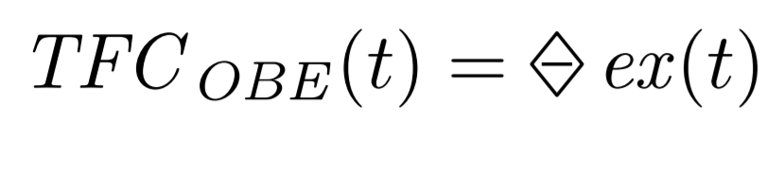
Occupancy Bound Execution
- past time operator

Slide 61
Occupancy Bound Execution
Problematic Paths
(0→2) (2→2)^{ω}
(0→1) (1→1)^{ω}

Slide 62
Occupancy Bound Execution
Problematic Paths
(0→2) (2→2)^{ω}
(0→1) (1→1)^{ω}

Slide 63
Occupancy Bound Execution
Problematic Paths
(0→2) (2→2)^{ω}
Disallowed!
(0→1) (1→1)^{ω}

Slide 64
Occupancy Bound Execution
Problematic Paths
(0→2) (2→2)^{ω}
Disallowed!
(0→1) (1→1)^{ω}
Disallowed!

Slide 65
Occupancy Bound Execution
Mutex works under OBE

Slide 66

HSA
Heterogeneous System Architecture (HSA): portable specification for GPU-like systems

Slide 67
HSA
Program with 5 threads
t4
thread queue
Only the thread with the lowest id is guaranteed fair execution
t0
t1
t3
CU
CU
CU
t2
GPU with 3 compute units
finished threads

Slide 68
HSA
Program with 5 threads
t4
thread queue
Only the thread with the lowest id is guaranteed fair execution
t0
t1
t3
CU
CU
CU
t2
GPU with 3 compute units
finished threads

Slide 69
HSA
Program with 5 threads
t4
t3
thread queue
Only the thread with the lowest id is guaranteed fair execution
t0
t1
CU
CU
CU
t2
GPU with 3 compute units
finished threads

Slide 70
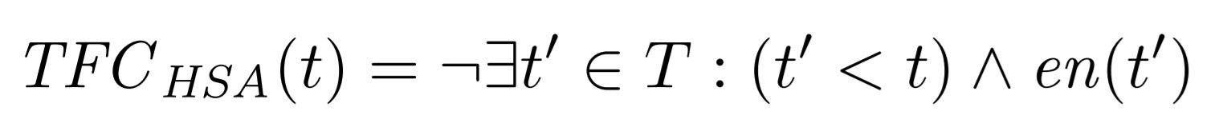
HSA
Only the thread with the lowest id gets fair execution

Slide 71
HSA
Problematic Paths
(0→2) (2→2)^{ω}
(0→1) (1→1)^{ω}

Slide 72
HSA
Problematic Paths
(0→2) (2→2)^{ω}
(0→1) (1→1)^{ω}
Disallowed!

Slide 73
HSA
Problematic Paths
(0→2) (2→2)^{ω}
allowed!
(0→1) (1→1)^{ω}
Disallowed!

Slide 74
HSA
Mutex not guaranteed termination under HSA

Slide 75
Semi-fair Schedulers
Mutex is guaranteed termination under OBE, but not HSA.
Does OBE offer strictly stronger guarantees than HSA?

Slide 76
Semi-fair Schedulers
One-way producer consumer
Thread 1 waits for Thread 0
T0: Produce
0
1
2
T1: Consume_success
T1: Consume_wait

Slide 77
Semi-fair Schedulers
One-way producer consumer
Thread 1 waits for Thread 0
Problematic Path
T0: Produce
0
1
2
(0→0) ^{ω}
T1: Consume_success
T1: Consume_wait

Slide 78
Semi-fair Schedulers
One-way producer consumer
Thread 1 waits for Thread 0
Problematic Path
T0: Produce
0
1
2
(0→0) ^{ω}
T1: Consume_success
Disallowed by HSA
Allowed by OBE
T1: Consume_wait

Slide 79
Semi-fair Scheduler
HSA and OBE incomparable!
OBE is pragmatic while HSA is industry endorsed
Real world applications exist for both

Slide 80
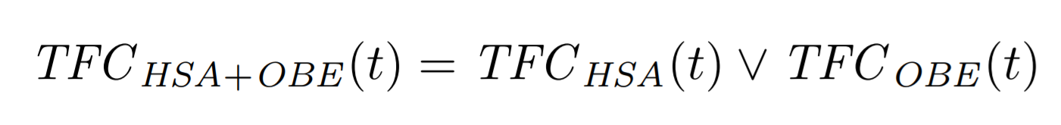
Unified Semi-fair Schedulers
Simple new TFC can combine guarantees:

Slide 81
More in the paper…
Discussion of applications that rely on semi-fair scheduling
A more intuitive unified semi-fair scheduler: LOBE
An application use-case for LOBE

Slide 82
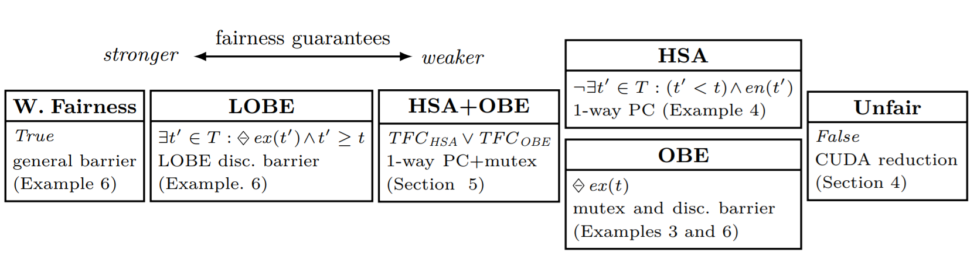
Conclusion
A formal framework for semi-fair schedulers found on current GPUs and perhaps general accelerators.
Tyler Sorensen: http://www.cs.princeton.edu/~ts20/

Slide 83
GPU Programming
Workgroup 0
Workgroup 1
Workgroup n
Within workgroups, threads
are grouped into subgroups
Threads
Local memory for WG0
Local memory for WG1
Local memory for WGn
Global Memory

