Slide 1
Weekly Review

Slide 2
Part 1

Slide 3
Pogs
Teams C, F, and G all receive one pog for each member
All members turned in their DocPacs on time
Team A had an absent member
Can still get a pog
No teams got pogs for perfect score
I put out a call on Slack saying I would still accept PR’s late
Two students saw this and took advantage of it
One student received a pog for a radical change in attitude

Slide 4
So what, pogs?
There are now 14 pogs now in the pogconomy
If two more students had turned in their DocPac, there would be 21
If everyone in the class is turning in work, and about half the class are getting all A’s, then there is no need to spend so much time doing work
Therefore, as noted on the board, the class should be able to buy their way out of doing work on Fridays
We should be averaging one free day every other week

Slide 5
Reminders
This has been covered before in previous Weekly Meetings, but:
Your attitude is the biggest obstacle to your success
Not just in the idea that it can prevent you from trying
but also if two students submit the same work, the one with the better attitude will get a better grade
Games, cellphones, and unrelated Youtube videos are still against the rules, even if you are “done with all of your work”
As I have always said, the distractions have predicted the grades
You are almost never actually done with your work
I will be enforcing the rules more strictly moving forward

Slide 6
Part 2

Slide 7
Read the DocPac
I devoted two slides to this, because the need to follow instructions is extremely important when it comes to the type of work we are doing.
Over half the class made mistakes that were explicitly outlined in in the DocPac, word for word
(seriously, node_modules?!)
Some students even decided their way was better, and now their work is ungradable (more on this later)
Attention to detail is critical in Computer Sciences
Most job listings will have it
Remember that my OAC has said time and time again that the actual code is the least of their worries when it comes to employable skills

Slide 8
Why do I make these instructions?
I spend six hours every Sunday lesson planning
I have only a few minutes per day to tell your why I built these lessons the way I did
The reason why you may think these instructions are stupid is because you are working with a limited data set, and drawing conclusions from it
You have less than a year of structured experience in programming, and no experience in pedagogy
You also do not understand the goal of the instructions.
I am not saying you’re stupid for thinking the rules are stupid. I’m saying you don’t have access to all of the information.
My friend said to me, “Could you imagine if you were their swimming instructor?”
Due to a conversation on Discord, I’ve decided to give you some insight on why I designed last week’s lesson

Slide 9
What do I focus on when lesson planning?
Exposure:
Have you heard of this before? Remember this for later.
Research:
Getting used to finding the answers you need while on the clock
Practice:
I know you’ve already done this, but we can get better at it
Teach:
Sometimes I’m just explicitly telling your what to do
Assess:
I need to know if these lessons are effective
This is a BIG DEAL in pedagogy, and we spend a lot of time talking about it
The Formbar has changed my life, and I do not know how to teach without it

Slide 10
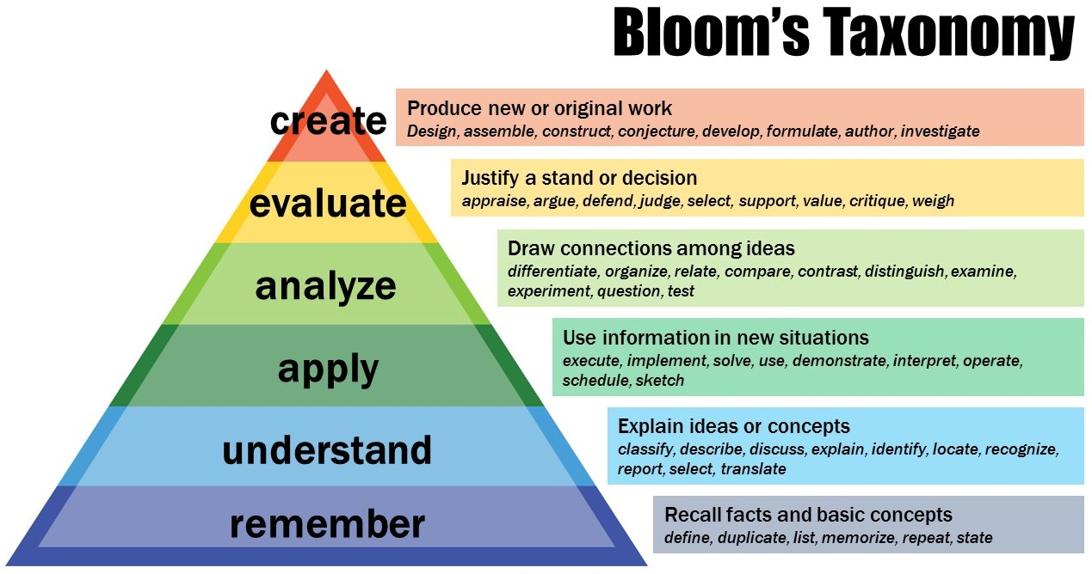

Slide 11
Bloom’s Taxonomy Example
Remember:
“A for loop repeats the same code for each item in a list”
Understand:
“I can iterate through an array or a set number of repetitions”
Apply:
“I can display all of my comments from an array to HTML in EJS using for”
Analyze:
“I can modify the for loop to only show every other element in the array”
Evaluate:
“I know when a for..in is better than a for..of, a classic for, or a forEach()
Create:
“I can write code that functions as a for loop without using one”

Slide 12
Where are we?

Slide 13
Why did we all type the Flash Cards?
A few students decided to use teletype and git merges so only one person had to type in the data for the Nocti Flash Cards
CLEARLY this is much more efficient than having everyone do it
but simply getting it done was not the goal of this assignment!
First, olive these questions are ON the Nocti
Simply committing only these questions to memory will get you the lowest passing grade on the Nocti written test
Studies have shown writing/typing the material is significantly more effective for memorization than simply reading
Second, many of you are bad at typing
And there’s only one way to get better
Third, many of you are bad at tracking braces/quotes ( [ ], { }, ( ), “ “, ‘ ‘ )
JSON is good practice

Slide 14
Handwriting
It is faster to type the answers, and typing has spell check, searchable text, submittable electronically, and can be easily reprinted
I know this. You know this.
But that’s not why we’re doing it.
Study after study has shown that handwriting reinforces the concepts orders of magnitude greater than typing.
Nearly all skilled labor requires some handwriting
Surveys have correlated good handwriting with success in your chosen field.
Sometimes employers just think you’re smarter because you have good handwriting
Some of your handwriting looks like it was done by a sociopath

Slide 15
What was I assessing last week?
Using branches properly (main vs. prepcards vs. application)
I have learned that we need serious remedial work on this
Distributing workload
Did you use a Kanban? No you didn’t. Don’t lie.
I have learned that some can function without, but some need remediation
Attention to detail
Again, this is critical. You will be passed on in interviews for making minor mistakes if given an entry quiz (in Computer Programming, they are called whiteboard problems)
Time Management and Professionalism
Hit or Miss. Most are good, some are failing
Everyone on a permanent team turned in both assignments
Understanding the content of the next Exam
About 80% of us are 80% of the way there

Slide 16
Part 3

Slide 17
Class Goals
I don’t actually want to spend all of my time teaching the content we’ve learned this year, however…
If not enough people pass the Nocti test, York Tech legally cannot run an IT program.
We also lost a lot of time during Covid last year, so the seniors now are barely more prepared than the juniors
This is why I’m grinding the Exam/Flowcharts so hard.
The Exam/Flowcharts in March is as close as I can get to the Nocti in April
HOWEVER:

Slide 18
Class Goals, Pt2
If everyone can pass the Exam in March, and therefore pass the Nocti in April, then there is no work to be done in May
Therefore, we can spend almost all of Quarter 4 working on things we actually enjoy.
“But what about the juniors? They don’t take the Nocti this year!”
Yes, but if you can pass the Nocti as a Junior, then you will have the entire next year to do your own projects.
In fact, you wouldn’t even have to participate in lessons, theoretically.
In fact, if it wasn’t for the attendance policy, you wouldn’t even need to come to class.

Slide 19
Storytime
Last week, I was driving my car when a Dallastown student jumped in front of me and started shoving my hood!
I told him to stop, but he just threw off his backpack and pushed harder!
He didn’t leave until I got out of my car and told him to go to school
Given this information, this is a story about a kid being rude and shoving my car
Some of you feel like the car, and I’m the kid shoving you around

Slide 20
The rest of the information
Some of you have already guessed or heard the story, but I was stuck in the mud.
The kid was trying to push my car back onto the road.
I told him to stop because he was getting mud all over himself from my tires spinning, but he just tried harder anyways.
I really told him to stop when it became clear there was just too much mud.
I waited two days for the mud to dry and drove out myself.
This is what I mean when I say you do not have all of the information.

Slide 21
How does this relate to you?
You really are the car, and I am the kid pushing you
It’s not because I think you can’t drive, but I see that you are stomping the gas and spinning your tires
Even if you tell me to stop and you’re slinging mud at me, I’m just going to push you harder
But at some point, I have to realize the reason you are stuck is because of your environment (the mud, rather than the road)
For some of you, the only way to get traction is for your environment to change

Slide 22
Also…
If I call or email your parents it’s because I’m legally obligated to.
They legally own you
I can get into serious trouble for trying to solve problems without them
It sucks because if telling your parents was going to make a difference, they wouldn’t have let you get to this point to begin with
If you were my child, I would start helping you with your homework the second I saw you had a D in any of your classes on Skyward.
Instead, it just makes them punish you, which doesn’t make you want to do better in my class.

Slide 23
This week
Many people believe they are too far behind to understand how to catch up
(check you attitude, and Do Your Best)
Therefore, this week’s lessons will be almost impossible to fail
You would have to be absent, not ask for help, or choose not to do the work in order to get less than an A on everything
I expect to hand out at least 48 pogs next week.
You have 12 hours of in-class time this week
Seriously, it’s going to be that easy. If you get a bad grade I will have to get your parents and principal involved because there are no excuses.

Slide 24
Guest Speaker: Ms. Fettrow
Ms. Fettrow graduated in 2021 from York Tech
You may recognize her from Discord
She was one of my students last year, but she was hired by the school in their co-op program
Since then she has been working for Geek Squad, and has been moving up the ranks
She is now Apple Repair Certified
She is here to discuss things you can expect your first few years out of school, should you choose not to attend college

Slide 25
READ

Slide 26
THE

Slide 27
DOCPAC

Slide 28
Company Culture
For the sake of these assignments, your Team is your company.
If you write “I don’t have a team/company” as an answer I will shake you so hard your ears will pop off
I just spent three full slides telling you to read your DocPac in its entirety
Do your own Individual assignment first, so that you are knowledgeable going into the Teams assignment
Schedule a meeting with your Team to complete the work
I will keep the back tables clean for you to use as your meeting space.
Each student needs to turn in a “Teams: Company Culture”

Slide 29
The End

