Slide 1
Weekly Review

Slide 2
Pogonomics Report
All teams already received pogs for each member for meeting the goal of having all DocPacs turned in classwide by Thursday
One person even submitted from ISS
50 pogs were turned in for a “Free Friday”
I am glad that everyone worked together to meet the goal.
However, I’m also disappointed that “Free Friday” turned into “Free Thursday”
If I’m walking around suggesting how to use your free time, it’s because it’s going to be an assignment soon anyways, so you might as well get ahead.
More pogs to be distributed as I grade more DocPacs
Pogs to be earned by sweeping team area on the last day of the week

Slide 3
R

Slide 4
e

Slide 5
a

Slide 6
d

Slide 7
T

Slide 8
h

Slide 9
e

Slide 10
D

Slide 11
o

Slide 12
c

Slide 13
P

Slide 14
a

Slide 15
c

Slide 16
Read the DocPac
Only 7 students got their work accepted into the prepcards and therefore main branch
One person PR’d to the wrong repo entirely
Biggest Mistakes:
You are not checking your .gitignore and testing it (node_modules)
You are not checking your Changes and deleting files I need
Your Export folder from DocPac digitalization is in the prepcards branch
You did not follow the instructions on naming your directories
I’m only going to become more and more strict as we go.

Slide 17
This week:
There are now Reflections for the beginning AND end of week
We are upgrading our Flashcards to use objects and add performance-related questions
Lesson on using professional language to your advantage
Mr. Shaw for scheduling at 10:20am on Thursday
No school this Friday
No “Free Friday”, even with 50 pogs

Slide 18
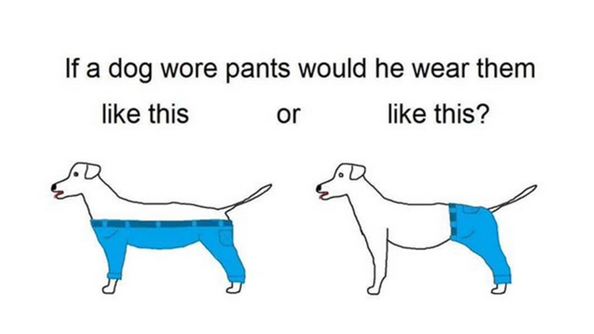
Dog pants

Slide 19
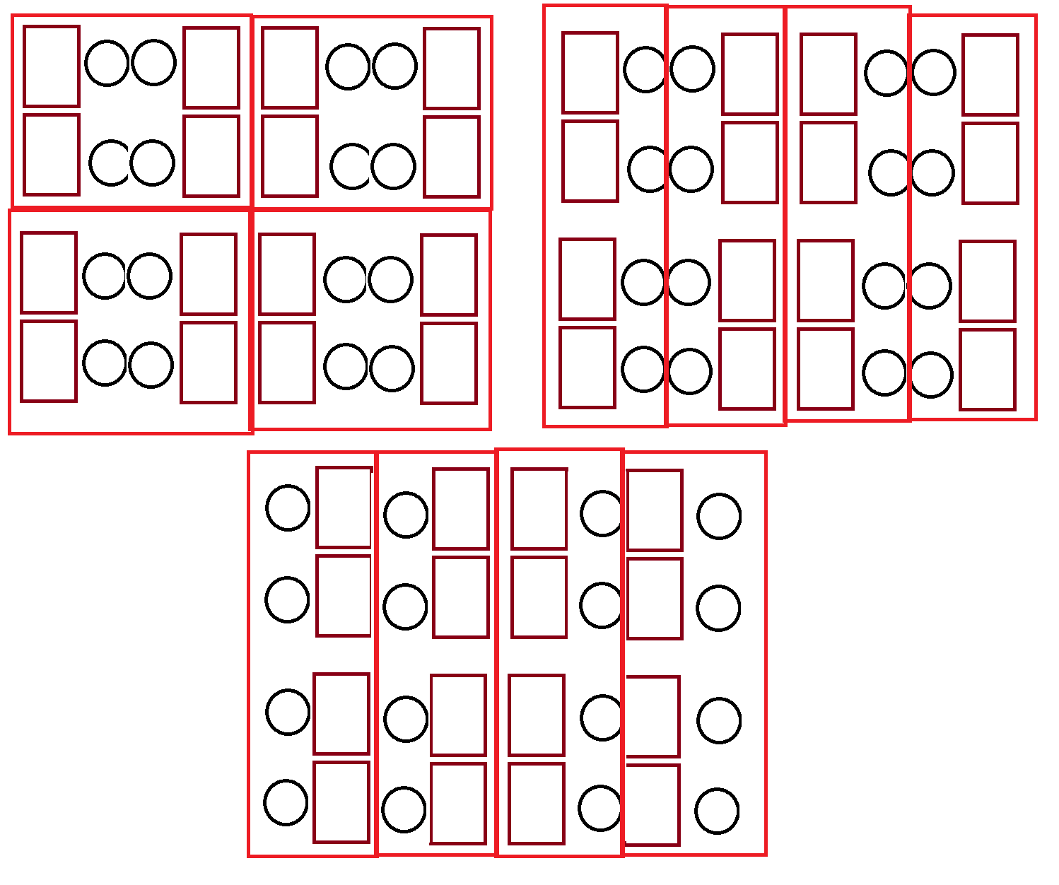
UP
Down
Wiggle

Slide 20
Getting Started
Please update your schedule books now
Please start your first day Reflection

Slide 21
The End

