Slide 1
Production Quality Python
Supplemental Lecture for DS 400
Adrian Henle

Slide 2
What is “Production Quality?”
Runs without errors or warnings (mostly)
Documentation
Function and/or Class definitions
Procedural code in “main block”
Good enough for a finished product
Compiled to a binary or executed via CLI

Slide 3
Integrated Development Environment (IDE)
IDEs (like Spyder) give the user a one-stop-shop for coding
Pros:
Looks cool
Does many useful things
Good for developing code
Cons:
User needs to run the IDE software
IDE and CLI output not always the same

Slide 4
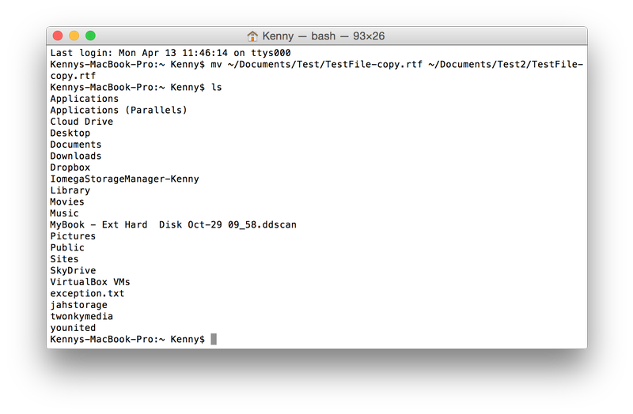
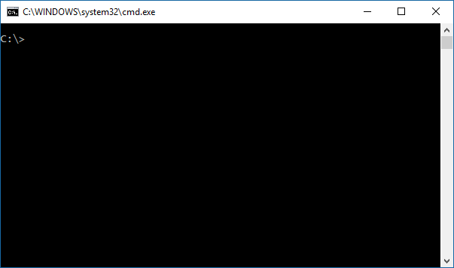
Command Line Interface (CLI)
“Real” Python code is not run in an IDE (e.g. Spyder)
Most Python code is executed on the command line

Slide 5
CLI Basics
Check what “python” means to the system: which python
Check the Python version: python --version
Enter the Python CLI: python
Test some code: x = 2 + 3 x print(x)

Slide 6
Links to Resources
How to get WSL and Ubuntu: https://docs.microsoft.com/en-us/windows/wsl/install-win10
Cygwin: https://cygwin.com/install.html
Anaconda: https://www.anaconda.com/download/

