Slide 1
Combinations, Permutations, and Probability
Lesson 3

Slide 2
Topics
Review
Counting (aka Combinatorics)
Axioms of Probability
Probability
Examples
Conditional Probability
Distributions
Continuous
Discrete

Slide 3
Counting

Slide 4
Why Counting
Counting is fundamental to probability theory.
Probability is the extent or likelihood of an event or set of events.
Depends heavily on the ability to count up potential outcomes.

Slide 5
Counting or Combinatorics
How many combinations are there? This is one of the biggest areas of mathematics, called Combinatorics.
Example:
Subway has 4 different breads, 5 different meats, 4 different toppings. How many sandwich combinations?
How many different 4-beer tasters can I have in a bar with 10 beers on tap?

Slide 6
Solve using the Multiplication Principle
4
5
4
*
*
= 80
(# of breads)
(# of meats)
(# of toppings)
10
9
8
7
*
*
*
= 5,040
(# for 1st beer)
(# for 3rd beer)
(# for 2nd beer)
(# for 4th beer)

Slide 7
Multiplication Principle
If there are A ways of doing task a, and B ways of doing task b, then there are A*B ways of completing both tasks.
Example:
If I have 5 books, how many ways can I order them on the bookshelf?
= 5 factorial = 5! = 120
5 choices *
4 choices *
3 choices *
2 choices *
1 choice
1st book
2nd book
3rd book
4th book
5th book

Slide 8
Factorials
Factorials
Count number of ways to order N things = N!
Factorials get VERY large quickly
21! Is larger than the biggest long-int in 64 bit.
21! = 5.1E19
Biggest long int (64 bit) = 9.2E18
Fun fact: every 52 card shuffle is highly likely to be the only time that shuffle has ever occurred.

Slide 9

Counting Subgroups
Revisit: 10 beers on tap, need a sample of 4 different beers
Let’s assume order matters
i.e. Amber-Stout-Porter-Red is different from Red-Porter-Stout-Amber
Use ‘combinations’ (number of possible scenarios), n choose r:
The total number of ways of selecting r distinct combinations of N objects, irrespective of order

Slide 10



Counting Subgroups
Now, Let’s assume order doesn’t matter.
Use ‘combinations’ (choose):

Slide 11
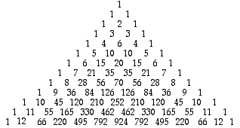

More on Combinations
Combinations appear on the Pascal’s Triangle!
C(N,x) appears on the Nth row, xth number (starting at 0)

Slide 12


Counting Examples
There are 10 Light beers on tap, and 10 Dark beers on tap, how many ways can Rick get a 4-beer sampler that contains exactly 1 light beer? (ordering doesn’t matter)

Slide 13
Counting in Python
Itertools:
http://jmduke.com/posts/a-gentle-introduction-to-itertools/
Counting and Combinatorics Lab
Side note: permutations = combinations where order matters

Slide 14
Probability

Slide 15
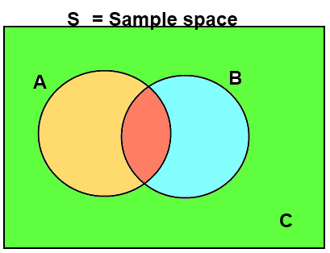
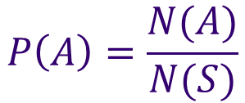
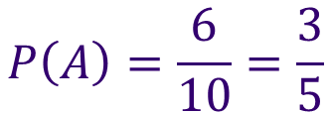
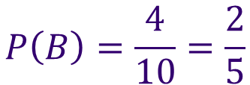
Probability
The Probability of an event, A, is the number of ways A can occur, divided by the number of total possible outcomes in our Sample Space, S.

Slide 16
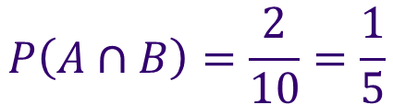
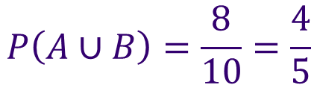
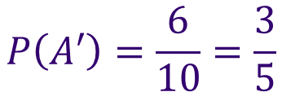
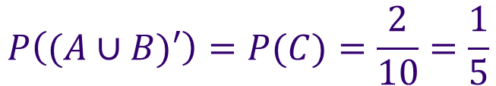
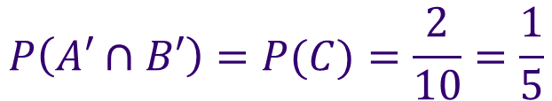
Probability
If is an event, then
Intersection: A and B
= P(A) * P(B)
Union: A or B
= P(A) + P(B)
Negation: A not happening
=1 – P(A)

Slide 17



Axioms of Probability
Probability is bounded between 0 and 1
Probability of the Sample Space = 1.
The probability of finite mutually exclusive (disjoint = not occurring at same time) unions is the sum of their probabilities.
Note: “Percent” literally means per one hundred
If A and B are M.E.

Slide 18
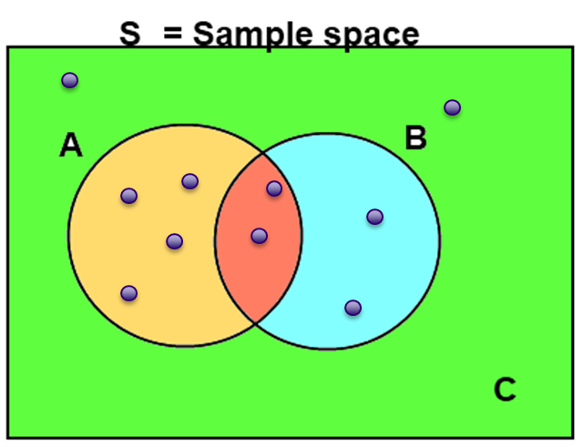

Why is this False?
$$P\left(A∪B\right)=P\left(A\right)+P\left(B\right)$$

Slide 19


Mutually Exclusive Events
In all cases, the probability of the union of A and B takes the form:
If A and B are mutually exclusive that means that
$$P\left(A∪B\right)=P\left(A\right)+P\left(B\right)−P(A∩B)$$
S = Sample space
$$P\left(A∩B\right)=0$$
A
B
$$P\left(A∪B\right)=P\left(A\right)+P(B)$$

Slide 20


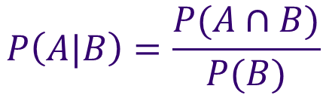
Conditional Probability
The probability of A given B is written:
And is equal to:
$$P\left(A|B\right)$$
$$P\left(A|B\right)=\frac{P(A∩B)}{P(B)}$$
$$P\left(E\right)=\frac{P(E)}{P(S)}$$
compare to:
S = Sample space
A
B

Slide 21
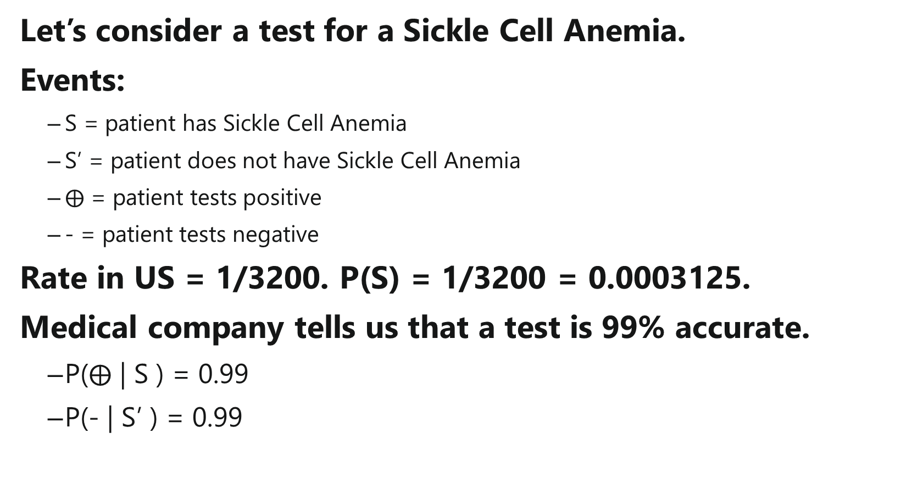
Conditional Probability Trees
Let’s consider a test for a Sickle Cell Anemia.
Events:
S = patient has Sickle Cell Anemia
S’ = patient does not have Sickle Cell Anemia
$⨁$ = patient tests positive
- = patient tests negative
Rate in US = 1/3200. P(S) = 1/3200 = 0.0003125.
Medical company tells us that a test is 99% accurate.
P($⨁$ | S ) = 0.99
P(- | S’ ) = 0.99

Slide 22
Conditional Probability Trees
P(S)
S
S’
P(S’)

Slide 23
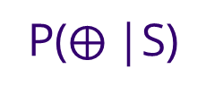
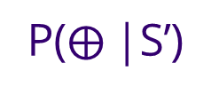
Conditional Probability Trees
P($⨁$|S)
+
P(S)
-
S
P(-|S)
P($⨁$|S’)
S’
+
P(S’)
-
P(-|S’)

Slide 24
Conditional Probability Trees
0.99
0.0003125
P($⨁$|S)
+
P(S)
-
S
P(-|S)
P($⨁$|S’)
S’
+
P(S’)
-
P(-|S’)
0.99

Slide 25
Conditional Probability Trees
0.99
0.0003125
P($⨁$|S)
+
P(S)
0.01
-
S
P(-|S)
P($⨁$|S’)
S’
+
0.01
P(S’)
-
0.9996875
P(-|S’)
0.99

Slide 26
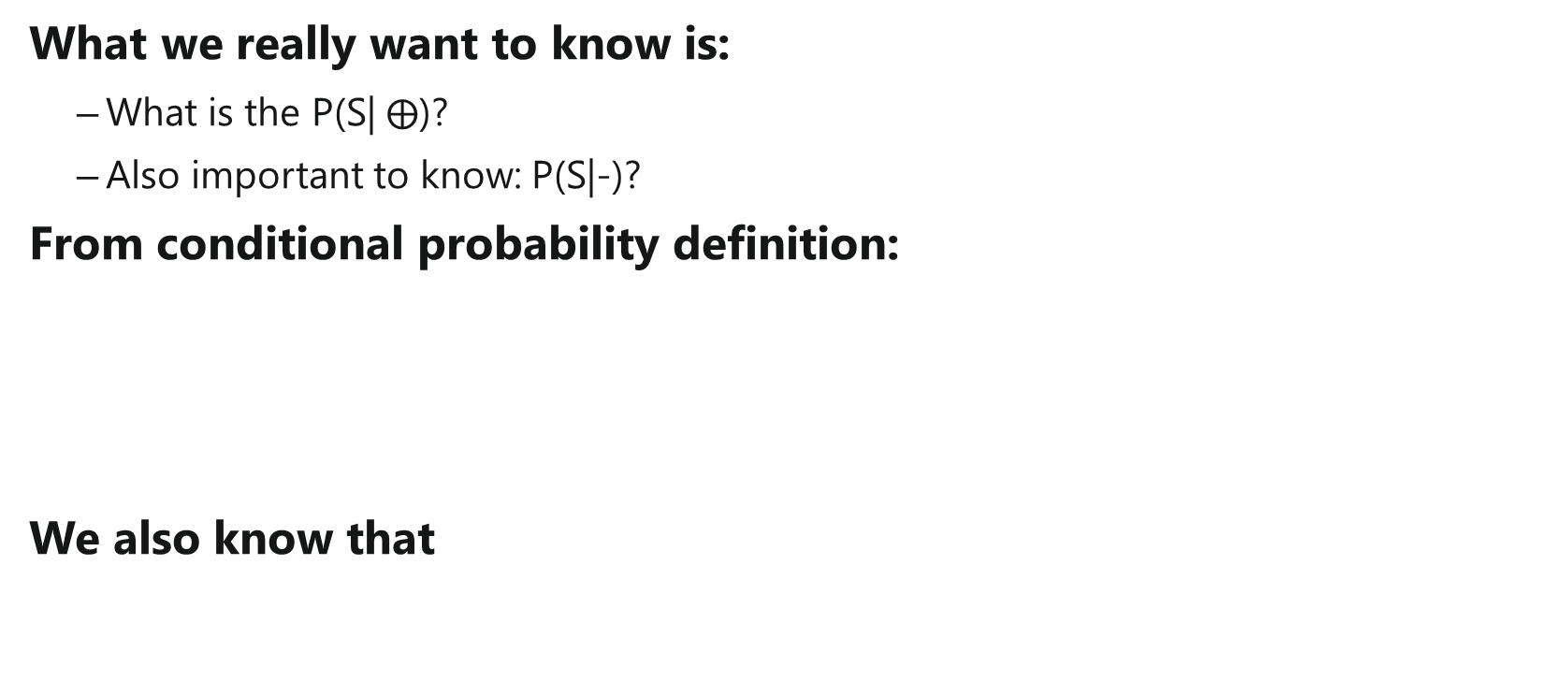
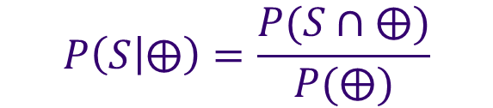
Conditional Probability Trees
What we really want to know is:
What is the P(S| $⨁$)?
Also important to know: P(S|-)?
From conditional probability definition:
We also know that
$$P\left(S | ⨁\right)=\frac{P(S∩⨁)}{P(⨁)}$$
$$P\left(⨁\right)=P(⨁∩S)+P(⨁∩S^{′})$$

Slide 27




Conditional Probability Trees
P($⨁$|S)
$$P\left(⨁∩S\right)=P\left(S\right)P(⨁|S)$$
+
0.0003125*0.99=0.000309375
P(S)
-
S
P(-|S)
$$P\left(−∩S\right)=P\left(S\right)P(−|S)$$
P($⨁$|S’)
$$P\left(⨁∩S′\right)=P\left(S^{′}\right)P(⨁|S′)$$
S’
+
P(S’)
-
P(-|S’)
$$P\left(−∩S′\right)=P\left(S\right)P(−|S′)$$

Slide 28
Conditional Probability Trees
P($⨁$|S)
0.000309375
+
P(S)
-
S
P(-|S)
0.000003125
P($⨁$|S’)
0.009996875
S’
+
P(S’)
-
P(-|S’)
0.9896906

Slide 29
Conditional Probability Trees
0.000309375
0.000003125
0.009996875
0.9896906

Slide 30






Conditional Probability Trees
$$P\left(⨁\right)=P(⨁∩S)+P(⨁∩S^{′})$$
0.000309375 =
$$P(⨁∩S)$$
$$P\left(⨁\right)=0.01030625$$
0.000003125 =
$$P(−∩S)$$
0.009996875 =
$$P(⨁∩S′)$$
0.9896906 =
$$P(−∩S′)$$

Slide 31








Conditional Probability Trees
$$P\left(⨁\right)=P(⨁∩S)+P(⨁∩S^{′})$$
0.000309375 =
$$P(⨁∩S)$$
$$P\left(⨁\right)=0.01030625$$
$$P\left(S | ⨁\right)=\frac{P(S∩⨁)}{P(⨁)}$$
0.000003125 =
$$P(−∩S)$$
$$P\left(S | ⨁\right)=\frac{0.000309375}{0.01030625}$$
0.009996875 =
$$P(⨁∩S′)$$
$$P\left(S | ⨁\right)=0.03001819$$
Similarly,
0.9896906 =
$$P(−∩S′)$$
$$P\left(S | −\right)=0.000003157543$$
*Now see the probability interview question

Slide 32


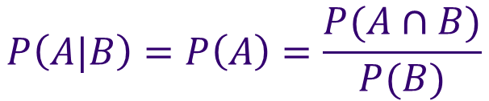




Independent Events
Events A is independent of B if and only if:
A being independent of B does NOT imply B is independent of A.
$$P\left(A|B\right)=P(A)$$
$$P\left(A|B\right)=P(A)$$
$$P\left(B|A\right)=P(B)$$
$$P\left(A|B\right)=P\left(A\right)=\frac{P(A∩B)}{P(B)}$$
$$P\left(B\right)P\left(A\right)=P(A∩B)$$
E.g. The event that my boss takes vacation has an impact on when I take vacation, but when I take vacation has no impact on when my boss takes vacation. (i.e., his vacation is independent of mine, but not vice versa)

Slide 33


Independence vs. Mutually Exclusive
Mutually exclusive events cannot occur at the same time:
If A is M.E. of B then:
If A is independent of B then the occurrence of one does not affect the occurrence of the other:
$$P\left(A|B\right)=0$$
B occurring has a HUGE impact on P(A)
$$P\left(A|B\right)=P(A)$$
Example: The probability the sidewalk is wet given it is raining is very high. But the probability that it is raining given the sidewalk is wet is lower (if I run my sprinklers often).

Slide 34
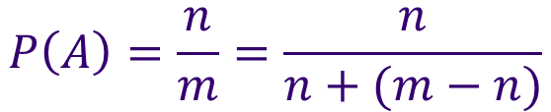

Odds
Odds are expressed as:
(Count in event favor):(Count not in event favor)
Make sure you reduce the fraction first
Implies odds are:
Examples:
$$P\left(A\right)=\frac{n}{m}=\frac{n}{n+(m−n)}$$
If P(A)=5/6, then the odds are
5:1. ‘Five to one’.
If the odds are 3:20, then
P(A)=3/23
A straight up sports bet in
Vegas has odds 1:1 (50%), but
pays 0.95 X bet.
Count in
favor of A
Count not in
favor of A
$$n:(m−n)$$

Slide 35
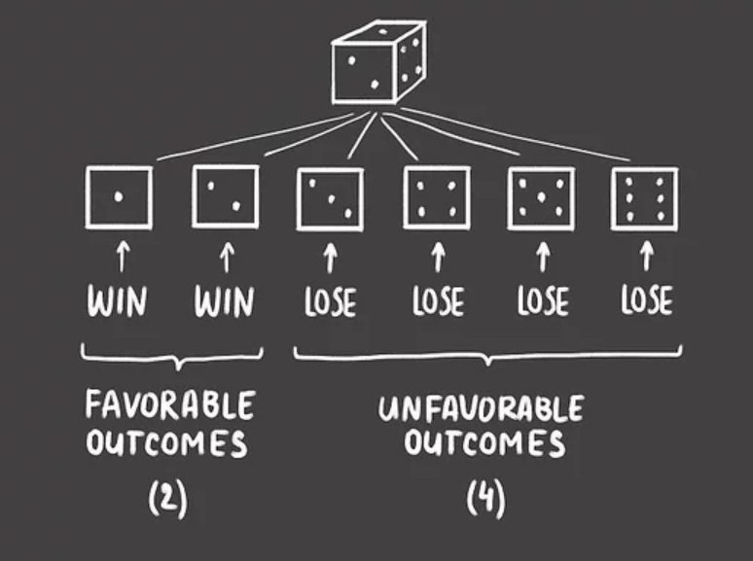
Calculating odds
Odds = Favorable: Unfavorable
Odds are 2:4 or 1:2
Does not = 50% chance to win
1chance to win compared to 2 chances to lose = 3 possible outcomes
1/3 * 100 = 33% chance to win
2/3 * 100 = 66% chance to lose

Slide 36
Monty Hall Problem
Famous conditional probability problem that divided statisticians when it came out.
Start with 3 doors. One prize behind unknown door. Pick a door. Host reveals a separate door with no prize.
You have the option to keep the door you picked, or switch.
Should you stay or switch?

Slide 37
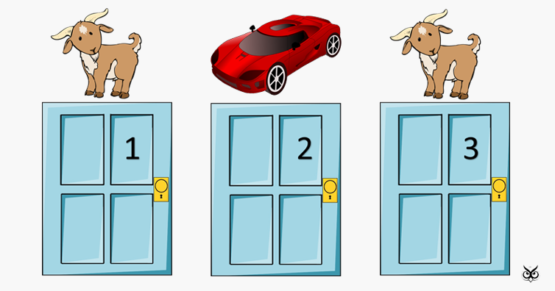
Monty Hall Problem
Mysterious Prizes

Slide 38
Monty Hall Problem
You Pick…

Slide 39
Monty Hall Problem
Host Picks…

Slide 40
Monty Hall Problem
Do you switch to door 2 or stay?

Slide 41
Monty Hall Problem
Don’t switch:
P(W) = 1/3
P(L) = 2/3
Switching:
P(W) = 2/3
P(L) = 1/3
What?!
Host has to pick not-prize door to show you so this increases your odds to 2/3
If you pick wrong the first time and switch, you will always win.

Slide 42
Distributions

Slide 43
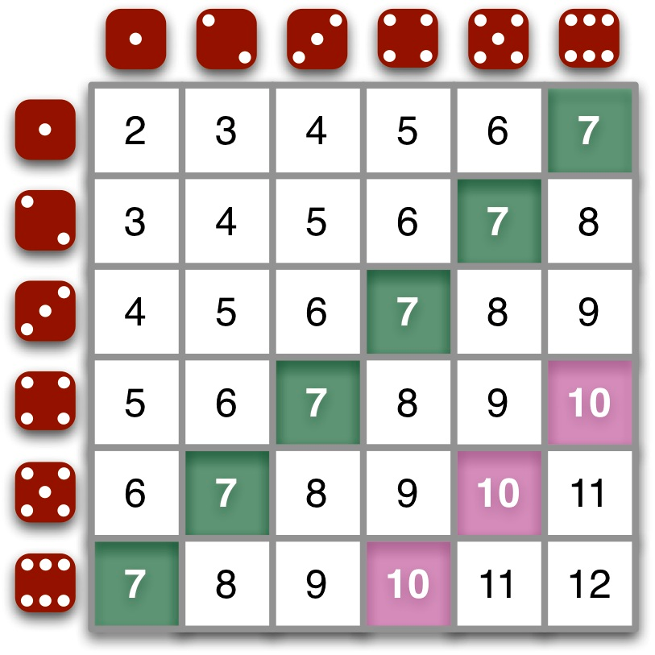
Die Rolling…
Consider the probabilities of all potential sums of 2 die:
P(2)=1/36
P(3)=2/36
P(4)=3/36
P(5)=4/36
P(6)=5/36
P(7)=6/36
P(8)=5/36
P(9)=4/36
P(10)=3/36
P(11)=2/36
P(12)=1/36
Sum(all) = 36/36 = 1
If we consider all possibilities together, this is called a distribution.

Slide 44
Two Types of Probability Distributions
Discrete
Discrete variables take on specific values
Examples:
Qualitative (1,2, 27.5)
Temperature
Performance ratings (1st, 2nd, 3rd)
Continuous
Continuous variables can take on any value between their min and max
Examples:
Height
Weight
Time

Slide 45
Discrete Distributions
Binomial –
probability of exactly x successes in n successive trials
Negative Binomial-
probability that it will take exactly n successive trials to produce exactly x successes
Geometric-
probability that it will take exactly n successive trials to produce the first success.
Poisson-
probability of exactly x successes over some continuous interval of time or space

Slide 46
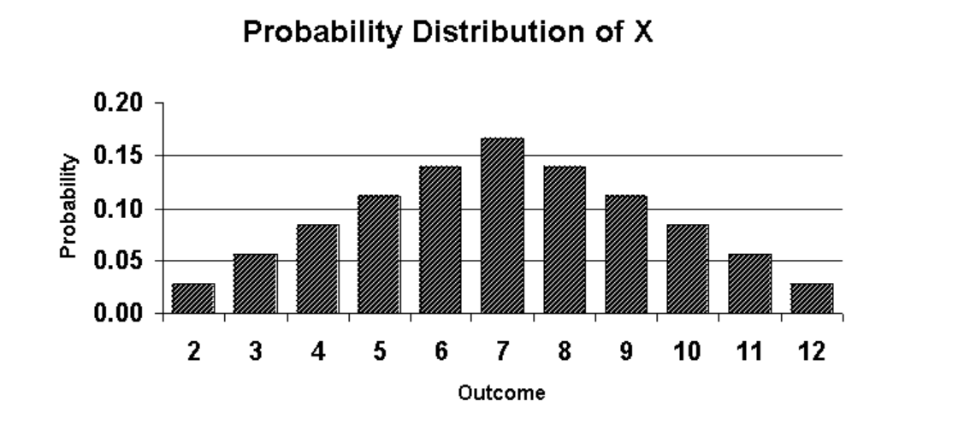
Discrete Distributions
Properties of a Discrete Distribution
Sum of all events must equal 1.
Probability of an event is equal to the value of the distribution at that point
No Negative values or values greater than 1

Slide 47
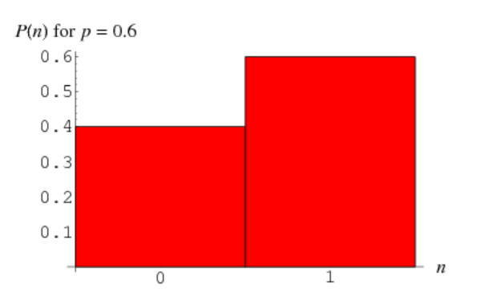
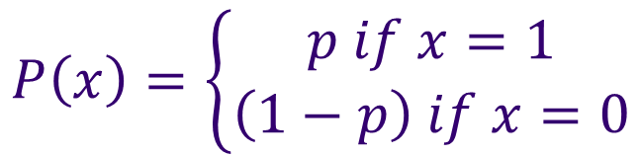

Discrete Distributions
Probability Density Function for X = p^{x} (1 – p)^{1 – x}
^{Also written as:}
Bernoulli – only two outcomes
Yes or no
True/False
0 or 1
Heads or tails
Success = p
Failure = Q
Q = 1 – p
P + Q = 1
$$P\left(x\right)=\left\{\begin{aligned}p if x=1 \\ \left(1−p\right) if x=0\end{aligned}\right.$$
$$x∈\{0,1\}$$

Slide 48
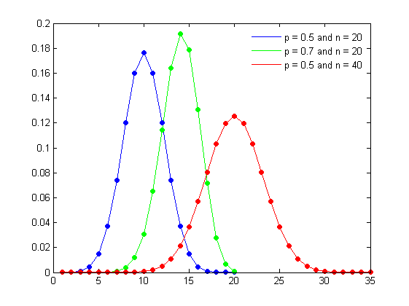
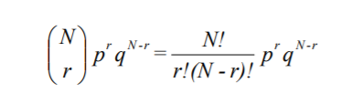
Data Distributions (Discrete)
Binomial Distribution (Multiple Bernoulli's Events)
Multiple Independent events = Product of Bernoulli Probabilities
Number of successes in r trials
N choose r = binomial coefficient
Mean = np (# exp * P(success)
Variance = np(1 – p)

Slide 49
Data Distributions (Discrete)
Poisson (Count number of events in a time span)
Events are independent
Rate that events occur is constant
Two events cannot occur at the same time
Mean =
Variance =

Slide 50
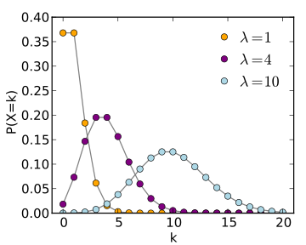
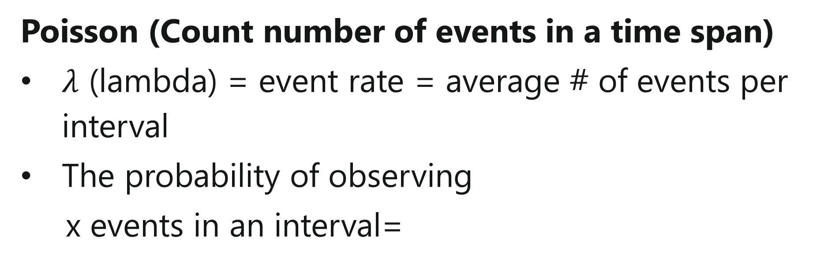
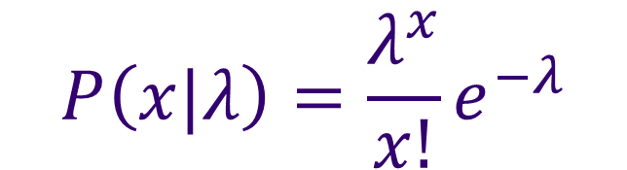
Data Distributions (Discrete)
Poisson (Count number of events in a time span)
$λ$ (lambda) = event rate = average # of events per interval
The probability of observing
x events in an interval=
$$P\left(x|λ\right)=\frac{λ^{x}}{x!}e^{−λ}$$
e = euler’s constant 2.71828

Slide 51
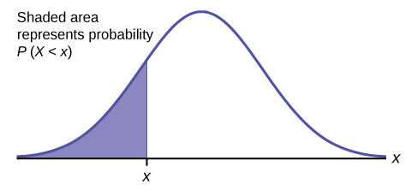
Continuous Distributions
Properties of a Continuous Distribution
Area under the curve = 1
P(event) = area under curve
No negative values
Probability of a single, exact value is 0 (it’s continuous, not discrete)

Slide 52
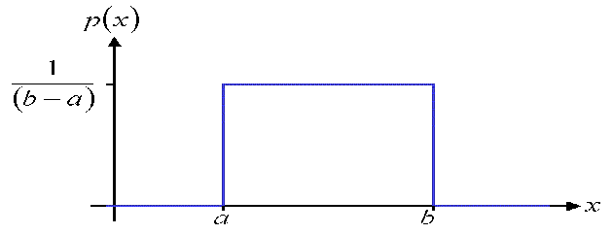
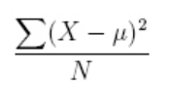

Data Distributions (Continuous)
Uniform (flat, bounded)
Very useful for parameter priors (future discussion)
Mean=(a+b)/num observations
Variance
$$P\left(x\right)=\left\{\begin{aligned}\frac{1}{(b−a)} if a≤x≤b \\ 0 if x<a or x>b\end{aligned}\right.$$

Slide 53
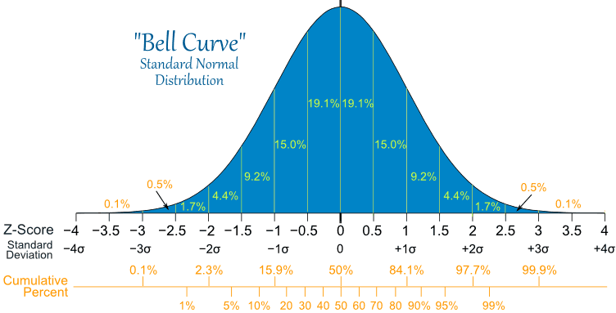
Data Distributions (Continuous)
Normal (Gaussian) distribution
Most common and occurs naturally.
Defined by mean and variance only
Tests for normality are very important

Slide 54
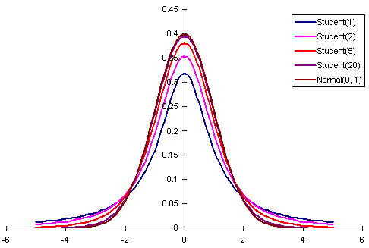
Data Distributions (Continuous)
Student’s T Used for:
Small sample sizes
Testing mean value when st. dev. is unknown.
Finding sig. diff between two sample means
Very similar to the normal distribution.

Slide 55
Distribution Transformations
The purpose of transforming a variable is to make it easier to distinguish between values.
Most commonly we are looking to transform a distribution to be normal.
Common Transformations
Log-based:
Log(x), log(x+1), log(x-min(x) + 1)
Nth Root based:
X^(1/n)
Any combination you can think of (remembering math rules).
We will cover normality tests in a later class.

