Slide 1


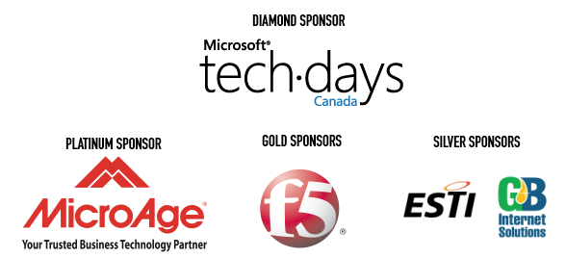

Active Directory in Azure

Slide 2
Deploying Active Directory in Windows Azure
Tyler Doerksen
Azure Solution Specialist
Imaginet

Slide 3
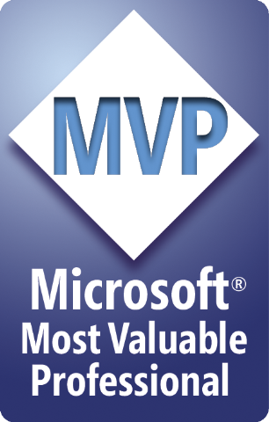





Tyler Doerksen
Azure Solution Specialist Imaginet
Azure Virtual Technical Specialist – Western Canada
Windows Azure MVP
Catch him on:
Tyler’s Blog blog.tylerdoerksen.com
tylergd@outlook.com
@tyler_gd
linkedin.com/in/tdoerksen
TylerDoerksen.com

Slide 4
Virtual Networks

Slide 5
Cross-premise Connectivity
CLOUD
ENTERPRISE
Data Synchronization
SQL Data Sync
Application-Layer
Connectivity & Messaging
Service Bus
Secure Machine-to-Machine Network Connectivity Windows Azure Connect
Secure Machine-to-Machine Network Connectivity Windows Azure Connect
Secure Site-to-Site
Network Connectivity
Windows Azure Virtual Network
Secure Site-to-Site
Network Connectivity
Windows Azure Virtual Network
IP-level connectivity

Slide 6
Windows Azure Virtual Network
Your “virtual” branch office / datacenter in the cloud
Enables customers to extend their Enterprise Networks into Windows Azure
Networking on-ramp for migrating existing apps and services to Windows Azure
Enables “hybrid” apps that span cloud and their premises
A protected private virtual network in the cloud
Enables customers to setup secure private IPv4 networks fully contained within Windows Azure
IP address persistence
Inter-service DIP-to-DIP communication
Corpnet
Windows Azure
VM 1
VM 2
Subnet 1
Subnet 2
ROLE 1

Slide 7
Do You Need a Virtual Network?
Persistent IP Address Requirements
Virtual Machines deployed into a virtual network have an infinite DHCP lease.
Hybrid On-Premises Cloud Apps
Requirement for connectivity between your data center and the public cloud.
Connectivity between cloud services.
Deploying Active Directory in the Cloud or connecting a PaaS to IaaS Service.
Corpnet
Windows Azure
VM 1
VM 2
Subnet 1
Subnet 2
ROLE 1

Slide 8
DEMO: Setup a Virtual Network

Slide 9
Why Active Directory?
Business drivers
Support pre-requisites for other Applications or Services
Serve as substitute or failover for branch-office/HQ domain controllers
Serve as primary authentication for cloud only data center
Design considerations
Certain Active Directory configuration knobs and deployment topologies are better suited to the cloud than others
Placing Active Directory domain controllers in Windows Azure equates to running virtualized domain controllers
Hypervisors provide or trivialize technologies that don’t sit well with many distributed systems… including Active Directory

Slide 10
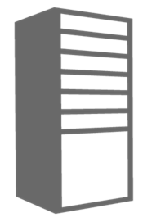
Cloud Service Configuration for AD
Deploy DC in Separate Cloud Service
ADVNET
Cloud Service for AD Domains
Location: North Central US
Name: ad-cloudservice.cloudapp.net
Affinity Group: ADAG
Cloud Service for AD Clients
Location: North Central US
Name: app-cloudservice.cloudapp.net
Affinity Group: ADAG
Deployment
Virtual Network: ADVNET
DNS Ips: (On-Premise AD IP)
Deployment
Virtual Network: MyVNET
DNS Ips: 192.168.1.4
DIP
Virtual Machine
Role Name: ad-dc
Subnet: ADSubnet
IP Address: 192.168.1.4
Virtual Machine
Role Name: advm1
Subnet: AppSubnet
IP Address: 192.168.2.4

Slide 11
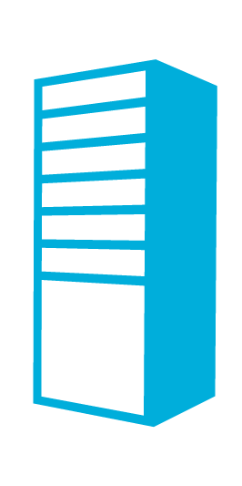
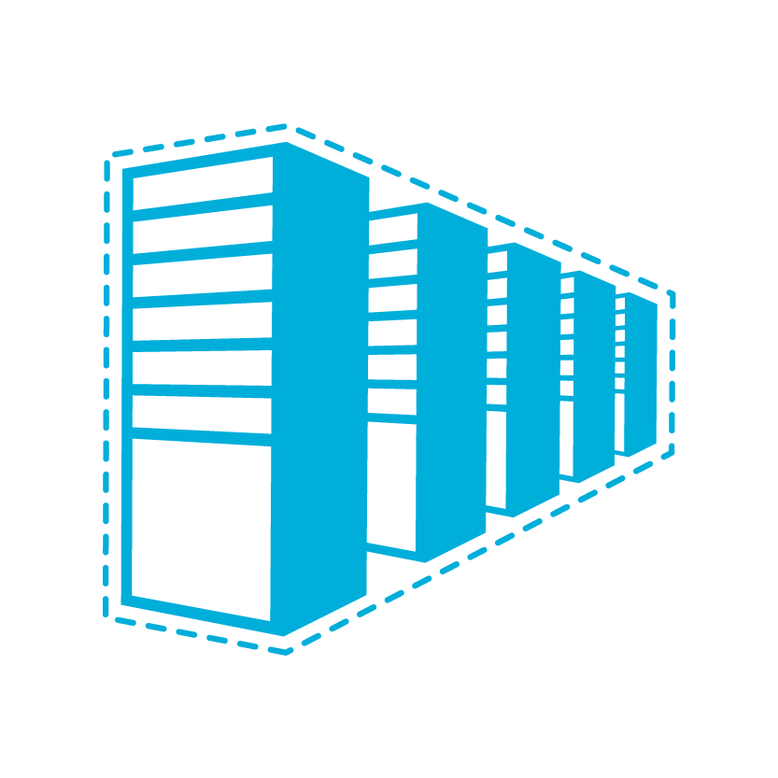

Domain Controller On-Premises
Contoso.com Active Directory
Contoso.com Active Directory
Contoso Corp Network
The Virtual Network
in Windows Azure
SQL Servers
IIS Servers
Site to Site VPN Tunnel
AD Authentication
+
On-Premises Resources
Gateway
AD / DNS
S2S VPN Device
IIS Servers
SQL Servers
Exchange
Load Balancer
Public IP

Slide 12
Domain Controller in the Cloud
Contoso.com Active Directory
Contoso.com Active Directory
Contoso Corp Network
The Virtual Network
in Windows Azure
SQL Servers
IIS Servers
Site to Site VPN Tunnel
AD / DNS
AD Authentication
+
On-Premises Resources
Gateway
S2S VPN Device
AD Auth
AD / DNS
IIS Servers
SQL Servers
Exchange
Load Balancer
Public IP

Slide 13
Active Directory Cloud Only
Contoso.com Active Directory
Contoso Corp Network
Extranet Active Directory
Contoso.com Active Directory
Extranet Active Directory
Contoso Corp Network
The Virtual Network
in Windows Azure
The Virtual Network
in Windows Azure
SQL Servers
IIS Servers
SQL Servers
IIS Servers
Site to Site VPN Tunnel
Site to Site VPN Tunnel
AD / DNS
AD / DNS
On Premises Resources
Gateway
On Premises Resources
Gateway
S2S VPN Device
AD Auth
S2S VPN Device
AD Auth
AD / DNS
AD / DNS
SQL Servers
IIS Servers
SQL Servers
IIS Servers
Exchange
Exchange
Load Balancer
Public IP
Load Balancer
Public IP

Slide 14
DEMO: Cloud Hosted Domain

Slide 15
Considerations
Placement of the Active Directory database (DIT)
Optimizing your deployment for traffic and cost
Read-Only DCs (RODC) or Read-Writes?
Global Catalog or not?
Trust or Replicate?
IP addressing and name resolution
Geo-distributed cloud-hosted domain controllers

Slide 16
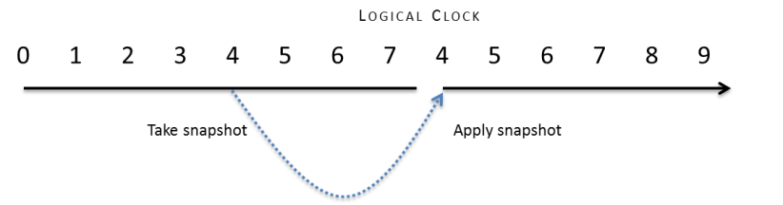
Is it safe to virtualize DCs?
Background
Common virtualization operations such as backing up/restoring VMs/VHDs can rollback the state of a virtual DC
Introduces USN bubbles leading to permanently divergent state causing:
lingering objects
inconsistent passwords
inconsistent attribute values
schema mismatches if the Schema FSMO is rolled back
The potential also exists for security principals to be created with duplicate SIDs

Slide 17



How Domain Controllers are Impacted
DC1
DC2
TIME: T1
Create
VHD copy
USN: 100
ID: A
RID Pool: 500 - 1000
+100 users added
USN rollback NOT detected: only 50 users converge across the two DCs
All others are either on one or the other DC
150 security principals (users in this example) with RIDs 500-649 have conflicting SIDs
Timeline of events
USN: 200
TIME: T2
DC2 receives updates: USNs >100
ID: A
RID Pool: 600 - 1000
DC1(A) @USN = 200
TIME: T3
T1 VHD copy restored
USN: 100
ID: A
RID Pool: 500 - 1000
+150 more users created
TIME: T4
USN: 250
ID: A
RID Pool: 650 - 1000
DC2 receives updates: USNs >200
DC1(A) @USN = 250

Slide 18
Placement of the Active Directory DIT
Active Directory DIT’s/sysvol should be deployed on data disks
Data Disks and OS Disks are two distinct Azure virtual-disk types
they exhibit different behaviors (and different defaults)
Unlike OS disks, data disks do not cache writes by default
NOTE: data disks are constrained to 1TB
1TB > largest known Active Directory database == non-issue
Why is this a concern?
Write-behind disk-caching invalidates assumptions made by the DC
DC’s assert FUA (forced unit access) and expect the IO subsystem to honor it
FUA is intended to ensure sensitive writes make it to durable media
can introduce USN bubbles in failure scenarios

Slide 19
Running AD in the Cloud (VPN)
VPN Connectivity with on-premises Domain
Configure Virtual Networking with VPN Gateway
Create New Virtual Machine “into” a Virtual Network
With PowerShell can deploy VM Domain Joined
DC Promo
Add Domain Existing Forest
Place .dit on Data Disk

Slide 20
Running AD in the Cloud (Cloud Only)
Cloud Only Deployment (New AD) Create New VM
Configure Data Disk for ReadOnly Cache Mode
DC Promo
Add Domain New Forest
Place .dit on Data Disk
Cloud Only Deployment (Existing AD) Upload Existing Domain Controller VHD(s)
Create New VM with VHD(s) attached
Configure Disk with .dit for ReadOnly Cache Mode

Slide 21
Virtualization Conclusions
AD is Supported in Windows Azure Virtual Machines
(Not VM Role)
Capture/Imaging is not supported with DCs To make a new DC provision a VM and run DC Promo

Slide 22
Optimizing your deployment for traffic and cost
Consider cost and deploy according to requirements
Inbound traffic is free, outbound traffic is not
Standard Azure outbound traffic costs apply
Nominal fee per hour for the gateway itself
Can be started and stopped as you see fit
if stopped, VMs are isolated from corporate network
RODCs will likely prove more cost effective

Slide 23
Optimizing your deployment for traffic and cost (cont.)
DC-locator and ISTG/ISM (intersite topology generator and messenger)
Correctly defining and connecting Active Directory subnets and sites will influence your bottom-line
sites, site-links and subnets affect who authenticates where and DCs’ replication topology
Ensure the cost between any on-premises site and the cloud-sites are appropriately dissuasive
i.e. the notion of “next closest site” (a common fallback in Active Directory) should not conclude that the cloud is the next closest
Ensure replication is scheduled (not “Notify-”driven)
Ensure it’s compressed (and crank it up—domain controllers offer aggressive controls around compression of replication traffic)
Align replication schedule with latency tolerance
DCs replicate only the last state of a value so slowing replication down saves cost if there’s sufficient churn

Slide 24
Read-Only DCs (RODC) or Read-Writes
Using RODCs for Azure is a no-brainer? Or is it?
This isn’t really what they’re designed for
designed to be caching DCs used at physically insecure branch sites
the question is one of trust… do “you” trust the Azure datacenter?
But is High Business Impact/Personal Ident a concern?
RODCs do offer ROFAS (a filtered attribute set) which permits targeted attributes to be excluded from RO replicas
but RODCs introduce known and unknown app-compat issues which increases the test-burden and associated support costs
Finally, RODCs NEVER replicate anything outbound
They do need to populate cacheable secrets which requires on-demand traffic to obtain them as a user/computer authenticates
Consider that the absence of outbound traffic through the lack of replication yields cost savings

Slide 25
Global Catalog (GC) or not?
GCs are necessary in multi-domain forests for authentication
Workloads in the cloud that authenticate against a DC in the cloud will still generate outbound authentication traffic without one
used to expand Universal Group memberships
less predictable cost associated with GCs since they host every domain (in-part)
completely unpredictable cost if workload hosts Internet-facing service and authenticates users against Active Directory
Could leverage “Universal Group Membership Caching”
Predominantly replicates inbound only
outbound replication is possible with other GCs

Slide 26
Trust or Replicate?
Choice
Add replica DCs in the cloud or build a new forest and create a trust?
Kerberos or Federated
Motivators
Security (selective authentication feature)
Compliance/privacy (HBI/PII concerns)
Cost
replicate more or generate more outbound traffic as a result of authentication and query load
Resiliency/fault-tolerance
if the link goes down, trusted scenarios are likely entirely broken

Slide 27
IP addressing and name resolution
Azure VMs require “DHCP leased addresses” but leases never expire or move between VMs
The non-static piece is the opposite of what most Active Directory administrators are used to using
When an Azure VM leases an address, it is routable for the period of the lease
The period of the lease directly equates to the lifetime of the service → so we’re good ☺
Traditional on-premises best practices for domain controller addressing do NOT apply
Do NOT consider statically defining a previously leased address as a workaround
this will appear to work for the remaining period of the lease but once the lease expires, the VM will lose all communication with the network → not good when it’s a domain controller
Name resolution
Deploy Windows Server DNS on the domain controllers
Windows Azure provided DNS does not meet the complex name resolution needs of Active Directory (DDNS, SRV records, etc.)
A critical configuration item for domain controllers and domain-joined clients
must be capable of registering (DCs) and resolving resources within their own
Since static addressing is not supported, these settings MUST be configured within the virtual network definition

Slide 28
Geo-distributed, cloud-hosted domain controllers
Azure offers an attractive option for geo-distribution of domain controllers
Off-site fault-tolerance
Physically closer to branch offices (lower latency)
Azure
X
Asia
US
But no direct virtual-network to virtual-network communication exists
Requires one tunnel from each virtual-network back to the corporate network on-premises
vNet pipes
HQ
All replication would route through or bounce off of CORP domain controllers
May generate large amounts of outbound traffic
CORP
Notes:
a single virtual-network is bounded by an affinity group
an affinity-group allows you to hint to Azure that machines within the same group expect high-speed communication

Slide 29
AD Cloud Deployment Patterns

Slide 30
Deploying AD in a Windows Azure VM
Cloud Service with Initial Domain Controller
Virtual Network Name
Existing DNS Servers (If any)
Virtual Network Subnet
Domain Join Settings (If existing domain)
Separate Data Disk for Active Directory Database
DCPromo
Create Separate Cloud Service for AD Members
Specify DNS at Deployment Level Using PowerShell for VMs (PS only)

Slide 31
Provisioning a VM for a DC – New Forest
## Create Domain Controller
## No AD Settings Specified because you will create a new forest with DC Promo
## In this example the OS disk host caching setting has been set to ReadOnly caching.
## By default the OS disk is ReadWrite which is not safe for databases
$dc1 = New-AzureVMConfig -Name 'MYDC1' -ImageName $imgname -InstanceSize Small |
Add-AzureProvisioningConfig -Windows -Password $pwd |
Set-AzureOSDisk -HostCaching ReadOnly |
Set-AzureSubnet 'DNSSubnet'
New-AzureVM -ServiceName $cloudsvc -AffinityGroup $ag -VNetName $vnet -VMs $dc1 `
–Location $location

Slide 32
Domain Variables to Join Active Directory
# Domain Settings
$domain = 'contoso'
$joindom = 'contoso.com'
$domuser = 'administrator'
$dompwd = 'dompassword'
$advmou = 'OU=AzureVMs,DC=contoso,DC=com' # create OU first
$vnetname = 'ADVNET'
$vmsubnet = 'FrontEndSubnet'

Slide 33
Provisioning a VM for a DC – Existing Forest
## Create Domain Controller
## Specifying Active Directory Join Settings and On-Premises DNS
$dc1 = New-AzureVMConfig -Name 'MYDC1' -ImageName $imgname -InstanceSize Small |
Add-AzureProvisioningConfig -WindowsDomain -Password $dompwd -Domain $domain `
-DomainUserName $domuser -DomainPassword $dompwd -MachineObjectOU $advmou `
-JoinDomain $joindom |
Add-AzureDataDisk -CreateNew -DiskSizeInGB 15 -DiskLabel 'dc1-datadisk' -LUN 0 |
Set-AzureSubnet 'DNSSubnet'
## Configure new Cloud Service to point to on-premises DNS/AD server for name resolution
$dns = New-AzureDns -Name 'OnPremiseAD' -IPAddress '192.168.1.9'
## Provision the VM in the data center. Specify the on-premises DNS.
New-AzureVM -ServiceName $cloudsvc -AffinityGroup $ag -VNetName $vnetname `
-DnsSettings $dns -VMs $dc1 –Location $location

Slide 34
Provisioning a VM to Join Active Directory
## Create VM1
## Specifying Active Directory Join Information
## DNS Information could be either a DC in the cloud or a DC on-premises
$vm1 = New-AzureVMConfig -Name 'myvm1' -ImageName $myimage -InstanceSize Medium |
Add-AzureProvisioningConfig -WindowsDomain -Password $dompwd -Domain $domain `
-DomainUserName $domuser -DomainPassword $dompwd -MachineObjectOU $advmou `
-JoinDomain $joindom |
Set-AzureSubnet $vmsubnet
## IP Address of Domain Controller (on-premises or cloud deployed) $dns1 = New-AzureDns -Name 'dns1' -IPAddress '10.1.2.4'
New-AzureVM -ServiceName $cloudsvc -AffinityGroup $ag -VNetName $vnetname `
-DnsSettings $dns1 -VMs $vm1 –Location $location

