Slide 1
Bike-Sharing Users
By: Tyler Dussuau
Last updated: 01/24/23

Slide 2
Table of Contents
Purpose
Analysis
Conclusion

Slide 3
Purpose
Identify the differences in bike usage between annual members and casual riders to increase membership

Slide 4
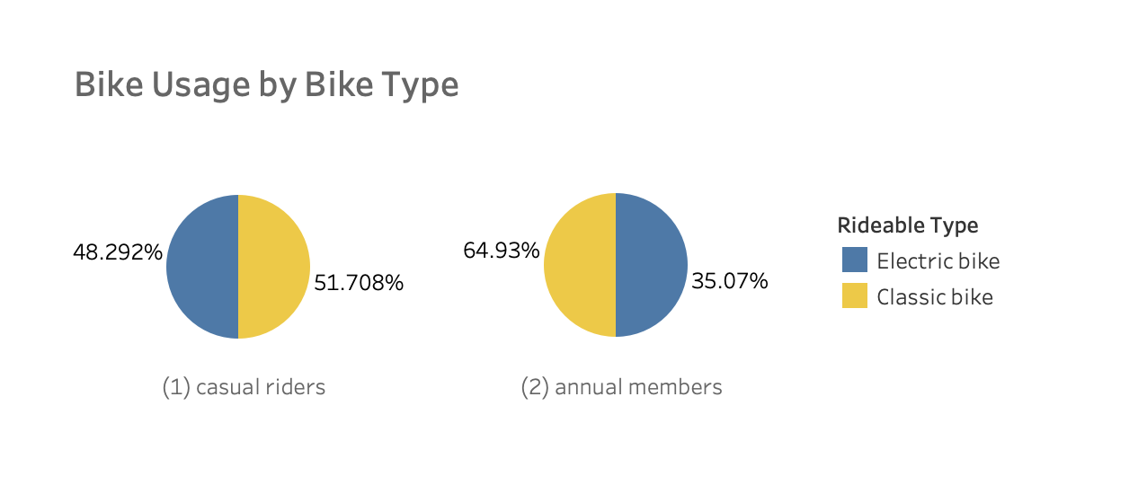
Bike Usage by Bike Type
The percentage of casual riders that use electric bikes is higher compared to annual members.

Slide 5
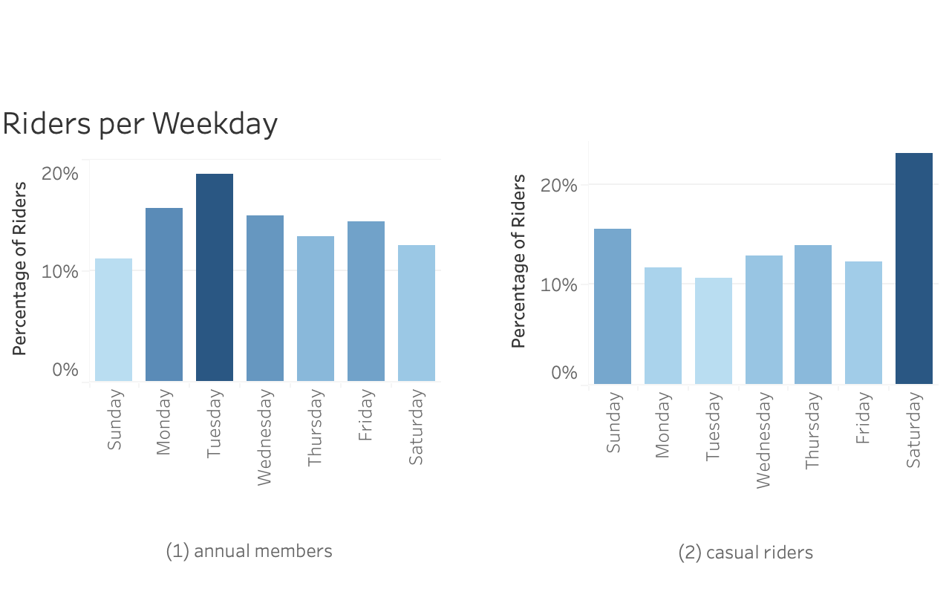
Bike Usage by Weekday
Annual members ride on the weekdays more often compared to casual riders.

Slide 6
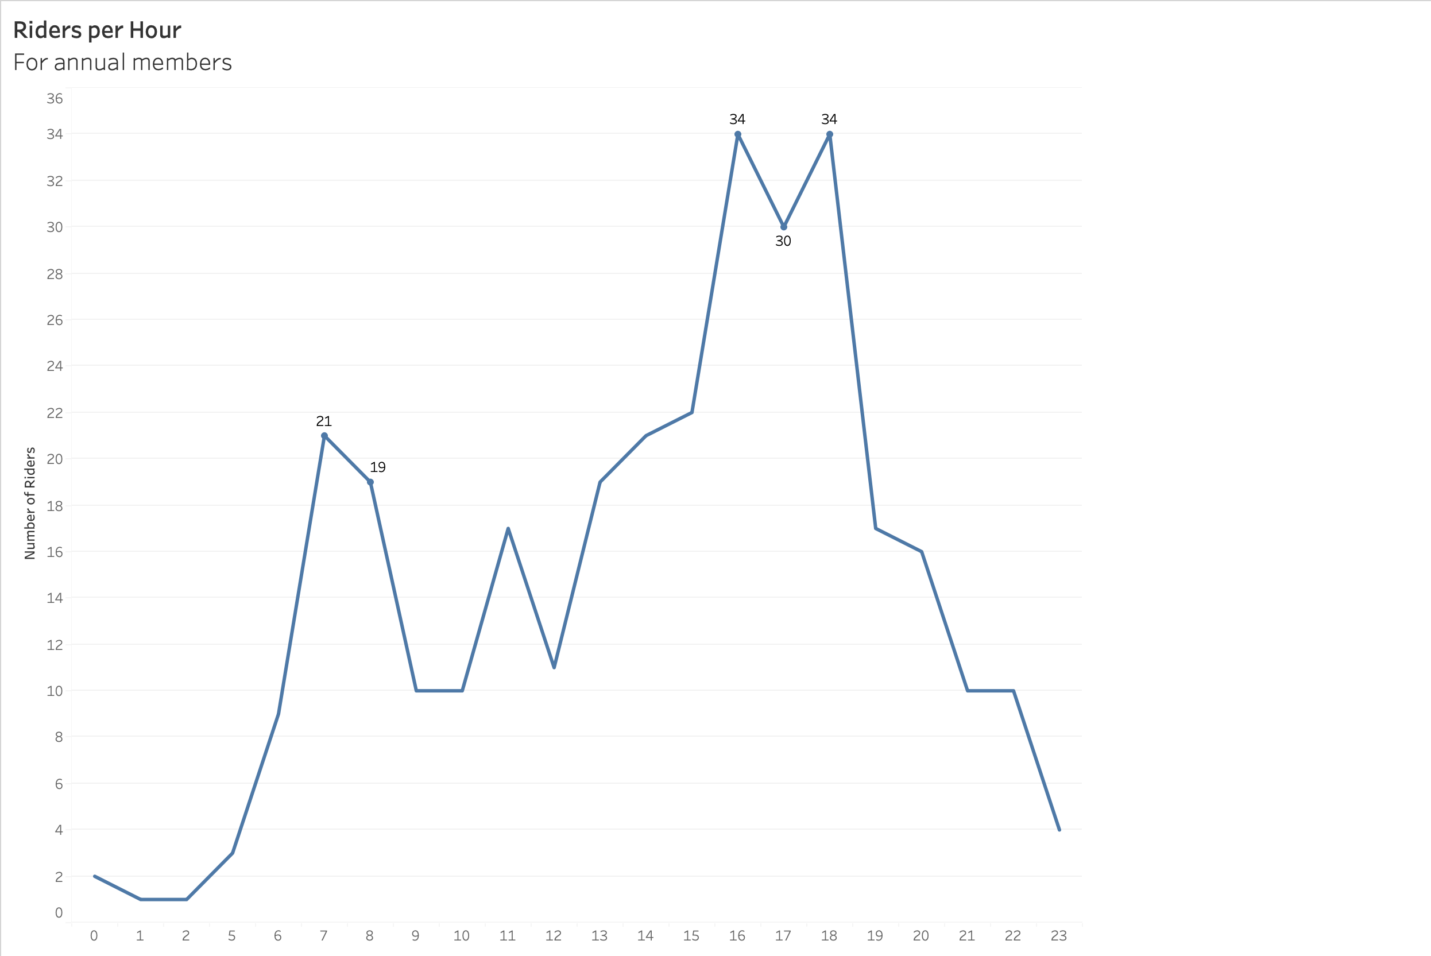
Bike Usage by Time of Day
Most annual members ride between: 7:00 and 9:00 and 17:00 and 20:00 during the weekday.

Slide 7
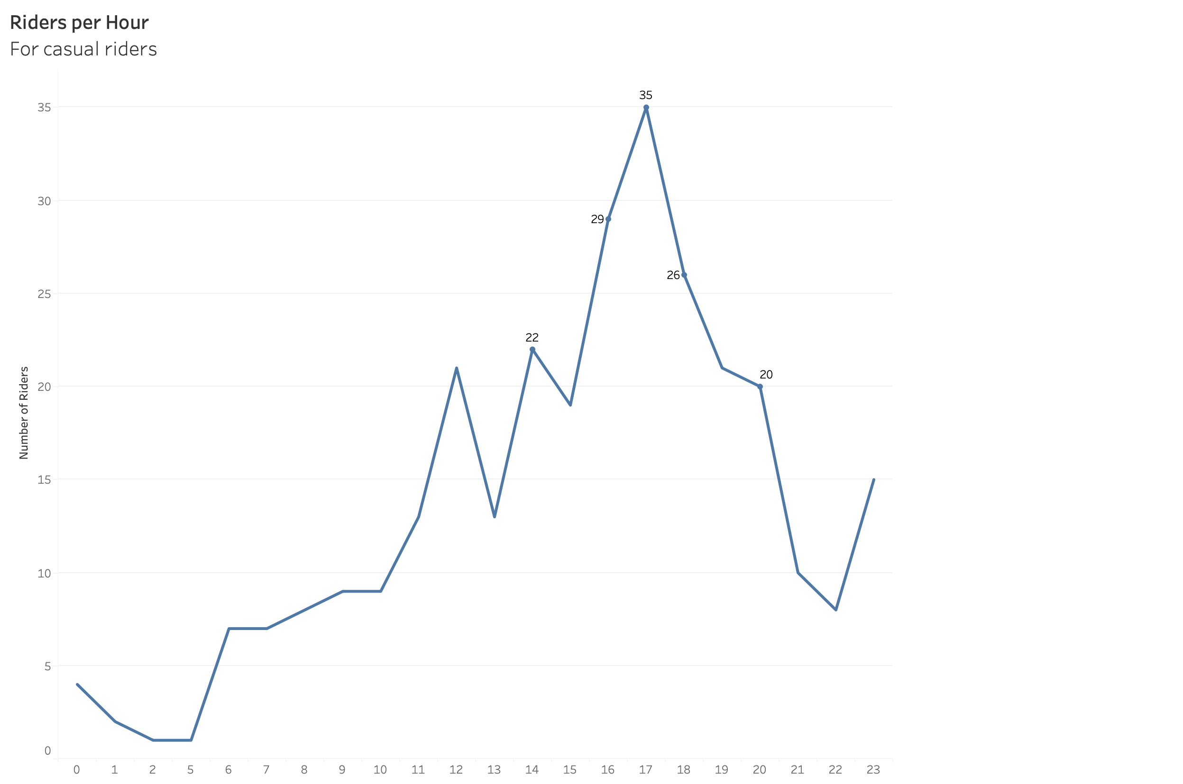
Bike Usage by Time of Day (cont.)
Most casual riders ride between: 2:00 and 9:00 during the weekday.

Slide 8
Conclusion
We should target casual riders who are likely to use bikes to travel to work and from work.
We could emphasize to workers the reduced costs compared to traveling with public transportation.
We could also target users who are older or have disabilities.

Slide 9
Thanks!

