Slide 1

Testing Plan
By Tyler gaudin

Slide 2
Unit test plan
This test will test the Vacation Details activity’s Start Date date picker.
This is a gray box test because I will be testing it and I am aware of most of the code except the underlying code in the SQLite database because I abstracted using the Room framework.
I will test that the picker opens on only one tap.
I will test that the picker takes a selection.
I will test that the picker retains the selection after clicking ok.

Slide 3
Test Scripts
Run the program. Click enter to get to Vacation List. Click the floating action button to get to the Vacation Details screen. Click the Start Date date picker. Observe response.
Click a different date, observe response.
Click the ok button, observe response, note updated text on picker.

Slide 4
Results
The date picker took two taps to open failing the test.
The date picker did accept a selection. This passed the test.
The date picker accepted the ok tap and updated the EditText line. This passed the test.

Slide 5
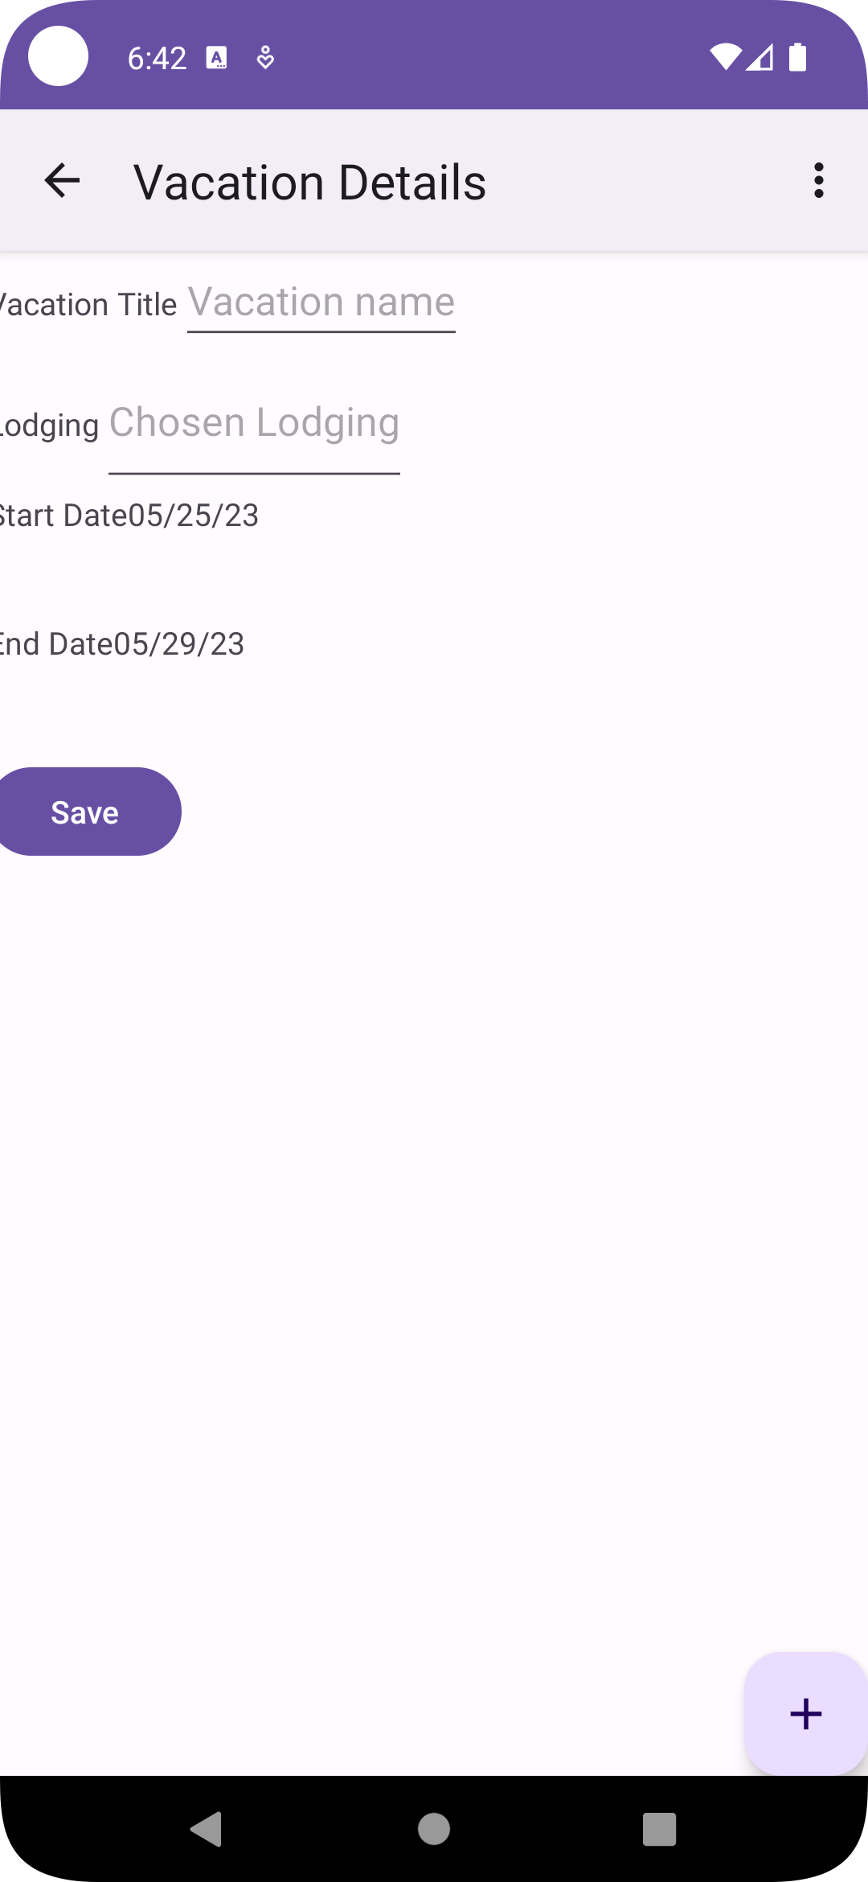
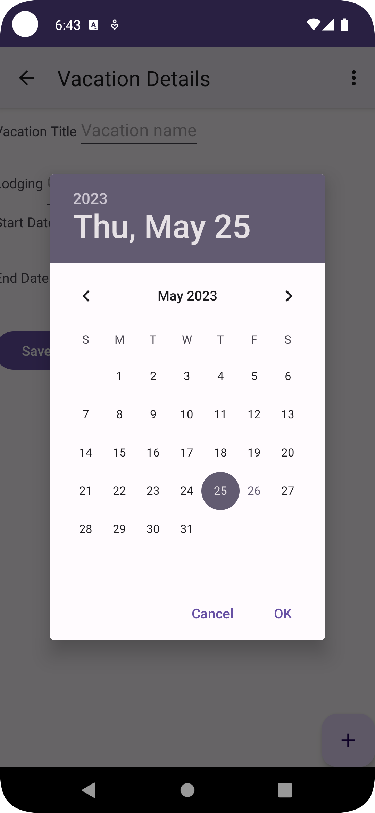
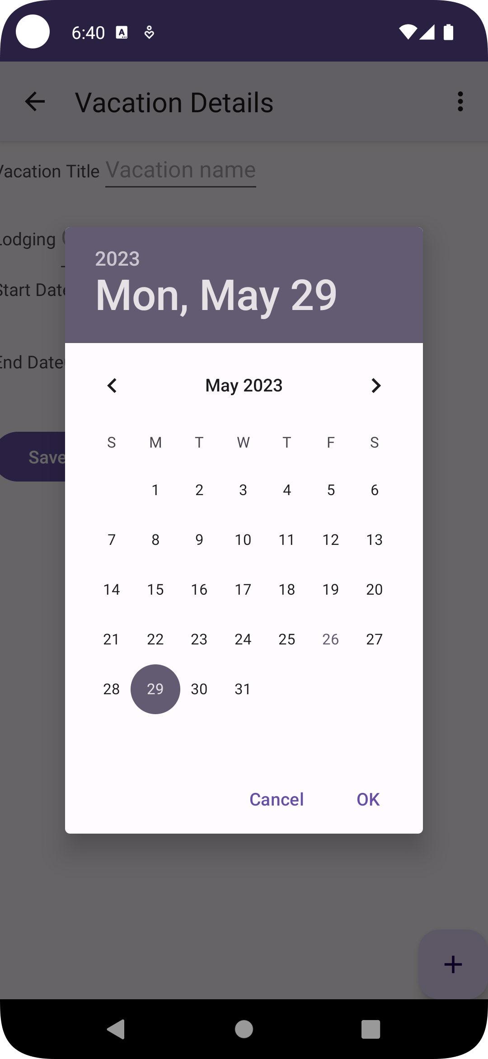

Screenshots
Script 1
Script 1-1
Script 2
Script 3

Slide 6
Summary of Changes
The EditText line was changed to a TextView and this fixed the two tap issue.

