Slide 1
Movie Reviews
By: Tyler Gehbauer, Gurpratap Singh, Nelson Lubinda, Nitish Arora, Demi

Slide 2
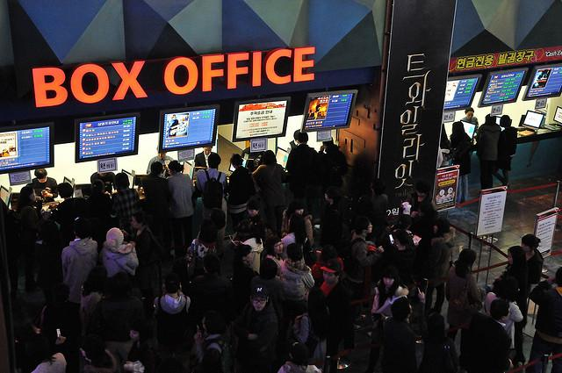
Introduction
All of us in this group love movies
Instead of analyzing movies, we wanted to analyze the statistics and data behind it.
Specifically, how critic consensus effects movie performance and how that can tie into stock price.

Slide 3
Project Summary and Goals
For our project, we decided to look at box office data and critic consensus for five major motion picture companies: Netflix, Disney, Universal, Warner Brothers, and Sony.
With all this data, we then used NLP (Natural Language Processing) and machine learning to predict future trends in stock prices for each of these companies
We believe by doing so, we can establish a framework for future financial tech enthusiasts who are interested in building their own fintech model.

Slide 4
Techniques and Libraries
We decided to use multiple libraries that have not been covered in our course yet:
Granger Causality Test
Flair
VADER
CIRCLIFY
Text2Blob (specifically to return polarity and subjectivity)

Slide 5
Demonstration
(GP, Tyler, Nelson, or I will show code for 1 out of the 5)

Slide 6
Results
(Disney)

Slide 7
Results (cont.)
(WB)

Slide 8
Results (cont.)
(Universal)

Slide 9
Results (cont.)
(sony)

Slide 10
Results (c0nt.)
(Netflix)

Slide 11
Analysis

Slide 12
Conclusion

Slide 13
Next Steps

Slide 14
References (IF NEEDED)

