Slide 1
Task Value Calculus: Multi-objective Trade off Analysis using Multiple-Valued Decision Diagrams
Tyler Giallanza, Erik Gabrielsen, Mike Taylor, Eric C. Larson, and Mitchell A. Thornton

Slide 2
Multiple-Objective Optimization
A priori: map multiple objectives into a single objective
Prior consideration of relative importance for objectives
Example: Weighted Sum Method
A posteriori: present trade-offs between objectives
Assumes no prior knowledge of objective importance
Example: NSGA-II (Genetic Algorithm)

Slide 3
Implementing A Posteriori
Represent problem as a set of variables
Characterize each objective as a function of these variables
Sample from the solution set of objective function values
Prune dominated solutions
Present user with trade-offs

Slide 4
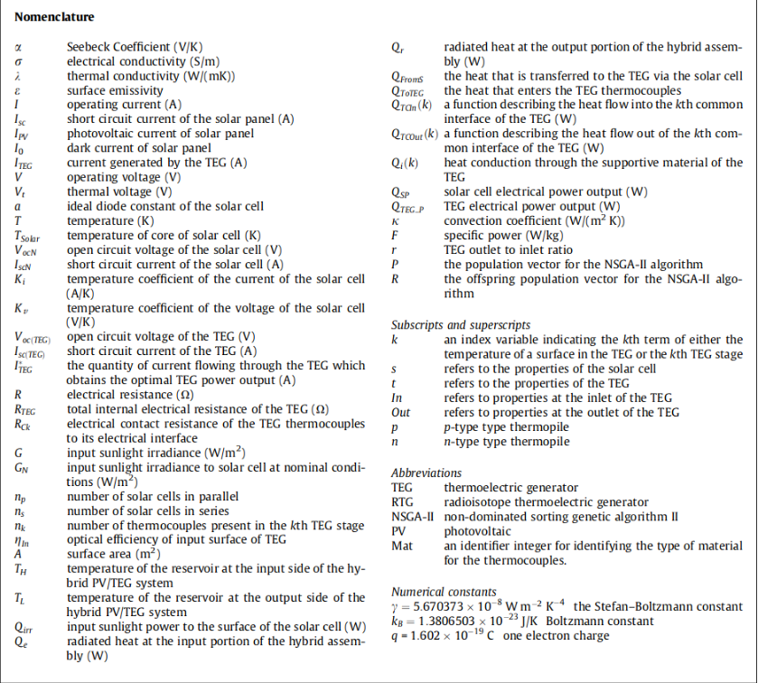
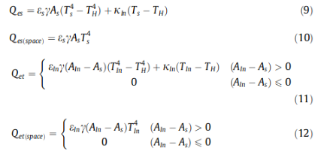
Current Solutions
Power and mass optimization of the hybrid solar panel and thermoelectric generators
Kwan et al. 2015

Slide 5
Areas for Improvement
Add support for discrete systems
Remove the need for complex models
Speed up computation on large datasets

Slide 6
The TVC Algorithm
Objective
Functions
Block
Diagram
MDD
Creation
Objective
Function
Calculation
Objective
Function
Calculation
Multi-
Objective
Optimization
Objective
Function Table

Slide 7
Objective
Functions
Block
Diagram
MDD
Creation
Objective
Function
Calculation
Objective
Function
Calculation
Multi-
Objective
Optimization
Objective
Function Table

Slide 8
Objective Functions
Limited but practical options for objective functions
Additive
Multiplicative
Minimize or maximize

Slide 9
Objective
Functions
Block
Diagram
MDD
Creation
Objective
Function
Calculation
Objective
Function
Calculation
Multi-
Objective
Optimization
Objective
Function Table

Slide 10
Block Diagram
Model scenario with a structure function
Captures serial and parallel decision relationships
Easy to understand and implement
Capable of representing intricate scenarios

Slide 11
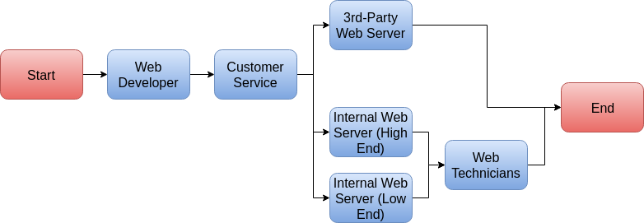
Sample Block Diagram

Slide 12
Objective
Functions
Block
Diagram
MDD
Creation
Objective
Function
Calculation
Objective
Function
Calculation
Multi-
Objective
Optimization
Objective
Function Table

Slide 13
Objective Function Table
Map each input variable to objective functions
Sample k mappings from each variable to each function where k is a user-chosen radix

Slide 14
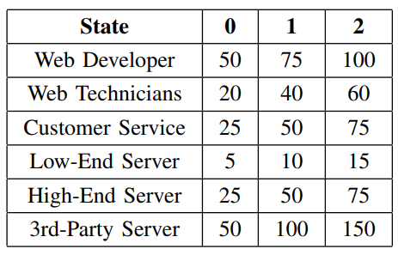
Objective Function Table (Cost)

Slide 15
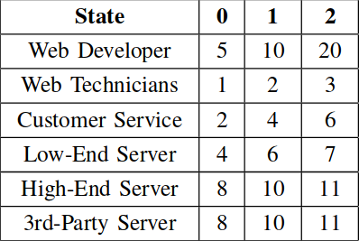
Objective Function Table (Build Time)

Slide 16
Objective
Functions
Block
Diagram
MDD
Creation
Objective
Function
Calculation
Objective
Function
Calculation
Multi-
Objective
Optimization
Objective
Function Table

Slide 17
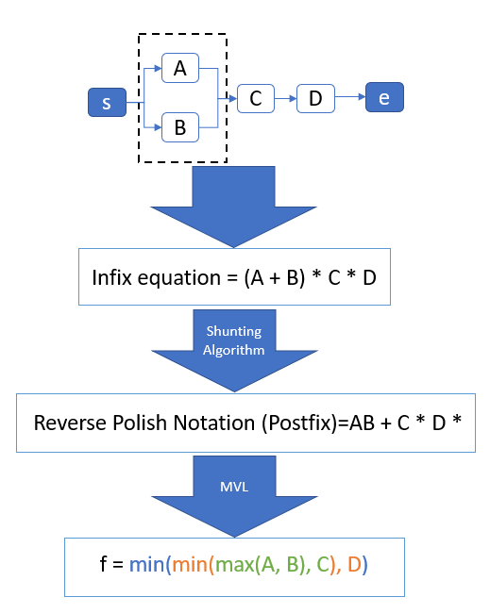
MDD Creation
radix=3

Slide 18
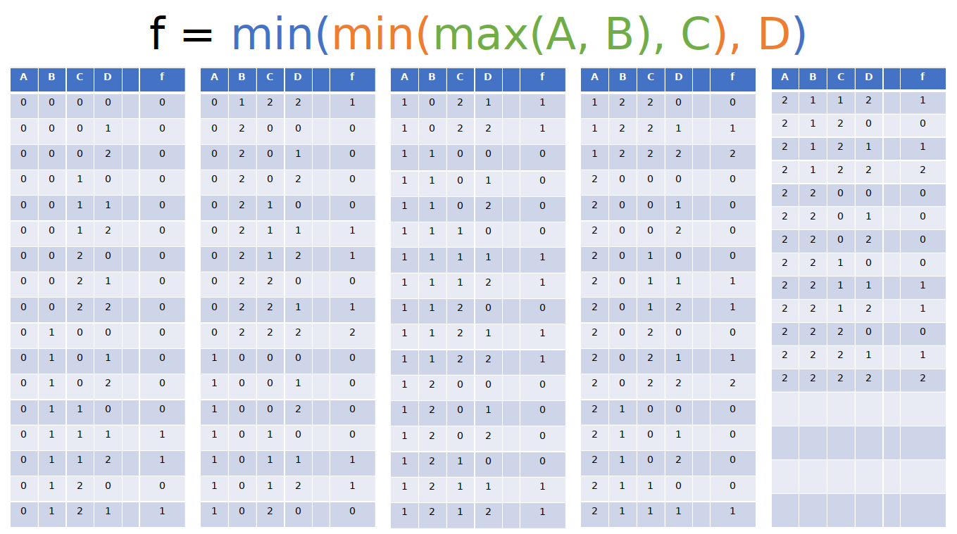

Slide 19
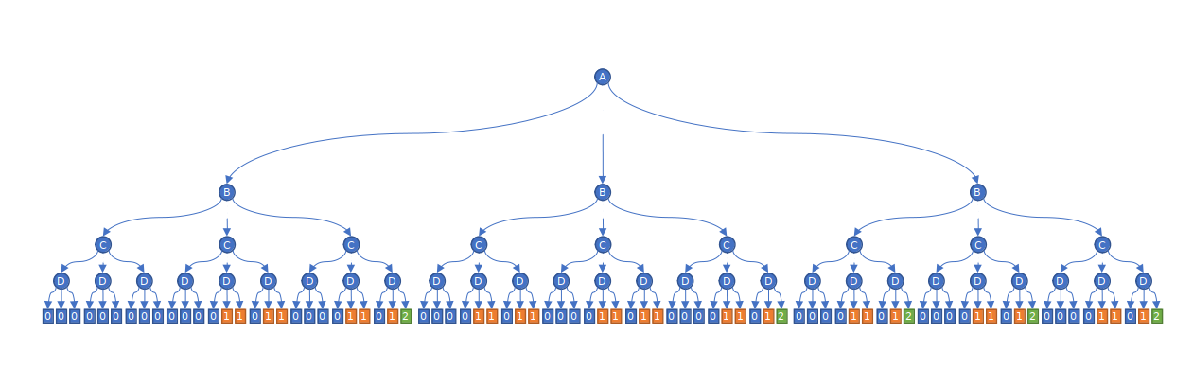
Shannon Expansion Tree

Slide 20
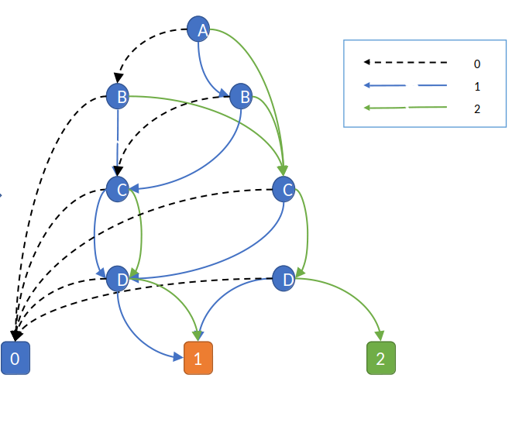
Final MDD

Slide 21
Objective
Functions
Block
Diagram
MDD
Creation
Objective
Function
Calculation
Objective
Function
Calculation
Multi-
Objective
Optimization
Objective
Function Table

Slide 22
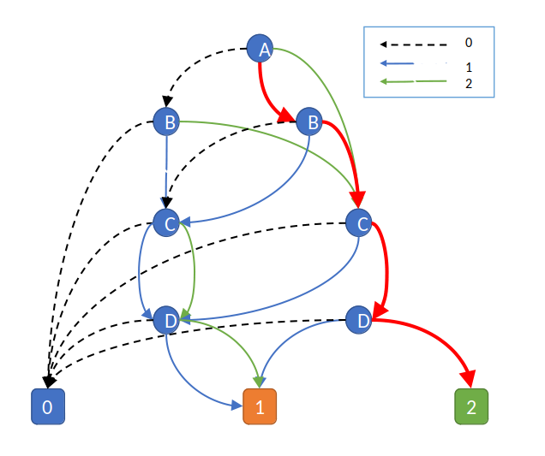
Additive cost function:
Edge Values Terminal Value
T₁ = A₂ + C₂ + D₂ 2
T₂ = A₁ + B₂ + C₂ + D₂ 2
T₃ = A₀ + B₂ + C₂ + D₂ 2
T₄ = A₂ + C₂ + D₁ 1
T₅ = A₁ + B₂ + C₂ + D₁ 1
T₆ = A₀ + B₂ + C₂ + D₁ 1

Slide 23
Objective
Functions
Block
Diagram
MDD
Creation
Objective
Function
Calculation
Objective
Function
Calculation
Multi-
Objective
Optimization
Objective
Function Table

Slide 24
Computing Pareto Front
Prune dominated solutions during MDD traversal
Prune solutions from user constraints (i.e. cost must be less than n)
Present user with optimal trade-off choices

Slide 25
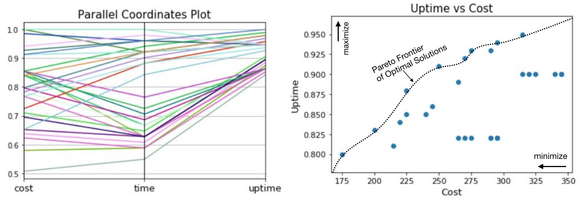

Slide 27
Contributions
Extension of multiple-objective optimization to discrete systems
Simplified modeling suitable for non-technical users
Optimized computations via MDD

