Slide 1

Applied AI for serious work.
Grayhaven builds custom models and AI agents for healthcare, legal, and banking teams.

Slide 2
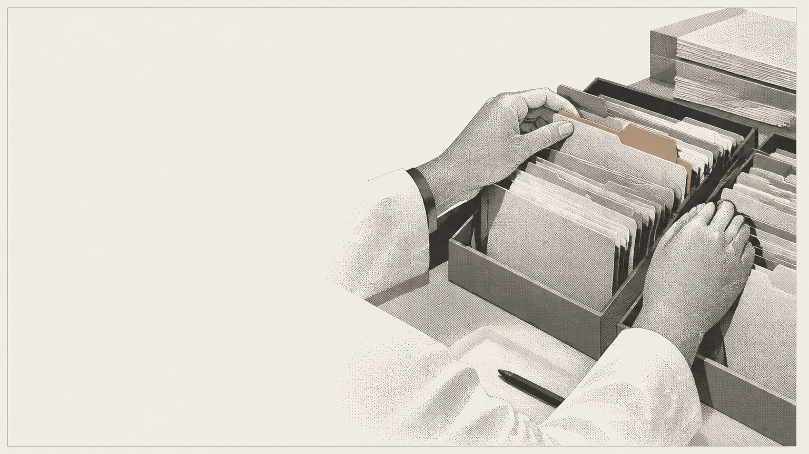
Triage across 3 TB of patient records.
A custom model for a regional health system. About 93% accurate.

Slide 3

We prove it works first.
If AI does not beat what your team uses today, we tell you before you pay to run it.

