Slide 1
Nursing Group – PCA Record User Guide
Prepared by: Leslee Trinastic, Linh Ament, and Peter Davis
December 2017

Slide 2
Welcome
The PCA Record project has been a collaboration with BIT students Leslee, Peter, and Linh, nursing instructor Julie Sommer, and nursing student Eric Eichelberger.

Slide 3
The Purpose
The purpose of this project was to create a usable digital Patient Care Assessment (PCA) record for nursing students to use on their iPads while doing coursework in the lab.

Slide 4
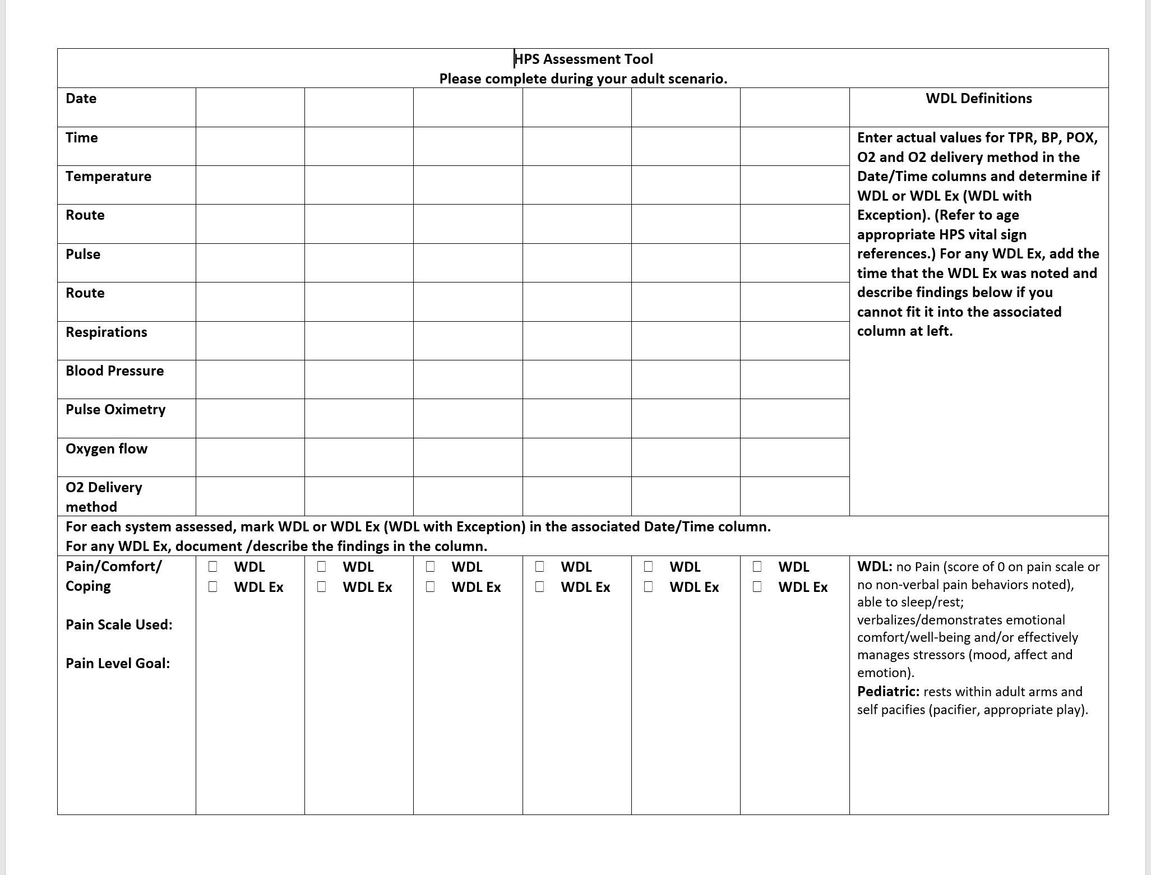
Current PCA Record

Slide 5
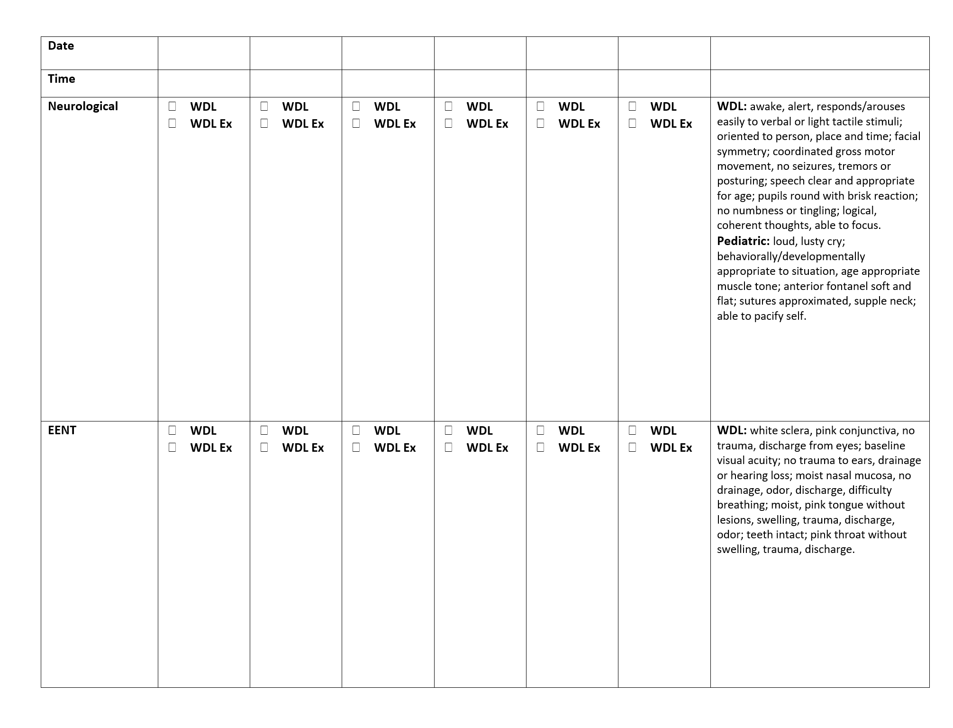
Current PCA Record (cont.)

Slide 6
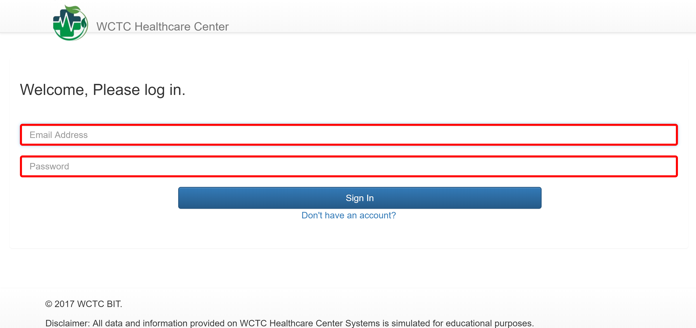
Getting Started
To access the PCA Record, the user must first login to the WCTC Healthcare Center site.

Slide 7
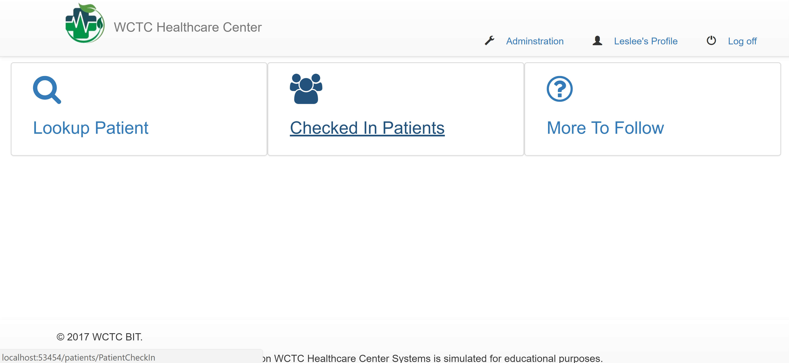
Once the user logs in, they will click on the "Checked In Patients" link. This will take the user to a list of currently checked in patients.

Slide 8
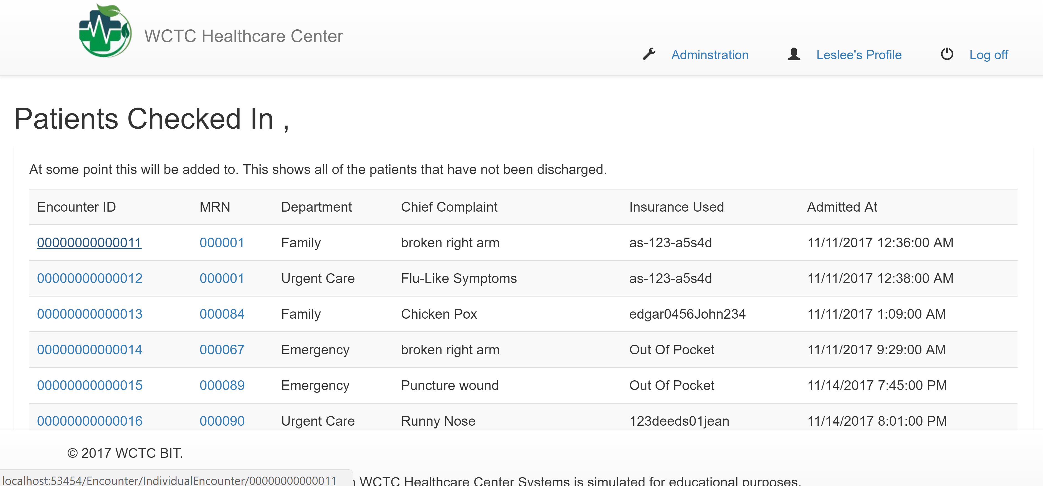
Next, the user should click on one of the "Encounter ID" 's to bring up a detail record for the patient.

Slide 9
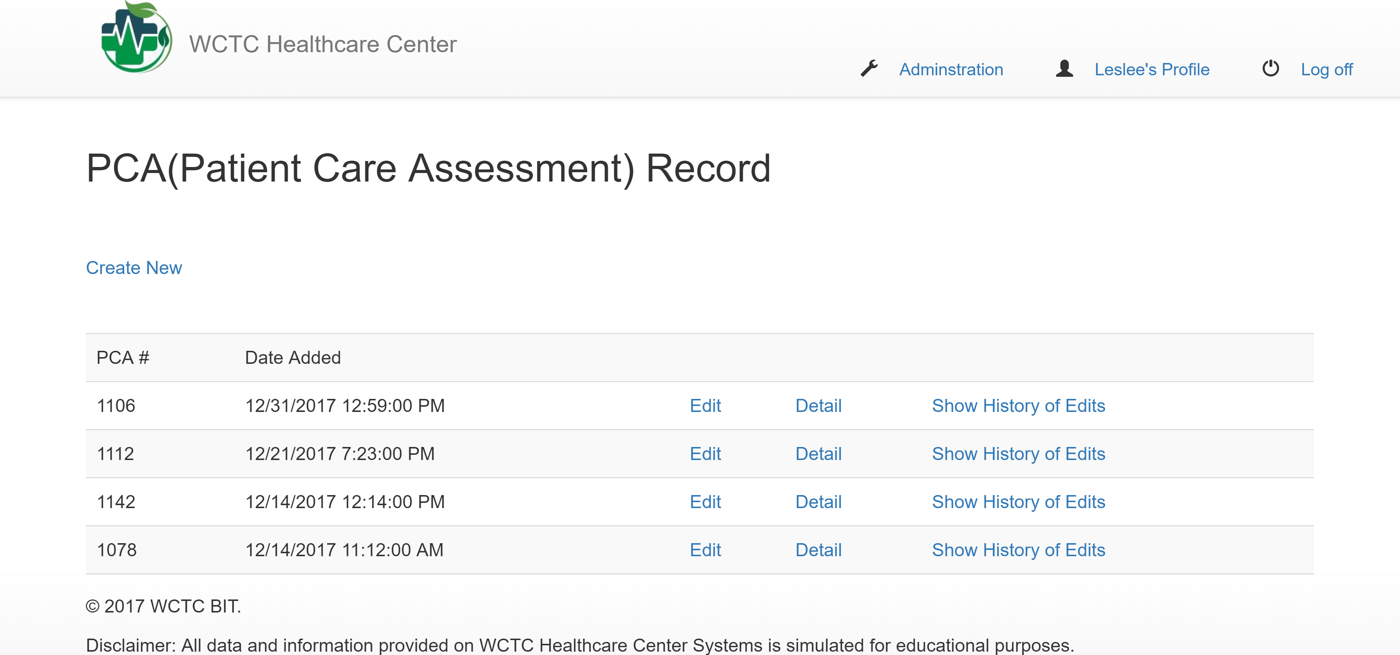
Next, the user will scroll down to see the PCA Record section. This is where the user can create a PCA record, edit a PCA record, view details of a PCA record, and view the history of edits for the PCA record for a give PCA record # (number).

Slide 10
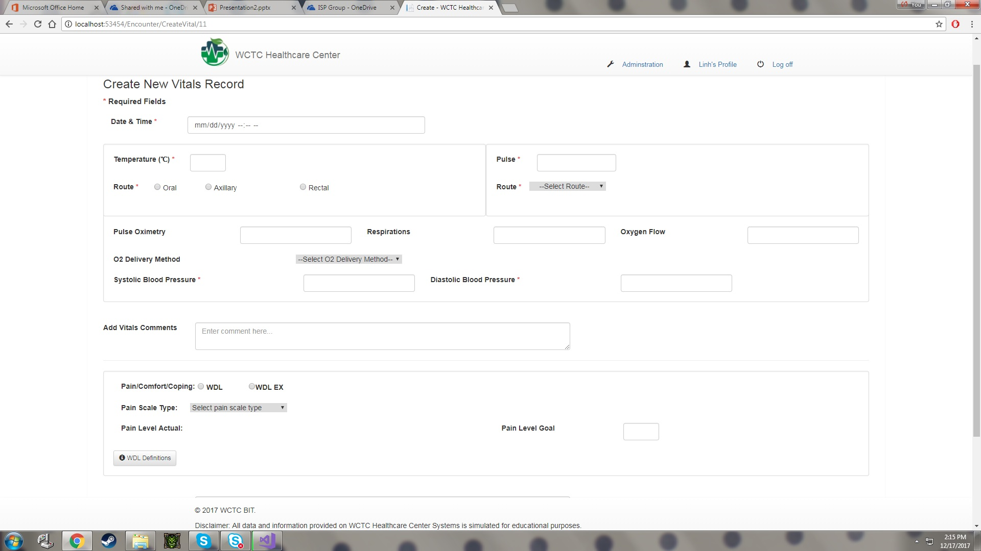
Vital Create Record This is where the user can create a new PCA record.

Slide 11
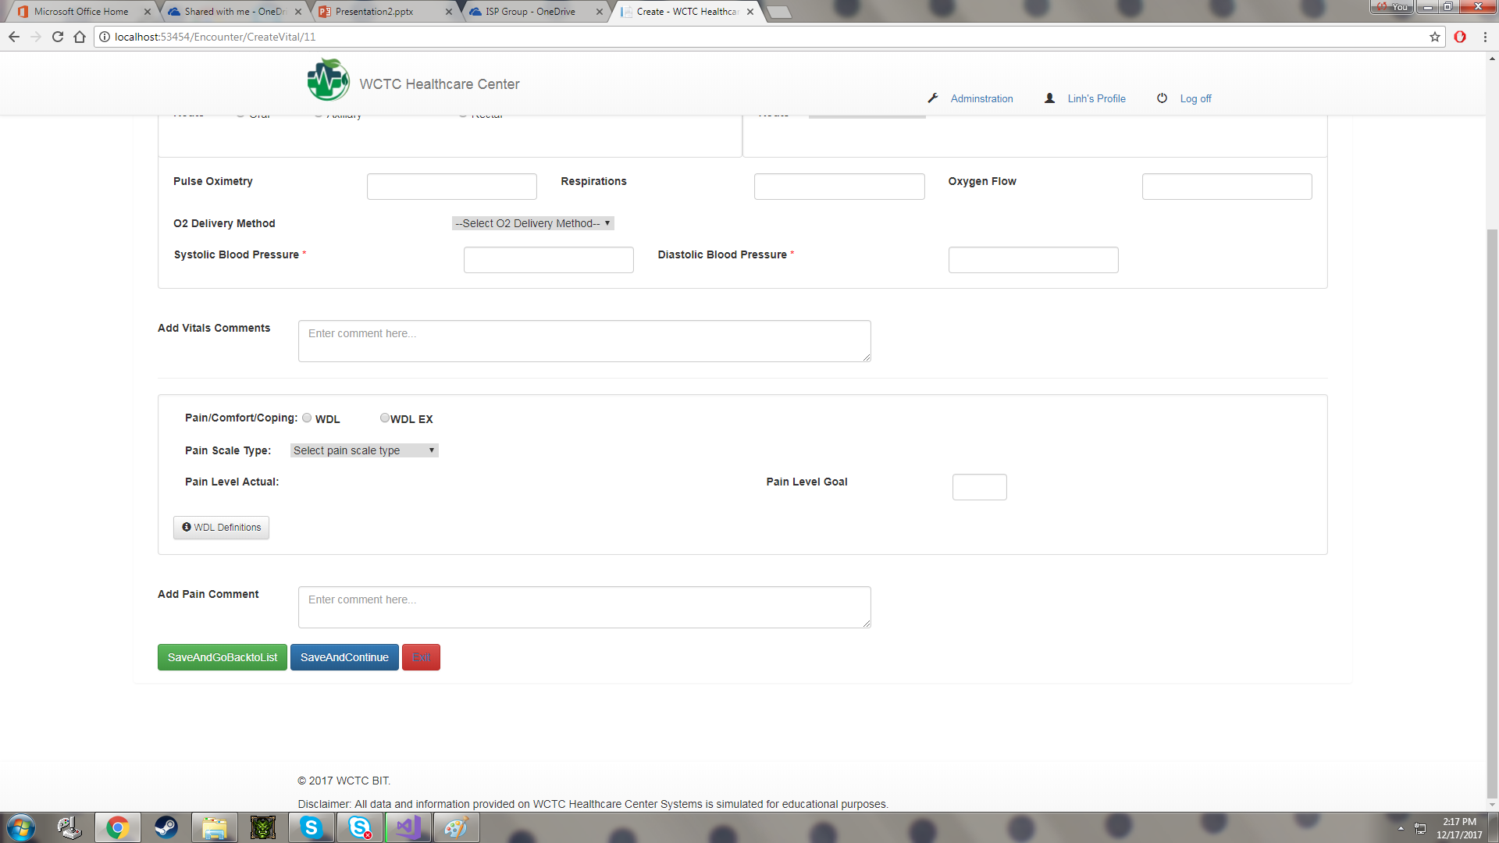
After creating new PCA record, the user can click on "Save and Go Back To List" button to save data and return to PCA List, or user can click " button to continue to save data and create new Bodysystems record. The "Exit" button can take the user return to PCA list page without saving any data.

Slide 12
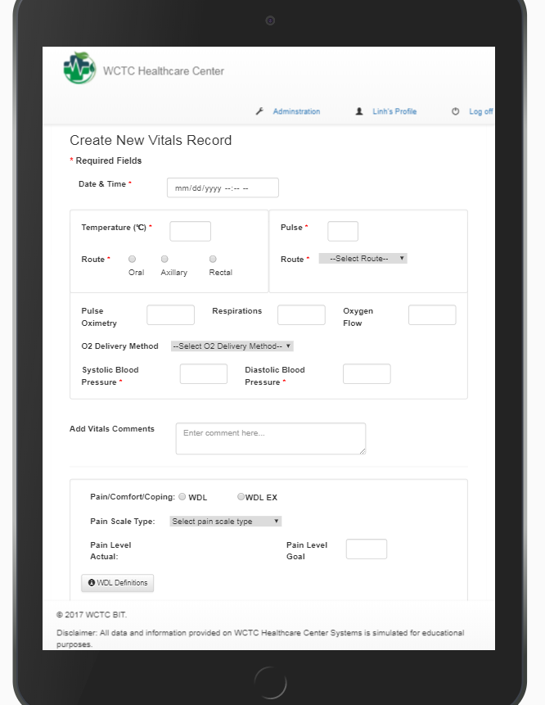
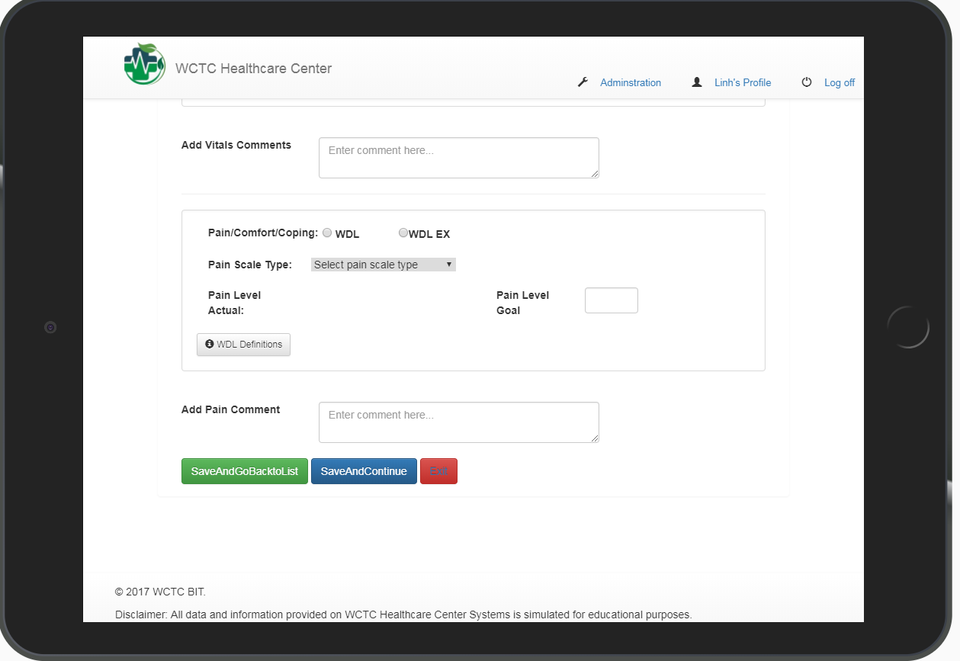
Responsive layout. (on mobile device-tablet)

Slide 13
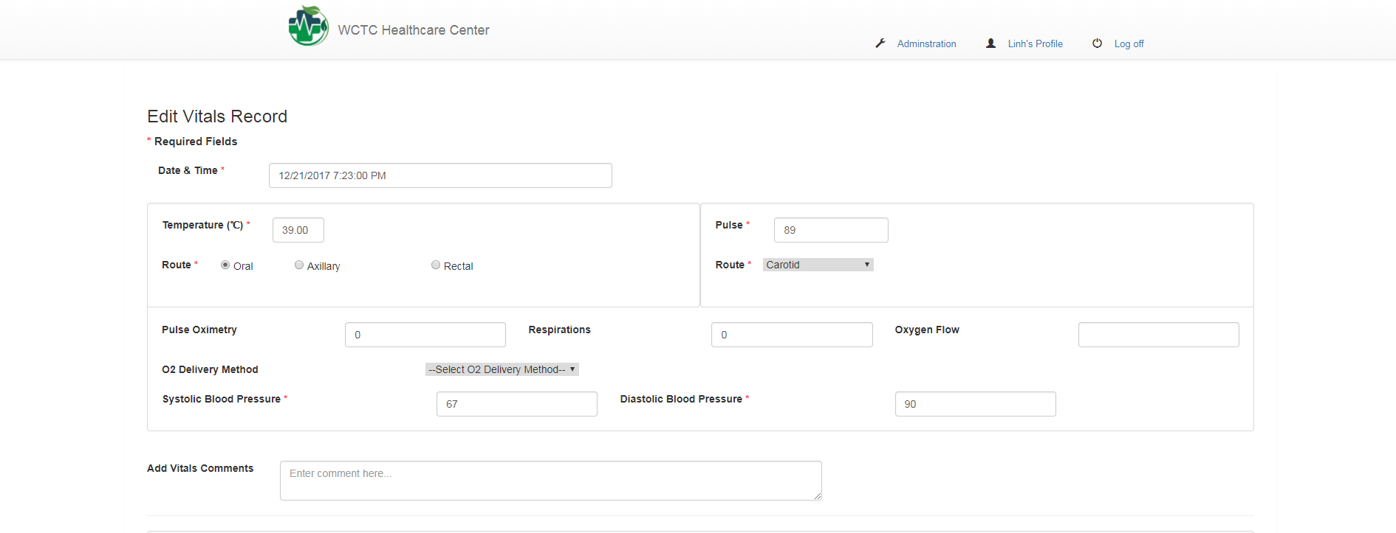
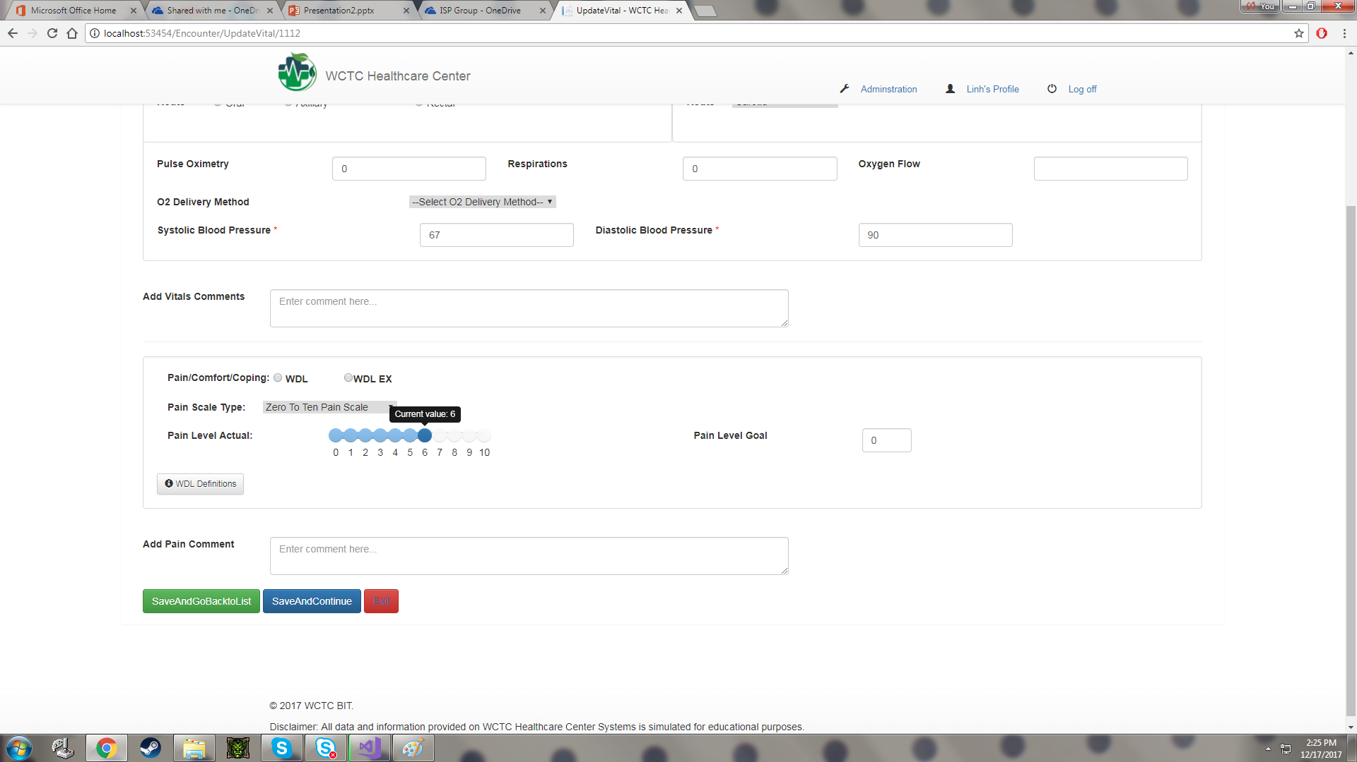
This is where the user can edit PCA record. After editing information, the user can click "Save and Go Back To List" button to return to PCA List, or the user can click "Save and Continue" button to save data and continue to Bodysystems part. If the user click "Exit" button, it will return to PCA list without saving data.

Slide 14
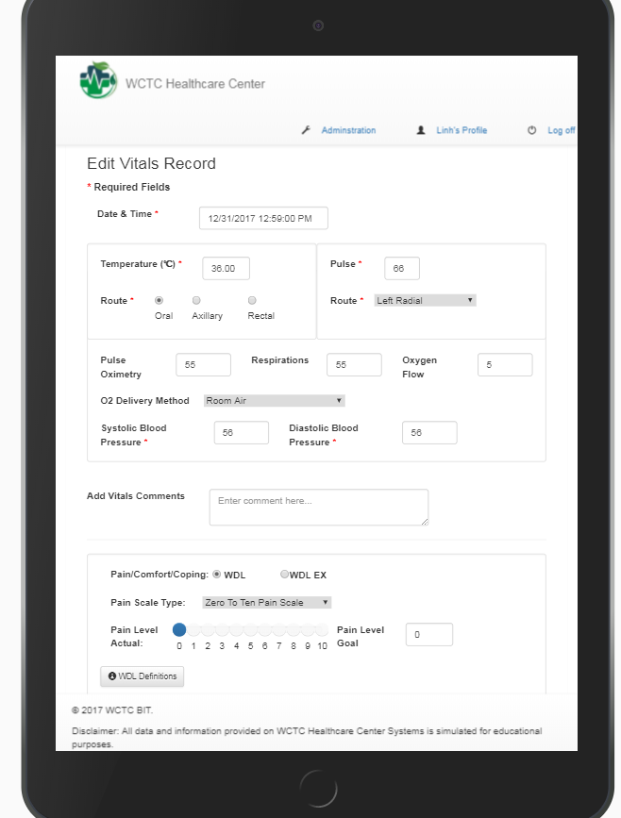
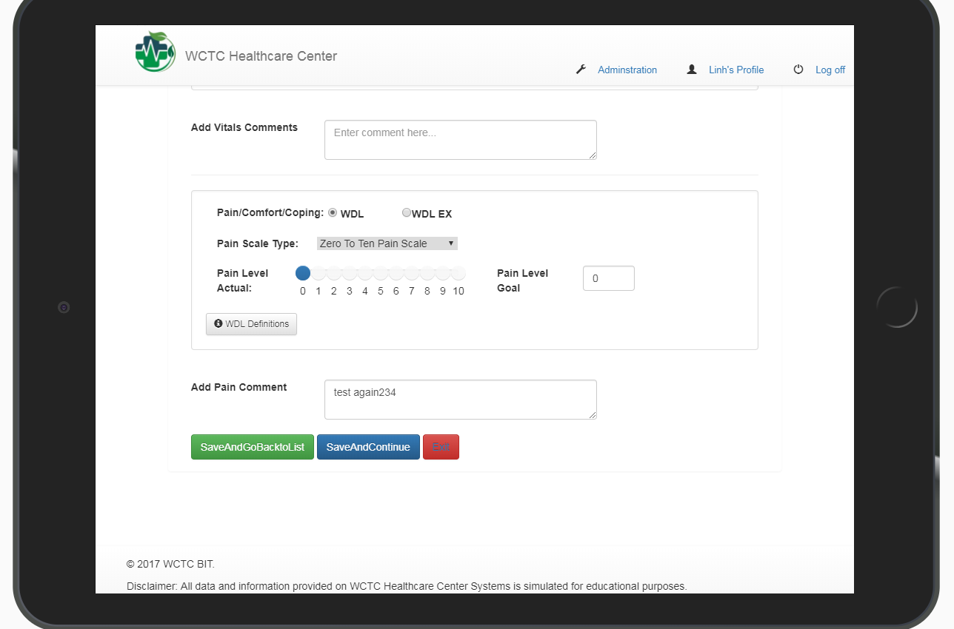
Responsive layout (on mobile device – tablet)

Slide 15
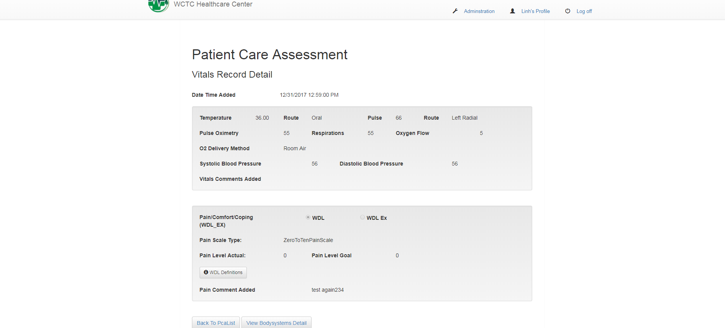
Once the user clicks on "detail", they will be brought to the Vitals Detail for that particular PCA record. The user will be able to view the data that was input.

Slide 16
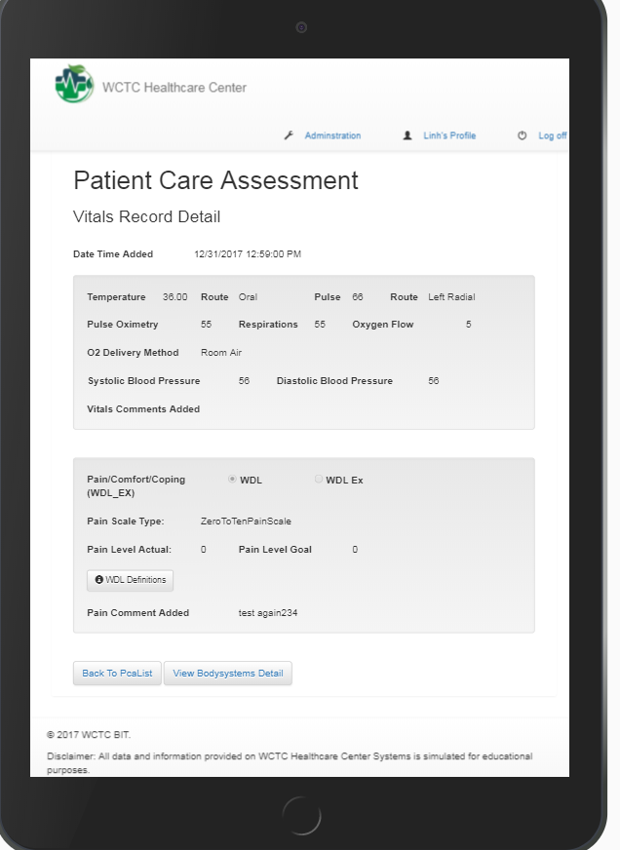
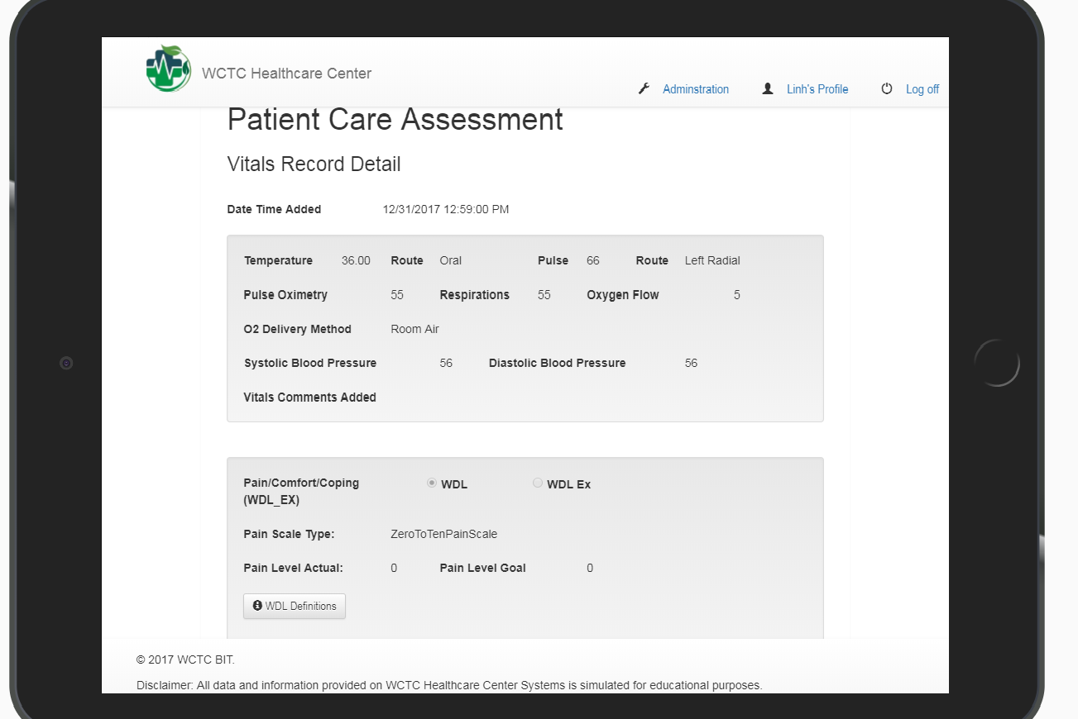
Responsive layout (on mobile device – tablet)

Slide 17
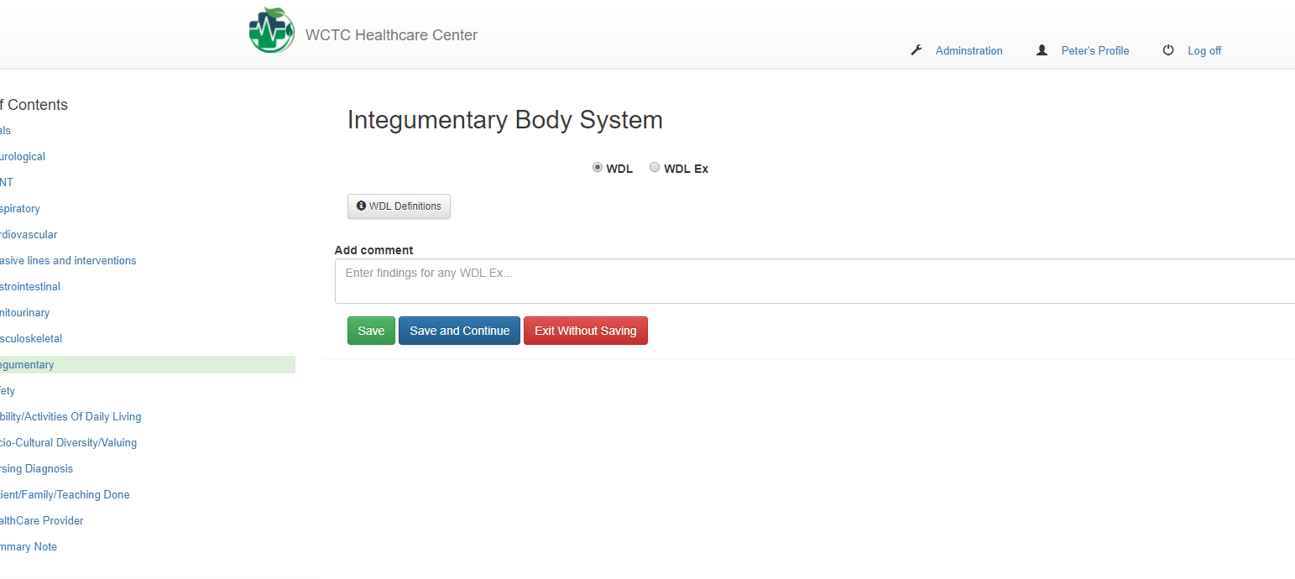
BodySystem Create

Slide 18
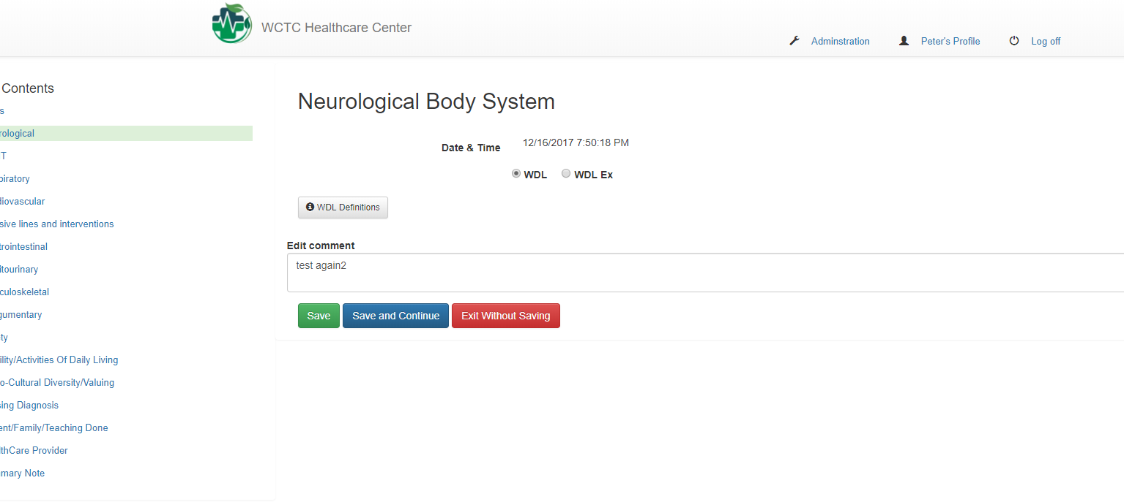
BodySystem Edit

Slide 19
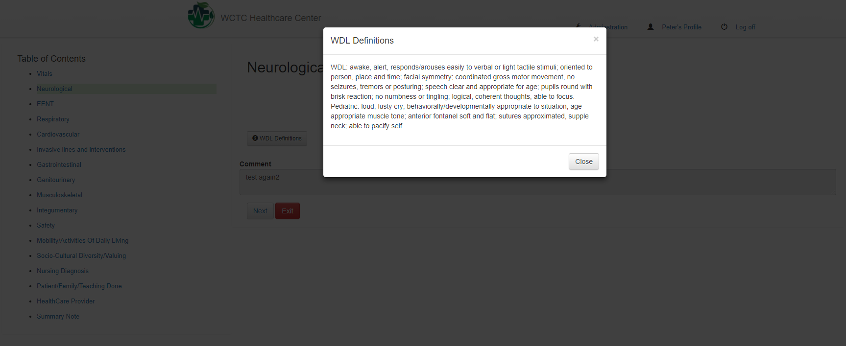
WDL Definitions

Slide 20
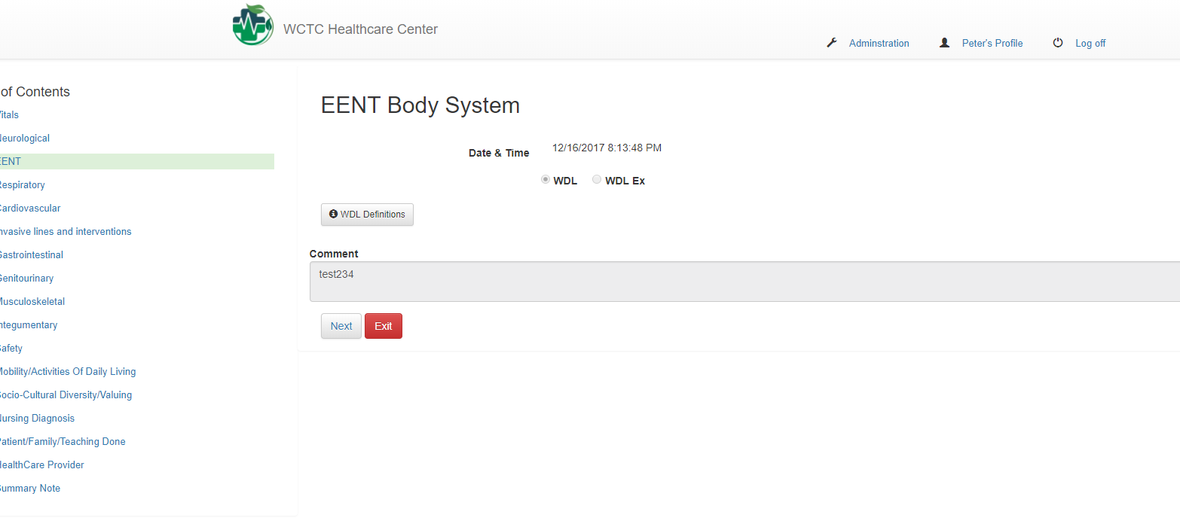
BodySystem Details

Slide 21
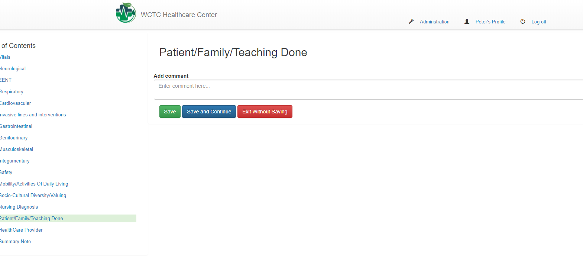
PCA Comment Create

Slide 22
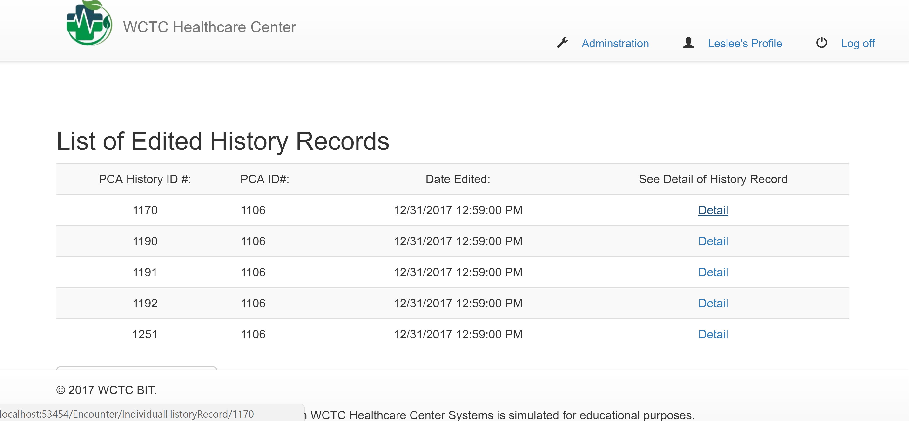
The user can navigate to the List of Edited History by clicking on "show history of edits" from the PCA Record List page. This will bring the user to a list of records that have been edited, if there are any, otherwise it will let the user know there are no records and give a link to return to the PCA Record List.

Slide 23
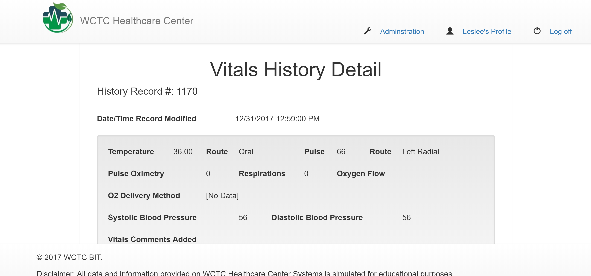
Once the user clicks on "show history of edits", they will be brought to the Vitals History Detail for that particular edited history record. The user will be able to view the data that was input.

Slide 24
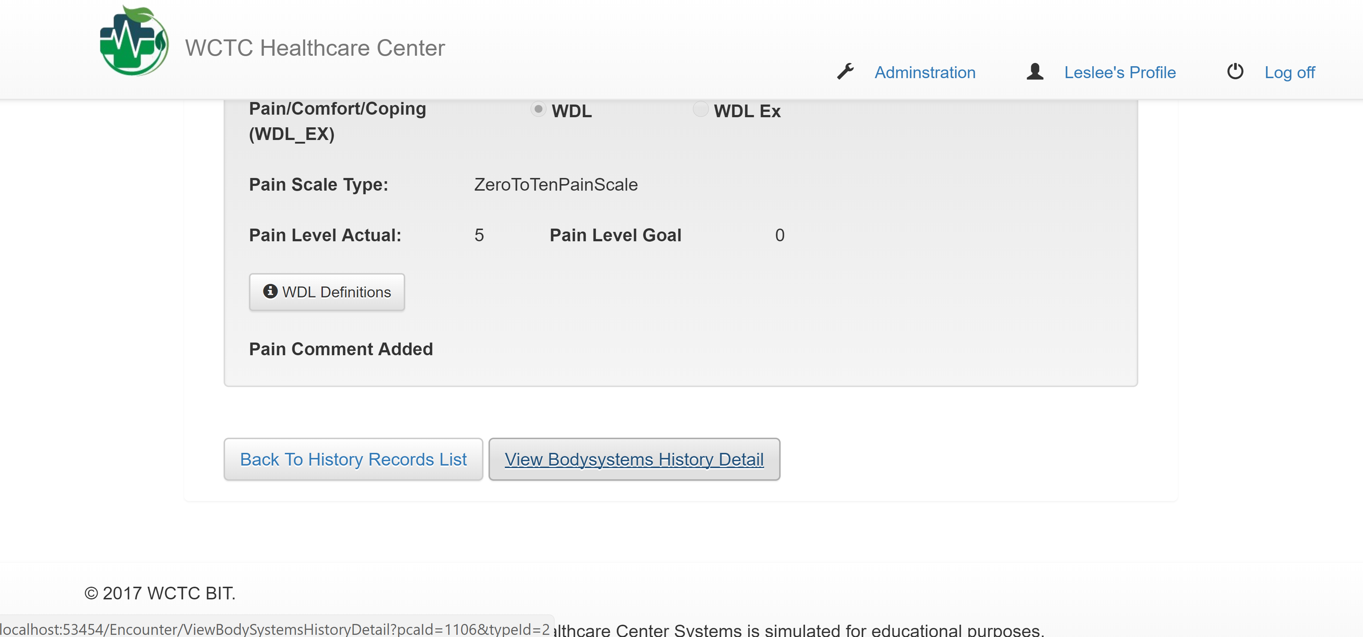
The user can then scroll down to see the rest of the edited vital history record. At the bottom of the page, the user can click on "View BodySystems History Detail" to continue on to the bodysystems edited history section for that record, or can return back to the History Records list.

Slide 25
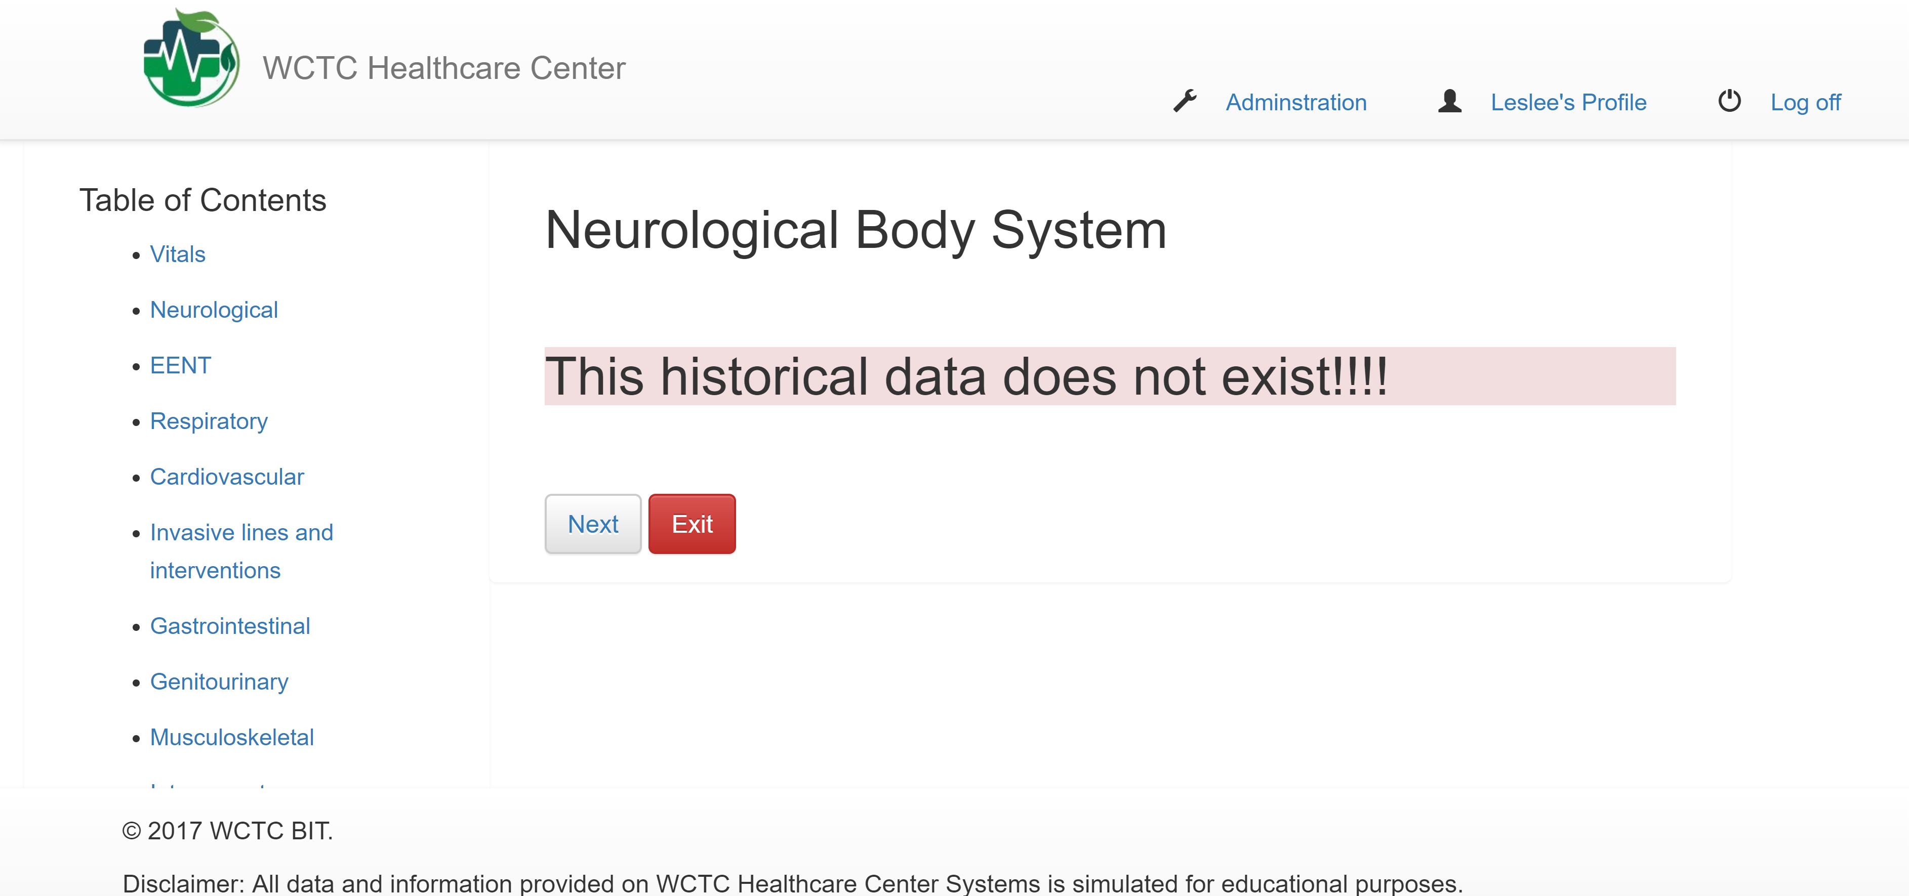
The user will be sent to the first section of the edited body systems history, "Neurological Body System" when the user clicks on "View Bodysystems Detail" from the Vitals History Record. The user can naviagate either by the "Next" button, or click on each section on the left-side navigation section. Once the user is finished navigating, they can click on "Exit" to return to the PCA Record List.

