Slide 1
[320] Search Order
and Queue Structures
Meenakshi Syamkumar

Slide 2
Tracing DFS
def find(self, dst):
self.graph.visited.add(self)
if self == dst:
return (self.name,)
for child in self.children:
if not child in self.graph.visited:
childpath = child.find(dst)
if childpath:
return (self.name,) + childpath
return None
A.find(D)
A
B
D
C

Slide 3
Queueing Structures

Slide 4
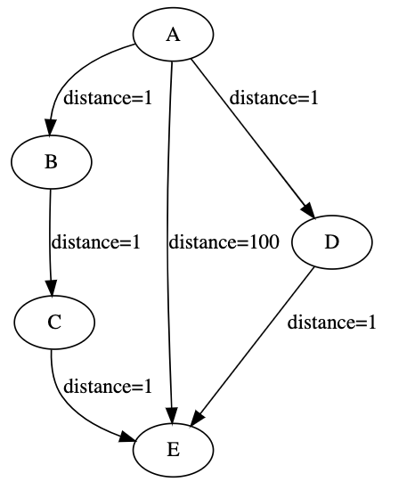
Shortest Weighted Path
What path will DFS choose?
What path will BFS choose?
What path would you choose?

Slide 5
Work queues ("to do" list)
Stack
end
end
(FILO)
Queue
front
end
(FIFO)
Priority Queue
end
smallest/biggest
Notes:
LEC 001 Finished Here (s22)

Slide 6
Work queues ("to do" list)
L.append(x)
Stack
end
end
(FILO)
x = L.pop(-1)
Queue
front
end
(FIFO)
L.append(x)
x = L.pop(0)
Priority Queue
end
L.append(x)
smallest/biggest
L.sort()
x = L.pop(-1)
what operations are slow?

Slide 7
Work queues ("to do" list)
L.append(x)
Stack
end
end
(FILO)
x = L.pop(-1)
Queue
front
end
(FIFO)
!
L.append(x)
x = L.pop(0)
Priority Queue
end
L.append(x)
smallest/biggest
!
L.sort()
x = L.pop(-1)
what operations are slow?

