Slide 1
[220 / 319] Conditionals 2
Exam1 conflict form – fill by Feb 16th
Meena Syamkumar
Andy Kuemmel
Cole Nelson
Readings:
Parts of Chapter 5 of Think Python
Chapter 4.6 to end (skip 4.7) of Python for Everybody

Slide 2
Learning Objectives
Write nested conditional statements
Refactor code with Boolean operators into equivalent code with nested conditional statements
Refactor code with nested conditional statements into equivalent code with Boolean operators
Identify code blocks
Count the number of blocks in nested code

Slide 3
Today's Outline
Nested Conditionals
Refactoring Conditionals

Slide 4
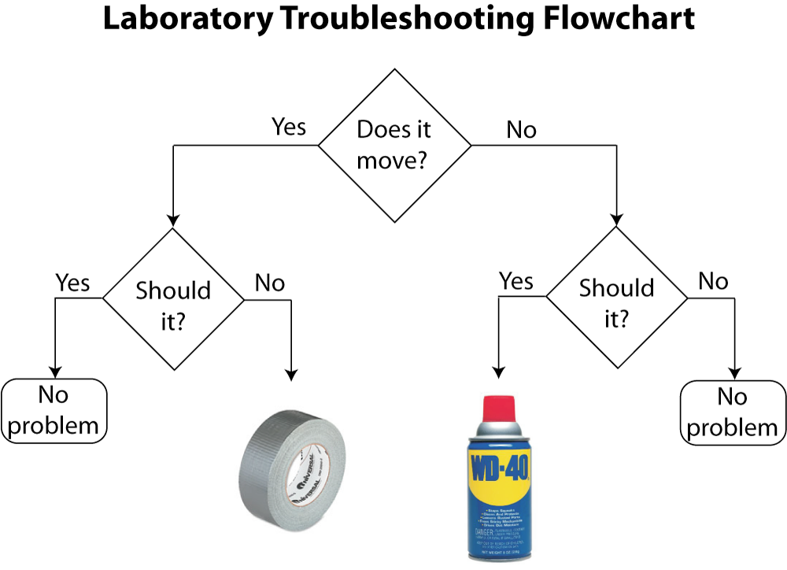
conditional execution
alternate execution
https://www.drphysics.com/prayer/flowchart.html

Slide 5
conditional execution
alternate execution
nested
conditional
chained would be
if we had more than
two possibilities
https://www.drphysics.com/prayer/flowchart.html

Slide 6
conditional execution
alternate execution
nested
conditional
chained would be
if we had more than
two possibilities
in programming:
questions are phrased as boolean expressions
actions are code/statements
https://www.drphysics.com/prayer/flowchart.html

Slide 7
Nested Conditionals Example
def fix(moves, should):
if moves:
if should:
return "good"
else:
return "duct tape"
else:
if should:
return "WD-40"
else:
return "good"

Slide 8
Example: Stoplight
color
RED
feet
YELLOW
what should the driver do?
GREEN

Slide 9
Example: Stoplight
color
RED
feet
hit the gas
feet < 15
stop abruptly
YELLOW
continue at same speed
feet < 30
GREEN
stop
smile

Slide 10
Today's Outline
Nested Conditionals
Refactoring Conditionals

Slide 11
How to use these slides
There are more examples here than we can cover in lecture.
However, you can walk through these examples along with the interactive exercises. You should do the following:
Think about what the answer is
Mentally step through the code using the example call when applicable
Step through the code with the Python Tutor examples we've setup for you. For the refactor examples, step through all three versions, and see which alternative (A or B) matches the output of the original version.
If you got something different than Python Tutor, tweak your mental model (talk to us if you don't understand something)

Slide 12
Refactor Exercise 1
    def or2(cond1, cond2):
    return cond1 or cond2
which refactor
is correct?
hint: or2(False, True)
    def or2(cond1, cond2):
    rv = False
    rv = rv or cond1
    rv = rv or cond2
    return rv
    def or2(cond1, cond2):
    if cond1:
    return cond2
    else:
    return False
A
B

Slide 13
Refactor Exercise 1
    return b1 or b2 or b3 or ... or bN
equivalent
    rv = False
    rv = rv or b1
    rv = rv or b2
    rv = rv or b3
    ...
    rv = rv or bN
Lesson: with "or", it only takes one to flip the whole thing True!

Slide 14
Refactor Exercise 2
    def and2(cond1, cond2):
    return cond1 and cond2
which refactor
is correct?
hint: and2(True, True)
    def and2(cond1, cond2):
    rv = False
    rv = rv and cond1
    rv = rv and cond2
    return rv
    def and2(cond1, cond2):
    if cond1:
    return cond2
    else:
    return False
A
B

Slide 15
Refactor Exercise 2
    return b1 and b2 and b3 and ... and bN
equivalent
    if b1:
    return b2 and b3 and ... and bN
    else:
    return False
Lesson: with "and", the first one can make the whole thing False!

Slide 16
    def fix(moves, should):
    if moves:
    if should:
    return "good"
    else:
    return "duct tape"
    else:
    if should:
    return "WD-40"
    else:
    return "good"
Refactor Exercise 3
which refactor
is correct?
hint: fix(False, False)
B
A
    def fix(moves, should):
    if should:
    if moves:
    return "duct tape"
    else:
    return "good"
    else:
    if moves:
    return "good"
    else:
    return "duct tape"
    def fix(moves, should):
    if moves and not should:
    return "duct tape"
    elif not moves and should:
    return "WD-40"
    elif moves and should:
    return "good"
    elif not moves and not should:
    return "good"

Slide 17
Refactor Exercise 3
A
T
F
B
B
T
F
T
F
case 1
case 2
case 3
case 4
Option 1: Nesting
Option 2: Chaining
equivalent
A, B
T,T
F,F
T,F
F,T
case 1
case 2
case 3
case 4
Lesson: when handling combinations of booleans, you can
either do either (a) nesting or (b) chaining with and

Slide 18
    def is_220(a, b, c):
    return a==2 and b==2 and c==0
Refactor Exercise 4
which refactor
is correct?
hint: is_220(2, 2, 0)
    def is_220(a, b, c):
    if a==2:
    if c==0:
    if b==2:
    return True
    return False
    def is_220(a, b, c):
    if a==2 or b==2 or c==0:
    return False
    return True
A
B

Slide 19
Refactor Exercise 4
    return b1 and b2 and b3 and ... and bN
equivalent
    if b1:
    if b2:
    if b3:
    ...
    if bN:
    return True
    return False
Lesson: nesting a lot of if's inside each other is equivalent to and'ing all the conditions

Slide 20
    def is_220(a, b, c):
    return a==2 and b==2 and c==0
Refactor Exercise 5
which refactor
is correct?
hint: is_220(2, 2, 1)
    def is_220(a, b, c):
    if a==2:
    return True
    if b==2:
    return True
    if c==0:
    return True
    return False
    def is_220(a, b, c):
    if a!=2:
    return False
    if b!=2:
    return False
    if c!=0:
    return False
    return True
A
B

Slide 21
Refactor Exercise 5
    return b1 and b2 and b3 and ... and bN
equivalent
    if not b1:
    return False
    if not b2:
    return False
    if not b3:
    return False
    ...
    if not bN:
    return False
    return True
Lesson: checking if everything is True can be translated
to seeing if we can find anything False

