Slide 1
[220 / 319] Creating Functions
Meena Syamkumar
Andy Kuemmel
Cole Nelson
Readings:
Parts of Chapter 3 of Think Python,
Chapter 5.5 to 5.8 of Python for Everybody
Creating Fruitful Functions

Slide 2
Learning Objectives
Explain the syntax of a function header:
def, ( ), :, tabbing, return
Write a function with:
correct header and indentation
a return value (fruitful function) or without (void function)
parameters that have default values
Write a function:
knowing difference in outcomes of print and return statements
Determine result of function calls with 3 types of arguments:
positional, keyword, and default
Trace function invocations, to determine control flow

Slide 3
Where do modules come from?
pre-installed (e.g., math)
sqrt()
sin(), cos()
pi, etc.
built in
input()
print()
len()
etc.
installed (e.g., jupyter)
pip install jupyter
pip install ...
custom
project (lab-p3)
Anaconda did these installations for us

Slide 4
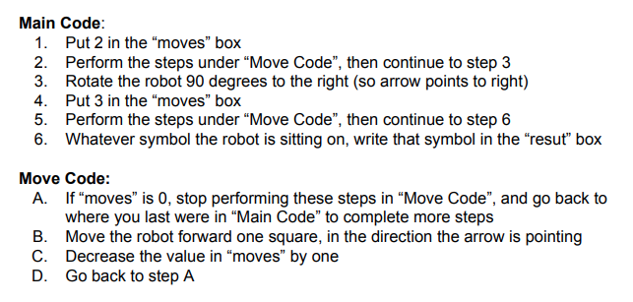
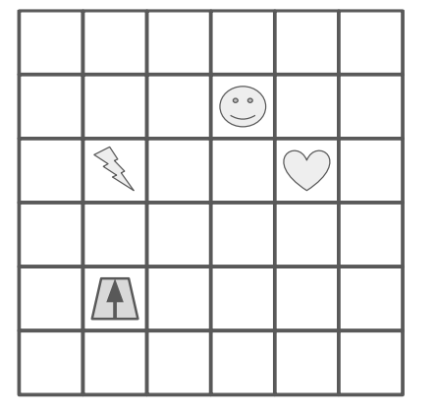
how do we write functions
like move code?
Functions are like “mini programs”,
as in our robot worksheet problem

Slide 5
Types of functions
Sometimes functions do things
Like “Move Code”
May produce output with print
May change variables
Sometimes functions produce values
Similar to mathematical functions
Many might say a function “returns a value”
Downey calls these functions “fruitful” functions
(we’ll use this, but don’t expect people to generally be aware of this terminology)
Sometimes functions do both!

Slide 6
Types of functions
Sometimes functions do things
Like “Move Code”
May produce output with print
May change variables
Sometimes functions produce values
Similar to mathematical functions
Many might say a function “returns a value”
Downey calls these functions “fruitful” functions
(we’ll use this, but don’t expect people to generally be aware of this terminology)
Sometimes functions do both!

Slide 7
Math to Python
Math:
f(x) = x²
Python:
def f(x):
return x ** 2

Slide 8
Math to Python
Math:
f(x) = x²
Python:
def f(x):
return x ** 2
Function name is “f”

Slide 9
Math to Python
Math:
f(x) = x²
Python:
def f(x):
return x ** 2
It takes one parameter, “x”

Slide 10
Math to Python
Math:
f(x) = x²
Python:
def f(x):
return x ** 2
In Python, start a function definition with “def” (short for definition),
and use a colon (“:”) instead of an equal sign (“=”)
1

Slide 11
Math to Python
Math:
f(x) = x²
Python:
def f(x):
return x ** 2
2
In Python, put the “return” keyword before
the expression associated with the function

Slide 12
Math to Python
Math:
f(x) = x²
Python:
def f(x):
return x ** 2
3
In Python, indent (tab space) before the statement(s)

Slide 13
Math to Python
Math:
g(r) = πr²
Python:
def g(r):
return 3.14 * r ** 2
4
Computing the area from the radius

Slide 14
Math to Python
Math:
g(r) = πr²
Python:
def get_area(radius):
return 3.14 * radius ** 2
5
In Python, it’s common to have longer names for functions and arguments

Slide 15
Math to Python
Math:
g(r) = πr²
Python:
def get_area(diameter):
radius = diameter / 2
return 3.14 * radius ** 2
6
It’s also common to have more than one line of code (all indented)

Slide 16
Let’s implement functions
cube(side)
is_between(lower, num, upper)
jupyter / PythonTutor demos ...

Slide 17
Rules for filling parameters...
function declaration
def foo(x, y=-1):
x =
y =
???
not actual code, but imagine
parameters as variables that are
automatically initialized for you
???
function invocation
foo(99, 100)
1
positional arguments

Slide 18
Rules for filling parameters...
def foo(x, y=-1):
x =
y =
99
100
foo(99, 100)
1
positional arguments

Slide 19
Rules for filling parameters...
def foo(x, y=-1):
def foo(x, y=-1):
x =
y =
99
x =
y =
100
100
99
foo(99, 100)
foo(y=99, x=100)
1
positional arguments
2
keyword arguments

Slide 20
Rules for filling parameters...
def foo(x, y=-1):
def foo(x, y=-1):
def foo(x, y=-1):
x =
y =
99
x =
y =
100
x =
y =
99
100
99
-1
foo(99, 100)
foo(y=99, x=100)
foo(99)
1
positional arguments
2
keyword arguments
3
default arguments
common pitfall: confusing keyword arguments and default arguments

Slide 21
Rules for filling parameters...
def foo(x, y=-1):
def foo(x, y=-1):
def foo(x, y=-1):
x =
y =
99
x =
y =
100
x =
y =
99
100
99
-1
foo(99, 100)
foo(y=99, x=100)
foo(99)
1
positional arguments
2
keyword arguments
3
default arguments
worksheet practice...

Slide 22
Generating grid for game like Battleship
Grid:
##########
##########
##########
##########
##########
##########
##########
##########
10 x 8 grid
get_grid(width, height, symb = ‘#’, title = ‘Grid:’)
PythonTutor demo...

Slide 23
Print vs. Return
A Function
parameters
call
return
arguments
Some Code

Slide 24
Print vs. Return
A Function
print
parameters
Program Output
(e.g., Terminal)
call
return
arguments
Some Code
print
we could call print from multiple places

Slide 25
Print vs. Return
A Function
print
1, 3, 2, 4
parameters
Program Output
(e.g., Terminal)
call
return
arguments
Some Code
print

Slide 26
Print vs. Return
A Function
print
parameters
Program Output
(e.g., Terminal)
call
return
1, 3, 2, 4
arguments
Some Code
print
returning, instead of printing, gives callers different options for how to use the result

Slide 27
Print vs. Return
A Function
print
parameters
Program Output
(e.g., Terminal)
call
return
1, 3, 2, 4
arguments
Some Code
print
returning, instead of printing, gives callers different options for how to use the result

Slide 28

Print vs. Return
A Function
print: a function can print as much as it likes
parameters
Program Output
(e.g., Terminal)
call
return: you only get to answer once, then function stops
arguments
Some Code
bad_add3
example...
https://memegenerator.net/instance/56355449/millionaire-regis-is-that-your-final-answer
returning, instead of printing, gives callers different options for how to use the result

Slide 29
Interactive Examples with PythonTutor
Course website schedule page entry for “Creating Functions”
def func_c():
print("C")
def func_b():
print("B1")
func_c()
print("B2")
def func_a():
print("A1")
func_b()
print("A2")
func_a()
Let’s trace this example

Slide 30
Challenge: Approximation Program
input: a number from user
output: is it approximately equal to an important number? (pi or zero)
please enter a number: 3.14
close to zero? False
close to pi? True
what is error between 4 and 8?
100%
50%
please enter a number: 0.000001
close to zero? True
close to pi? False
abs(8 - 4)
max(abs(4), abs(8))
please enter a number: 3
close to zero? False
close to pi? False

