Slide 1
[220] Error Handling
Meena Syamkumar
Mike Doescher
Fill out exam 2 conflict form by Friday Oct 30th

Slide 2


Learning Objectives Today
How to crash more
turn semantic bugs into runtime bugs with assert
How to crash less
assert statements
catch exceptions with try/except
raise custom exceptions
https://en.wikipedia.org/wiki/Pizza
https://en.wikipedia.org/wiki/Grace_Hopper

Slide 3
Example: Pizza Analyzer
import math
def pizza_size(radius):
return (radius ** 2) * math.pi
def slice_size(radius, slice_count):
total_size = pizza_size(radius)
return total_size * (1 / slice_count)
def main():
for i in range(10):
# grab input
args = input("Enter pizza diameter(inches), slice count): ")
args = args.split(',')
radius = float(args[0].strip()) / 2
slices = int(args[1].strip())
# pizza analysis
size = slice_size(radius, slices)
print('PIZZA: radius={}, slices={}, slice square inches={}'
.format(radius, slices, size))
main()
Exercise: what are possible bad inputs for
diameter
slice count
other?
Does it cause a runtime error or semantic error?

Slide 4
Assert
Syntax:
        assert BOOLEAN_EXPRESSION
Purpose:
Force program to crash if something is non-sensible, rather than run and produce garbage.
semantic errors
(hard to debug)
runtime errors
(easier to debug)

Slide 5
Assert
Warning: sometimes people disable
assertions when running your code
to improve performance
Syntax:
        assert BOOLEAN_EXPRESSION
True
False
Crash!
nothing happens
Enter pizza diameter(inches), slice count): -10, 8
Traceback (most recent call last):
File "pizza.py", line 24, in <module>
main()
File "pizza.py", line 20, in main
size = slice_size(radius, slices)
File "pizza.py", line 8, in slice_size
total_size = pizza_size(radius)
File "pizza.py", line 4, in pizza_size
assert(radius > 0)
AssertionError

Slide 6
Assert
Syntax:
        assert BOOLEAN_EXPRESSION
Examples:
  assert x > 0
  assert items != None
  assert “age” in person
  assert len(nums) % 2 == 1
Pizza Example: add asserts to crash upon
diameter <= 0
slices <= 0

Slide 7
What if we want to keep running even if there is an error?

Slide 8
Try/Except
Syntax:
        flaky_function()

Slide 9
Try/Except
Syntax:
try:
flaky_function()
except:
print(“error!”) # or some other handling

Slide 10
Try/Except
Syntax:
Description:
try and except blocks come in pairs (runtime errors are “exceptions”)
try:
flaky_function()
except:
print(“error!”) # or some other handling

Slide 11
Try/Except
Syntax:
Description:
try and except blocks come in pairs (runtime errors are “exceptions”)
Python tries to run the code in the try block. If there’s an exception,
it just runs the except block (instead of crashing). This is called “catching” the exception.
If there is no exception, the except block does not run.
try:
flaky_function()
except:
print(“error!”) # or some other handling

Slide 12
Try/Except
Pizza Example: try/except to continue running upon
parse errors
analysis errors
Syntax:
Description:
try and except blocks come in pairs (runtime errors are “exceptions”)
Python tries to run the code in the try block. If there’s an exception,
it just runs the except block (instead of crashing). This is called “catching” the exception.
If there is no exception, the except block does not run.
try:
flaky_function()
except:
print(“error!”) # or some other handling

Slide 13
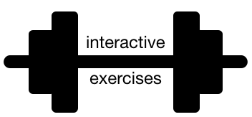
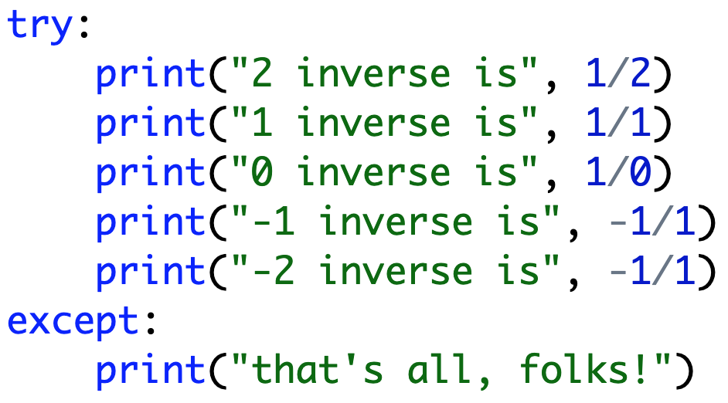
Exceptions are Exceptions to Regular Control Flow
never runs

Slide 14
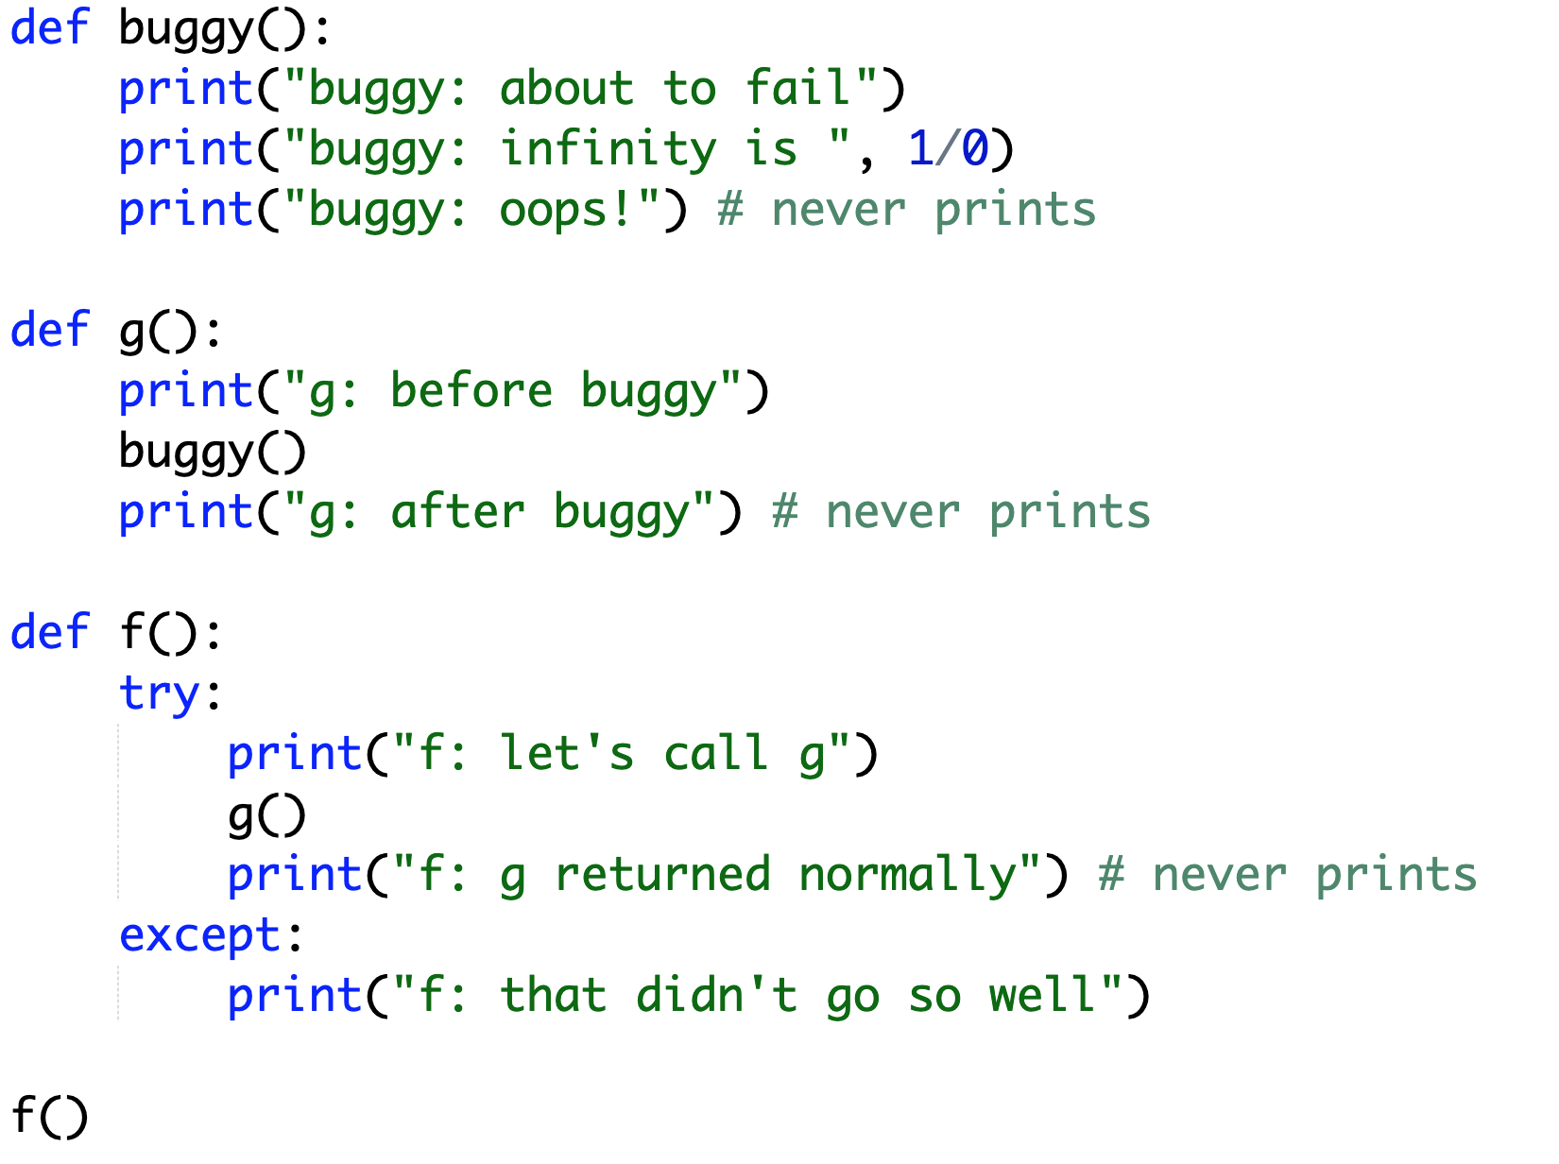
Exceptions are Exceptions to Regular Control Flow
Try this example in notebook or script format

Slide 15
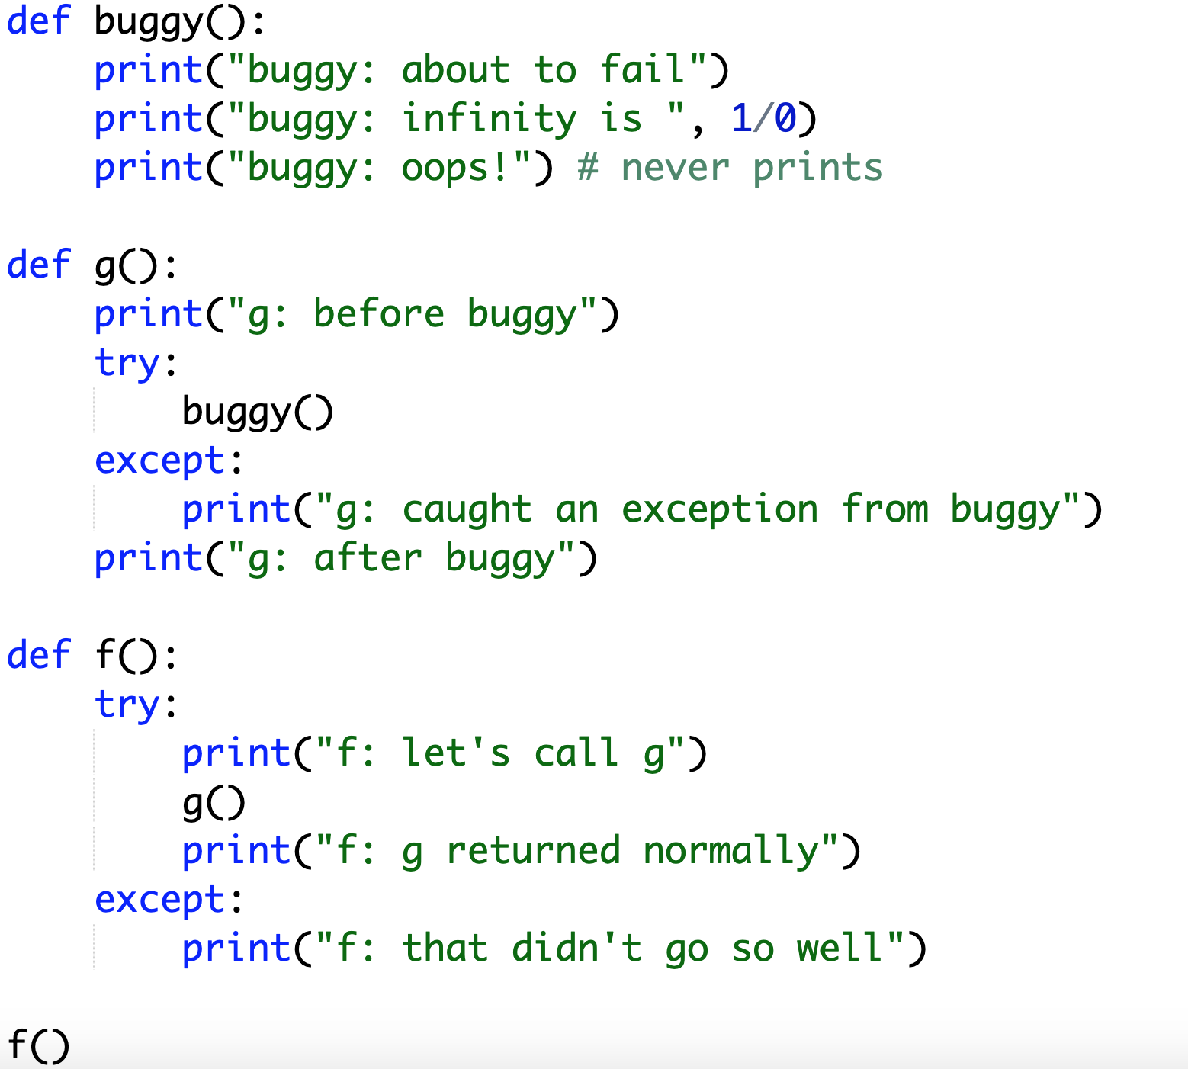
Exceptions are Exceptions to Regular Control Flow
g catches, so f never knows about the exception
Try this example in notebook or script format

Slide 16
What if we want to know the reason for the exception?

Slide 17
Crash Cause
Version 1:
Version 2:
try:
flaky_function()
except:
print(“error!”) # or some other handling
get exception object
describing the problem
try:
flaky_function()
except Exception as e:
print(“error because:”, str(e))

Slide 18
Crash Cause
Pizza Example: print failure reasons
for parse errors
for analysis errors
Version 1:
Version 2:
try:
flaky_function()
except:
print(“error!”) # or some other handling
e is of type Exception (very general)
(there are different types of exceptions)
get exception object
describing the problem
try:
flaky_function()
except Exception as e:
print(“error because:”, str(e))
why it failed

Slide 19
What if we only want to catch certain exceptions?

Slide 20
Narrow Catching
Version 2:
Version 3:
try:
flaky_function()
except Exception as e:
print(“error because:”, str(e))
try:
flaky_function()
except (ValueError, IndexError) as e:
print(“error because:”, str(e))

Slide 21
Narrow Catching
Pizza Example: catch only real parse errors
strings when want ints
not enough values
NOT typos in variable names
Version 2:
Version 3:
try:
flaky_function()
except Exception as e:
print(“error because:”, str(e))
only catch these two
(not NameError and others)
try:
flaky_function()
except (ValueError, IndexError) as e:
print(“error because:”, str(e))
General Rule: always catch specific types of exceptions,
and/or make sure the user knows there was an error
(unexpected silent errors are the worst!)

Slide 22
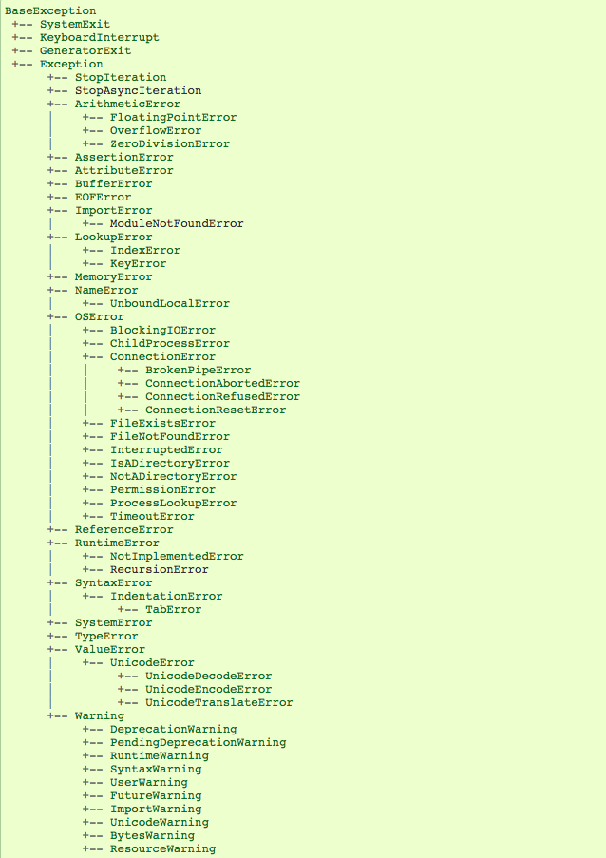
Exception Hierarchy
        Documentation:
        https://docs.python.org/3/library/exceptions.html#exception-hierarchy
screenshot
of hierarchy

Slide 23
What if we want to produce a specific kind of error? (not just an assert)

Slide 24
Custom Errors
BaseException
+-- Exception
+-- ArithmeticError
| +-- FloatingPointError
| +-- OverflowError
| +-- ZeroDivisionError
+-- AssertionError
+-- AttributeError
+-- TypeError
+-- ValueError

Slide 25
Asserts vs. Raising Exception Objects
Version 1 (quick and dirty):
        def slice_size(radius, slice_count):
        assert radius > 0
        return pizza_size(radius) / slice_count
Version 2 (more robust and informative):
        def slice_size(radius, slice_count):
        if radius <= 0:
        raise ArithmeticError(“number of slices <= 0”)
        return pizza_size(radius) / slice_count
tell Python this exception
occurred here
with this message
create TypeError object

Slide 26
Summary
Asserts
force a crash/exception
better to crash in an obvious way than to use corrupt data
Exceptions
produce them with raise
catch them with try/except
can choose specific types of exceptions
General Rule: always catch specific types of exceptions,
and/or make sure the user knows there was an error
(unexpected silent errors are the worst!)

