Slide 1
[220 / 319] Variables and Expressions
Meena Syamkumar
Andy Kuemmel

Slide 2
Today's Outline
Review
Operator Precedence
Expressions, Variables, and Assignments
        Demos
Bugs
Demos
Naming variables
Demos

Slide 3
Unordered
Ordered by Precedence
What is it? | Python Operator
comparison | ==, !=, <, <=, >, >=
signs | +x, -x
AND | and
add/subtract | +, -
exponents | **
NOT | not
OR | or
multiply/divide | *, /, //, %
What is it? | Python Operator
simplify first
simplify last

Slide 4
Unordered
Ordered by Precedence
What is it? | Python Operator
comparison | ==, !=, <, <=, >, >=
signs | +x, -x
AND | and
add/subtract | +, -
NOT | not
OR | or
multiply/divide | *, /, //, %
What is it? | Python Operator
exponents | **
simplify first
simplify last

Slide 5
Unordered
Ordered by Precedence
What is it? | Python Operator
comparison | ==, !=, <, <=, >, >=
AND | and
add/subtract | +, -
NOT | not
OR | or
multiply/divide | *, /, //, %
What is it? | Python Operator
exponents | **
signs | +x, -x
simplify first
simplify last

Slide 6
Unordered
Ordered by Precedence
What is it? | Python Operator
comparison | ==, !=, <, <=, >, >=
AND | and
add/subtract | +, -
NOT | not
OR | or
What is it? | Python Operator
exponents | **
signs | +x, -x
multiply/divide | *, /, //, %
simplify first
simplify last

Slide 7
Unordered
Ordered by Precedence
What is it? | Python Operator
comparison | ==, !=, <, <=, >, >=
AND | and
NOT | not
OR | or
What is it? | Python Operator
exponents | **
signs | +x, -x
multiply/divide | *, /, //, %
add/subtract | +, -
simplify first
simplify last

Slide 8
Unordered
Ordered by Precedence
What is it? | Python Operator
AND | and
NOT | not
OR | or
What is it? | Python Operator
exponents | **
signs | +x, -x
multiply/divide | *, /, //, %
add/subtract | +, -
comparison | ==, !=, <, <=, >, >=
simplify first
simplify last

Slide 9
Unordered
Ordered by Precedence
What is it? | Python Operator
AND | and
OR | or
What is it? | Python Operator
exponents | **
signs | +x, -x
multiply/divide | *, /, //, %
add/subtract | +, -
comparison | ==, !=, <, <=, >, >=
NOT | not
simplify first
simplify last

Slide 10
Unordered
Ordered by Precedence
What is it? | Python Operator
OR | or
What is it? | Python Operator
exponents | **
signs | +x, -x
multiply/divide | *, /, //, %
add/subtract | +, -
comparison | ==, !=, <, <=, >, >=
NOT | not
AND | and
simplify first
simplify last

Slide 11
Unordered
Ordered by Precedence
What is it? | Python Operator
What is it? | Python Operator
exponents | **
signs | +x, -x
multiply/divide | *, /, //, %
add/subtract | +, -
comparison | ==, !=, <, <=, >, >=
NOT | not
AND | and
OR | or
simplify first
simplify last

Slide 12
Unordered
Ordered by Precedence
What is it? | Python Operator
What is it? | Python Operator
exponents | **
signs | +x, -x
multiply/divide | *, /, //, %
add/subtract | +, -
comparison | ==, !=, <, <=, >, >=
NOT | not
AND | and
OR | or
simplify first
10 - -2 // 3
simplify last

Slide 13
Unordered
Ordered by Precedence
What is it? | Python Operator
What is it? | Python Operator
exponents | **
signs | +x, -x
multiply/divide | *, /, //, %
add/subtract | +, -
comparison | ==, !=, <, <=, >, >=
NOT | not
AND | and
OR | or
simplify first
simplify last
logical operators
can "short circuit"
1+1==2 or 3 ** 10000000 > 2 ** 20000000

Slide 14
Today's Outline
Review
Expressions, Variables, and Assignments
        Demos
Bugs
Demos
Naming variables
Demos

Slide 15
Expressions
Expressions are a mix of operators and operands. For example:
5 + 5
(8/2) ** 2 * 3.14
3 * 3 > 4 + 4
3 % 2 == 0 or 3 % 2 == 1

Slide 16
Expressions
Expressions are a mix of operators and operands. For example:
5 + 5
(8/2) ** 2 * 3.14
3 * 3 > 4 + 4
3 % 2 == 0 or 3 % 2 == 1
Each of these operands is an example of a literal: a fixed value

Slide 17
Expressions
Expressions are a mix of operators and operands. For example:
x + y
(diameter/2) ** 2 * pi
value1 * value1 > value2 + value2
num % 2 == 0 or num % 2 == 1
An operand may also be a variable: not fixed

Slide 18
Expressions
Expressions are a mix of operators and operands. For example:
x + y
(diameter/2) ** 2 * pi
value1 * value1 > value2 + value2
num % 2 == 0 or num % 2 == 1
Quick Test! Circle the literals (others are variables)
      0
      zero
      num1
      True
      hello
      "goodbye"
An operand may also be a variable: not fixed

Slide 19
Expressions
Expressions are a mix of operators and operands. For example:
x + y
(diameter/2) ** 2 * pi
value1 * value1 > value2 + value2
num % 2 == 0 or num % 2 == 1
Quick Test! Circle the literals (others are variables)
      0
      zero
      num1
      True
      hello
      "goodbye"
An operand may also be a variable: not fixed

Slide 20
Expressions
Expressions are a mix of operators and operands. For example:
x + y
(diameter/2) ** 2 * pi
value1 * value1 > value2 + value2
num % 2 == 0 or num % 2 == 1
Quick Test! Circle the literals (others are variables)
      0
      zero
      num1
      True
      hello
      "goodbye"
An operand may also be a variable: not fixed

Slide 21
Expressions
Expressions are a mix of operators and operands. For example:
x + y
(diameter/2) ** 2 * pi
value1 * value1 > value2 + value2
num % 2 == 0 or num % 2 == 1
Quick Test! Circle the literals (others are variables)
      0
      zero
      num1
      True
      hello
      "goodbye"
An operand may also be a variable: not fixed

Slide 22
Expressions
Expressions are a mix of operators and operands. For example:
x + y
(diameter/2) ** 2 * pi
value1 * value1 > value2 + value2
num % 2 == 0 or num % 2 == 1
Quick Test! Circle the literals (others are variables)
      0
      zero
      num1
      True
      hello
      "goodbye"
An operand may also be a variable: not fixed
How do we put a value in a variable?

Slide 23
Assignment
An assignment computes an expression (maybe a simple one) and puts the result in a variable:
x + y
(diameter/2) ** 2 * pi
value1 * value1 > value2 + value2
num % 2 == 0 or num % 2 == 1

Slide 24
Assignment
An assignment computes an expression (maybe a simple one) and puts the result in a variable:
total = x + y
area = (diameter/2) ** 2 * pi
is_bigger = value1 * value1 > value2 + value2
is_even_or_odd = num % 2 == 0 or num % 2 == 1

Slide 25
Assignment
An assignment computes an expression (maybe a simple one) and puts the result in a variable:
total = x + y
area = (diameter/2) ** 2 * pi
is_bigger = value1 * value1 > value2 + value2
is_even_or_odd = num % 2 == 0 or num % 2 == 1

Slide 26
Assignment
An assignment computes an expression (maybe a simple one) and puts the result in a variable:
total = x + y
area = (diameter/2) ** 2 * pi
is_bigger = value1 * value1 > value2 + value2
is_even_or_odd = num % 2 == 0 or num % 2 == 1

Slide 27
Assignment
An assignment computes an expression (maybe a simple one) and puts the result in a variable:
total = x + y
area = (diameter/2) ** 2 * pi
is_bigger = value1 * value1 > value2 + value2
is_even_or_odd = num % 2 == 0 or num % 2 == 1
Expression

Slide 28
Assignment
An assignment computes an expression (maybe a simple one) and puts the result in a variable:
total = x + y
area = (diameter/2) ** 2 * pi
is_bigger = value1 * value1 > value2 + value2
is_even_or_odd = num % 2 == 0 or num % 2 == 1
Expression
Assignment Operator

Slide 29
Assignment
An assignment computes an expression (maybe a simple one) and puts the result in a variable:
total = x + y
area = (diameter/2) ** 2 * pi
is_bigger = value1 * value1 > value2 + value2
is_even_or_odd = num % 2 == 0 or num % 2 == 1
Variable
Expression
Assignment Operator

Slide 30
Today's Outline
Review
Expressions, Variables, and Assignments
        Demos
Bugs
Demos
Naming variables
Demos

Slide 31
Today's Outline
Review
Expressions, Variables, and Assignments
        Demos
Bugs
Demos
Naming variables
Demos

Slide 32
Categories of Errors
1
dog cat the of chase any
[word soup, not grammatically sensible]
2
3

Slide 33
Categories of Errors
1
Syntax Error
It never makes sense in any context; Python doesn't even run
5 = x
2
3

Slide 34
Categories of Errors
1
Syntax Error
It never makes sense in any context; Python doesn't even run
5 = x
2
this sentence is false
[grammatical, but my head explodes if I think about it]
3

Slide 35
Categories of Errors
1
Syntax Error
It never makes sense in any context; Python doesn't even run
5 = x
Runtime Error
Need to run to find out whether it will crash
Appears with different names (TypeError, ZeroDivisionError, etc)
x = 5 / 0
2
3

Slide 36
Categories of Errors
1
Syntax Error
It never makes sense in any context; Python doesn't even run
5 = x
Runtime Error
Need to run to find out whether it will crash
Appears with different names (TypeError, ZeroDivisionError, etc)
x = 5 / 0
2
3
one week is 10 days long
[grammatical, coherent, but incorrect]

Slide 37
Categories of Errors
1
Syntax Error
It never makes sense in any context; Python doesn't even run
5 = x
Runtime Error
Need to run to find out whether it will crash
Appears with different names (TypeError, ZeroDivisionError, etc)
x = 5 / 0
Semantic Error
It runs with no error, but you get the wrong answer
square_area = square_side * 2
2
3

Slide 38
Categories of Errors
1
Syntax Error
It never makes sense in any context; Python doesn't even run
5 = x
Runtime Error
Need to run to find out whether it will crash
Appears with different names (TypeError, ZeroDivisionError, etc)
x = 5 / 0
Semantic Error
It runs with no error, but you get the wrong answer
square_area = square_side * 2
2
what kind of error is the worst?
3

Slide 39
Today's Outline
Review
Expressions, Variables, and Assignments
        Demos
Bugs
Demos
Naming variables
Demos

Slide 40
int Demo
?
a = 3
b = 4
c = 5
d = 6
What is the sum of all the odd values?
(in this case, 3 + 5)

Slide 41
float Demo
?
Compound growth:
you start with $1000
every year it grows by 7%
you wait 30 years
how much do you have at the end?
year 0: $1000
year 1: $1070
year 2: ...

Slide 42
str Demo
Visually compare two scores:
Alice has 10 points
Bob has 8 points
Desired output:
alice: ||||||||||
bob: ||||||||
even better
alice: ||||||||||
bob: ||||||||

Slide 43
bool Demo
Bounds check: is the value between 0 and 100?
YES
NO
output is
you may continue: True
output is
you may continue: False

Slide 44
Today's Outline
Review
Expressions, Variables, and Assignments
        Demos
Bugs
Demos
Naming variables
Demos

Slide 45
What Variable Names are Allowed?
1st_score = 100 [bad variable] score_1 = 100 [good variable]
firstScore = 100 [not a recommended variable] first_score = 100 [recommended variable]
current rules are quite complex:
https://www.python.org/dev/peps/pep-3131
please don’t use camel case:
https://www.python.org/dev/peps/pep-0008/
Python 3 has become friendlier to non-English programmers
quero_café = True
this is allowed, and
different than "e"

Slide 46
Conservative Rules for English Code
1
Only use letters a-z (upper and lower), numbers, and underscores
2
Don’t start with a number
3
Don’t use Python keywords (e.g., and, False, etc)
for 220, you may use characters from any script and variables in any language you prefer, but we won't cover variable naming rules for any other language

Slide 47
Conservative Rules for English Code
1
Only use letters a-z (upper and lower), numbers, and underscores
2
Don’t start with a number
3
Don’t use Python keywords (e.g., and, False, etc)
GOOD:
cs220
CS220
cs_220
_cs220
BAD:
220class
and
pi3.14
x!
what rules are violated?

Slide 48
Conservative Rules for English Code
1
Only use letters a-z (upper and lower), numbers, and underscores
2
Don’t start with a number
3
Don’t use Python keywords (e.g., and, False, etc)
GOOD:
cs220
CS220
cs_220
_cs220
BAD:
220class
and
pi3.14
x!
2

Slide 49
Conservative Rules for English Code
1
Only use letters a-z (upper and lower), numbers, and underscores
2
Don’t start with a number
3
Don’t use Python keywords (e.g., and, False, etc)
GOOD:
cs220
CS220
cs_220
_cs220
BAD:
220class
and
pi3.14
x!
2
3

Slide 50
Conservative Rules for English Code
1
Only use letters a-z (upper and lower), numbers, and underscores
2
Don’t start with a number
3
Don’t use Python keywords (e.g., and, False, etc)
GOOD:
cs220
CS220
cs_220
_cs220
BAD:
220class
and
pi3.14
x!
2
3
1
1

Slide 51
Conservative Rules for English Code
1
Only use letters a-z (upper and lower), numbers, and underscores
2
Don’t start with a number
3
Don’t use Python keywords (e.g., and, False, etc)
GOOD:
cs220
CS220
cs_220
_cs220
BAD:
220class
and
pi3.14
x!
2
3
1
1
PLEASE never name a variable after a type (e.g., int, str, etc)

Slide 52
Today's Outline
Review
Expressions, Variables, and Assignments
        Demos
Bugs
Demos
Naming variables
Demos

Slide 53
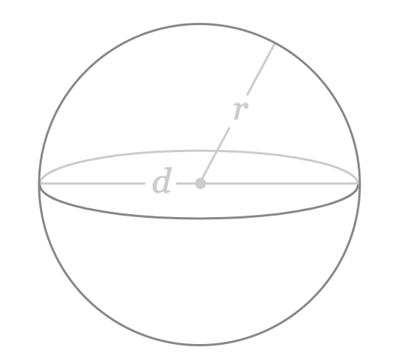
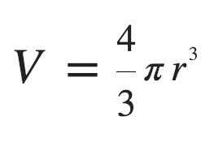
Sphere Volume Demo
bonus: find radius given a volume
https://www.google.com/search?q=sphere%20calc%3A%20find%20V&oq=area+of+a+sphere&aqs=chrome.0.0l6.2671j0j7&sourceid=chrome&ie=UTF-8&skip=s

Slide 54
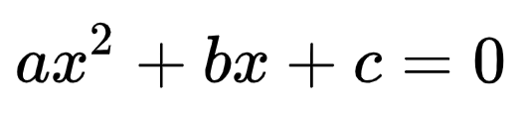
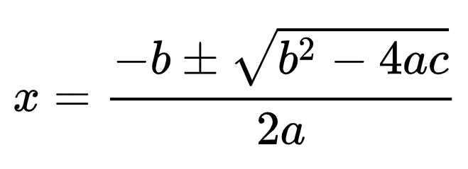
Quadratic Formula Demo
what values of x satisfy the above?
https://en.wikipedia.org/wiki/Quadratic_formula

Slide 55
Character Art: Block
write some code to draw the following:
##########
##########
##########
##########
##########
##########
height
width

Slide 56
Character Art: Checkers
write some code to draw the following:
# # # # #
# # # # #
# # # # #
# # # # #
# # # # #
# # # # #
height
width

Slide 57
Character Art: Border
write some code to draw the following:
##########
# #
# #
# #
# #
##########
height
width

Slide 58
Character Art: Snake
write some code to draw the following:
##########
#
##########
#
##########
#
##########
#
height
width

