Slide 1
[220 / 319] Variables and Expressions
Meena Syamkumar
Andy Kuemmel

Slide 2
Today's Outline
Review
Operator Precedence
Expressions, Variables, and Assignments
        Demos
Bugs
Demos
Naming variables
Demos

Slide 3
Unordered
Ordered by Precedence
What is it? | Python Operator
comparison | ==, !=, <, <=, >, >=
signs | +x, -x
AND | and
add/subtract | +, -
exponents | **
NOT | not
OR | or
multiply/divide | *, /, //, %
What is it? | Python Operator
simplify first
simplify last

Slide 4
Unordered
Ordered by Precedence
What is it? | Python Operator
What is it? | Python Operator
exponents | **
signs | +x, -x
multiply/divide | *, /, //, %
add/subtract | +, -
comparison | ==, !=, <, <=, >, >=
NOT | not
AND | and
OR | or
simplify first
10 - -2 // 3
simplify last

Slide 5
Unordered
Ordered by Precedence
What is it? | Python Operator
What is it? | Python Operator
exponents | **
signs | +x, -x
multiply/divide | *, /, //, %
add/subtract | +, -
comparison | ==, !=, <, <=, >, >=
NOT | not
AND | and
OR | or
simplify first
simplify last
logical operators
can "short circuit"
1+1==2 or 3 ** 10000000 > 2 ** 20000000

Slide 6
Today's Outline
Review
Expressions, Variables, and Assignments
        Demos
Bugs
Demos
Naming variables
Demos

Slide 7
Expressions
Expressions are a mix of operators and operands. For example:
5 + 5
(8/2) ** 2 * 3.14
3 * 3 > 4 + 4
3 % 2 == 0 or 3 % 2 == 1
Each of these operands is an example of a literal: a fixed value

Slide 8
Expressions
Expressions are a mix of operators and operands. For example:
x + y
(diameter/2) ** 2 * pi
value1 * value1 > value2 + value2
num % 2 == 0 or num % 2 == 1
An operand may also be a variable: not fixed

Slide 9
Expressions
Expressions are a mix of operators and operands. For example:
x + y
(diameter/2) ** 2 * pi
value1 * value1 > value2 + value2
num % 2 == 0 or num % 2 == 1
Quick Test! Circle the literals (others are variables)
      0
      zero
      num1
      True
      hello
      "goodbye"
An operand may also be a variable: not fixed
How do we put a value in a variable?

Slide 10
Assignment
An assignment computes an expression (maybe a simple one) and puts the result in a variable:
x + y
(diameter/2) ** 2 * pi
value1 * value1 > value2 + value2
num % 2 == 0 or num % 2 == 1

Slide 11
Assignment
An assignment computes an expression (maybe a simple one) and puts the result in a variable:
total = x + y
area = (diameter/2) ** 2 * pi
is_bigger = value1 * value1 > value2 + value2
is_even_or_odd = num % 2 == 0 or num % 2 == 1
Variable
Expression
Assignment Operator

Slide 12
Today's Outline
Review
Expressions, Variables, and Assignments
        Demos
Bugs
Demos
Naming variables
Demos

Slide 13
Today's Outline
Review
Expressions, Variables, and Assignments
        Demos
Bugs
Demos
Naming variables
Demos

Slide 14
Categories of Errors
1
dog cat the of chase any
[word soup, not grammatically sensible]
2
3

Slide 15
Categories of Errors
1
Syntax Error
It never makes sense in any context; Python doesn't even run
5 = x
2
3

Slide 16
Categories of Errors
1
Syntax Error
It never makes sense in any context; Python doesn't even run
5 = x
2
this sentence is false
[grammatical, but my head explodes if I think about it]
3

Slide 17
Categories of Errors
1
Syntax Error
It never makes sense in any context; Python doesn't even run
5 = x
Runtime Error
Need to run to find out whether it will crash
Appears with different names (TypeError, ZeroDivisionError, etc)
x = 5 / 0
2
3

Slide 18
Categories of Errors
1
Syntax Error
It never makes sense in any context; Python doesn't even run
5 = x
Runtime Error
Need to run to find out whether it will crash
Appears with different names (TypeError, ZeroDivisionError, etc)
x = 5 / 0
2
3
one week is 10 days long
[grammatical, coherent, but incorrect]

Slide 19
Categories of Errors
1
Syntax Error
It never makes sense in any context; Python doesn't even run
5 = x
Runtime Error
Need to run to find out whether it will crash
Appears with different names (TypeError, ZeroDivisionError, etc)
x = 5 / 0
Semantic Error
It runs with no error, but you get the wrong answer
square_area = square_side * 2
2
3

Slide 20
Categories of Errors
1
Syntax Error
It never makes sense in any context; Python doesn't even run
5 = x
Runtime Error
Need to run to find out whether it will crash
Appears with different names (TypeError, ZeroDivisionError, etc)
x = 5 / 0
Semantic Error
It runs with no error, but you get the wrong answer
square_area = square_side * 2
2
what kind of error is the worst?
3

Slide 21
Today's Outline
Review
Expressions, Variables, and Assignments
        Demos
Bugs
Demos
Naming variables
Demos

Slide 22
Example: int expressions
?
seconds = 12345
Print out hours, minutes, and seconds

Slide 23
Example: float expressions
?
Compound growth:
you start with $1000
every year it grows by 7%
you wait 30 years
how much do you have at the end?
year 0: $1000
year 1: $1070
year 2: ...

Slide 24
Example: string expressions
Visually compare two scores:
Alice has 10 points
Bob has 8 points
Desired output:
alice: ||||||||||
bob: ||||||||
even better
alice: ||||||||||
bob: ||||||||

Slide 25
Example: bool expressions
Bounds check: is the value between 0 and 100?
YES
NO
output is
you may continue: True
output is
you may continue: False

Slide 26
Today's Outline
Review
Expressions, Variables, and Assignments
        Demos
Bugs
Demos
Naming variables
Demos

Slide 27
What Variable Names are Allowed?
1st_score = 100 [bad variable] score_1 = 100 [good variable]
firstScore = 100 [not a recommended variable] first_score = 100 [recommended variable]
current rules are quite complex:
https://www.python.org/dev/peps/pep-3131
please don’t use camel case:
https://www.python.org/dev/peps/pep-0008/
Python 3 has become friendlier to non-English programmers
quero_café = True
this is allowed, and
different than "e"

Slide 28
Conservative Rules for English Code
1
Only use letters a-z (upper and lower), numbers, and underscores
2
Don’t start with a number
3
Don’t use Python keywords (e.g., and, False, etc)
for 220, you may use characters from any script and variables in any language you prefer, but we won't cover variable naming rules for any other language

Slide 29
Conservative Rules for English Code
1
Only use letters a-z (upper and lower), numbers, and underscores
2
Don’t start with a number
3
Don’t use Python keywords (e.g., and, False, etc)
GOOD:
cs220
CS220
cs_220
_cs220
BAD:
220class
and
pi3.14
x!
what rules are violated?

Slide 30
Conservative Rules for English Code
1
Only use letters a-z (upper and lower), numbers, and underscores
2
Don’t start with a number
3
Don’t use Python keywords (e.g., and, False, etc)
GOOD:
cs220
CS220
cs_220
_cs220
BAD:
220class
and
pi3.14
x!
2
3
1
1
PLEASE never name a variable after a type (e.g., int, str, etc)

Slide 31
Today's Outline
Review
Expressions, Variables, and Assignments
        Demos
Bugs
Demos
Naming variables
Demos

Slide 32
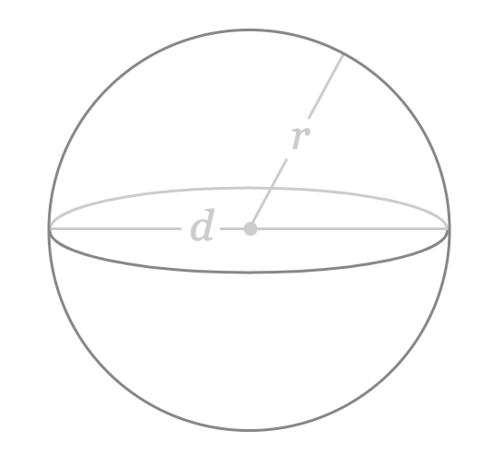
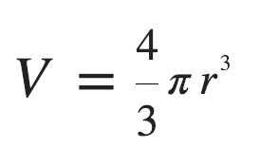
Practice: Sphere Volume
extension: find radius given a volume
https://www.google.com/search?q=sphere%20calc%3A%20find%20V&oq=area+of+a+sphere&aqs=chrome.0.0l6.2671j0j7&sourceid=chrome&ie=UTF-8&skip=s

Slide 33
Practice: Character Art - Block
write some code to draw the following:
##########
##########
##########
##########
##########
##########
height
width

Slide 34
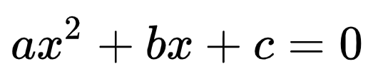
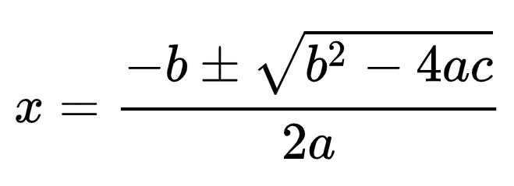
Practice: Quadratic Formula
what values of x satisfy the above?
https://en.wikipedia.org/wiki/Quadratic_formula

Slide 35
Challenge*: Checkers
write some code to draw the following:
# # # # #
# # # # #
# # # # #
# # # # #
# # # # #
# # # # #
height
width
* Challenge = beyond what you would be asked to do on an exam

Slide 36
Challenge: Border
write some code to draw the following:
##########
# #
# #
# #
# #
##########
height
width

Slide 37
Challenge: Snake
write some code to draw the following:
##########
#
##########
#
##########
#
##########
#
height
width

