Slide 1
[220 / 319] Using Functions
Meena Syamkumar
Andy Kuemmel
Please read Ch 3
of Think Python

Slide 2
Learning Objectives Today
How to call functions
input/output
terminology: call / invoke, parameter, argument, return value
control flow
Function usage examples
input(),
type cast functions: int(), bool(), float(), str()
Using functions from built-in or user-created module:
keywords: import, as
attribute operator: “.”
help: inspect a module
make a battleship game!

Slide 3
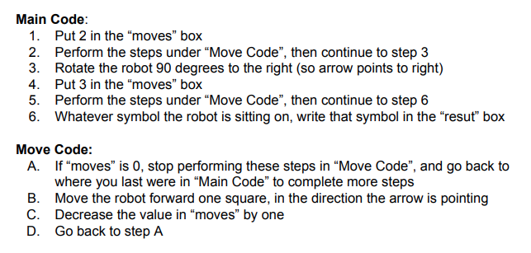
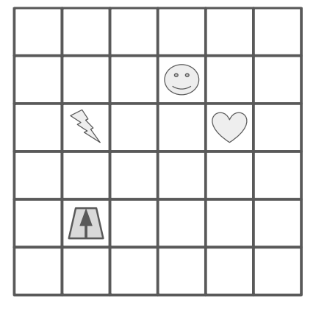
we’ll learn about how to give functions input by passing arguments (e.g., 2) to parameters (e.g., moves)
today we’ll learn how to use functions in Python
we’ll also learn how to ask functions
questions and get answers called return values
“Move Code” is a function
next lecture, we’ll learn how to write our own new functions
Functions are like “mini programs”,
as in our robot worksheet problem

Slide 4
Vocabulary
...
General Function Concepts
Some Code
...
code
...
code
Yikes, copied code!
...

Slide 5
Vocabulary
refactor: change organization of code (e.g., to avoid repetition)
parameter: variable that receives input to function
argument: value sent to a function (lines up with parameter)
return value (or result): function output sent back to calling code
default argument: value put in parameter if argument not passed
A Function
param1
param2
return
inputs
default
outputs
Some Code
...
arg1
result
...
call/invoke
...

Slide 6
Vocabulary
refactor: change organization of code (e.g., to avoid repetition)
parameter: variable that receives input to function
argument: value sent to a function (lines up with parameter)
return value (or result): function output sent back to calling code
default argument: value put in parameter if argument not passed
named/keyword argument: argument explicitly tied to a parameter
A Function
param1
param2
return
inputs
default
outputs
Some Code
...
param1 = arg1
result
...
call/invoke
...

Slide 7
print(“hello”) result = f(x)
Calling/Invoking a Function in Python
return value
ALWAYS: function’s name
ALWAYS: followed by parentheses
SOMETIMES: with one or more arguments
SOMETIMES: producing a result

Slide 8
print(“hello”, “world”) x = input()
Calling/Invoking a Function in Python
ALWAYS: function’s name
ALWAYS: followed by parentheses
SOMETIMES: with one or more arguments
SOMETIMES: producing a result

Slide 9
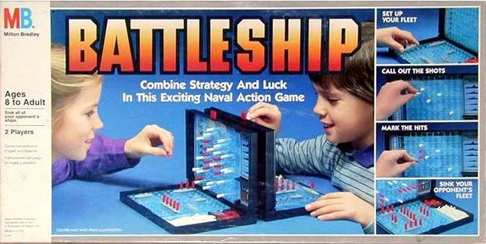
Example: Battleship Demo (Version 1)
https://boardgamegeek.com/image/288374/battleship
x
guess 2,1
(miss!)
Version 1 (MVP)
1 ship, 1 guess
ship is 1 space
fixed position
top/left is 0,0
horrible graphics
........
..0.....
........
........
........
........
........
........
........
........
........
........
........
........
........
.......1
y
guess 7,7
(hit!)

Slide 10
Practice: Battleship Demo (Version 2)
Version 1 (MVP)
1 ship, 1 guess
ship is 1 space
fixed position
top/left is 0,0
horrible graphics
Version 2
larger ship
multiple ships
random locations
https://boardgamegeek.com/image/288374/battleship
guess 2,1
(miss!)
........
..0.....
........
........
........
........
........
........
........
........
........
........
........
........
........
.......1
guess 7,7
(hit!)
time permitting

Slide 11
Challenge: Polar Coords Distance
3
5
0
4
point 1: distance 3 at angle 90°
distance: 5
point 2: distance 4 at angle 0°

