Slide 1
[220 / 319] Conditionals
Meena Syamkumar
Andy Kuemmel
Exam 1 Conflict Form is available on the website

Slide 2

Mental Model of Control Flow
Code:
...
x = 5
y = f(x)
return y+1
...
x = 5
y = f(x)
return y+1
do statements in order, one at a time
functions: jump in and out of these
conditionals: sometimes skip statements
loops: sometimes go back to previous
three
exceptions
TODAY

Slide 3
Learning Objectives Today
Reason about conditionals
Conditional execution
Alternate execution
Chained conditionals
Nested conditionals
Understand code blocks
Be able to identify the lines of code in the same block
Sanity checking
Recognize errors
Sanitize bad data automatically
Chapter 5 of Think Python
(skip "Recursion" sections)
Do PythonTutor Practice!
(posted on schedule)

Slide 4
Today's Outline
Review
Control Flow Diagrams
Basic syntax for “if”
Identifying code blocks
        Demos

Slide 5
Review 1: Indentation Example
what does it print?
    print(“A”)
    print(“B”)
    def print_letters():
    print(“C”)
    print(“D”)
  print(“E”)
  print(“F”)
  print_letters()
not indented, so
“outside” any function
A
B
E
F
C
D
indented, so “inside”
print_letters function
also not indented, so
“outside” any function.
Runs BEFORE
print_letters is called
printed last because
print_letters is called last

Slide 6
Review 1: Indentation Example
what does it print?
    print(“A”)
    print(“B”)
    def print_letters():
    print(“C”)
    print(“D”)
  print(“E”)
  print(“F”)
  print_letters()
not indented, so
“outside” any function
A
B
E
F
C
D
indented, so “inside”
print_letters function
blank lines are irrelevant
also not indented, so
“outside” any function.
Runs BEFORE
print_letters is called
We use indenting to tell Python which code is inside or outside
of a function (or other things we’ll learn about soon).

Slide 7
Review 1: Indentation Example
what does it print?
    print(“A”)
    print(“B”)
    def print_letters():
    print(“C”)
    print(“D”)
  print(“E”)
  print(“F”)
  print_letters()
A
B
E
F
C
D
we’ll often call the lines
of code inside something
a “block” of code

Slide 8
Review 1: Indentation Example
what does it print?
    print(“A”)
    print(“B”)
    def print_letters():
    print(“C”)
    print(“D”)
    print(“E”)
    print(“F”)
  print_letters()
A
B
E
F
C
D
horizontal spaces
identify blocks
(not vertical space)

Slide 9
Review 2: Argument Passing
    def h(x=1, y=2):
    print(x, y) # what is printed?
    def g(x, y):
    print(x, y) # what is printed?
    h(y)
  def f(x, y):
  print(x, y) # what is printed?
  g(x=x, y=y+1)
  x = 10
  y = 20
  f(y, x)

Slide 10
Today's Outline
Review
Control Flow Diagrams
Basic syntax for “if”
Identifying code blocks
        Demos

Slide 11
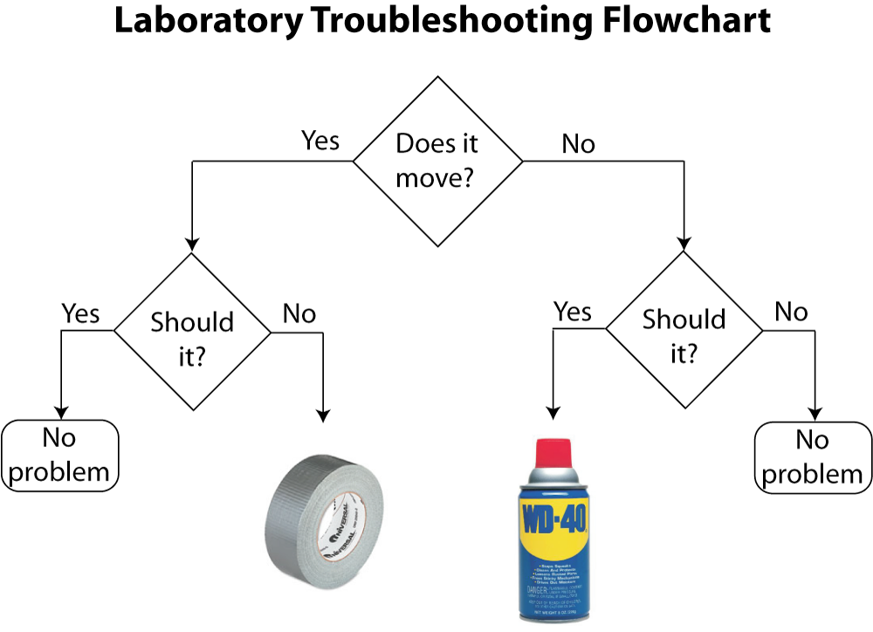
conditional execution
alternate execution
nested
conditional
chained would be
if we had more than
two possibilities
in programming:
questions are phrased as boolean expressions
actions are code/statements
https://www.drphysics.com/prayer/flowchart.html

Slide 12
Control Flow Diagrams (Flowcharts for Code)
    x = input(“enter x: ”)
    x = int(x)
conditional
boolean expressions are mostly
used for deciding what to do next
(not for printing “True” or “False”
as in most of our examples thus far)
condition
x % 2 == 0
Sometimes
we do this
True
False
Other times
we do this
print(“it’s even”)
print(“it’s odd”)
print(“thank you”)

Slide 13
Branches (aka "Paths of Execution”)
Input/Output:
    x = input(“enter x: ”)
    x = int(x)
enter x: 8
it’s even
thank you
x % 2 == 0
True
False
print(“it’s even”)
print(“it’s odd”)
print(“thank you”)

Slide 14
Branches (aka "Paths of Execution”)
Input/Output:
    x = input(“enter x: ”)
    x = int(x)
enter x: 7
it’s odd
thank you
x % 2 == 0
True
False
print(“it’s even”)
print(“it’s odd”)
print(“thank you”)

Slide 15
Today's Outline
Review
Control Flow Diagrams
Basic syntax for “if”
Identifying code blocks
        Demos

Slide 16
Writing conditions in Python
Code:
x = input(“enter x: ”)
x = int(x)
if x % 2 == 0:
x = input(“enter x: ”)
x = int(x)
x % 2 == 0
True
False
print(“it’s even”)
print(“it’s odd”)
boolean expression
print(“thank you”)

Slide 17
Writing conditions in Python
Code:
x = input(“enter x: ”)
x = int(x)
if x % 2 == 0:
print(“it’s even”)
else:
print(“it’s odd”)
print(“thank you”)
x = input(“enter x: ”)
x = int(x)
x % 2 == 0
True
False
print(“it’s even”)
print(“it’s odd”)
print(“thank you”)
colons will almost always be
followed by a tabbed new line

Slide 18
Writing conditions in Python
Code:
x = input(“enter x: ”)
x = int(x)
if x % 2 == 0:
print(“it’s even”)
print(“we wanted odd”)
else:
print(“it’s odd”)
print(“good!”)
print(“thank you”)
print(“all done”)
x = input(“enter x: ”)
x = int(x)
x % 2 == 0
True
False
print(“it’s even”)
print("we wanted odd")
print(“it’s odd”)
print("good!")
print(“thank you”)
print("all done")

Slide 19
Today's Outline
Review
Control Flow Diagrams
Basic syntax for “if”
Identifying code blocks
        Demos

Slide 20
Code Blocks
Code:
x = input(“enter x: ”)
x = int(x)
if x % 2 == 0:
print(“it’s even”)
print(“we wanted odd”)
else:
print(“it’s odd”)
print(“good!”)
print(“thank you”)
print(“all done”)
block of code
inside “if”
block of code
inside “else”
What if all this were inside a function?

Slide 21
Code Blocks
You need to get good at “seeing” code blocks in Python code.
Even blocks inside blocks inside blocks…
Code:
def check_oddness():
x = input(“enter x: ”)
x = int(x)
if x % 2 == 0:
print(“it’s even”)
print(“we wanted odd”)
else:
print(“it’s odd”)
print(“good!”)
print(“thank you”)
print(“all done”)
check_oddness()
block of code
inside “if”
block of code
inside “else”
block of code in
check_oddness

Slide 22
Identifying Code Blocks
Code:
def check_oddness():
x = input(“enter x: ”)
x = int(x)
if x % 2 == 0:
print(“it’s even”)
print(“we wanted odd”)
else:
print(“it’s odd”)
print(“good!”)
print(“thank you”)
print(“all done”)
check_oddness()
Step 1: look for a colon at
end of a line
Step 2: start drawing a line
on next code line, indented in

Slide 23
Identifying Code Blocks
Code:
def check_oddness():
x = input(“enter x: ”)
x = int(x)
if x % 2 == 0:
print(“it’s even”)
print(“we wanted odd”)
else:
print(“it’s odd”)
print(“good!”)
print(“thank you”)
print(“all done”)
check_oddness()
Step 3: continue down until you hit
code that is less indented
Step 4: box off the code

Slide 24
Identifying Code Blocks
Code:
def check_oddness():
x = input(“enter x: ”)
x = int(x)
if x % 2 == 0:
print(“it’s even”)
print(“we wanted odd”)
else:
print(“it’s odd”)
print(“good!”)
print(“thank you”)
print(“all done”)
check_oddness()
Step 4: box off the code
to find more boxes,
look for the next colon
and repeat

Slide 25
Identifying Code Blocks
Worksheet
Code:
def check_oddness():
x = input(“enter x: ”)
x = int(x)
if x % 2 == 0:
print(“it’s even”)
print(“we wanted odd”)
else:
print(“it’s odd”)
print(“good!”)
print(“thank you”)
print(“all done”)
check_oddness()
to find more boxes,
look for the next colon
and repeat

Slide 26
Today's Outline
Review
Control Flow Diagrams
Basic syntax for “if”
Identifying code blocks
        Demos

Slide 27
Example: Absolute
compare 4 ways to compute the absolute of a number
(step through in Interactive Exercises)

Slide 28
Example: Piecewise Function
y
y = f(x)
...
3
2
1
-4
-2
0
1
2
3
x
-1
Implement the f function in Python

Slide 29
Example: Stoplight – Next lecture …
color
RED
feet
YELLOW
what should the driver do?
GREEN

Slide 30
Example: Stoplight – Next lecture …
color
RED
feet
hit the gas
feet < 15
stop abruptly
YELLOW
continue at same speed
feet < 30
GREEN
stop
smile

Slide 31
Example: Date Printer – Next lecture …
please enter a year: (YYYY): 2021
please enter a month (1-12): 9
please enter a day (1-31): 29
the date is: Sep 29th of ‘21
convert month num to name
’2-digit year
e.g., 1st, 2nd, 3rd, etc

Slide 32
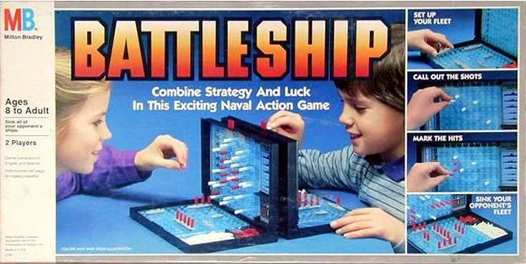
Challenge: Better Battleship
Improvements
give more meaningful feedback (not "True" or "False")
check that user guessed in a reasonable range
choose random placement for two ships, not overlapping
show different symbols depending on which ship was hit
give user up to 3 guesses (or until they get a hit)

Slide 33
Challenge: Addition Tester
1 point
what is 3+5? 5
what is 9+2? 10
what is 9+5? 2
...
Your score is 6.5 of 10
0.5 points (close answer)
0 points
We can get random number by using the random module:
random.randint(1, 10)

