Slide 1
[320] Web 1: Selenium
Meenakshi Syamkumar

Slide 2
how to scrape a webpage graph?
how to scrape a complicated page?
Page A
Page B
Page C
Page D

Slide 3
how to scrape a webpage graph?
requests module (220)
how to scrape a complicated page?
selenium module (320)
Page A
Page B
Page C
Page D

Slide 4
Document Object Model:
Every Webpage is a Tree

Slide 5
What does a web browser do when it gets some HTML in an HTTP response?
(hyper-text
markup language)
(hyper-text
transfer protocol)
url: http://domain/rsrc.html
HTTP Response
Browser
HTTP/1.0 200 OK
Content-Type: text/html; charset=utf-8
Content-Length: 74
<html>
<head><script>...</script></head>
<body>
<h1>Welcome</h1>
<a href="about.html">About</a>
<a href="contact.html">Contact</a>
</body>
</html>

Slide 6
url: http://domain/rsrc.html
HTTP Response
<html>
<body>
<h1>Welcome</h1>
<a href="about.html">About</a>
<a href="contact.html">Contact</a>
</body>
</html>
HTTP/1.0 200 OK
Content-Type: text/html; charset=utf-8
Content-Length: 74
<html>
<head><script>...</script></head>
<body>
<h1>Welcome</h1>
<a href="about.html">About</a>
<a href="contact.html">Contact</a>
</body>
</html>

Slide 7
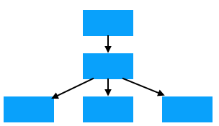
url: http://domain/rsrc.html
HTTP Response
HTTP/1.0 200 OK
Content-Type: text/html; charset=utf-8
Content-Length: 74
<html>
<head><script>...</script></head>
<body>
<h1>Welcome</h1>
<a href="about.html">About</a>
<a href="contact.html">Contact</a>
</body>
</html>
before displaying a page, the browser uses HTML to generate a
Document Object Model (DOM Tree)

Slide 8
url: http://domain/rsrc.html
HTTP Response
HTTP/1.0 200 OK
Content-Type: text/html; charset=utf-8
Content-Length: 74
<html>
<head><script>...</script></head>
<body>
<h1>Welcome</h1>
<a href="about.html">About</a>
<a href="contact.html">Contact</a>
</body>
</html>
html
body
h1
a
a
vocab: elements

Slide 9
Elements may contain
attributes
url: http://domain/rsrc.html
HTTP Response
HTTP/1.0 200 OK
Content-Type: text/html; charset=utf-8
Content-Length: 74
<html>
<head><script>...</script></head>
<body>
<h1>Welcome</h1>
<a href="about.html">About</a>
<a href="contact.html">Contact</a>
</body>
</html>
html
body
h1
a
a
attr: href
attr: href

Slide 10
Elements may contain
attributes
text
url: http://domain/rsrc.html
HTTP Response
HTTP/1.0 200 OK
Content-Type: text/html; charset=utf-8
Content-Length: 74
<html>
<head><script>...</script></head>
<body>
<h1>Welcome</h1>
<a href="about.html">About</a>
<a href="contact.html">Contact</a>
</body>
</html>
html
body
h1
a
a
attr: href
attr: href
Welcome
About
Contact

Slide 11
Elements may contain
attributes
text
other elements
url: http://domain/rsrc.html
HTTP Response
HTTP/1.0 200 OK
Content-Type: text/html; charset=utf-8
Content-Length: 74
<html>
<head><script>...</script></head>
<body>
<h1>Welcome</h1>
<a href="about.html">About</a>
<a href="contact.html">Contact</a>
</body>
</html>
html
body
parent
h1
a
a
child
attr: href
attr: href
Welcome
About
Contact

Slide 12
JavaScript (if there's an engine to execute it) may directly edit the DOM!
url: http://domain/rsrc.html
HTTP Response
HTTP/1.0 200 OK
Content-Type: text/html; charset=utf-8
Content-Length: 74
<html>
<head><script>...</script></head>
<body>
<h1>Welcome</h1>
<a href="about.html">About</a>
<a href="contact.html">Contact</a>
</body>
</html>
html
body
parent
h1
a
a
child
attr: href
attr: href
Welcome
About
Contact
table
original .html file doesn't change, but the result is equivalent

Slide 13
we need a JavaScript engine so we can scrape the generated table
url: http://domain/rsrc.html
HTTP Response
Welcome
About Contact
HTTP/1.0 200 OK
Content-Type: text/html; charset=utf-8
Content-Length: 74
<html>
<head><script>...</script></head>
<body>
<h1>Welcome</h1>
<a href="about.html">About</a>
<a href="contact.html">Contact</a>
</body>
</html>
browser renders (displays) the DOM tree, based on original file and any JavaScript changes

Slide 14
Web Scraping: Simple and Complicated

Slide 15


requests vs. Selenium
requests module (FAST!)
can fetch .html, .js, .etc file
Selenium
can fetch .html, .js, .etc file
can run a .js file in browser
can grab HTML version of DOM after JavaScript has modified it
IP address: 18.216.110.65
index.html, please [GET]
Web Server
Jupyter:
import requests
r=requests.get(...)
<html>
<body>
<img src=“A.png”>
<b>Hello</b>
<script src=“B.js”>
</script>
</body>
</html>
computer 1
(laptop)
computer 2
(Virtual Machine)

Slide 16
requests vs. Selenium
requests module (FAST!)
can fetch .html, .js, .etc file
Selenium
can fetch .html, .js, .etc file
can run a .js file in browser
can grab HTML version of DOM after JavaScript has modified it
note: Selenium is most commonly used for testing websites, but it works great for tricky scraping too
IP address: 18.216.110.65
<html>
<body>
<img src=“A.png”>
<b>Hello</b>
<script src=“B.js”>
</script>
</body>
</html>
from selenium
import webdriver
driver=webdriver.Chrome()
chromedriver
index.html, please [GET]
Web Server
A.png, please [GET]
...
computer 1
(laptop)
computer 2
(Virtual Machine)

Slide 17
Installing: Selenium, Chrome, Driver

Slide 18
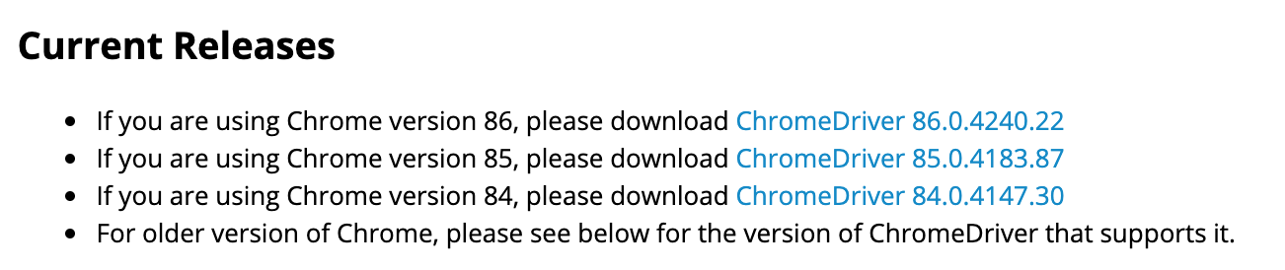
Selenium Install (Ubuntu 20.04)
https://github.com/msyamkumar/cs320-s23-projects/tree/main/p3#part-3-web-crawling-websearcher
on some systems, chromedriver is installed separately
pip3 install selenium
https://chromedriver.chromium.org/downloads
from selenium
import webdriver
driver=webdriver.Chrome()
sudo apt -y install chromium-browser
chromedriver
Check...
msyamkumar@instance-1:~$ chromium-browser --version
Chromium 110.0.5481.100 snap
msyamkumar@instance-1:~$ chromium.chromedriver --version
ChromeDriver 110.0.5481.100 (4be7a36f7cb943af6118e449bbab494b43dcaddd-refs/branch-heads/5481_77@{#14})
msyamkumar@instance-1:~$
computer 1
(laptop)

Slide 19
Why Drivers?
Python
Java
Ruby
JavaScript
Python module for Selenium
Java module for Selenium
Ruby module for Selenium
JavaScript mod for Selenium
Chrome Driver
Firefox Driver
Edge Driver

Slide 20
Examples

Slide 21
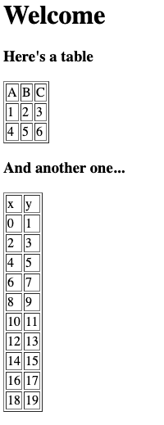
Example 1a: Late Loading Table (page1.html)
added after 1 second

Slide 22
Example 1b: Headless Mode and Screenshots
from selenium import webdriver
from selenium.webdriver.chrome.options import Options
from selenium.common.exceptions import NoSuchElementException
options = Options()
options.headless = True
b = webdriver.Chrome(options=options)
b.get(????)
from IPython.core.display import Image
b.save_screenshot("out.png")
Image("out.png")
b.close()

Slide 23
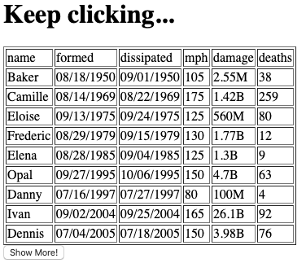
Example 2: Auto-Clicking Buttons
from selenium import webdriver
from selenium.webdriver.chrome.options import Options
from selenium.common.exceptions import NoSuchElementException
options = Options()
options.headless = True
b = webdriver.Chrome(options=options)
b.get(????)
btn = b.find_element_by_id("BTN_ID")
btn.click()
b.close()
auto click

Slide 24
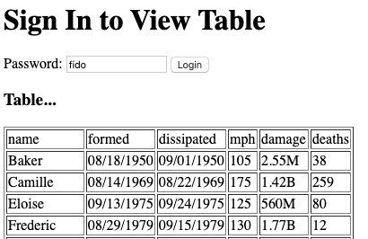
Example 3: Entering Passwords
from selenium import webdriver
from selenium.webdriver.chrome.options import Options
from selenium.common.exceptions import NoSuchElementException
options = Options()
options.headless = True
b = webdriver.Chrome(options=options)
b.get(????)
pw = b.find_element_by_id("pw")
pw.send_keys("fido")
b.close()

Slide 25
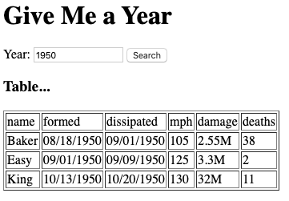
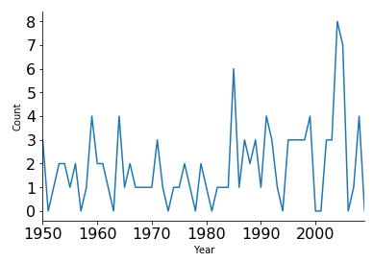
Example 4: Many Queries

