Slide 1
[220 / 319] Iteration
Meena Syamkumar
Andy Kuemmel
Exam I next Wednesday
Exam Conflict Form

Slide 2
Learning Objectives Today
Implement an iterative algorithm using a while loop
printing / counting
validating user input
performing an iterative calculation
printing grids
Trace iterative algorithms and determine their output
Recognize common while loop errors
Infinite loops (when unintentional)
Off-by-one mistakes in the loop control variable
Chapter 7 of Think Python

Slide 3
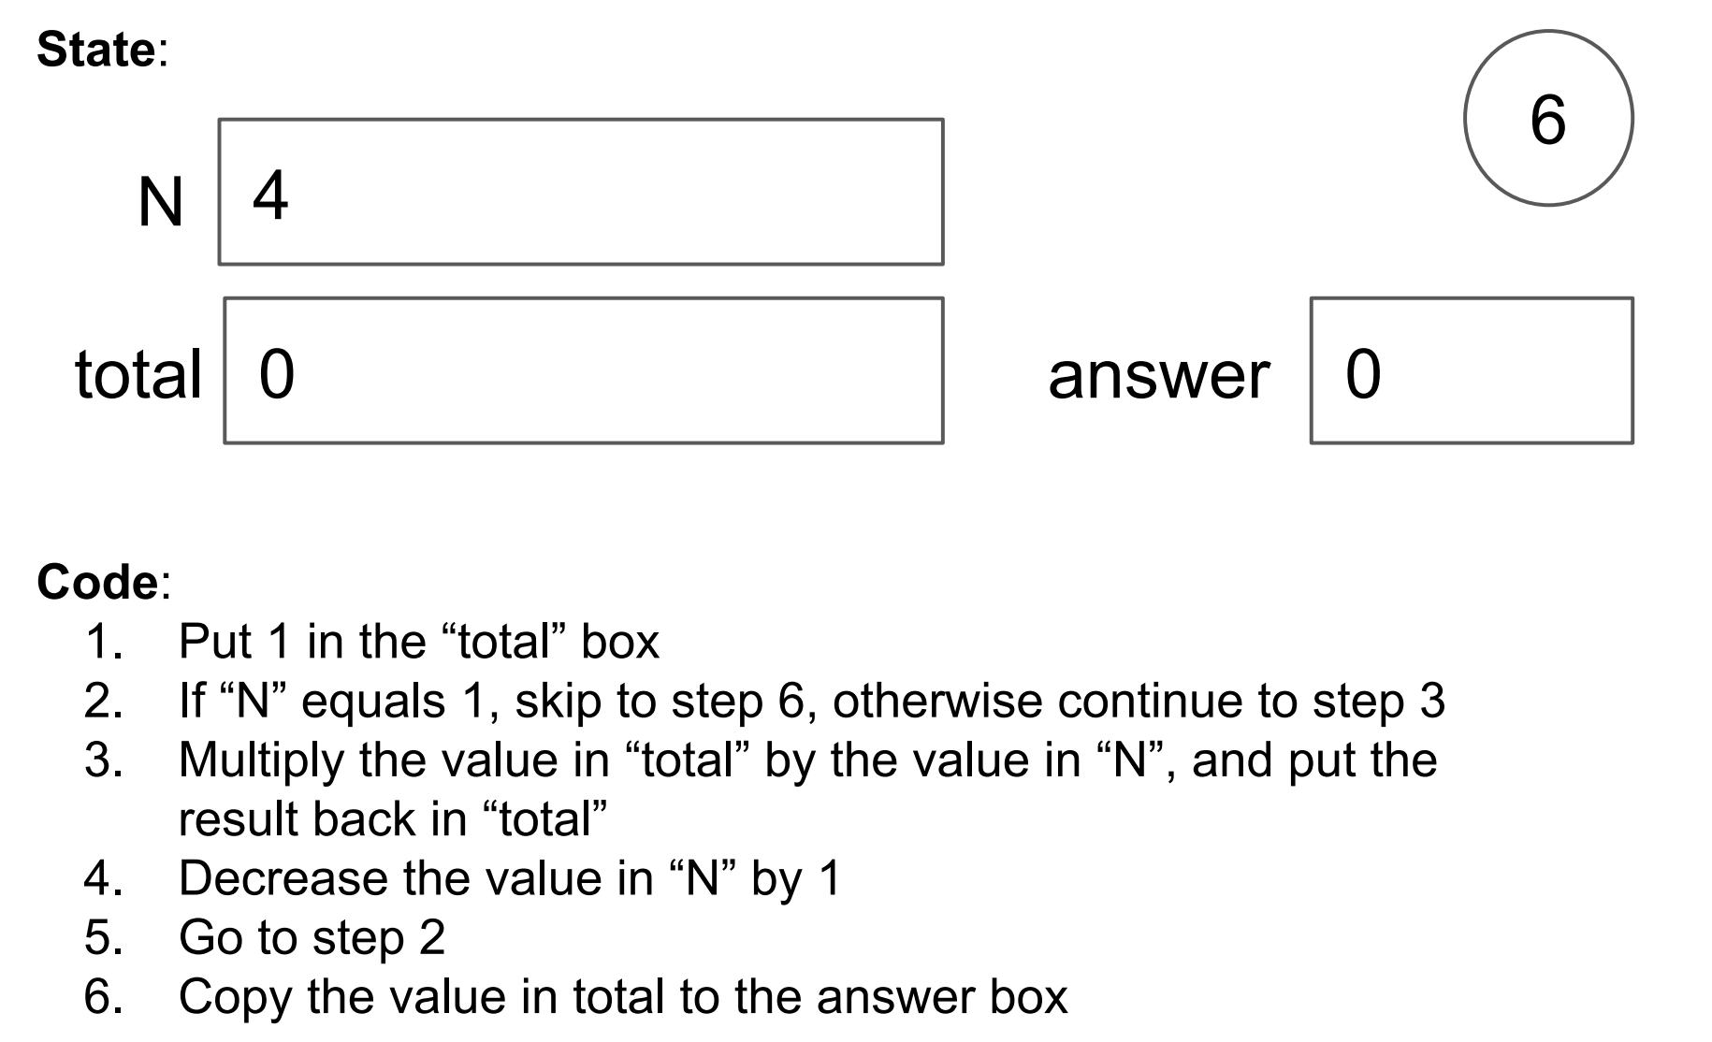
Worksheet

Slide 4
Worksheet
Combination of conditionally skipping forward (2) with
going back is (5) is called a “while loop”

Slide 5
Worksheet
loop condition
loop body

Slide 6
Worksheet
loop condition
loop body
going back will be implicit in Python, and will happen right after loop body.
you can identify the loop body because it will be indented

Slide 7
Worksheet
loop condition
skip past loop body
continue to loop body
loop body
going back will be implicit in Python, and will happen right after loop body.
you can identify the loop body because it will be indented

Slide 8
Today's Outline
Control Flow Diagrams
Basic syntax for “while”
        Examples

Slide 9
Control Flow Diagrams: “if”
x = input(“enter x: ”)
x = float(x)
x < 0
False
True
print(“the square root:”)
print(math.sqrt(x))
print(“need a positive”)
print(“exiting”)

Slide 10
Control Flow Diagrams: “if”
x = input(“enter x: ”)
x = float(x)
x < 0
False
True
print(“the square root:”)
print(math.sqrt(x))
print(“need a positive”)
Wouldn’t it be nice if we
could go back and give
the user a second chance?
print(“exiting”)

Slide 11
Control Flow Diagrams: “while”
x = input(“enter x: ”)
x = float(x)
x < 0
False
True
print(“the square root:”)
print(math.sqrt(x))
print(“please try again”)
x = float(input(“enter x: ”))
print(“exiting”)

Slide 12
Control Flow Diagrams: “while”
x = input(“enter x: ”)
x = float(x)
we call this cycle a “loop”
x < 0
False
True
print(“the square root:”)
print(math.sqrt(x))
print(“please try again”)
x = float(input(“enter x: ”))
Each time through is called an “iteration”
print(“exiting”)

Slide 13
Control Flow Diagrams: “while”
We keep executing the loop body while the condition
is true, so this is called a “while” loop
x = input(“enter x: ”)
x = float(x)
loop condition
x < 0
False
True
print(“the square root:”)
print(math.sqrt(x))
print(“please try again”)
x = float(input(“enter x: ”))
loop body
print(“exiting”)

Slide 14
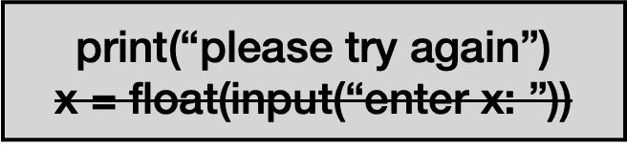
Control Flow Diagrams: “while”
x = input(“enter x: ”)
x = float(x)
x < 0
False
True
print(“the square root:”)
print(math.sqrt(x))
what does this loop do? (note crossed out line)
print(“exiting”)

Slide 15
Control Flow Diagrams: “while”
x = input(“enter x: ”)
x = float(x)
x < 0
False
True
print(“the square root:”)
print(math.sqrt(x))
runs forever! called an “infinite loop”
print(“exiting”)

Slide 16
Control Flow Diagrams: “while”
To avoid infinite loops, make sure something will/can
eventually happen in the body to change the condition
x = input(“enter x: ”)
x = float(x)
x < 0
False
True
print(“the square root:”)
print(math.sqrt(x))
print(“please try again”)
x = float(input(“enter x: ”))
print(“exiting”)

Slide 17
Today's Outline
Control Flow Diagrams
Basic syntax for “while”
        Examples

Slide 18
Syntax
x = int(input(“enter x: “))
  if x < 0:
  x = int(input(“please try again: ”))
Syntax for “if”

Slide 19
Syntax
x = int(input(“enter x: “))
  while x < 0:
  x = int(input(“please try again: ”))
Syntax for “while loop” is just like for “if”, just replace “if” with “while”
This example gives user an arbitrary number of tries
until they get it right

Slide 20
Control Flow
  while CONDITION:
  # your code

Slide 21
Control Flow
  while CONDITION:
  code after the loop…
block of code…
maybe many lines…

Slide 22
Control Flow
  while CONDITION:
  code after the loop…
block of code…
maybe many lines…

Slide 23
Control Flow
at end, always go
back to condition check
  while CONDITION:
  code after the loop…
True
block of code…
maybe many lines…
False

Slide 24
Steps to follow
Whenever you write a while loop, keep these in mind:
Initialize your loop condition variable
a) Update your loop condition variable in loop body
  b) Make progress towards eventually turning your loop condition to False

Slide 25
Congrats!
You now understand the 4 key Flow of Execution ideas,
in the context of Python.
1. generally, proceed forward, one step at a time
2. sometimes go run a “mini program” somewhere else before continuing to the next line
This is a function call
3. sometimes skip forward over some lines of code
Conditional or while loop, when the condition is false
4. sometimes go back to a previous line of code
while loop. When at the end of body, always go back to condition
three primary exceptions to the general case (1)

Slide 26
Today's Outline
Control Flow Diagrams
Basic syntax for “while”
        Examples

Slide 27
Example: Countdown Timer
how many seconds? 5
5
4
3
2
1
DING DING DING DING DING!
use time.sleep(1)

Slide 28
Example: Checkers
write a loop to draw the following:
# # # # #
# # # # #
# # # # #
# # # # #
# # # # #
# # # # #
height
width

Slide 29
Example: Border
write a loop to draw the following:
##########
# #
# #
# #
# #
##########
height
width

Slide 30
Example: Snake
write a loop to draw the following:
##########
#
##########
#
##########
#
##########
#
height
width

Slide 31
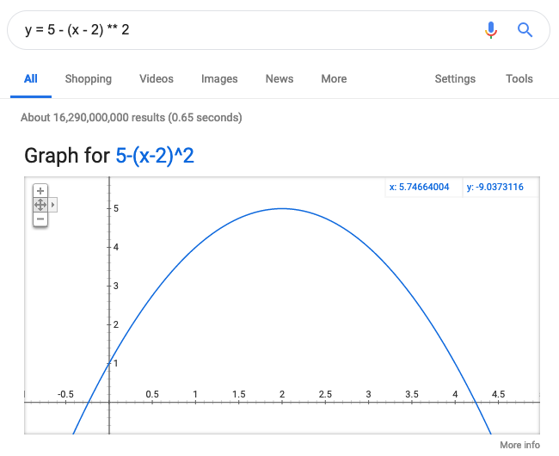
Example: Maximum (Finding the Peak)
where does this curve peak?

Slide 32
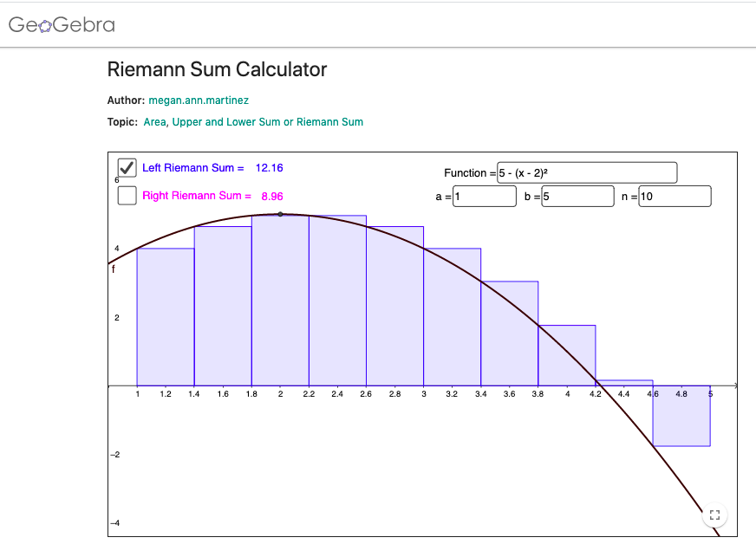
Example: Integration (Riemann Sum)

Slide 33
Example: Prime Finder
Prime numbers:
2 is prime
3 is prime
4 is not prime
5 is prime
6 is not prime
7 is prime
8 is not prime
9 is not prime
…

Slide 34
Challenge: Countdown Timer
how many seconds? 5
5
4
3
2
1
DING DING DING DING DING!
how many seconds? 2
2
1
0
DING DING DING DING DING!
how many seconds? q
good bye!
use time.sleep(1)
exit program
this program should involve a nested loop!!!

Slide 35
Challenge: Battleship
columns
..........
..........
..*+***...
..........
........*.
........*.
..........
....*.....
....*.....
....*.....
show where ship(s) are after guess
guess and ship: +
just ship: *
guess and miss: -
blank spot: .
rows

