Slide 1
[220 / 319] Error Handling
Exam2 conflict form – fill by today
Meena Syamkumar
Andy Kuemmel
Cole Nelson
Readings:
Chapter 11 of Sweigart book

Slide 2
Learning Objectives Today
Explain the purpose of assert statements, try/except blocks, and raise statements
Use an assert statement to force a program to crash, and trace code that uses assert.
Use try/except blocks to catch runtime errors and deal with them
by specifying the exception(s) caught
by using the exception object
Use the raise statement to raise an exception that may be caught in another part of the program
Hand trace code that uses assert, try/except blocks and raise statements

Slide 3


Today’s theme
https://en.wikipedia.org/wiki/Pizza
https://en.wikipedia.org/wiki/Grace_Hopper

Slide 4
Example: Pizza Analyzer
import math
def pizza_size(radius):
return (radius ** 2) * math.pi
def slice_size(radius, slice_count):
total_size = pizza_size(radius)
return total_size * (1 / slice_count)
def main():
for i in range(10):
# grab input
args = input("Enter pizza diameter(inches), slice count): ")
args = args.split(',')
radius = float(args[0].strip()) / 2
slices = int(args[1].strip())
# pizza analysis
size = slice_size(radius, slices)
print('PIZZA: radius={}, slices={}, slice square inches={}'
.format(radius, slices, size))
main()
Exercise: what are possible bad inputs for
diameter
slice count
other?
Does it cause a runtime error or semantic error?

Slide 5
Assert
Syntax:
        assert BOOLEAN_EXPRESSION
Purpose:
Force program to crash if something is non-sensible, rather than run and produce garbage.
semantic errors
(hard to debug)
runtime errors
(easier to debug)

Slide 6
Assert
Warning: sometimes people disable
assertions when running your code
to improve performance
Syntax:
        assert BOOLEAN_EXPRESSION
True
False
Crash!
nothing happens
Enter pizza diameter(inches), slice count): -10, 8
Traceback (most recent call last):
File "pizza.py", line 24, in <module>
main()
File "pizza.py", line 20, in main
size = slice_size(radius, slices)
File "pizza.py", line 8, in slice_size
total_size = pizza_size(radius)
File "pizza.py", line 4, in pizza_size
assert(radius > 0)
AssertionError

Slide 7
Assert
Syntax:
        assert BOOLEAN_EXPRESSION
Examples:
  assert x > 0
  assert items != None
  assert “age” in person
  assert len(nums) % 2 == 1
Pizza Example: add asserts to crash upon
diameter <= 0
slices <= 0

Slide 8
What if we want to keep running even if there is an error?

Slide 9
Try/Except
Syntax:
        flaky_function()

Slide 10
Try/Except
Syntax:
try:
flaky_function()
except:
print(“error!”) # or some other handling

Slide 11
Try/Except
Syntax:
Description:
try and except blocks come in pairs (runtime errors are “exceptions”)
try:
flaky_function()
except:
print(“error!”) # or some other handling

Slide 12
Try/Except
Syntax:
Description:
try and except blocks come in pairs (runtime errors are “exceptions”)
Python tries to run the code in the try block. If there’s an exception,
it just runs the except block (instead of crashing). This is called “catching” the exception.
If there is no exception, the except block does not run.
try:
flaky_function()
except:
print(“error!”) # or some other handling

Slide 13
Try/Except
Pizza Example: try/except to continue running upon
parse errors
analysis errors
Syntax:
Description:
try and except blocks come in pairs (runtime errors are “exceptions”)
Python tries to run the code in the try block. If there’s an exception,
it just runs the except block (instead of crashing). This is called “catching” the exception.
If there is no exception, the except block does not run.
try:
flaky_function()
except:
print(“error!”) # or some other handling

Slide 14
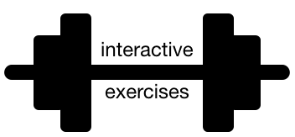
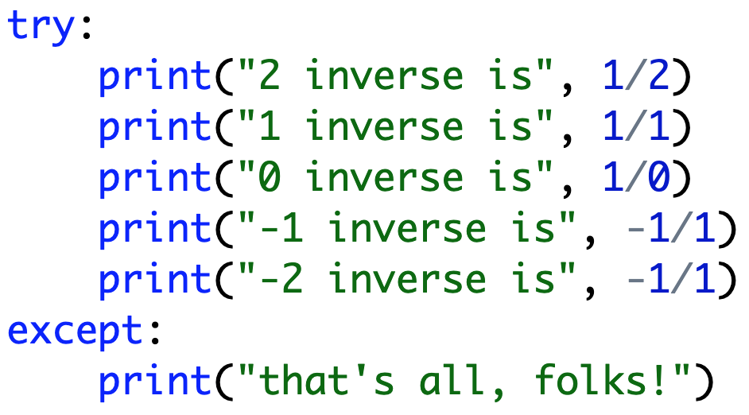
Exceptions are Exceptions to Regular Control Flow
never runs

Slide 15
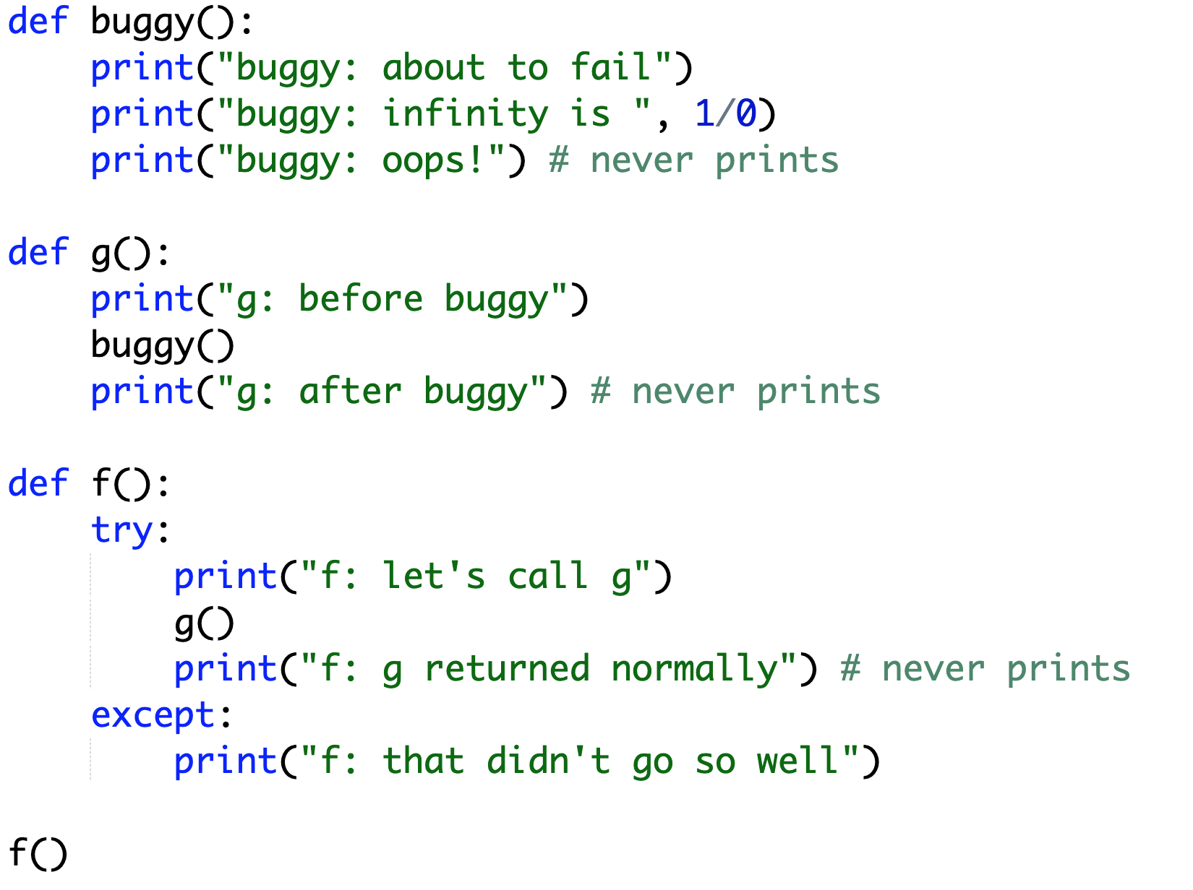
Exceptions are Exceptions to Regular Control Flow
Try this example in notebook or script format

Slide 16
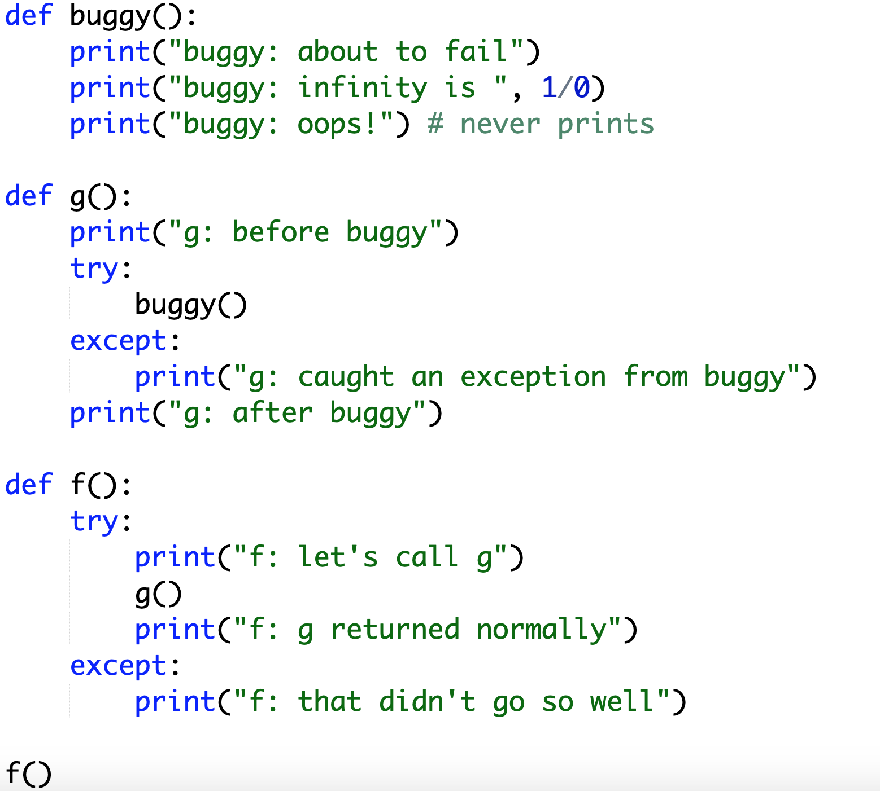
Exceptions are Exceptions to Regular Control Flow
g catches, so f never knows about the exception
Try this example in notebook or script format

Slide 17
What if we want to know the reason for the exception?

Slide 18
Crash Cause
Version 1:
Version 2:
try:
flaky_function()
except:
print(“error!”) # or some other handling
get exception object
describing the problem
try:
flaky_function()
except Exception as e:
print(“error because:”, str(e))

Slide 19
Crash Cause
Pizza Example: print failure reasons
for parse errors
for analysis errors
Version 1:
Version 2:
try:
flaky_function()
except:
print(“error!”) # or some other handling
e is of type Exception (very general)
(there are different types of exceptions)
get exception object
describing the problem
try:
flaky_function()
except Exception as e:
print(“error because:”, str(e))
why it failed

Slide 20
What if we only want to catch certain exceptions?

Slide 21
Narrow Catching
Version 2:
Version 3:
try:
flaky_function()
except Exception as e:
print(“error because:”, str(e))
try:
flaky_function()
except (ValueError, IndexError) as e:
print(“error because:”, str(e))

Slide 22
Narrow Catching
Pizza Example: catch only real parse errors
strings when want ints
not enough values
NOT typos in variable names
Version 2:
Version 3:
try:
flaky_function()
except Exception as e:
print(“error because:”, str(e))
only catch these two
(not NameError and others)
try:
flaky_function()
except (ValueError, IndexError) as e:
print(“error because:”, str(e))
General Rule: always catch specific types of exceptions,
and/or make sure the user knows there was an error
(unexpected silent errors are the worst!)

Slide 23
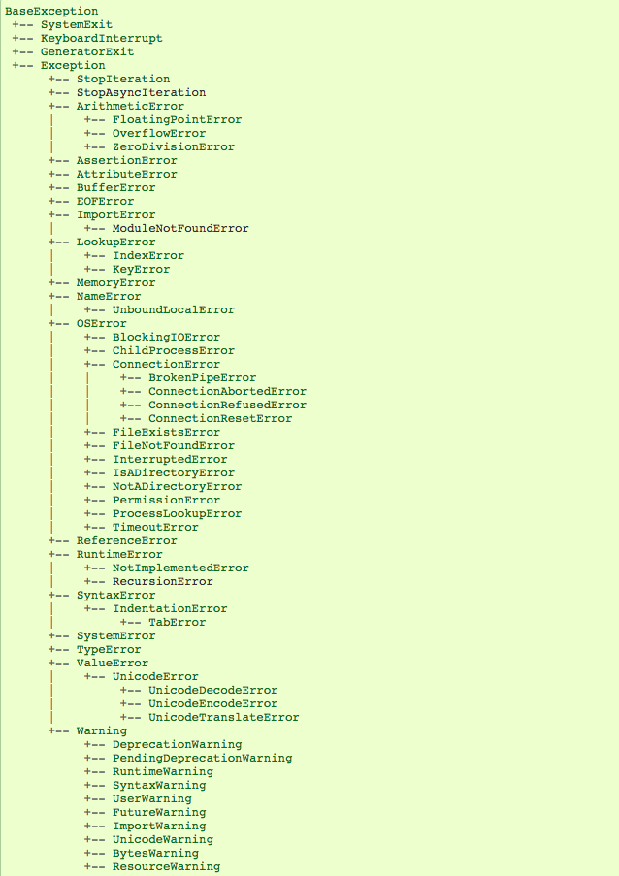
Exception Hierarchy
        Documentation:
        https://docs.python.org/3/library/exceptions.html#exception-hierarchy
screenshot
of hierarchy

Slide 24
What if we want to produce a specific kind of error? (not just an assert)

Slide 25
Custom Errors
BaseException
+-- Exception
+-- ArithmeticError
| +-- FloatingPointError
| +-- OverflowError
| +-- ZeroDivisionError
+-- AssertionError
+-- AttributeError
+-- TypeError
+-- ValueError

Slide 26
Asserts vs. Raising Exception Objects
Version 1 (quick and dirty):
        def slice_size(radius, slice_count):
        assert radius > 0
        return pizza_size(radius) / slice_count
Version 2 (more robust and informative):
        def slice_size(radius, slice_count):
        if radius <= 0:
        raise ArithmeticError(“number of slices <= 0”)
        return pizza_size(radius) / slice_count
tell Python this exception
occurred here
with this message
create TypeError object

Slide 27
Summary
Asserts
force a crash/exception
better to crash in an obvious way than to use corrupt data
Exceptions
produce them with raise
catch them with try/except
can choose specific types of exceptions
General Rule: always catch specific types of exceptions,
and/or make sure the user knows there was an error
(unexpected silent errors are the worst!)

