Slide 1
[320] Branching and Merging
Meenakshi Syamkumar

Slide 2
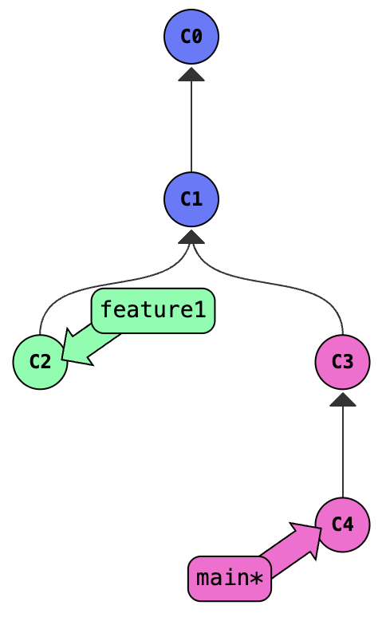
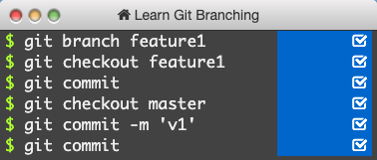
Practice Branching
Git equivalent of PythonTutor:
https://www.msyamkumar.com/cs320/learnGitBranching/index.html

Slide 3
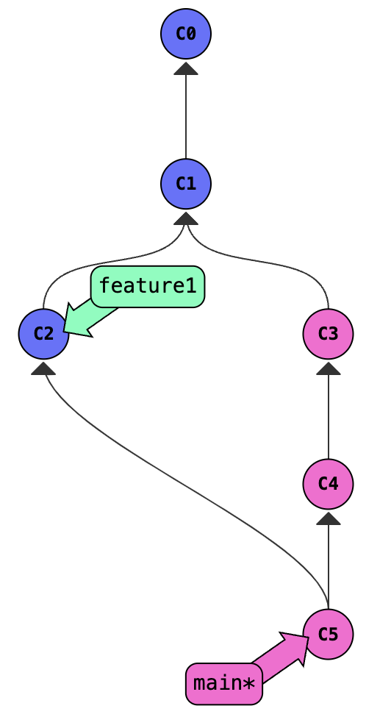
Merging without Conflicts
Switch branch
git merge frombranch
add whatever is there to the current branch
tip (or learn vim): export EDITOR=nano
Notes:
do the same thing with feature1, but in an actual repo

Slide 4
Merging with Conflicts
What happens when two people try to fix the same issue, in two different (incompatible) ways?
main branch
paper.txt
My bike which has a broken seat is in the garage
time
https://www.grammarly.com/blog/which-vs-that/

Slide 5
Merging with Conflicts
What happens when two people try to fix the same issue, in two different (incompatible) ways?
paper.txt
main branch
My bike, which has a broken seat, is in the garage.
paper.txt
My bike which has a broken seat is in the garage
paper.txt
My mountain bike that has a broken seat is in the garage
that branch
time
https://www.grammarly.com/blog/which-vs-that/

Slide 6
Merging with Conflicts
What happens when two people try to fix the same issue, in two different (incompatible) ways?
paper.txt
main branch
paper.txt
My bike, which has a broken seat, is in the garage.
My mountain bike, which has a broken seat, is in the garage.
paper.txt
My bike which has a broken seat is in the garage
paper.txt
My mountain bike that has a broken seat is in the garage
needs manual conflict resolution because only a human knows what is intended
that branch
time
https://www.grammarly.com/blog/which-vs-that/

Slide 7
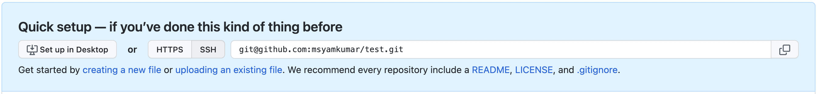
Remotes
We will often want to work on our laptops, but also have our repositories on GitHub (or similar)
Create GitHub account, go here: https://github.com/new
Pushing a branch to GitHub
git remote add github https://github.com/msyamkumar/test.git
git push github main
remote
name
branch
name
see reading about naming in software

Slide 8
Summary of Terms
commit: a snapshot of files at a point in time
HEAD: a convenient label for the current commit
tag: a long-term label associated with a commit
branch: a label attached to a commit that re-attaches to new commits
merge: to combine changes on another branch into the current branch
conflict: differences that cannot automatically be merged

Slide 9
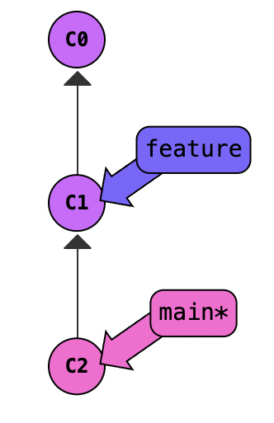
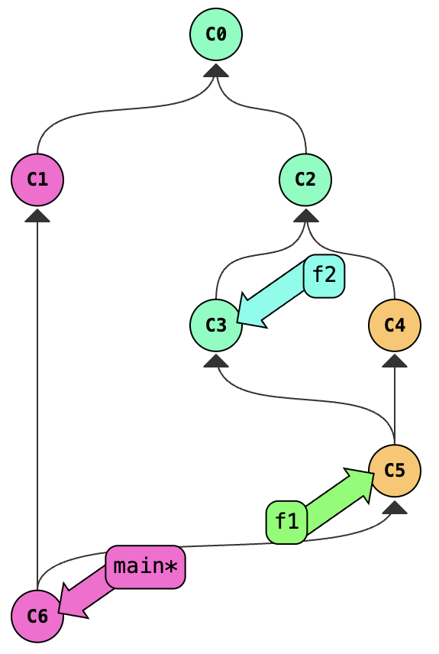
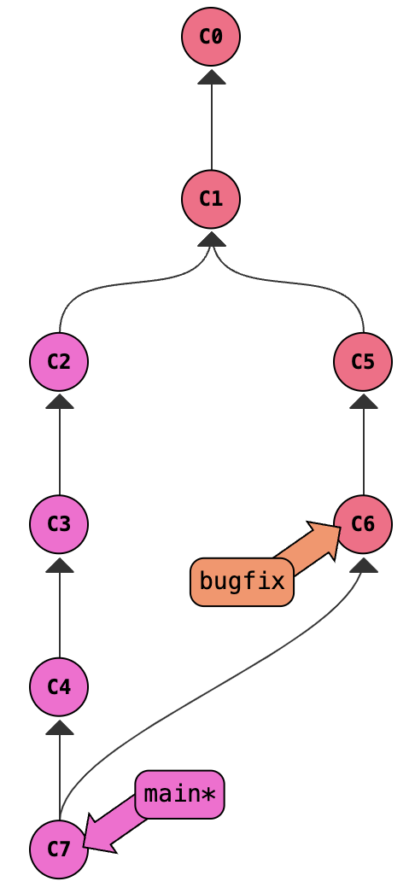
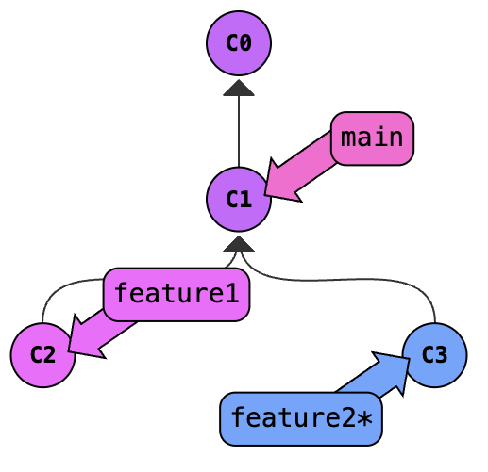
Challenges (figure out how to reproduce):

