Slide 1
[320] Object Oriented Programming
Yiyin Shen

Slide 2
Creating New Types

Slide 3
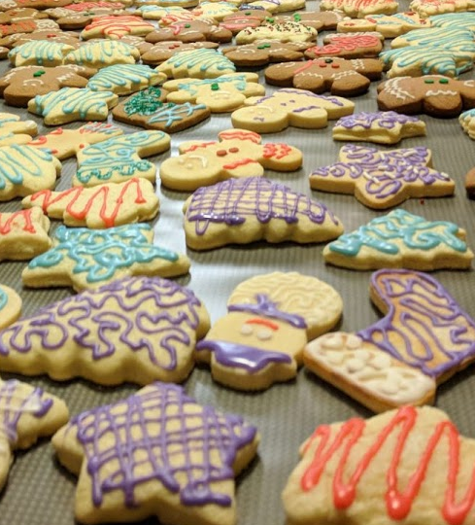
Classes and Other Types
Objects
list
dict
movie
str
person
player
https://www.macys.com/shop/product/martha-stewart-collection-set-of-6-cookie-cutters-created-for-macys?ID=5467270

Slide 4
Classes

Slide 5
dicts can represent many kinds of things
https://earthquake.usgs.gov/fdsnws/event/1/query?format=geojson&starttime=2021-09-21&endtime=2021-09-22
classes (today) are often a better option when all your keys are the same

Slide 6
create some objects
of type dict for movies
m1 = {...}
m2 = {...}
p1 = {}
p2 = {}
p3 = dict()
p1["Fname"] = "Joseph"
p2["fname"] = "Peyman"
p3["fname"] = "Shri Shruthi"
print(type(m1))
print(type(p1))
create some objects
of type dict for people
set some keys/values

Slide 7
class Person:
pass
p1 = Person()
p2 = Person()
p3 = Person()
p1.Fname = "Joseph"
p2.fname = "Peyman"
p3.fname = "Shri Shruthi"
print(type(p3))
create a Person
type/class
create some objects
of type Person
set some attributes
Objects created from classes are mutable.
Attribute names are not fixed at creation.

Slide 8
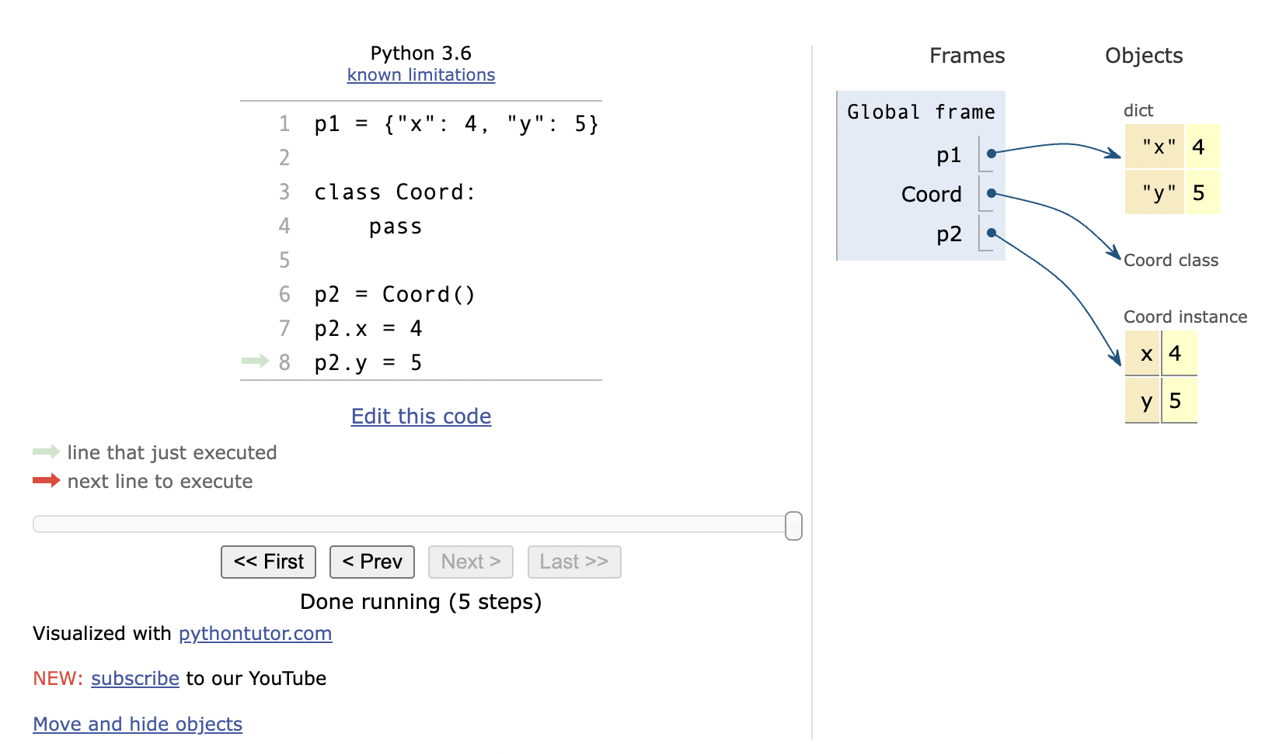
PythonTutor: Compare dicts to class types

Slide 9
Coding Examples: Animal Classes
Principals
objects and functions
methods
checking object type
type-based dispatch
receiver (self parameter)
constructors

