Slide 1
[320] Machine Learning: Intro
Meenakshi Syamkumar

Slide 2
Functions/Models

Slide 3
How do we make functions?
programmer
write code
function
inputs
output(s)

Slide 4
How do we make functions?
programmer
write code
beds | baths | year
2 | 1 | 1985
function
predicted price
$190K
many functions are models that can be used to predict

Slide 5
How do we make functions?
programmer
write code
beds | baths | year
2 | 1 | 1985
3 | 1 | 1998
4 | 3 | 2005
4 | 2 | 2020
predicted price
$190K
$254K
$328K
$343K
function
many functions are models that can be used to predict

Slide 6
How do we make functions?
Machine Learning Algorithm
train
beds | baths | year
2 | 1 | 1985
3 | 1 | 1998
4 | 3 | 2005
4 | 2 | 2020
predicted price
$190K
$254K
$328K
$343K
function
many functions are models that can be used to predict

Slide 7
How do we make functions?
training data
beds | baths | year | price
1 | 1 | 1980 | $140K
3 | 1 | 1990 | $240K
3 | 4 | 2004 | $295K
4 | 3 | 2018 | $350K
Machine Learning Algorithm
live data
train
beds | baths | year
2 | 1 | 1985
3 | 1 | 1998
4 | 3 | 2005
4 | 2 | 2020
predicted price
$190K
$254K
$328K
$343K
function
many functions are models that can be used to predict

Slide 8
How do we make functions?
training data
beds | baths | year | price
1 | 1 | 1980 | $140K
3 | 1 | 1990 | $240K
3 | 4 | 2004 | $295K
4 | 3 | 2018 | $350K
Machine Learning Algorithm
live data
train
beds | baths | year
2 | 1 | 1985
3 | 1 | 1998
4 | 3 | 2005
4 | 2 | 2020
predicted price
$190K
$254K
$328K
$343K
function
this is an example of a regression model, which in a type of supervised machine learning, which is one of the 3 main categories of ML

Slide 9
Machine Learning
Reinforcement Learning
https://en.wikipedia.org/wiki/Reinforcement_learning
not covered in CS 320
Supervised Machine Learning
data is labeled, we know what we want to predict
Unsupervised Machine Learning
data is unlabeled, we're just looking for patterns

Slide 10
Machine Learning
Reinforcement Learning
https://en.wikipedia.org/wiki/Reinforcement_learning
not covered in CS 320
Regression
Supervised Machine Learning
predict a quantity
data is labeled, we know what we want to predict
Classification
predict a category
Unsupervised Machine Learning
Clustering
place rows in groups
data is unlabeled, we're just looking for patterns
Decomposition
represent rows as combos of "component" rows

Slide 11
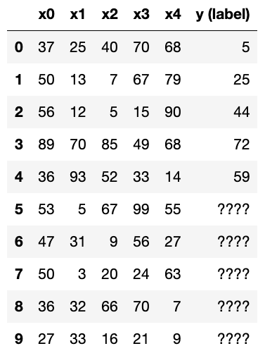
1. Regression (Supervised)
features
problem: can we predict an unknown quantity based on features?

Slide 12
1. Regression (Supervised)
model
train: fit a model to the relationship between some label (y) and feature (x's) values

Slide 13

1. Regression (Supervised)
model
70
60
test: make some predictions for known rows -- how close are we?

Slide 14
1. Regression (Supervised)
model
predict: estimate for actual unknowns

Slide 15
1. Regression (Supervised)
90
model
85
25
33
21
predict: estimate for actual unknowns

Slide 16
1. Regression (Supervised)
90
85
25
model
33
21
interpret: what can we learn by looking directly at the model?

Slide 17
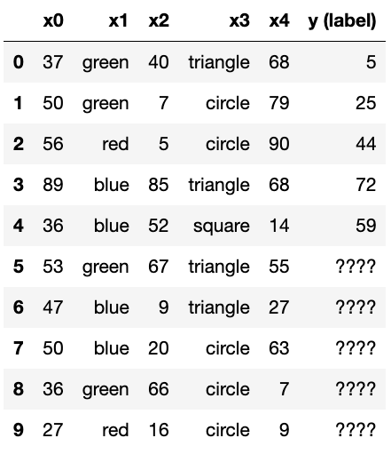
categorical
features
quantitative
label
1. Regression (Supervised)
a problem with some categorical features is
still a regression as long as the lable is quantitative

Slide 18
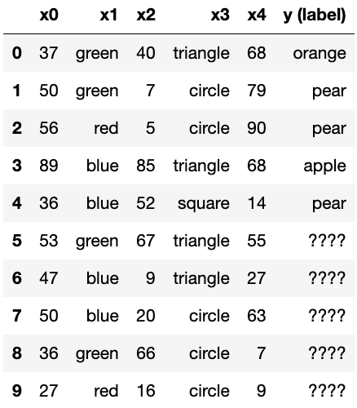
categorical
label
2. Classification (Supervised)
problem: can we predict an unknown category?

Slide 19
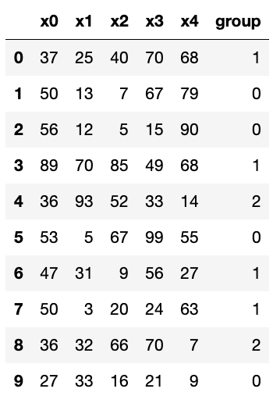
no
label!
3. Clustering (Unsupervised)
problem: can we organize data into groups of similar rows?

Slide 20
the algorithm
decides groups
3. Clustering (Unsupervised)
group 0
group 1
group 2
there is no official grouping to check the model against,
but a good grouping places similar rows together

Slide 21
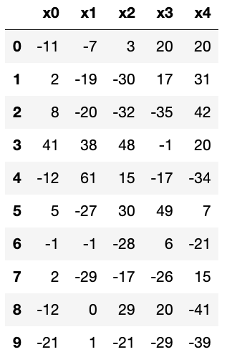
4. Decomposition (Unsupervised)

Slide 22
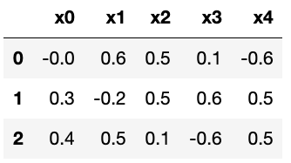
4. Decomposition (Unsupervised)
original data
components
-11
21
-8

Slide 23
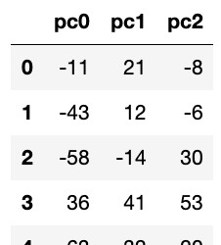
4. Decomposition (Unsupervised)
original data
components
-11
21
-8
weights
...

Slide 24
4. Decomposition (Unsupervised)
original data
components
-43
12
-6
weights
...

Slide 25
Machine Learning
Reinforcement Learning
https://en.wikipedia.org/wiki/Reinforcement_learning
not covered in CS 320
Regression
Supervised Machine Learning
predict a quantity
data is labeled, we know what we want to predict
Classification
predict a category
Unsupervised Machine Learning
Clustering
place rows in groups
data is unlabeled, we're just looking for patterns
Decomposition
represent rows as combos of "component" rows
this semester, we'll learn at least one technique in each of these four categories

Slide 26
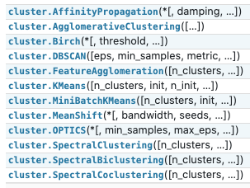
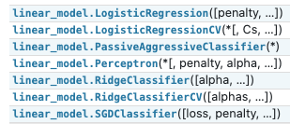

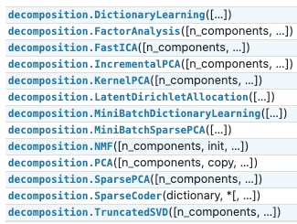



1. Regression (Supervised)
3. Clustering (Unsupervised)
+
2. Classification (Supervised)
classification!
4. Decomposition (Unsupervised)
scikit-learn machine learning modules: https://scikit-learn.org/stable/modules/classes.html

Slide 27
Foundations: Modules and Math

Slide 28
Important Packages
We'll be learning the following to do ML and related calculations efficiently:
1
numpy
2
pytorch
3
scikit-learn
pip3 install numpy scikit-learn
pip3 install torch==1.4.0+cpu torchvision==0.5.0+cpu -f https://download.pytorch.org/whl/torch_stable.html

Slide 29
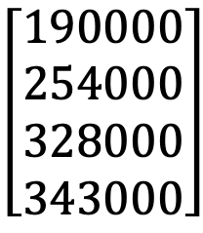
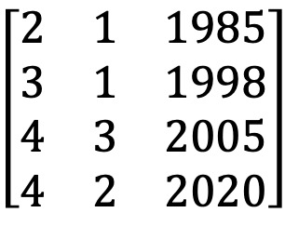
Linear Algebra
beds | baths | year
2 | 1 | 1985
3 | 1 | 1998
4 | 3 | 2005
4 | 2 | 2020
predicted price
$190K
$254K
$328K
$343K
function
with matrices...
$$\left[\begin{matrix}2 & 1 & 1985 \\ 3 & 1 & 1998 \\ 4 & 3 & 2005 \\ 4 & 2 & 2020\end{matrix}\right]$$
y = Xc + b
$$\left[\begin{aligned}190000 \\ 254000 \\ 328000 \\ 343000\end{aligned}\right]$$

Slide 30

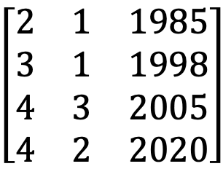
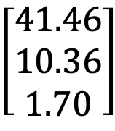
Linear Algebra
beds | baths | year
2 | 1 | 1985
3 | 1 | 1998
4 | 3 | 2005
4 | 2 | 2020
predicted price
$190K
$254K
$328K
$343K
function
with matrices...
$$\left[\begin{matrix}2 & 1 & 1985 \\ 3 & 1 & 1998 \\ 4 & 3 & 2005 \\ 4 & 2 & 2020\end{matrix}\right]$$
y = Xc + b
$$\left[\begin{aligned}190000 \\ 254000 \\ 328000 \\ 343000\end{aligned}\right]$$
X
c
$$\left[\begin{matrix}2 & 1 & 1985 \\ 3 & 1 & 1998 \\ 4 & 3 & 2005 \\ 4 & 2 & 2020\end{matrix}\right]$$
$$\left[\begin{aligned}41.46 \\ 10.36 \\ 1.70\end{aligned}\right]$$
b
⋅
$$+−3277.31$$
*dot product is usually between vectors by definition, but numpy uses np.dot for matrix multiplication
dot product*

Slide 31
Linear Algebra
beds | baths | year
2 | 1 | 1985
3 | 1 | 1998
4 | 3 | 2005
4 | 2 | 2020
predicted price
$190K
$254K
$328K
$343K
function
with matrices...
$$\left[\begin{matrix}2 & 1 & 1985 \\ 3 & 1 & 1998 \\ 4 & 3 & 2005 \\ 4 & 2 & 2020\end{matrix}\right]$$
y = Xc + b
$$\left[\begin{aligned}190000 \\ 254000 \\ 328000 \\ 343000\end{aligned}\right]$$
X
c
x
c
x
c
x
c
b
$$\left[\begin{matrix}2 & 1 & 1985 \\ 3 & 1 & 1998 \\ 4 & 3 & 2005 \\ 4 & 2 & 2020\end{matrix}\right]$$
$$\left[\begin{aligned}41.46 \\ 10.36 \\ 1.70\end{aligned}\right]$$
b
2 * 41.46 + 1 * 10.36 + 1985 * 1.7 - 3277.31
⋅
$$+−3277.31$$
= 190000
y
dot product

Slide 32
Linear Algebra
beds | baths | year
2 | 1 | 1985
3 | 1 | 1998
4 | 3 | 2005
4 | 2 | 2020
predicted price
$190K
$254K
$328K
$343K
function
with matrices...
$$\left[\begin{matrix}2 & 1 & 1985 \\ 3 & 1 & 1998 \\ 4 & 3 & 2005 \\ 4 & 2 & 2020\end{matrix}\right]$$
y = Xc + b
$$\left[\begin{aligned}190000 \\ 254000 \\ 328000 \\ 343000\end{aligned}\right]$$
X
c
x
c
x
c
x
c
b
$$\left[\begin{matrix}2 & 1 & 1985 \\ 3 & 1 & 1998 \\ 4 & 3 & 2005 \\ 4 & 2 & 2020\end{matrix}\right]$$
$$\left[\begin{aligned}41.46 \\ 10.36 \\ 1.70\end{aligned}\right]$$
b
3 * 41.46 + 1 * 10.36 + 1998 * 1.7 - 3277.31
⋅
$$+−3277.31$$
= 254000
y
dot product

Slide 33
Linear Algebra
beds | baths | year
2 | 1 | 1985
3 | 1 | 1998
4 | 3 | 2005
4 | 2 | 2020
predicted price
$190K
$254K
$328K
$343K
function
with matrices...
$$\left[\begin{matrix}2 & 1 & 1985 \\ 3 & 1 & 1998 \\ 4 & 3 & 2005 \\ 4 & 2 & 2020\end{matrix}\right]$$
y = Xc + b
$$\left[\begin{aligned}190000 \\ 254000 \\ 328000 \\ 343000\end{aligned}\right]$$
note! Some resources will use A instead of X and x instead of c
X
c
$$\left[\begin{matrix}2 & 1 & 1985 \\ 3 & 1 & 1998 \\ 4 & 3 & 2005 \\ 4 & 2 & 2020\end{matrix}\right]$$
$$\left[\begin{aligned}41.46 \\ 10.36 \\ 1.70\end{aligned}\right]$$
b
import numpy as np
X = df.values
y = np.dot(X, c) + b
⋅
$$+−3277.31$$
dot product

Slide 34
Linear Algebra
not linear
y = x ** 2
y = x0*4 + x1*(-1) + x2*0.5 + ... + x10*3
linear
with matrices...
$$\left[\begin{matrix}2 & 1 & 1985 \\ 3 & 1 & 1998 \\ 4 & 3 & 2005 \\ 4 & 2 & 2020\end{matrix}\right]$$
y = Xc + b
$$\left[\begin{aligned}190000 \\ 254000 \\ 328000 \\ 343000\end{aligned}\right]$$
X
c
$$\left[\begin{matrix}2 & 1 & 1985 \\ 3 & 1 & 1998 \\ 4 & 3 & 2005 \\ 4 & 2 & 2020\end{matrix}\right]$$
$$\left[\begin{aligned}41.46 \\ 10.36 \\ 1.70\end{aligned}\right]$$
b
import numpy as np
X = df.values
y = np.dot(X, c) + b
⋅
$$+−3277.31$$
dot product

Slide 35
Calculus: Minimizing Something
training data
beds | baths | year | price
1 | 1 | 1980 | $140K
3 | 1 | 1990 | $240K
3 | 4 | 2004 | $295K
Machine Learning Algorithm
train
predicted price
$190K
$254K
$328K
y = Xc + b

Slide 36
Calculus: Minimizing Something
loss function
training data
beds | baths | year | price
1 | 1 | 1980 | $140K
3 | 1 | 1990 | $240K
3 | 4 | 2004 | $295K
loss
how bad are
the predictions?
Machine Learning Algorithm
train
predicted price
$190K
$254K
$328K
y = Xc + b

Slide 37
Calculus: Minimizing Something
loss function
training data
beds | baths | year | price
1 | 1 | 1980 | $140K
3 | 1 | 1990 | $240K
3 | 4 | 2004 | $295K
loss
Machine Learning Algorithm
train
predicted price
$190K
$254K
$328K
y = Xc + b
how do we optimize c to minimize loss?
Important concepts: derivative, gradient
(pytorch can do this)

Slide 38
Conclusion: Developers vs. Users

Slide 39
Conclusion: Our Focus
training data
writing new algorithms
(not our focus)
beds | baths | year | price
1 | 1 | 1980 | $140K
3 | 1 | 1990 | $240K
3 | 4 | 2004 | $295K
4 | 3 | 2018 | $350K
Machine Learning Algorithm
live data
train
beds | baths | year
2 | 1 | 1985
3 | 1 | 1998
4 | 3 | 2005
4 | 2 | 2020
predicted price
$190K
$254K
$328K
$343K
function

Slide 40
Conclusion: Our Focus
how can we clean this up?
training data
which algorithm (from sklearn?) should we pick, and how should we configure it?
beds | baths | year | price
1 | 1 | 1980 | $140K
3 | 1 | 1990 | $240K
3 | 4 | 2004 | $295K
4 | 3 | 2018 | $350K
Machine Learning Algorithm
is it working well? (evaluation)
live data
train
beds | baths | year
2 | 1 | 1985
3 | 1 | 1998
4 | 3 | 2005
4 | 2 | 2020
predicted price
$190K
$254K
$328K
$343K
function

