Slide 1
[220] Using Functions
Meena Syamkumar
Mike Doescher

Slide 2
Learning Objectives Today
How to call functions
input/output
Modules:
import styles
attribute operator (the ".")
math module
Inspection:
discover functions in a module
learn what function does
Please read Ch 3
of Think Python
make a battleship game!

Slide 3
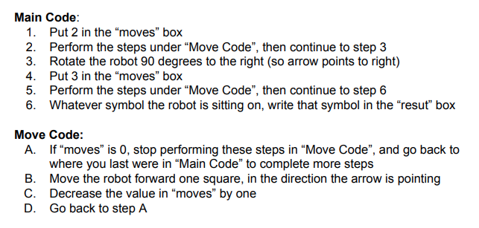
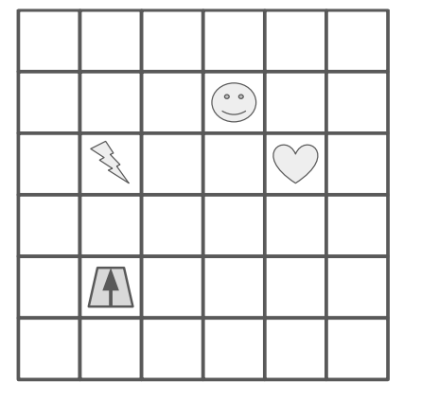
“Move Code” is a function
Functions are like “mini programs”,
as in our robot worksheet problem

Slide 4
we’ll learn about how to give functions input by passing arguments (e.g., 2) to parameters (e.g., moves)
today we’ll learn how to use functions in Python
we’ll also learn how to ask functions
questions and get answers called return values
next lecture, we’ll learn how to write our own new functions
Functions are like “mini programs”,
as in our robot worksheet problem

Slide 5
Vocabulary
...
General Function Concepts
Some Code
...
code
...
code
Yikes, copied code!
...

Slide 6
Vocabulary
refactor: change organization of code (e.g., to avoid repetition)
parameter: variable that receives input to function
argument: value sent to a function (lines up with parameter)
return value (or result): function output sent back to calling code
A Function
param1
param2
return
inputs
outputs
Some Code
...
arg1
arg2
result
...
call/invoke
...

Slide 7
Vocabulary
refactor: change organization of code (e.g., to avoid repetition)
parameter: variable that receives input to function
argument: value sent to a function (lines up with parameter)
return value (or result): function output sent back to calling code
default argument: value put in parameter if argument not passed
A Function
param1
param2
return
inputs
default
outputs
Some Code
...
arg1
result
...
call/invoke
...

Slide 8
Vocabulary
refactor: change organization of code (e.g., to avoid repetition)
parameter: variable that receives input to function
argument: value sent to a function (lines up with parameter)
return value (or result): function output sent back to calling code
default argument: value put in parameter if argument not passed
named/keyword argument: argument explicitly tied to a parameter
A Function
param1
param2
return
inputs
default
outputs
Some Code
...
param1 = arg1
result
...
call/invoke
...

Slide 9
print(“hello”) result = f(x)
Calling/Invoking a Function in Python
ALWAYS: function’s name

Slide 10
print(“hello”) result = f(x)
Calling/Invoking a Function in Python
ALWAYS: function’s name
ALWAYS: followed by parentheses

Slide 11
print(“hello”) result = f(x)
Calling/Invoking a Function in Python
arguments
ALWAYS: function’s name
ALWAYS: followed by parentheses
SOMETIMES: with one or more arguments

Slide 12
print(“hello”) result = f(x)
Calling/Invoking a Function in Python
return value
ALWAYS: function’s name
ALWAYS: followed by parentheses
SOMETIMES: with one or more arguments
SOMETIMES: producing a result

Slide 13
print(“hello”, “world”) x = input()
Calling/Invoking a Function in Python
ALWAYS: function’s name
ALWAYS: followed by parentheses
SOMETIMES: with one or more arguments
SOMETIMES: producing a result

Slide 14
demos

Slide 15
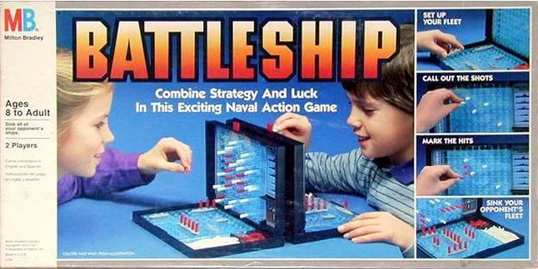
Battleship Demo (Version 1)
https://boardgamegeek.com/image/288374/battleship
x
guess 2,1
(miss!)
Version 1 (MVP)
1 ship, 1 guess
ship is 1 space
fixed position
top/left is 0,0
horrible graphics
........
..0.....
........
........
........
........
........
........
........
........
........
........
........
........
........
.......1
y
guess 7,7
(hit!)

Slide 16
Types of modules (collections of functions)
1
built into Python (__builtins__ module). print(), type(), ...
2
pre-installed with Python (e.g., math). sin, log, max, ...
3
installed with pip (e.g. jupyter)
4
written yourself (a .py file)

Slide 17
Types of modules (collections of functions)
1
built into Python (__builtins__ module). print(), type(), ...
2
pre-installed with Python (e.g., math). sin, log, max, ...
3
installed with pip (e.g. jupyter)
from math import *
4
OR
written yourself (a .py file)
from math import log
OR
import math

Slide 18
demos

Slide 19
Battleship Demo (Version 2)
Version 1 (MVP)
1 ship, 1 guess
ship is 1 space
fixed position
top/left is 0,0
horrible graphics
Version 2
larger ship
multiple ships
random locations
https://boardgamegeek.com/image/288374/battleship
guess 2,1
(miss!)
........
..0.....
........
........
........
........
........
........
........
........
........
........
........
........
........
.......1
guess 7,7
(hit!)
time permitting

Slide 20
Demo: Polar Coords Distance
3
5
0
4
point 1: distance 3 at angle 90°
distance: 5
point 2: distance 4 at angle 0°
time permitting

