Slide 1
[320] Inheritance
Meenakshi Syamkumar

Slide 2
Review

Slide 3
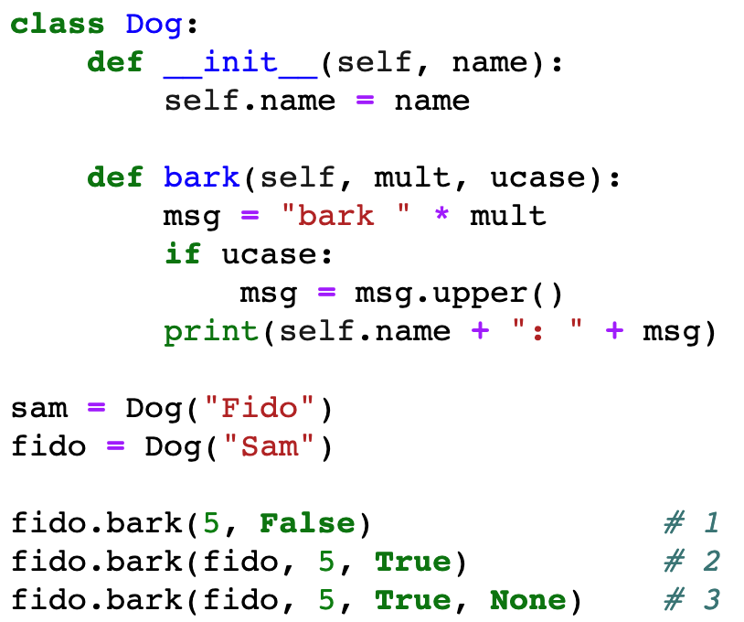
Review Classes + Special Methods
which call produces the following error?
TypeError: bark() takes 3 positional arguments but 4 were given

Slide 4
Review Classes + Special Methods
which call is correct?

Slide 5
Review Classes + Special Methods
what is printed?
Fido: bark bark bark bark bark
Fido: BARK BARK BARK BARK BARK
Sam: bark bark bark bark bark

Slide 6
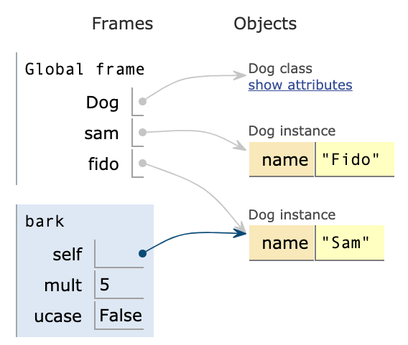
Review Classes + Special Methods
what is printed?
Fido: bark bark bark bark bark
Fido: BARK BARK BARK BARK BARK
Sam: bark bark bark bark bark

Slide 7
Review Classes + Special Methods
Special methods usually get called
explicitly
implicitly
What does print(...) use to represent an object?
__str__
__repr__
_repr_html_
What special method must be implemented for sorting to work?
__repr__
__order__
__lt__
__gt__

Slide 8
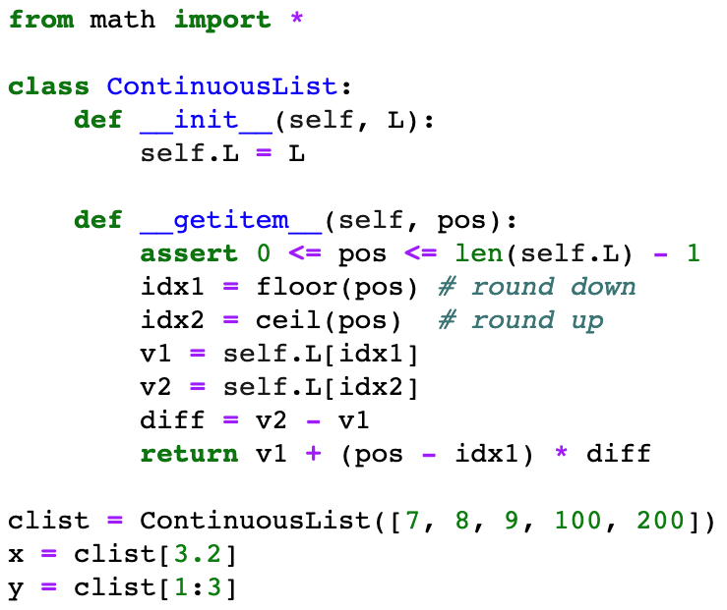
Review Classes + Special Methods: Self study
what will x be? (there won't be an error)

Slide 9
Review Classes + Special Methods: Self study
what will pos be? (there will be an error)

Slide 10
Inheritance

Slide 11
Types, Sub Types, and Objects
namedtuple
hierarchy of types
Person
Hurricane
????
objects
classes (and types in general) form a hierarchy

Slide 12
Types, Sub Types, and Objects
object
namedtuple
hierarchy of types
Person
Hurricane
????
objects
weird naming: the top type is called "object"

Slide 13
Types, Sub Types, and Objects
object
Dog
Person
parent class / base class
hierarchy
of types
child class / sub class
CoursePerson
Employee
Student
Instructor
TA
Admin
Janitor
objects
we can design the hierarchy with inheritance

Slide 14
Types, Sub Types, and Objects
object
Dog
Person
CoursePerson
Employee
Student
Instructor
TA
Admin
Janitor
multiple inheritance

Slide 15
Coding Examples
Principals
method inheritance
method resolution order
overriding methods, constructor
calling overridden methods
abc's (abstract base classes)

