Slide 1
[220] Function Scope
Meena Syamkumar
Mike Doescher

Slide 2
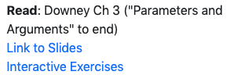
Learning Objectives Today
Understand local variables
When are they created?
When do they die?
When are they shared?
Where are they stored? (frames)
Understand global variables
How are they accessed? (global keyword)
Where are they stored? (global frame)
Understand argument passing
Meaning of “pass by value”
don't memorize the examples,
learn the rules of Python
good question: why did PyTutor
do this thing I didn't expect
at this specific line (ask us!)

Slide 3
Today's Outline
Context
Examples
Frames
        Demos: Local Variables
Demos: Global Variables
Demos: Argument Passing

Slide 4
Context
Often (in life and programming), the same name can mean different things in different contexts
Examples?

Slide 5
Context
Often (in life and programming), the same name can mean different things in different contexts
Examples?
Human name: Nicholas (who is in the room?)
Street address: 534 State Street (what city are we in?)
Functions: speak (cat module or dog module?)
Files: main.ipynb (which directory are we in?)

Slide 6
Context
Often (in life and programming), the same name can mean different things in different contexts
Examples?
Human name: Nicholas (who is in the room?)
Street address: 534 State Street (what city are we in?)
Functions: speak (cat module or dog module?)
Files: main.ipynb (which directory are we in?)
Our code often have different variables with the same name
How do we keep variable names organized?
How do we know what a variable name is referring to?

Slide 7
Context
Often (in life and programming), the same name can mean different things in different contexts
Examples?
Human name: Nicholas (who is in the room?)
Street address: 534 State Street (what city are we in?)
Functions: speak (cat module or dog module?)
Files: main.ipynb (which directory are we in?)
Our code often have different variables with the same name
How do we keep variable names organized?
How do we know what a variable name is referring to?
with groups called “frames”
we’ll learn some
rules for this

Slide 8
Today's Outline
Context
Frames
        Demos: Local Variables
Demos: Global Variables
Demos: Argument Passing

Slide 9
Frames
Every time a function is invoked (i.e., called), the invocation gets a new “frame” for holding variables
The parameters also exist in a frame
Global frame
There is always one global frame that all functions can access
When a variable name is used, Python looks two places:
    the function invocation’s frame
    the global frame
1
2

Slide 10
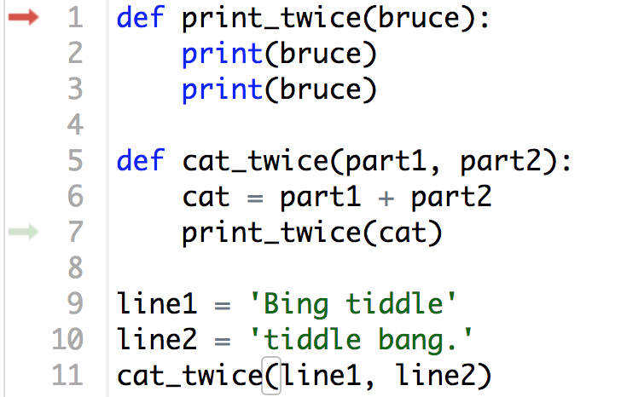
Example from Think Python (3.8)

Slide 11
Example from Think Python (3.8)
line1 and line2 will be in the global frame

Slide 12
Example from Think Python (3.8)
two frames will exist during
the time we’re executing
in print_twice
line1 and line2 will be in the global frame

Slide 13
Example from Think Python (3.8)
two frames will exist during
the time we’re executing
in print_twice
line1 and line2 will be in the global frame
you don’t generally see or interact
with frames when programming,
but it’s an important mental model

Slide 14
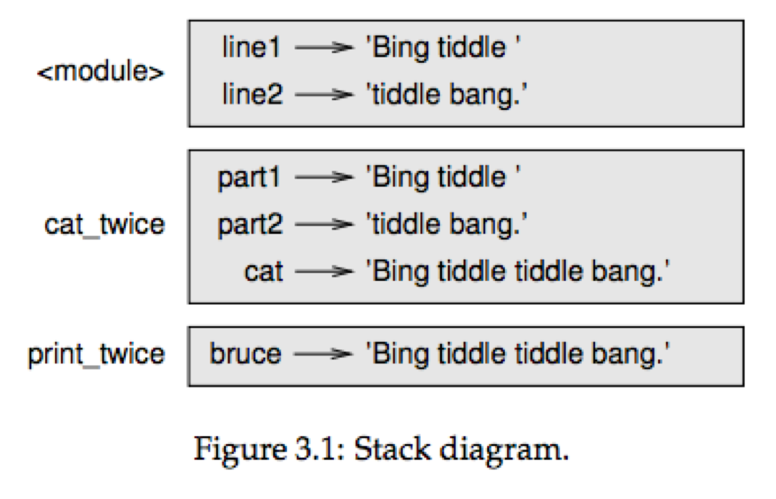
Example from Think Python (3.8)
two frames will exist during
the time we’re executing
in print_twice
line1 and line2 will be in the global frame
you don’t generally see or interact
with frames when programming,
but it’s an important mental model
Downey illustrates like this
(this is called a stack diagram)

Slide 15
Example from Think Python (3.8)
this code can access: line1, line2
global frame

Slide 16
Example from Think Python (3.8)
can access: line1, line2, part1, part2, cat
global frame

Slide 17
Example from Think Python (3.8)
can access: line1, line2, bruce
global frame

Slide 18
Example from Think Python (3.8)
can access: line1, line2, bruce
we call the variables that can currently be
accessed “in scope” and variables that
cannot be “out of scope”
global frame

Slide 19
Example from Think Python (3.8)
Arguments are copied to parameters:
this is called “pass by value”

Slide 20
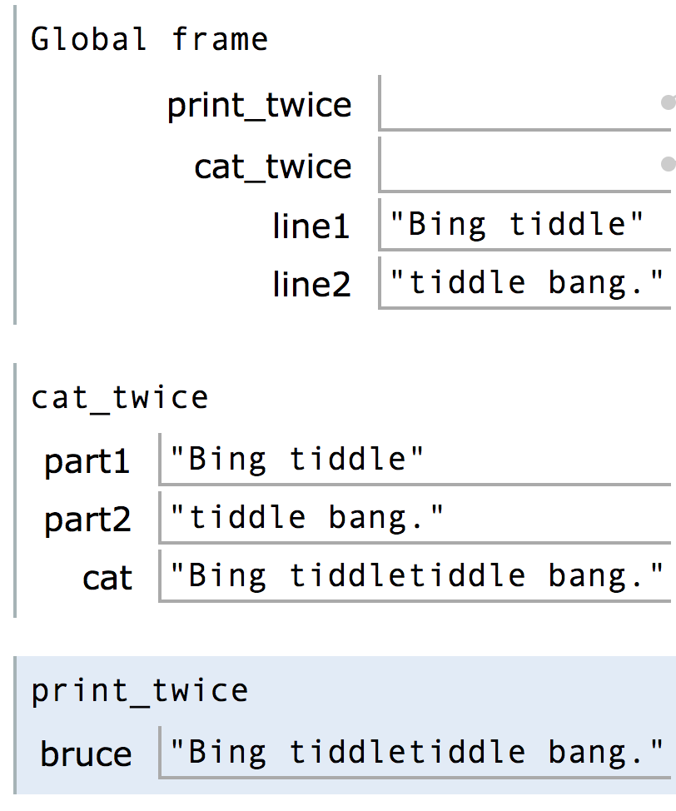
Think Python vs PythonTutor

Slide 21
Think Python vs PythonTutor
Difference 1: PythonTutor uses boxes instead of arrows (by default)

Slide 22
Think Python vs PythonTutor
Difference 2: PythonTutor more clearly indicates the global frame

Slide 23
Think Python vs PythonTutor
Difference 3: PythonTutor also shows function definitions in the global frame

Slide 24
Think Python vs PythonTutor
Let's do some examples in PythonTutor
Difference 3: PythonTutor also shows function definitions in the global frame

Slide 25
Today's Outline
Context
Frames
        Demos: Local Variables
Demos: Global Variables
Demos: Argument Passing

Slide 26
Lessons about Local Variables
def set_x():
x = 100
print(x)
Lesson 1: functions don't execute unless they're called

Slide 27
Lessons about Local Variables
def set_x():
x = 100
set_x()
print(x)
Lesson 2: variables created in a function die after function returns

Slide 28
Lessons about Local Variables
def count():
x = 1
x += 1
print(x)
count()
count()
count()
Lesson 3: variables start fresh every time a function is called again

Slide 29
Lessons about Local Variables
def display_x():
print(x)
def main():
x = 100
display_x()
main()
Lesson 4: you can't see the variables of other function invocations, even those that call you

Slide 30
Today's Outline
Context
Frames
        Demos: Local Variables
Demos: Global Variables
Demos: Argument Passing

Slide 31
Lessons about Global Variables
msg = 'hello' # global, outside any func
def greeting():
print(msg)
print('before: ' + msg)
greeting()
print('after: ' + msg)
Lesson 5: you can generally just use global variables inside a function

Slide 32
Lessons about Global Variables
msg = 'hello'
def greeting():
msg = 'welcome!'
print('greeting: ' + msg)
print('before: ' + msg)
greeting()
print('after: ' + msg)
Lesson 6: if you do an assignment to a variable in a function, Python assumes you want it local

Slide 33
Lessons about Global Variables
msg = 'hello'
def greeting():
print('greeting: ' + msg)
msg = 'welcome!'
print('before: ' + msg)
greeting()
print('after: ' + msg)
Lesson 7: assignment to a variable should be before its use in a function, even if there's
a global variable with the same name

Slide 34
Lessons about Global Variables
msg = 'hello'
def greeting():
global msg
print('greeting: ' + msg)
msg = 'welcome!'
print('before: ' + msg)
greeting()
print('after: ' + msg)
Lesson 8: use a global declaration to prevent Python from creating a
local variable when you want a global variable

Slide 35
Today's Outline
Context
Frames
        Demos: Local Variables
Demos: Global Variables
Demos: Argument Passing

Slide 36
Lessons about Argument Passing
def f(x):
x = 'B'
print('inside: ' + x)
val = 'A'
print('before: ' + val)
f(val)
print('after: ' + val)
Lesson 9: in Python, arguments are "passed by value", meaning
reassignments to a parameter don't change the argument outside

Slide 37
Lessons about Argument Passing
x = 'A'
def f(x):
x = 'B'
print('inside: ' + x)
print('before: ' + x)
f(x)
print('after: ' + x)
Lesson 10: it's irrelevant whether the argument (outside) and
parameter (inside) have the same variable name

Slide 38
Lesson Summary
Lesson 1: functions don't execute unless they're called
Lesson 2: variables created in a function die after function returns
Lesson 3: variables start fresh every time a function is called again
Lesson 4: you can't see the variables of other function invocations, even those that call you
Lesson 5: you can generally just use global variables inside a function
Lesson 6: if you do an assignment to a variable in a function, Python assumes you want it local
Lesson 7: assignment to a variable should be before its use in a function, even if there's a a global variable with the same name
Lesson 8: use a global declaration to prevent Python from creating a local variable when you want a global variable
Lesson 9: in Python, arguments are "passed by value", meaning reassignments to a parameter don't change the argument outside
Lesson 10: it's irrelevant whether the argument (outside) and parameter (inside) have the same variable name
Local
Global
Parameters

