Slide 1
[320] Hierarchical Clustering
(AgglomerativeClustering and Dendrograms)
Meenakshi Syamkumar

Slide 2
Hierarchical clusters can contain other custers (example: AgglomerativeClustering)
Non-hierarchical clusters cannot contain other custers (example: KMeans)

Slide 3
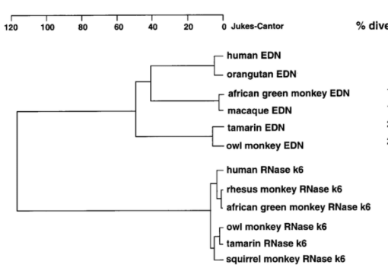
Hierarchical Clusters with Dendrograms
https://www.researchgate.net/figure/A-Dendrogram-depicting-the-relationships-among-human-and-non-human-primate-EDNs-and_fig1_13459488

Slide 4
Hierarchical Clusters with Dendrograms
this node's children have ~40 distance
leaves correspond
to original data
every non-leaf has
EXACTLY 2 children
https://www.researchgate.net/figure/A-Dendrogram-depicting-the-relationships-among-human-and-non-human-primate-EDNs-and_fig1_13459488
We'll represent hierarchies as special binary trees.

Slide 5
Strategy: Combine Nearby Points/Groups
(and repeat!)

Slide 6
Strategy: Combine Nearby Points/Groups
(and repeat!)

Slide 7
Strategy: Combine Nearby Points/Groups
(and repeat!)

Slide 8
Strategy: Combine Nearby Points/Groups
(and repeat!)

Slide 9
Strategy: Combine Nearby Points/Groups
(and repeat!)

Slide 10
Strategy: Combine Nearby Points/Groups
(and repeat!)

Slide 11
Strategy: Combine Nearby Points/Groups
(and repeat!)
D
F
A
E
G
B
C
A B C D E F G

Slide 12
Configuration: what is "nearest"?
option: linkage

Slide 13
Configuration: what is "nearest"?
OR...

Slide 14
Configuration: what is "nearest"?
linkage="single"
OR...

Slide 15
Configuration: what is "nearest"?
linkage="complete"
OR...

Slide 16
Configuration: what is "nearest"?
linkage="????"
From docs: https://scikit-learn.org/stable/modules/generated/sklearn.cluster.AgglomerativeClustering.html
ward minimizes the variance of the clusters being merged.
average uses the average of the distances of each observation of the two sets.
complete or maximum linkage uses the maximum distances between all observations of the two sets.
single uses the minimum of the distances between all observations of the two sets.
Linkage comparison plots: https://scikit-learn.org/stable/auto_examples/cluster/plot_linkage_comparison.html

Slide 17
Configuration: when to stop?
option: n_clusters or distance_threshold

Slide 18
Configuration: when to stop?
n_clusters=3
each cluster is it's own tree!

Slide 19
Configuration: when to stop?
distance_threshold=10
14

Slide 20
Configuration: when to stop?
distance_threshold=0

Slide 21
Demos...

Slide 22
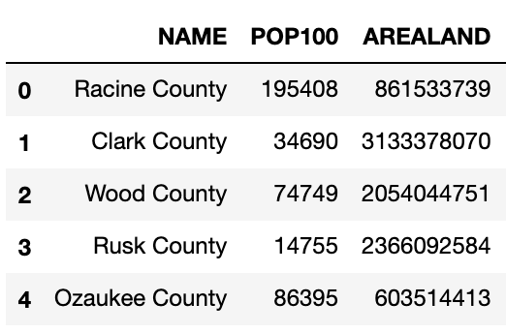
Node Representation
.fit
Agglomerative
Clustering
all
nodes
...
72
array([[ 3, 1],
[ 4, 72],
[ 11, 12],
[ 19, 73],
[ 31, 43],
...
])
73
74
...
.children

Slide 23
Linkage Matrix
left child
right child
distances
node count
N
N+1
N+2
...

