Slide 1
[220 / 319] Conditionals
Exam1 conflict form – fill by Feb 16th
Meena Syamkumar
Andy Kuemmel
Cole Nelson
Readings:
Parts of Chapter 5 of Think Python
Chapter 5.5 to 5.8 of Python for Everybody
Due: Quiz2
Due: Student Information Survey

Slide 2

Mental Model of Control Flow
Code:
...
x = 5
y = f(x)
return y+1
...
x = 5
y = f(x)
return y+1
do statements in order, one at a time
functions: jump in and out of these
conditionals: sometimes skip statements
loops: sometimes go back to previous
three
exceptions
TODAY

Slide 3
Learning Objectives Today
Write conditional statements
Conditional execution (if)
Alternate execution (else)
Chained conditionals (elif)
Nested conditionals (if….if )
Determine the output of conditional statements
Identify nested code blocks
Count the number of blocks in a segment of code
Chapter 5 of Think Python
(skip "Recursion" sections)
Do PythonTutor Practice!
(posted on schedule)

Slide 4
Today's Outline
Review
Control Flow Diagrams
Basic syntax for “if”
Identifying code blocks
        Demos

Slide 5
Today's Outline
Review
Control Flow Diagrams
Basic syntax for “if”
Identifying code blocks
        Demos

Slide 6
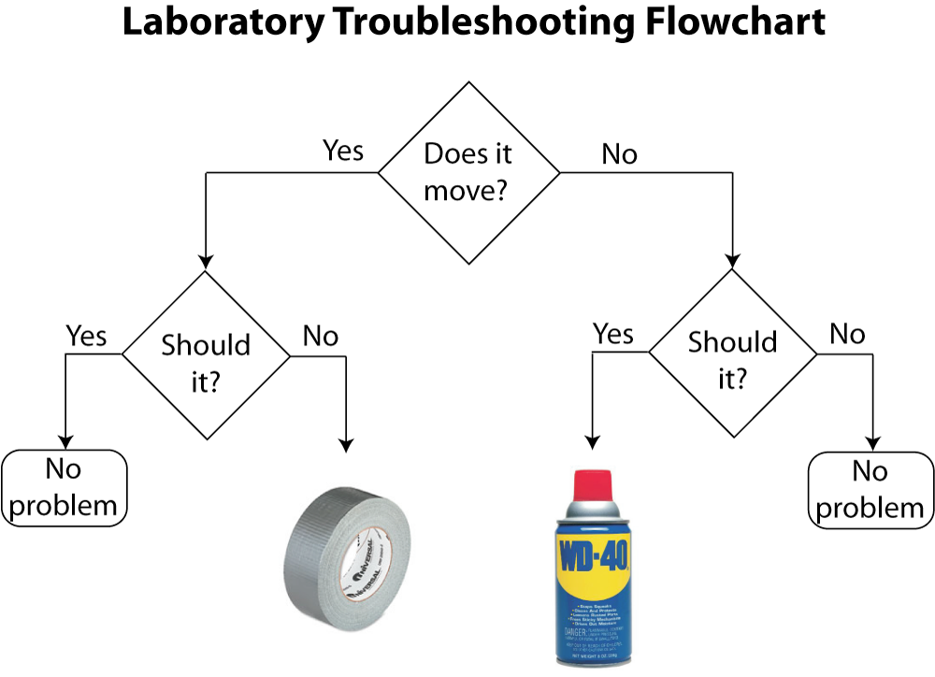
conditional execution
alternate execution
https://www.drphysics.com/prayer/flowchart.html

Slide 7
conditional execution
alternate execution
nested
conditional
chained would be
if we had more than
two possibilities
https://www.drphysics.com/prayer/flowchart.html

Slide 8
conditional execution
alternate execution
nested
conditional
chained would be
if we had more than
two possibilities
in programming:
questions are phrased as boolean expressions
actions are code/statements
https://www.drphysics.com/prayer/flowchart.html

Slide 9
Control Flow Diagrams (Flowcharts for Code)
    x = input(“enter x: ”)
    x = int(x)
x % 2 == 0
True
False
print(“it’s even”)
print(“it’s odd”)
print(“thank you”)

Slide 10
Control Flow Diagrams (Flowcharts for Code)
    x = input(“enter x: ”)
    x = int(x)
condition
x % 2 == 0
Sometimes
we do this
True
False
Other times
we do this
print(“it’s even”)
print(“it’s odd”)
print(“thank you”)

Slide 11
Control Flow Diagrams (Flowcharts for Code)
    x = input(“enter x: ”)
    x = int(x)
boolean expressions are mostly
used for deciding what to do next
(not for printing “True” or “False”
as in most of our examples thus far)
condition
x % 2 == 0
Sometimes
we do this
True
False
Other times
we do this
print(“it’s even”)
print(“it’s odd”)
print(“thank you”)

Slide 12
Control Flow Diagrams (Flowcharts for Code)
    x = input(“enter x: ”)
    x = int(x)
conditional
boolean expressions are mostly
used for deciding what to do next
(not for printing “True” or “False”
as in most of our examples thus far)
condition
x % 2 == 0
Sometimes
we do this
True
False
Other times
we do this
print(“it’s even”)
print(“it’s odd”)
print(“thank you”)

Slide 13
Branches (aka "Paths of Execution”)
Input/Output:
    x = input(“enter x: ”)
    x = int(x)
enter x: 8
it’s even
thank you
x % 2 == 0
True
False
print(“it’s even”)
print(“it’s odd”)
print(“thank you”)

Slide 14
Branches (aka "Paths of Execution”)
Input/Output:
    x = input(“enter x: ”)
    x = int(x)
enter x: 7
it’s odd
thank you
x % 2 == 0
True
False
print(“it’s even”)
print(“it’s odd”)
print(“thank you”)

Slide 15
Today's Outline
Review
Control Flow Diagrams
Basic syntax for “if”
Identifying code blocks
        Demos

Slide 16
Writing conditions in Python
Code:
x = input(“enter x: ”)
x = int(x)
x % 2 == 0
True
False
print(“it’s even”)
print(“it’s odd”)
print(“thank you”)

Slide 17
Writing conditions in Python
Code:
x = input(“enter x: ”)
x = int(x)
x = input(“enter x: ”)
x = int(x)
x % 2 == 0
True
False
print(“it’s even”)
print(“it’s odd”)
print(“thank you”)

Slide 18
Writing conditions in Python
Code:
x = input(“enter x: ”)
x = int(x)
if x % 2 == 0:
x = input(“enter x: ”)
x = int(x)
x % 2 == 0
True
False
print(“it’s even”)
print(“it’s odd”)
boolean expression
print(“thank you”)

Slide 19
Writing conditions in Python
Code:
x = input(“enter x: ”)
x = int(x)
if x % 2 == 0:
print(“it’s even”)
x = input(“enter x: ”)
x = int(x)
x % 2 == 0
True
False
print(“it’s even”)
print(“it’s odd”)
print(“thank you”)

Slide 20
Writing conditions in Python
Code:
x = input(“enter x: ”)
x = int(x)
if x % 2 == 0:
print(“it’s even”)
else:
print(“it’s odd”)
x = input(“enter x: ”)
x = int(x)
x % 2 == 0
True
False
print(“it’s even”)
print(“it’s odd”)
print(“thank you”)
colons will almost always be
followed by a tabbed new line

Slide 21
Writing conditions in Python
Code:
x = input(“enter x: ”)
x = int(x)
if x % 2 == 0:
print(“it’s even”)
else:
print(“it’s odd”)
print(“thank you”)
x = input(“enter x: ”)
x = int(x)
x % 2 == 0
True
False
print(“it’s even”)
print(“it’s odd”)
print(“thank you”)

Slide 22
Writing conditions in Python
Code:
x = input(“enter x: ”)
x = int(x)
if x % 2 == 0:
print(“it’s even”)
else:
print(“it’s odd”)
print(“good!”)
print(“thank you”)
x = input(“enter x: ”)
x = int(x)
x % 2 == 0
True
False
print(“it’s even”)
print(“it’s odd”)
print("good!")
print(“thank you”)

Slide 23
Writing conditions in Python
Code:
x = input(“enter x: ”)
x = int(x)
if x % 2 == 0:
print(“it’s even”)
print(“we wanted odd”)
else:
print(“it’s odd”)
print(“good!”)
print(“thank you”)
x = input(“enter x: ”)
x = int(x)
x % 2 == 0
True
False
print(“it’s even”)
print("we wanted odd")
print(“it’s odd”)
print("good!")
print(“thank you”)

Slide 24
Writing conditions in Python
Code:
x = input(“enter x: ”)
x = int(x)
if x % 2 == 0:
print(“it’s even”)
print(“we wanted odd”)
else:
print(“it’s odd”)
print(“good!”)
print(“thank you”)
print(“all done”)
x = input(“enter x: ”)
x = int(x)
x % 2 == 0
True
False
print(“it’s even”)
print("we wanted odd")
print(“it’s odd”)
print("good!")
print(“thank you”)
print("all done")

Slide 25
Today's Outline
Review
Control Flow Diagrams
Basic syntax for “if”
Identifying code blocks
        Demos

Slide 26
Code Blocks
Code:
x = input(“enter x: ”)
x = int(x)
if x % 2 == 0:
print(“it’s even”)
print(“we wanted odd”)
else:
print(“it’s odd”)
print(“good!”)
print(“thank you”)
print(“all done”)
block of code
inside “if”
block of code
inside “else”

Slide 27
Code Blocks
Code:
x = input(“enter x: ”)
x = int(x)
if x % 2 == 0:
print(“it’s even”)
print(“we wanted odd”)
else:
print(“it’s odd”)
print(“good!”)
print(“thank you”)
print(“all done”)
block of code
inside “if”
block of code
inside “else”
What if all this were inside a function?

Slide 28
Code Blocks
You need to get good at “seeing” code blocks in Python code.
Even blocks inside blocks inside blocks…
Code:
def check_oddness():
x = input(“enter x: ”)
x = int(x)
if x % 2 == 0:
print(“it’s even”)
print(“we wanted odd”)
else:
print(“it’s odd”)
print(“good!”)
print(“thank you”)
print(“all done”)
check_oddness()
block of code
inside “if”
block of code
inside “else”
block of code in
check_oddness

Slide 29
Identifying Code Blocks
Code:
def check_oddness():
x = input(“enter x: ”)
x = int(x)
if x % 2 == 0:
print(“it’s even”)
print(“we wanted odd”)
else:
print(“it’s odd”)
print(“good!”)
print(“thank you”)
print(“all done”)
check_oddness()
Step 1: look for a colon at
end of a line

Slide 30
Identifying Code Blocks
Code:
def check_oddness():
x = input(“enter x: ”)
x = int(x)
if x % 2 == 0:
print(“it’s even”)
print(“we wanted odd”)
else:
print(“it’s odd”)
print(“good!”)
print(“thank you”)
print(“all done”)
check_oddness()
Step 2: start drawing a line
on next code line, indented in

Slide 31
Identifying Code Blocks
Code:
def check_oddness():
x = input(“enter x: ”)
x = int(x)
if x % 2 == 0:
print(“it’s even”)
print(“we wanted odd”)
else:
print(“it’s odd”)
print(“good!”)
print(“thank you”)
print(“all done”)
check_oddness()
Step 3: continue down until you hit
code that is less indented

Slide 32
Identifying Code Blocks
Code:
def check_oddness():
x = input(“enter x: ”)
x = int(x)
if x % 2 == 0:
print(“it’s even”)
print(“we wanted odd”)
else:
print(“it’s odd”)
print(“good!”)
print(“thank you”)
print(“all done”)
check_oddness()
Step 4: box off the code

Slide 33
Identifying Code Blocks
Code:
def check_oddness():
x = input(“enter x: ”)
x = int(x)
if x % 2 == 0:
print(“it’s even”)
print(“we wanted odd”)
else:
print(“it’s odd”)
print(“good!”)
print(“thank you”)
print(“all done”)
check_oddness()
Step 4: box off the code

Slide 34
Identifying Code Blocks
Code:
def check_oddness():
x = input(“enter x: ”)
x = int(x)
if x % 2 == 0:
print(“it’s even”)
print(“we wanted odd”)
else:
print(“it’s odd”)
print(“good!”)
print(“thank you”)
print(“all done”)
check_oddness()
to find more boxes,
look for the next colon
and repeat

Slide 35
Identifying Code Blocks
Code:
def check_oddness():
x = input(“enter x: ”)
x = int(x)
if x % 2 == 0:
print(“it’s even”)
print(“we wanted odd”)
else:
print(“it’s odd”)
print(“good!”)
print(“thank you”)
print(“all done”)
check_oddness()
to find more boxes,
look for the next colon
and repeat

Slide 36
Identifying Code Blocks
Code:
def check_oddness():
x = input(“enter x: ”)
x = int(x)
if x % 2 == 0:
print(“it’s even”)
print(“we wanted odd”)
else:
print(“it’s odd”)
print(“good!”)
print(“thank you”)
print(“all done”)
check_oddness()
to find more boxes,
look for the next colon
and repeat

Slide 37
Identifying Code Blocks
Code:
def check_oddness():
x = input(“enter x: ”)
x = int(x)
if x % 2 == 0:
print(“it’s even”)
print(“we wanted odd”)
else:
print(“it’s odd”)
print(“good!”)
print(“thank you”)
print(“all done”)
check_oddness()
to find more boxes,
look for the next colon
and repeat

Slide 38
Identifying Code Blocks
Worksheet
Code:
def check_oddness():
x = input(“enter x: ”)
x = int(x)
if x % 2 == 0:
print(“it’s even”)
print(“we wanted odd”)
else:
print(“it’s odd”)
print(“good!”)
print(“thank you”)
print(“all done”)
check_oddness()
to find more boxes,
look for the next colon
and repeat

Slide 39
Today's Outline
Review
Control Flow Diagrams
Basic syntax for “if”
Identifying code blocks
        Demos

Slide 40
Example: Classifying Children by Age
What are all the different ways to classify children?
If you are 3 years old you are a ……
If you are 15 years old you are a ……
Write a function that is given an int and returns a string
def categorize_age(age):
if age < …..
return …..

Slide 41
Example: Stoplight – Next lecture …
color
RED
feet
YELLOW
what should the driver do?
GREEN

Slide 42
Example: Stoplight – Next lecture …
color
RED
feet
hit the gas
feet < 15
stop abruptly
YELLOW
continue at same speed
feet < 30
GREEN
stop
smile

Slide 43
Example: Date Printer – Next lecture …
please enter a year: (YYYY): 2021
please enter a month (1-12): 9
please enter a day (1-31): 29
the date is: Sep 29th of ‘21
convert month num to name
’2-digit year
e.g., 1st, 2nd, 3rd, etc

Slide 44
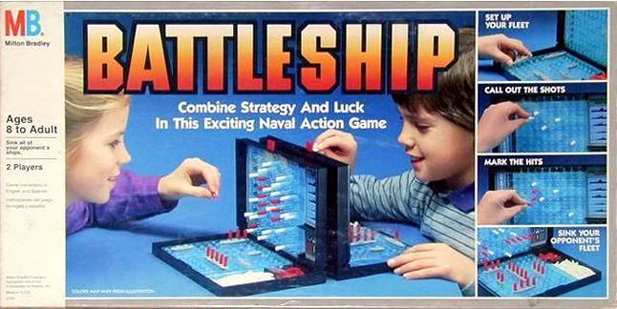
Challenge: Better Battleship
Improvements
give more meaningful feedback (not "True" or "False")
check that user guessed in a reasonable range
choose random placement for two ships, not overlapping
show different symbols depending on which ship was hit
give user up to 3 guesses (or until they get a hit)

Slide 45
Challenge: Addition Tester
1 point
what is 3+5? 5
what is 9+2? 10
what is 9+5? 2
...
Your score is 6.5 of 10
0.5 points (close answer)
0 points
We can get random number by using the random module:
random.randint(1, 10)

