Slide 1
[220 / 319] Programming
Meena Syamkumar
Andy Kuemmel

Slide 2
Learning Objectives
Skills:
Run Python
Run Jupyter
Learn common Python operators:
Mathematical (e.g., “+” and “-“)
Comparison (e.g., “==” and “>”)
Logical (e.g., “and” and “not”)
Learn about different data types:
int, float, str, bool
Learn about boolean logic
Reading: Chapter 1 of Think Python

Slide 3
Today's Outline
Software
Interpreters
Editors
Notebooks
        Demos
Operator Precedence
Demos
Boolean Logic
Demos

Slide 4
What you need to write/run code
An interpreter
Python 3 (not 2!)
Some extra packages (installed with pip)
An editor
Which one doesn’t matter much
idle comes with Python
Jupyter Notebooks
installed with pip

Slide 5
Interpreter
A program that runs a program
Translates something the human likes (nice Python code) to something the machine likes (ONEs and ZEROs)

Slide 6
Interpreter
A program that runs a program
Translates something the human likes (nice Python code) to something the machine likes (ONEs and ZEROs)
Worksheet:
Put 11 in
the box
You were an interpreter when you did the pseudocode worksheets!

Slide 7
Interpreter
A program that runs a program
Translates something the human likes (nice Python code) to something the machine likes (ONEs and ZEROs)
Worksheet:
Put 11 in
the box
You were an interpreter when you did the pseudocode worksheets!

Slide 8
Interpreter
A program that runs a program
Translates something the human likes (nice Python code) to something the machine likes (ONEs and ZEROs)
Worksheet:
Put 11 in
the box
move
hand
down
You were an interpreter when you did the pseudocode worksheets!

Slide 9
Interpreter
A program that runs a program
Translates something the human likes (nice Python code) to something the machine likes (ONEs and ZEROs)
Worksheet:
Put 11 in
the box
move
hand
down
You were an interpreter when you did the pseudocode worksheets!

Slide 10
Interpreter
A program that runs a program
Translates something the human likes (nice Python code) to something the machine likes (ONEs and ZEROs)
Worksheet:
Put 11 in
the box
lift hand
You were an interpreter when you did the pseudocode worksheets!

Slide 11
Interpreter
A program that runs a program
Translates something the human likes (nice Python code) to something the machine likes (ONEs and ZEROs)
Worksheet:
Put 11 in
the box
move
hand
up and to right
You were an interpreter when you did the pseudocode worksheets!

Slide 12
Interpreter
A program that runs a program
Translates something the human likes (nice Python code) to something the machine likes (ONEs and ZEROs)
Worksheet:
Put 11 in
the box
lower hand
You were an interpreter when you did the pseudocode worksheets!

Slide 13
Interpreter
A program that runs a program
Translates something the human likes (nice Python code) to something the machine likes (ONEs and ZEROs)
Worksheet:
Put 11 in
the box
move
hand
down
You were an interpreter when you did the pseudocode worksheets!

Slide 14
Interpreter
A program that runs a program
Translates something the human likes (nice Python code) to something the machine likes (ONEs and ZEROs)
Worksheet:
Put 11 in
the box
move
hand
down
Python Code
Python
name = “tyler”
print(“hello ”+name)
011011010...

Slide 15
Interpreter
A program that runs a program
Translates something the human likes (nice Python code) to something the machine likes (ONEs and ZEROs)
both are interpreters
Worksheet:
Put 11 in
the box
move
hand
down
Python Code
Python
name = “tyler”
print(“hello ”+name)
011011010...

Slide 16
Interpreter
A program that runs a program
Translates something the human likes (nice Python code) to something the machine likes (ONEs and ZEROs)
a program
a program that runs a program
Python Code
Python
name = “tyler”
print(“hello ”+name)
011011010...

Slide 17
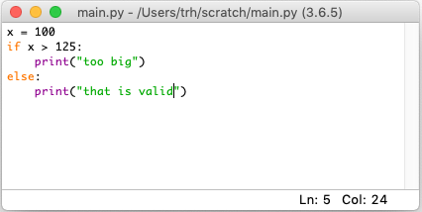
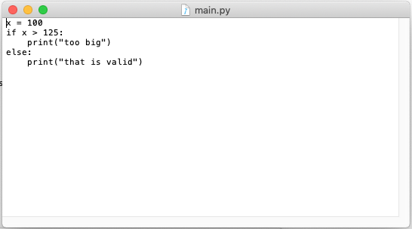
Editor
Program for typing code
Different editors can open the same .py files (Python programs)
(like different browsers can show the same page)
Idle
TextEdit
some editors might colorize code

Slide 18
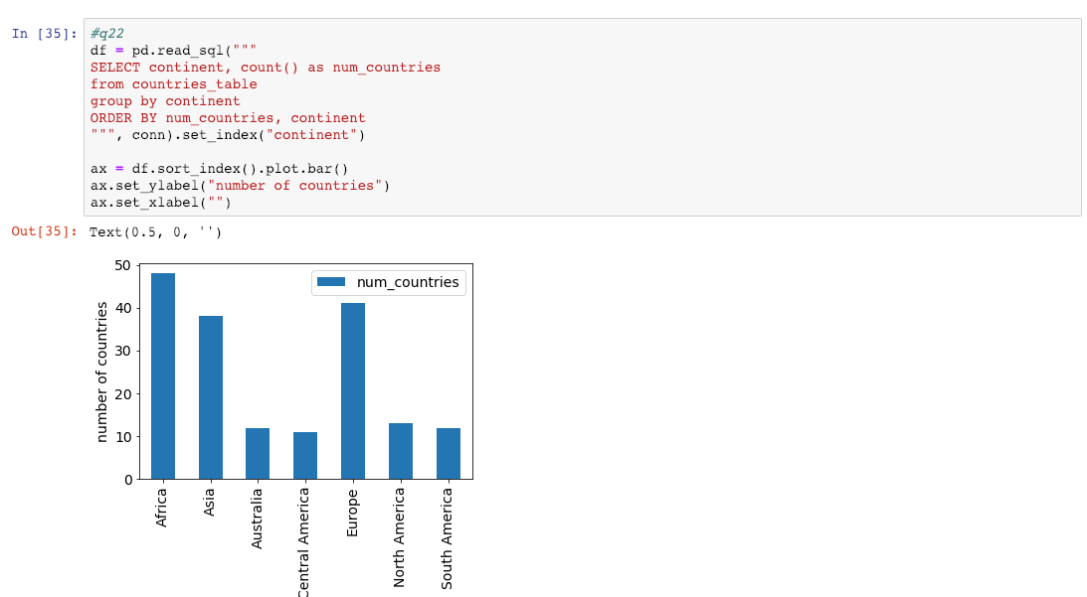
Jupyter Notebooks
notebooks breakup code into
"cells" containing Python code
...
visuals produced by the
code are interleaved
Tool for mixing analysis code with other things
(e.g., documentation, images, tables, etc.)
...

Slide 19
Jupyter Notebooks
notebooks breakup code into
"cells" containing Python code
...
visuals produced by the
code are interleaved
.ipynb (Interactive Python Notebook) files are not easy to open in a regular text editor

Slide 20
3 ways we'll run Python
1. interactive mode
ty-mac:~$ python
Python 3.7.2 (v3.7.2:9a3ffc0492, Dec 24 2018, 02:44:43)
[Clang 6.0 (clang-600.0.57)] on darwin
Type "help", "copyright", "credits" or "license" for more information.
>>> 1 + 1
2
triple arrows mean Python code runs as you type it

Slide 21
3 ways we'll run Python
1. interactive mode
ty-mac:~$ python
Python 3.7.2 (v3.7.2:9a3ffc0492, Dec 24 2018, 02:44:43)
[Clang 6.0 (clang-600.0.57)] on darwin
Type "help", "copyright", "credits" or "license" for more information.
>>> 1 + 1
2
triple arrows mean Python code runs as you type it
2. script mode
the interpreter program is named "python"; run it
ty-mac:~$ python my_program.py
the name of the file containing your code (called a "script")
is passed as an argument to the python program

Slide 22
3 ways we'll run Python
1. interactive mode
ty-mac:~$ python
Python 3.7.2 (v3.7.2:9a3ffc0492, Dec 24 2018, 02:44:43)
[Clang 6.0 (clang-600.0.57)] on darwin
Type "help", "copyright", "credits" or "license" for more information.
>>> 1 + 1
2
triple arrows mean Python code runs as you type it
2. script mode
the interpreter program is named "python"; run it
ty-mac:~$ python my_program.py
the name of the file containing your code (called a "script")
is passed as an argument to the python program
3. notebook "mode"
ty-mac:~$ jupyter notebook
open Jupyter in a web browser
we'll do most work in notebooks this semester

Slide 23
Today's Outline
Software
Interpreters
Editors
Notebooks
        Demos
Operator Precedence
Demos
Boolean Logic
Demos

Slide 24
Today's Outline
Software
Interpreters
Editors
Notebooks
        Demos
Operator Precedence
Demos
Boolean Logic
Demos

Slide 25
Order of Simplification
Python works by simplifying, applying one operator at a time
3 * 3 + 2 * 2 + 16 ** (1/2)
Rules
First work within parentheses
Do higher precedence first
Break ties left to right

Slide 26
Order of Simplification
Python works by simplifying, applying one operator at a time
3 * 3 + 2 * 2 + 16 ** (1/2)
Rules
First work within parentheses
Do higher precedence first
Break ties left to right

Slide 27
Order of Simplification
Python works by simplifying, applying one operator at a time
3 * 3 + 2 * 2 + 16 ** (1/2)
3 * 3 + 2 * 2 + 16 ** (0.5)
Rules
First work within parentheses
Do higher precedence first
Break ties left to right

Slide 28
Order of Simplification
Python works by simplifying, applying one operator at a time
3 * 3 + 2 * 2 + 16 ** (1/2)
3 * 3 + 2 * 2 + 16 ** (0.5)
Rules
First work within parentheses
Do higher precedence first
Break ties left to right

Slide 29
Order of Simplification
Python works by simplifying, applying one operator at a time
3 * 3 + 2 * 2 + 16 ** (1/2)
3 * 3 + 2 * 2 + 16 ** (0.5)
3 * 3 + 2 * 2 + 4
Rules
First work within parentheses
Do higher precedence first
Break ties left to right

Slide 30
Order of Simplification
Python works by simplifying, applying one operator at a time
3 * 3 + 2 * 2 + 16 ** (1/2)
3 * 3 + 2 * 2 + 16 ** (0.5)
3 * 3 + 2 * 2 + 4
Rules
First work within parentheses
Do higher precedence first
Break ties left to right

Slide 31
Order of Simplification
Python works by simplifying, applying one operator at a time
3 * 3 + 2 * 2 + 16 ** (1/2)
3 * 3 + 2 * 2 + 16 ** (0.5)
3 * 3 + 2 * 2 + 4
9 + 2 * 2 + 4
Rules
First work within parentheses
Do higher precedence first
Break ties left to right

Slide 32
Order of Simplification
Python works by simplifying, applying one operator at a time
3 * 3 + 2 * 2 + 16 ** (1/2)
3 * 3 + 2 * 2 + 16 ** (0.5)
3 * 3 + 2 * 2 + 4
9 + 2 * 2 + 4
Rules
First work within parentheses
Do higher precedence first
Break ties left to right

Slide 33
Order of Simplification
Python works by simplifying, applying one operator at a time
3 * 3 + 2 * 2 + 16 ** (1/2)
3 * 3 + 2 * 2 + 16 ** (0.5)
3 * 3 + 2 * 2 + 4
9 + 2 * 2 + 4
9 + 4 + 4
Rules
First work within parentheses
Do higher precedence first
Break ties left to right

Slide 34
Order of Simplification
Python works by simplifying, applying one operator at a time
3 * 3 + 2 * 2 + 16 ** (1/2)
3 * 3 + 2 * 2 + 16 ** (0.5)
3 * 3 + 2 * 2 + 4
9 + 2 * 2 + 4
9 + 4 + 4
Rules
First work within parentheses
Do higher precedence first
Break ties left to right

Slide 35
Order of Simplification
Python works by simplifying, applying one operator at a time
3 * 3 + 2 * 2 + 16 ** (1/2)
3 * 3 + 2 * 2 + 16 ** (0.5)
3 * 3 + 2 * 2 + 4
9 + 2 * 2 + 4
9 + 4 + 4
13 + 4
Rules
First work within parentheses
Do higher precedence first
Break ties left to right

Slide 36
Order of Simplification
Python works by simplifying, applying one operator at a time
3 * 3 + 2 * 2 + 16 ** (1/2)
3 * 3 + 2 * 2 + 16 ** (0.5)
3 * 3 + 2 * 2 + 4
9 + 2 * 2 + 4
9 + 4 + 4
13 + 4
Rules
First work within parentheses
Do higher precedence first
Break ties left to right

Slide 37
Order of Simplification
Python works by simplifying, applying one operator at a time
3 * 3 + 2 * 2 + 16 ** (1/2)
3 * 3 + 2 * 2 + 16 ** (0.5)
3 * 3 + 2 * 2 + 4
9 + 2 * 2 + 4
9 + 4 + 4
13 + 4
17
Rules
First work within parentheses
Do higher precedence first
Break ties left to right

Slide 38
Operator Precendence
What is it? | Python Operator
exponents | **
signs | +x, -x
multiply/divide | *, /, //, %
add/subtract | +, -
comparison | ==, !=, <, <=, >, >=
boolean stuff | not
… | and
… | or
simplify first
simplify last*
these are the ones you should be learning at this point in the semester
(there are a few more not covered now)
* one exception is an optimization
known as "short circuiting"

Slide 39
Operator Precendence
What is it? | Python Operator
exponents | **
signs | +x, -x
multiply/divide | *, /, //, %
add/subtract | +, -
comparison | ==, !=, <, <=, >, >=
boolean stuff | not
… | and
… | or
simplify first
Mathematical
Logic
simplify last*
these are the ones you should be learning at this point in the semester
(there are a few more not covered now)
* one exception is an optimization
known as "short circuiting"

Slide 40
Today's Outline
Software
Interpreters
Editors
Notebooks
        Demos
Operator Precedence
Demos
Boolean Logic
Demos

Slide 41
Today's Outline
Software
Interpreters
Editors
Notebooks
        Demos
Operator Precedence
Demos
Boolean Logic
Demos

Slide 42
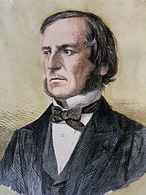
Boolean Logic
The logic of truth:
Named after George Boole
Two values: True and False
Three operators: and, or, and not

Slide 43
Boolean Logic
The logic of truth:
Named after George Boole
Two values: True and False
Three operators: and, or, and not
AND
OR
NOT
False
True
False
True
False
True
False
False
False
False
False
True
True
False
True
False
True
True
True
True

Slide 44
It’s a Saturday AND
we’re in CS 220 live session
AND
OR
NOT
False
True
False
True
False
True
False
False
False
False
False
True
True
False
True
False
True
True
True
True

Slide 45
FALSE!
It’s a Saturday AND
we’re in CS 220 live session
AND
OR
NOT
False
True
False
True
False
True
False
False
False
False
False
True
True
False
True
False
True
True
True
True

Slide 46
Project 1 is due on Wednesday
OR I’ll eat my hat
AND
OR
NOT
False
True
False
True
False
True
False
False
False
False
False
True
True
False
True
False
True
True
True
True

Slide 47
TRUE!
Project 1 is due on Wednesday
OR I’ll eat my hat
AND
OR
NOT
False
True
False
True
False
True
False
False
False
False
False
True
True
False
True
False
True
True
True
True

Slide 48
Control Flow: Remember that conditionals and loops sometimes do something.
We'll use bool logic a LOT to control when we do/don't.
AND
OR
NOT
False
True
False
True
False
True
False
False
False
False
False
True
True
False
True
False
True
True
True
True

Slide 49
Today's Outline
Software
Interpreters
Editors
Notebooks
        Demos
Operator Precedence
Demos
Boolean Logic
Demos

