Slide 1
[220 / 319] Operators
Meena Syamkumar
Andy Kuemmel
Cole Nelson
Readings:
Chapter 1 of Think Python,
Chapter 2 of Python for Everybody
Additional readings:
Computer terminology

Slide 2
Learning Objectives
Run Python code using:
  Command line
  Jupyter Notebook
Evaluate:
numeric expressions containing mathematical operators (e.g., “+” and “-“)
string expressions containing string operators and escape characters
Differentiate:
behavior of the /, //, and % operators
Recognize examples of different Python data types:
int, float, str, bool
Evaluate:
expressions containing comparison operators (e.g., “==” and “>”)
Boolean expressions containing the operators “and”, “or”, “not”
mixed expressions using the correct order of operations (precedence)

Slide 3
Today's Outline
Software
Interpreters
Notebooks
        Demos
Operator Precedence
Demos
Boolean Logic
Demos

Slide 4
What you need to write/run code
An interpreter
Python 3 (not 2!)
some extra packages (comes with anaconda installation)
runs Python code
Jupyter Notebooks
comes with anaconda installation
acts like both interpreter and editor (type and save Python code)

Slide 5
Interpreter
A program that runs a program
Translates something the human likes (nice Python code) to something the machine likes (ONEs and ZEROs)

Slide 6
Interpreter
A program that runs a program
Translates something the human likes (nice Python code) to something the machine likes (ONEs and ZEROs)
Worksheet:
Put 11 in
the box
You were an interpreter when you did the pseudocode worksheets!

Slide 7
Interpreter
A program that runs a program
Translates something the human likes (nice Python code) to something the machine likes (ONEs and ZEROs)
Worksheet:
Put 11 in
the box
You were an interpreter when you did the pseudocode worksheets!

Slide 8
Interpreter
A program that runs a program
Translates something the human likes (nice Python code) to something the machine likes (ONEs and ZEROs)
Worksheet:
Put 11 in
the box
move
hand
down
You were an interpreter when you did the pseudocode worksheets!

Slide 9
Interpreter
A program that runs a program
Translates something the human likes (nice Python code) to something the machine likes (ONEs and ZEROs)
Worksheet:
Put 11 in
the box
move
hand
down
You were an interpreter when you did the pseudocode worksheets!

Slide 10
Interpreter
A program that runs a program
Translates something the human likes (nice Python code) to something the machine likes (ONEs and ZEROs)
Worksheet:
Put 11 in
the box
lift hand
You were an interpreter when you did the pseudocode worksheets!

Slide 11
Interpreter
A program that runs a program
Translates something the human likes (nice Python code) to something the machine likes (ONEs and ZEROs)
Worksheet:
Put 11 in
the box
move
hand
up and to right
You were an interpreter when you did the pseudocode worksheets!

Slide 12
Interpreter
A program that runs a program
Translates something the human likes (nice Python code) to something the machine likes (ONEs and ZEROs)
Worksheet:
Put 11 in
the box
lower hand
You were an interpreter when you did the pseudocode worksheets!

Slide 13
Interpreter
A program that runs a program
Translates something the human likes (nice Python code) to something the machine likes (ONEs and ZEROs)
Worksheet:
Put 11 in
the box
move
hand
down
You were an interpreter when you did the pseudocode worksheets!

Slide 14
Interpreter
A program that runs a program
Translates something the human likes (nice Python code) to something the machine likes (ONEs and ZEROs)
Worksheet:
Put 11 in
the box
move
hand
down
Python Code
Python
name = “meena”
print(“hello ”+name)
011011010...

Slide 15
Interpreter
A program that runs a program
Translates something the human likes (nice Python code) to something the machine likes (ONEs and ZEROs)
both are interpreters
Worksheet:
Put 11 in
the box
move
hand
down
Python Code
Python
name = “meena”
print(“hello ”+name)
011011010...

Slide 16
Interpreter
A program that runs a program
Translates something the human likes (nice Python code) to something the machine likes (ONEs and ZEROs)
a program
a program that runs a program
Python Code
Python
name = “meena”
print(“hello ”+name)
011011010...

Slide 17
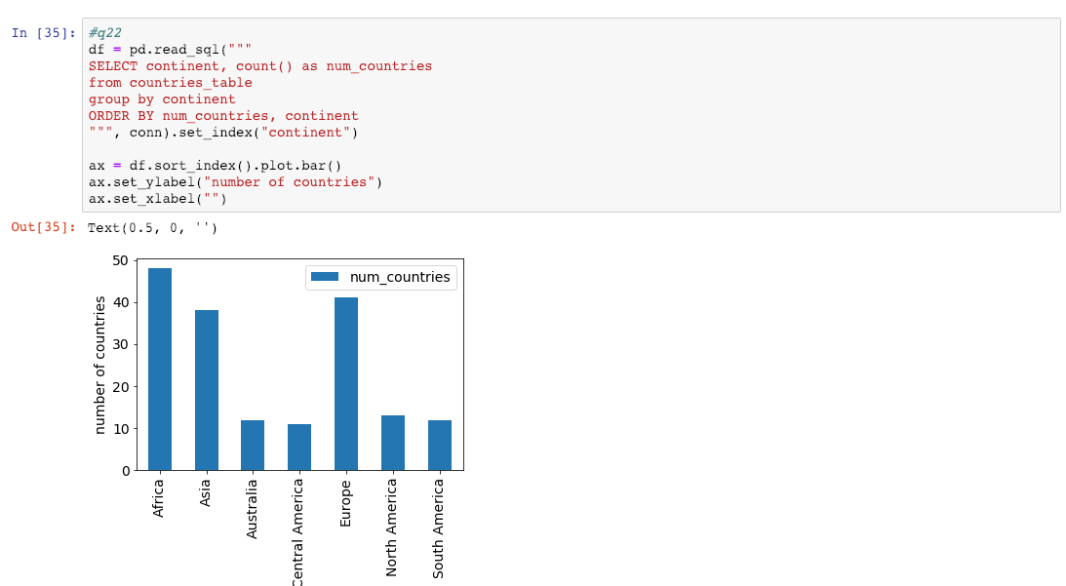
Jupyter Notebooks
notebooks breakup code into
"cells" containing Python code
...
visuals produced by the
code are interleaved
A Notebook is a file that contains code and other things
(e.g., documentation, images, tables, etc.)
...

Slide 18
Jupyter Notebooks
notebooks breakup code into
"cells" containing Python code
...
visuals produced by the
code are embedded in the Notebook
.ipynb (Interactive Python Notebook) files are not easy to open in a regular text editor

Slide 19
3 ways we'll run Python
1. interactive mode
Quick syntax check
ty-mac:~$ python
Python 3.9.7 (default, Sep 16 2021, 16:59:28)
[Clang 10.0.0 ] :: Anaconda, Inc. on darwin
Type "help", "copyright", "credits" or "license" for more information.
>>> 1 + 1
2
triple arrows mean Python code runs as you type it

Slide 20
3 ways we'll run Python
1. interactive mode
ty-mac:~$ python
Python 3.9.7 (default, Sep 16 2021, 16:59:28)
[Clang 10.0.0 ] :: Anaconda, Inc. on darwin
Type "help", "copyright", "credits" or "license" for more information.
>>> 1 + 1
2
triple arrows mean Python code runs as you type it
2. script mode
Run auto-grader tests
the interpreter program is named "python"; run it
ty-mac:~$ python test.py
the name of the file containing your code (called a "script")
is passed as an argument to the python program

Slide 21
3 ways we'll run Python
1. interactive mode
ty-mac:~$ python
Python 3.9.7 (default, Sep 16 2021, 16:59:28)
[Clang 10.0.0 ] :: Anaconda, Inc. on darwin
Type "help", "copyright", "credits" or "license" for more information.
>>> 1 + 1
2
triple arrows mean Python code runs as you type it
2. script mode
the interpreter program is named "python"; run it
ty-mac:~$ python test.py
the name of the file containing your code (called a "script")
is passed as an argument to the python program
3. notebook "mode"
ty-mac:~$ jupyter notebook
open Jupyter in a web browser
we'll do most work in notebooks this semester

Slide 22
Today's Outline
Software
Interpreters
Notebooks
        Demos
Operator Precedence
Demos
Boolean Logic
Demos

Slide 23
Today's Outline
Software
Interpreters
Notebooks
        Demos
Operator Precedence
Demos
Boolean Logic
Demos

Slide 24
Order of Simplification
Python works by simplifying, applying one operator at a time
3 * 3 + 2 * 2 + 16 ** (1/2)
Rules
First work within parentheses
Do higher precedence first
Break ties left to right (exception: exponent ** operator)

Slide 25
Order of Simplification
Python works by simplifying, applying one operator at a time
3 * 3 + 2 * 2 + 16 ** (1/2)
Rules
First work within parentheses
Do higher precedence first
Break ties left to right (exception: exponent ** operator)

Slide 26
Order of Simplification
Python works by simplifying, applying one operator at a time
3 * 3 + 2 * 2 + 16 ** (1/2)
3 * 3 + 2 * 2 + 16 ** (0.5)
Rules
First work within parentheses
Do higher precedence first
Break ties left to right (exception: exponent ** operator)

Slide 27
Order of Simplification
Python works by simplifying, applying one operator at a time
3 * 3 + 2 * 2 + 16 ** (1/2)
3 * 3 + 2 * 2 + 16 ** (0.5)
Rules
First work within parentheses
Do higher precedence first
Break ties left to right (exception: exponent ** operator)

Slide 28
Order of Simplification
Python works by simplifying, applying one operator at a time
3 * 3 + 2 * 2 + 16 ** (1/2)
3 * 3 + 2 * 2 + 16 ** (0.5)
3 * 3 + 2 * 2 + 4
Rules
First work within parentheses
Do higher precedence first
Break ties left to right (exception: exponent ** operator)

Slide 29
Order of Simplification
Python works by simplifying, applying one operator at a time
3 * 3 + 2 * 2 + 16 ** (1/2)
3 * 3 + 2 * 2 + 16 ** (0.5)
3 * 3 + 2 * 2 + 4
Rules
First work within parentheses
Do higher precedence first
Break ties left to right (exception: exponent ** operator)

Slide 30
Order of Simplification
Python works by simplifying, applying one operator at a time
3 * 3 + 2 * 2 + 16 ** (1/2)
3 * 3 + 2 * 2 + 16 ** (0.5)
3 * 3 + 2 * 2 + 4
9 + 2 * 2 + 4
Rules
First work within parentheses
Do higher precedence first
Break ties left to right (exception: exponent ** operator)

Slide 31
Order of Simplification
Python works by simplifying, applying one operator at a time
3 * 3 + 2 * 2 + 16 ** (1/2)
3 * 3 + 2 * 2 + 16 ** (0.5)
3 * 3 + 2 * 2 + 4
9 + 2 * 2 + 4
Rules
First work within parentheses
Do higher precedence first
Break ties left to right (exception: exponent ** operator)

Slide 32
Order of Simplification
Python works by simplifying, applying one operator at a time
3 * 3 + 2 * 2 + 16 ** (1/2)
3 * 3 + 2 * 2 + 16 ** (0.5)
3 * 3 + 2 * 2 + 4
9 + 2 * 2 + 4
9 + 4 + 4
Rules
First work within parentheses
Do higher precedence first
Break ties left to right (exception: exponent ** operator)

Slide 33
Order of Simplification
Python works by simplifying, applying one operator at a time
3 * 3 + 2 * 2 + 16 ** (1/2)
3 * 3 + 2 * 2 + 16 ** (0.5)
3 * 3 + 2 * 2 + 4
9 + 2 * 2 + 4
9 + 4 + 4
Rules
First work within parentheses
Do higher precedence first
Break ties left to right (exception: exponent ** operator)

Slide 34
Order of Simplification
Python works by simplifying, applying one operator at a time
3 * 3 + 2 * 2 + 16 ** (1/2)
3 * 3 + 2 * 2 + 16 ** (0.5)
3 * 3 + 2 * 2 + 4
9 + 2 * 2 + 4
9 + 4 + 4
13 + 4
Rules
First work within parentheses
Do higher precedence first
Break ties left to right (exception: exponent ** operator)

Slide 35
Order of Simplification
Python works by simplifying, applying one operator at a time
3 * 3 + 2 * 2 + 16 ** (1/2)
3 * 3 + 2 * 2 + 16 ** (0.5)
3 * 3 + 2 * 2 + 4
9 + 2 * 2 + 4
9 + 4 + 4
13 + 4
Rules
First work within parentheses
Do higher precedence first
Break ties left to right (exception: exponent ** operator)

Slide 36
Order of Simplification
Python works by simplifying, applying one operator at a time
3 * 3 + 2 * 2 + 16 ** (1/2)
3 * 3 + 2 * 2 + 16 ** (0.5)
3 * 3 + 2 * 2 + 4
9 + 2 * 2 + 4
9 + 4 + 4
13 + 4
17
Rules
First work within parentheses
Do higher precedence first
Break ties left to right (exception: exponent ** operator)

Slide 37
Operator Precendence
What is it? | Python Operator
exponents | **
signs | +x, -x
multiply/divide | *, /, //, %
add/subtract | +, -
comparison | ==, !=, <, <=, >, >=
boolean stuff | not
… | and
… | or
simplify first
simplify last*
these are the ones you should be learning at this point in the semester
(there are a few more not covered now)
* one exception is an optimization
known as "short circuiting"

Slide 38
Operator Precendence
What is it? | Python Operator
exponents | **
signs | +x, -x
multiply/divide | *, /, //, %
add/subtract | +, -
comparison | ==, !=, <, <=, >, >=
boolean stuff | not
… | and
… | or
simplify first
Mathematical
Logic
simplify last*
these are the ones you should be learning at this point in the semester
(there are a few more not covered now)
* one exception is an optimization
known as "short circuiting"

Slide 39
Today's Outline
Software
Interpreters
Notebooks
        Demos
Operator Precedence
Demos
Boolean Logic
Demos

Slide 40
Today's Outline
Software
Interpreters
Notebooks
        Demos
Operator Precedence
Demos
Boolean Logic
Demos

Slide 41
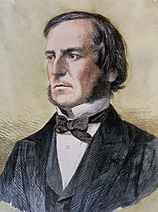
Boolean Logic
The logic of truth:
Named after George Boole
Two values: True and False
Three operators: and, or, and not

Slide 42
Boolean Logic
The logic of truth:
Named after George Boole
Two values: True and False
Three operators: and, or, and not
AND
OR
NOT
False
True
False
True
False
True
False
False
False
False
False
True
True
False
True
False
True
True
True
True

Slide 43
It’s a Saturday AND
we’re attending CS 220 lecture
AND
OR
NOT
False
True
False
True
False
True
False
False
False
False
False
True
True
False
True
False
True
True
True
True

Slide 44
FALSE!
It’s a Saturday AND
we’re attending CS 220 lecture
AND
OR
NOT
False
True
False
True
False
True
False
False
False
False
False
True
True
False
True
False
True
True
True
True

Slide 45
Project 1 is due on Wednesday
OR I’ll eat my hat
AND
OR
NOT
False
True
False
True
False
True
False
False
False
False
False
True
True
False
True
False
True
True
True
True

Slide 46
TRUE!
Project 1 is due on Wednesday
OR I’ll eat my hat
AND
OR
NOT
False
True
False
True
False
True
False
False
False
False
False
True
True
False
True
False
True
True
True
True

Slide 47
Control Flow: Remember that conditionals and loops sometimes do something.
We'll use bool logic a LOT to control when we do/don't.
AND
OR
NOT
False
True
False
True
False
True
False
False
False
False
False
True
True
False
True
False
True
True
True
True

Slide 48
Today's Outline
Software
Interpreters
Notebooks
        Demos
Operator Precedence
Demos
Boolean Logic
Demos

