Slide 1
[220] Iteration
Meena Syamkumar
Mike Doescher
Exam I next Friday evening
Exam Conflict Form
Partner matching
Where is my exam – Exam location updated on website
Cheaters caught: 0
Piazza Enrollment 439 / 446

Slide 2
Learning Objectives Today
Reason about loops
Motivation: need for repetition
Condition and body of loop
“while” syntax
loops inside loops
Understand common use cases
Taking input from a user
Computing over ranges of numbers
Learn to avoid pitfalls
Infinite loops (when unintentional)
Off-by-one mistakes
Chapter 7 of Think Python

Slide 3
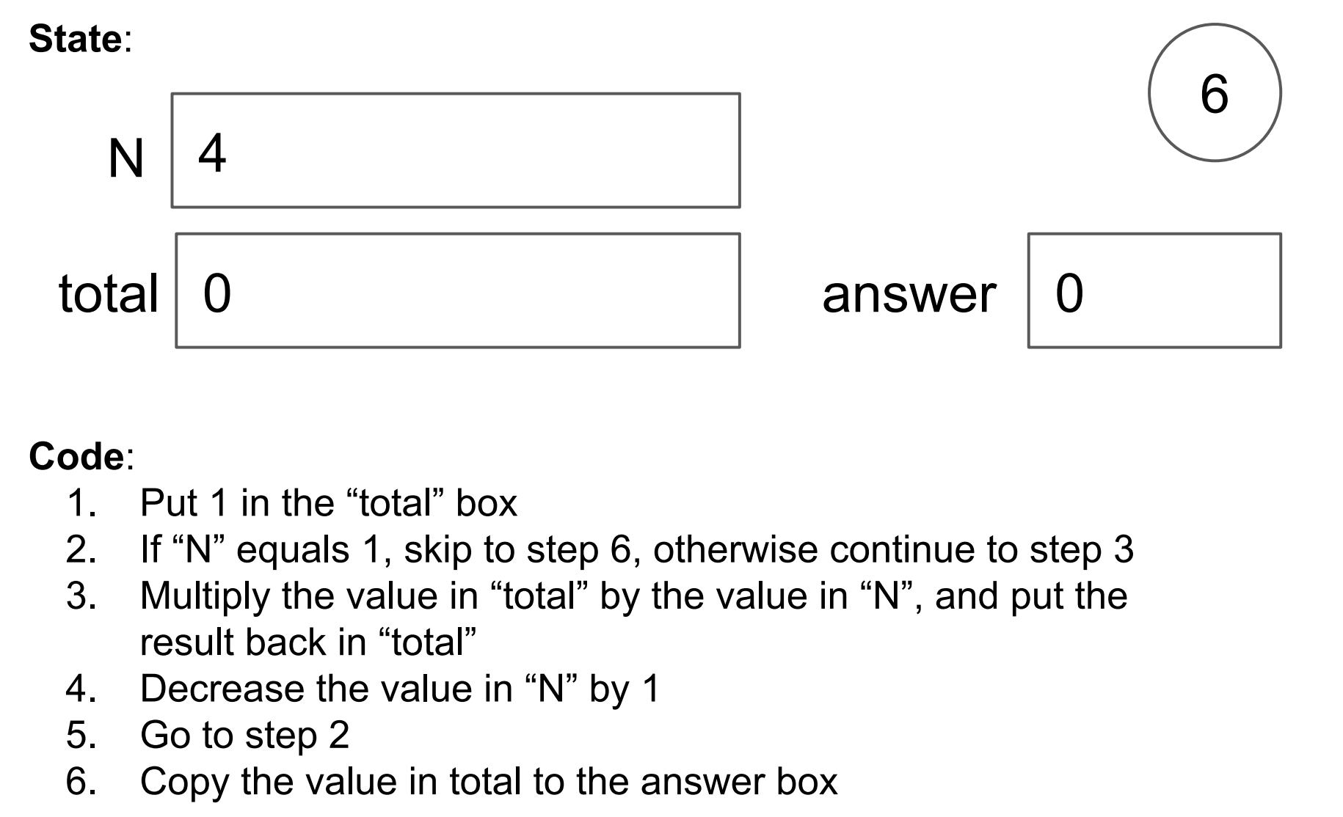
Worksheet

Slide 4
Worksheet
Combination of conditionally skipping forward (2) with
going back is (5) is called a “while loop”

Slide 5
Worksheet
loop condition
loop body

Slide 6
Worksheet
loop condition
loop body
going back will be implicit in Python, and will happen right after loop body.
you can identify the loop body because it will be indented

Slide 7
Worksheet
loop condition
skip past loop body
continue to loop body
loop body
going back will be implicit in Python, and will happen right after loop body.
you can identify the loop body because it will be indented

Slide 8
Today's Outline
Control Flow Diagrams
Basic syntax for “while”
        Demos

Slide 9
Control Flow Diagrams: “if”
x = input(“enter x: ”)
x = float(x)
x < 0
False
True
print(“the square root:”)
print(math.sqrt(x))
print(“need a positive”)
print(“exiting”)

Slide 10
Control Flow Diagrams: “if”
x = input(“enter x: ”)
x = float(x)
x < 0
False
True
print(“the square root:”)
print(math.sqrt(x))
print(“need a positive”)
Wouldn’t it be nice if we
could go back and give
the user a second chance?
print(“exiting”)

Slide 11
Control Flow Diagrams: “while”
x = input(“enter x: ”)
x = float(x)
x < 0
False
True
print(“the square root:”)
print(math.sqrt(x))
print(“please try again”)
x = input(“enter x: ”)
print(“exiting”)

Slide 12
Control Flow Diagrams: “while”
x = input(“enter x: ”)
x = float(x)
we call this cycle a “loop”
x < 0
False
True
print(“the square root:”)
print(math.sqrt(x))
print(“please try again”)
x = input(“enter x: ”)
print(“exiting”)

Slide 13
Control Flow Diagrams: “while”
x = input(“enter x: ”)
x = float(x)
x < 0
False
True
print(“the square root:”)
print(math.sqrt(x))
print(“please try again”)
x = input(“enter x: ”)
Each time through is called an “iteration”
print(“exiting”)

Slide 14
Control Flow Diagrams: “while”
x = input(“enter x: ”)
x = float(x)
loop condition
x < 0
False
True
print(“the square root:”)
print(math.sqrt(x))
print(“please try again”)
x = input(“enter x: ”)
loop body
print(“exiting”)

Slide 15
Control Flow Diagrams: “while”
We keep executing the loop body while the condition
is true, so this is called a “while” loop
x = input(“enter x: ”)
x = float(x)
loop condition
x < 0
False
True
print(“the square root:”)
print(math.sqrt(x))
print(“please try again”)
x = input(“enter x: ”)
loop body
print(“exiting”)

Slide 16
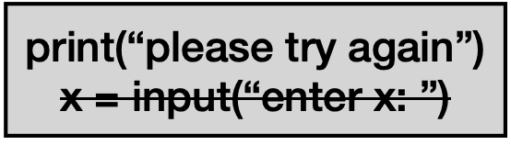
Control Flow Diagrams: “while”
x = input(“enter x: ”)
x = float(x)
x < 0
False
True
print(“the square root:”)
print(math.sqrt(x))
what does this loop do? (note crossed out line)
print(“exiting”)

Slide 17
Control Flow Diagrams: “while”
x = input(“enter x: ”)
x = float(x)
x < 0
False
True
print(“the square root:”)
print(math.sqrt(x))
print(“please try again”)
x = input(“enter x: ”)
runs forever! called an “infinite loop”
print(“exiting”)

Slide 18
Control Flow Diagrams: “while”
To avoid infinite loops, make sure something will/can
eventually happen in the body to change the condition
x = input(“enter x: ”)
x = float(x)
x < 0
False
True
print(“the square root:”)
print(math.sqrt(x))
print(“please try again”)
x = input(“enter x: ”)
print(“exiting”)

Slide 19
Today's Outline
Control Flow Diagrams
Basic syntax for “while”
        Demos

Slide 20
Syntax
x = int(input(“enter x: “))
  if x < 0:
  x = int(input(“please try again: ”))
Syntax for “if”

Slide 21
Syntax
x = int(input(“enter x: “))
  if x < 0:
  x = int(input(“please try again: ”))
Syntax for “if”

Slide 22
Syntax
x = int(input(“enter x: “))
  while x < 0:
  x = int(input(“please try again: ”))
Syntax for “while loop” is just like for “if”, just replace “if” with “while”

Slide 23
Syntax
x = int(input(“enter x: “))
  while x < 0:
  x = int(input(“please try again: ”))
this example gives user an arbitrary number of tries
until they get it right

Slide 24
Control Flow
  while CONDITION:
  # your code

Slide 25
Control Flow
  while CONDITION:
  code after the loop…
block of code…
maybe many lines…

Slide 26
Control Flow
  while CONDITION:
  code after the loop…
block of code…
maybe many lines…

Slide 27
Control Flow
at end, always go
back to condition check
  while CONDITION:
  code after the loop…
True
block of code…
maybe many lines…
False

Slide 28
Congrats!
You now understand the 4 key Flow of Execution ideas,
in the context of Python.
1. generally, proceed forward, one step at a time
2. sometimes go run a “mini program” somewhere else before continuing to the next line
This is a function call
3. sometimes skip forward over some lines of code
Conditional or while loop, when the condition is false
4. sometimes go back to a previous line of code
while loop. When at the end of body, always go back to condition
three primary exceptions to the general case (1)

Slide 29
Today's Outline
Control Flow Diagrams
Basic syntax for “while”
        Demos

Slide 30
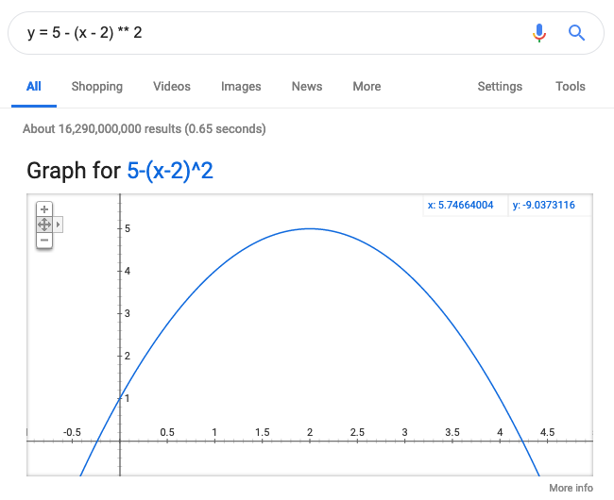
Demo: Maximum (Finding the Peak)
where does this curve peak?

Slide 31
Demo: Countdown Timer
how many seconds? 5
5
4
3
2
1
DING DING DING DING DING!
how many seconds? 2
2
1
0
DING DING DING DING DING!
how many seconds? q
good bye!
use time.sleep(1)
exit program
this program will involve a nested loop!!!

Slide 32
Demo: Integration (Finding the area)
what is the area of this quarter circle?
2
0
2

Slide 33
Demo: Integration (Finding the area)
what is the area of this quarter circle?
2
0
2

Slide 34
Demo: Integration (Finding the area)
what is the area of this quarter circle?
2
0
2
y = math.sin(a)
1
y
a = math.acos(x)
a
x

Slide 35
Demo: Integration (Finding the area)
what is the area of this quarter circle?
2
challenge: keep using narrower slices until it doesn't make much difference
0
2
y = math.sin(a)
1
y
a = math.acos(x)
a
x

Slide 36
Demo: Prime Finder
Here are a "few" primes:
2
3
5
7
11
13
... runs forever ...

Slide 37
Demo: Battleship
columns
..........
..........
..*+***...
..........
........*.
........*.
..........
....*.....
....*.....
....*.....
show where ship(s) are after guess
guess and ship: +
just ship: *
guess and miss: -
blank spot: .
rows

