Slide 1
[220] Creating Functions
Meena Syamkumar
Mike Doescher

Slide 2
Learning Objectives Today
Function syntax:
basics, return, tabbing
Input/output:
parameters
three types of arguments
print vs. return
Tracing:
What happens when?
PythonTutor
Please continue reading
Chapter 3 of Think Python
Also read 220 bonus:
“Creating Fruitful Functions”
link on schedule

Slide 3
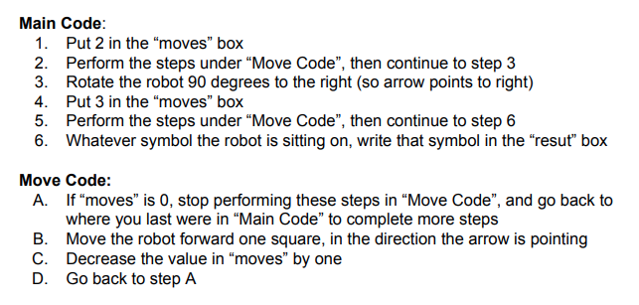
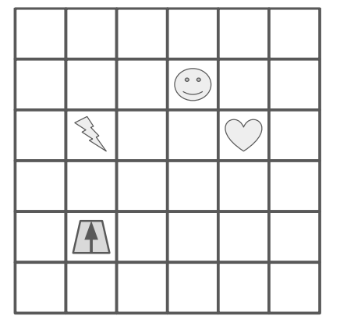
how do we write functions
like move code?
Functions are like “mini programs”,
as in our robot worksheet problem

Slide 4
Types of functions
Sometimes functions do things
Like “Move Code”
May produce output with print
May change variables
Sometimes functions produce values
Similar to mathematical functions
Many might say a function “returns a value”
Downey calls these functions “fruitful” functions
(we’ll use this, but don’t expect people to generally be aware of this terminology)
Sometimes functions do both!

Slide 5
Types of functions
Sometimes functions do things
Like “Move Code”
May produce output with print
May change variables
Sometimes functions produce values
Similar to mathematical functions
Many might say a function “returns a value”
Downey calls these functions “fruitful” functions
(we’ll use this, but don’t expect people to generally be aware of this terminology)
Sometimes functions do both!

Slide 6
Math to Python
Math:
f(x) = x²
Python:
def f(x):
return x ** 2

Slide 7
Math to Python
Math:
f(x) = x²
Python:
def f(x):
return x ** 2
Function name is “f”

Slide 8
Math to Python
Math:
f(x) = x²
Python:
def f(x):
return x ** 2
It takes one parameter, “x”

Slide 9
Math to Python
Math:
f(x) = x²
Python:
def f(x):
return x ** 2
In Python, start a function definition with “def” (short for definition),
and use a colon (“:”) instead of an equal sign (“=”)
1

Slide 10
Math to Python
Math:
f(x) = x²
Python:
def f(x):
return x ** 2
2
In Python, put the “return” keyword before
the expression associated with the function

Slide 11
Math to Python
Math:
f(x) = x²
Python:
def f(x):
return x ** 2
3
In Python, indent before the statement(s)

Slide 12
Math to Python
Math:
g(r) = πr²
Python:
def g(r):
return 3.14 * r ** 2
4
Computing the area from the radius

Slide 13
Math to Python
Math:
g(r) = πr²
Python:
def get_area(radius):
return 3.14 * radius ** 2
5
In Python, it’s common to have longer names for functions and arguments

Slide 14
Math to Python
Math:
g(r) = πr²
Python:
def get_area(diameter):
radius = diameter / 2
return 3.14 * radius ** 2
6
It’s also common to have more than one line of code (all indented)

Slide 15
Can we implement our own version of popular math functions?
abs(x)
sqrt(x)
pow(base, exp)
demos...

Slide 16
Rules for filling parameters...
function declaration
def foo(x, y=-1):
x =
y =
???
not actual code, but imagine
parameters as variables that are
automatically initialized for you
???
function invocation
foo(99, 100)
1
positional arguments

Slide 17
Rules for filling parameters...
def foo(x, y=-1):
x =
y =
99
100
foo(99, 100)
1
positional arguments

Slide 18
Rules for filling parameters...
def foo(x, y=-1):
def foo(x, y=-1):
x =
y =
99
x =
y =
100
100
99
foo(99, 100)
foo(y=99, x=100)
1
positional arguments
2
keyword arguments

Slide 19
Rules for filling parameters...
def foo(x, y=-1):
def foo(x, y=-1):
def foo(x, y=-1):
x =
y =
99
x =
y =
100
x =
y =
99
100
99
-1
foo(99, 100)
foo(y=99, x=100)
foo(99)
1
positional arguments
2
keyword arguments
3
default arguments
common pitfall: confusing keyword arguments and default arguments

Slide 20
Rules for filling parameters...
def foo(x, y=-1):
def foo(x, y=-1):
def foo(x, y=-1):
x =
y =
99
x =
y =
100
x =
y =
99
100
99
-1
foo(99, 100)
foo(y=99, x=100)
foo(99)
1
positional arguments
2
keyword arguments
3
default arguments
worksheet practice...

Slide 21
Where do modules come from?
pre-installed (e.g., math)
sqrt()
sin(), cos()
pi, etc.
built in
input()
print()
len()
etc.
installed (e.g., jupyter)
pip install jupyter
pip install ...
custom
dog
cat
...
demos...

Slide 22
Print vs. Return
A Function
parameters
call
return
arguments
Some Code

Slide 23
Print vs. Return
A Function
print
parameters
Program Output
(e.g., Terminal)
call
return
arguments
Some Code
print
we could call print from multiple places

Slide 24
Print vs. Return
A Function
print
1, 3, 2, 4
parameters
Program Output
(e.g., Terminal)
call
return
arguments
Some Code
print

Slide 25
Print vs. Return
A Function
print
parameters
Program Output
(e.g., Terminal)
call
return
1, 3, 2, 4
arguments
Some Code
print
returning, instead of printing, gives callers different options for how to use the result

Slide 26
Print vs. Return
A Function
print
parameters
Program Output
(e.g., Terminal)
call
return
1, 3, 2, 4
arguments
Some Code
print
returning, instead of printing, gives callers different options for how to use the result

Slide 27

Print vs. Return
A Function
print: a function can print as much as it likes
parameters
Program Output
(e.g., Terminal)
call
return: you only get to answer once, then function stops
arguments
Some Code
countdown
example...
https://memegenerator.net/instance/56355449/millionaire-regis-is-that-your-final-answer
returning, instead of printing, gives callers different options for how to use the result

Slide 28
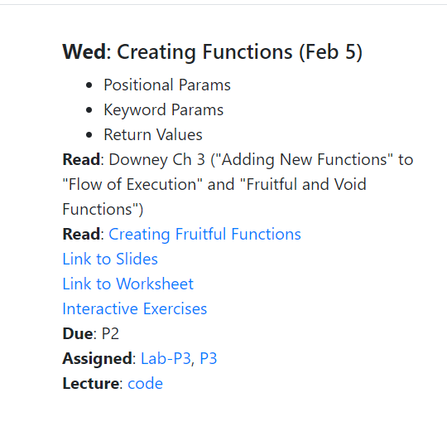
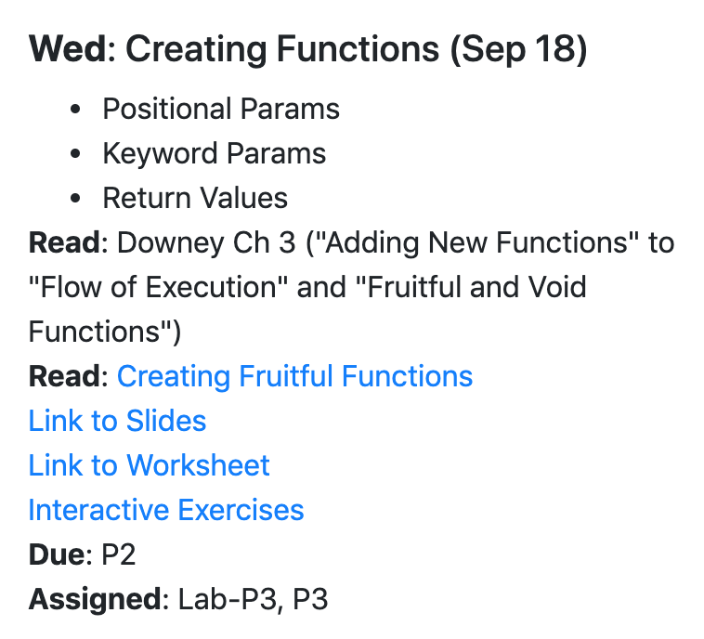
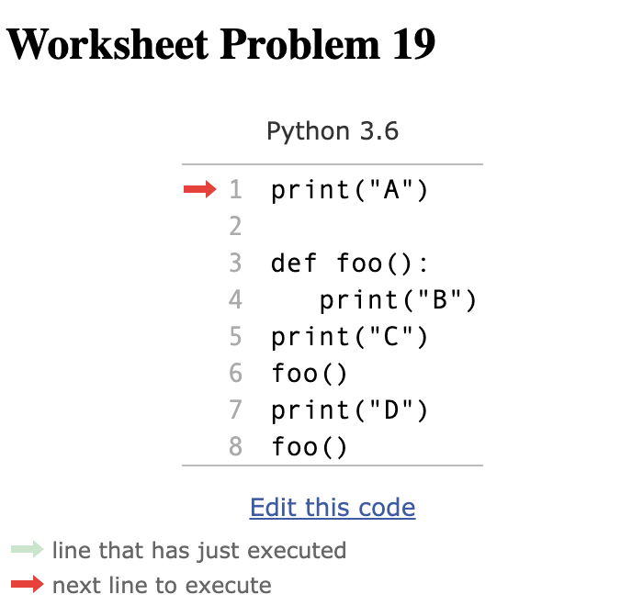
Checking Examples with PythonTutor
...

Slide 29
Demo: Approximation Program
input: a number from user
output: is it approximately equal to an important number? (pi or zero)
python approx.py
please enter a number: 3.14
close to zero? False
close to pi? True
what is error between 4 and 8?
100%
50%
python approx.py
please enter a number: 0.000001
close to zero? True
close to pi? False
abs(8 - 4)
max(abs(4), abs(8))
python approx.py
please enter a number: 3
close to zero? False
close to pi? False

