Slide 1
[320] Special Methods
Meenakshi Syamkumar

Slide 2
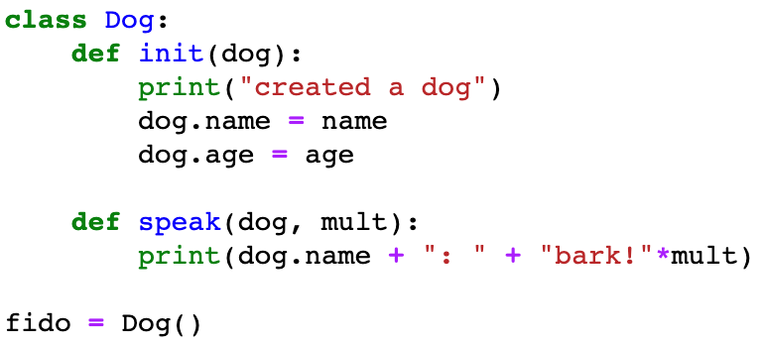
Classes
which one is an attribute?
dog
name
mult
fido

Slide 3
Classes
is this printed? do we crash?

Slide 4
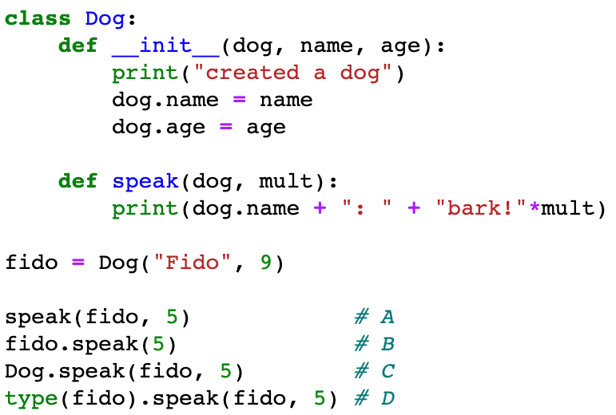
Classes
is this printed? do we crash?

Slide 5
Classes
# 1
# 2
# 3
# 4
which call won't work?

Slide 6
Classes
# 1
# 2
# 3
# 4
which call won't work?

Slide 7
Classes
# 1
# 2
# 3
# 4
which one is NOT an example
of type-based dispatch?

Slide 8
Classes
# 1
# 2
# 3
# 4
which one is NOT an example
of type-based dispatch?

Slide 9
Classes
# 1
# 2
# 3
# 4
which call style is preferred?

Slide 10
Classes
preferred style

Slide 11
Classes
what will be passed to the dog param?

Slide 12
Classes
what is a better name for the receiver parameter?

Slide 13
Classes
what is a better name for the receiver parameter?
answer: self

Slide 14
Special Methods

Slide 15
Special Methods
__init__ is a special method, with non-standard behavior

Slide 16
Special Methods
There are MANY special method names:
https://docs.python.org/3/reference/datamodel.html#special-method-names
We'll learn a few:
__str__, __repr__, _repr_html_
__eq__, __lt__
__len__, __getitem__
__enter__, __exit__
control how an object looks when we print it or see it in Out[N]
generate HTML to create more visual representations of objects in Jupyter. Like tables for DataFrames

Slide 17
Special Methods
There are MANY special method names:
https://docs.python.org/3/reference/datamodel.html#special-method-names
We'll learn a few:
__str__, __repr__, _repr_html_
__eq__, __lt__
__len__, __getitem__
__enter__, __exit__
define how == behaves for two different objects
define how a list of objects should be sorted
c = (a==b) # type of c?

Slide 18
Special Methods
There are MANY special method names:
https://docs.python.org/3/reference/datamodel.html#special-method-names
We'll learn a few:
__str__, __repr__, _repr_html_
__eq__, __lt__
__len__, __getitem__
__enter__, __exit__
build our own sequences that we index, slice, and loop over:
val = obj[idx]
vals = obj[3:7]
for x in obj:
print(x)
what goes
in brackets?

Slide 19
Special Methods
There are MANY special method names:
https://docs.python.org/3/reference/datamodel.html#special-method-names
We'll learn a few:
__str__, __repr__, _repr_html_
__eq__, __lt__
__len__, __getitem__
__enter__, __exit__
context managers
with open("file.txt") as f:
data = f.read()
# automatically close

