Slide 1
[320] Regular Expressions
Meenakshi Syamkumar

Slide 2
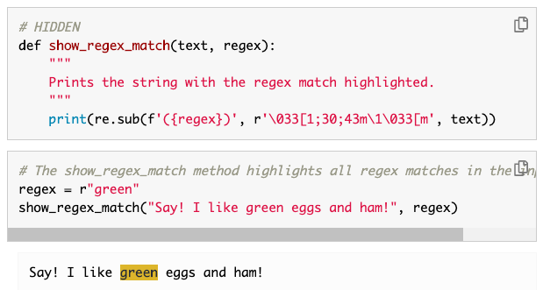

Reading
New text: Principles and Techniques of Data Science New text: by Sam Lau, Joey Gonzalez, and Deb Nolan
Used for Berkeley's DS100 Course.
Read Chapter 13: https://www.textbook.ds100.org/ch/13/text_regex.html
be sure to expand
the hidden cells!

Slide 3
Regular Expressions
Regex:
a small language for describing patterns to search for
regex patterns are used in many different programming languages (like how many different languages might use SQL queries)
https://blog.teamtreehouse.com/regular-expressions-10-languages
msg = "In CS 320, there are 14 quizzes, 7 projects, 41 lectures, and 1000 things to learn. CS 320 is awesome!"
# does the string contain "320"?
has_320 = msg.find("320") >= 0
Stephen Cole Kleene
(UW-Madison mathematician)
str.find is VERY limited -- what if we want to:
find all occurrences of "320"
find any 3-digit numbers?
find any numbers at all?
find a number before the word "projects"?
substitute a number for something else?
Regexes can do all these things!

Slide 4
In Python, regular expressions usually use "raw" strings
what character(s) does print("A\tB") print between "A" and "B"?

Slide 5
In Python, regular expressions usually use "raw" strings
TAB, because
backslash is the
escape character
what character(s) does print("A\tB") print between "A" and "B"?
what if we actually want a backslash and a "t"?

Slide 6
In Python, regular expressions usually use "raw" strings
TAB, because
backslash is the
escape character
what character(s) does print("A\tB") print between "A" and "B"?
what if we actually want a backslash and a "t"?
print("A\\tB")
print(r"A\tB")
this is a raw string,
so "\" isn't an escape character
Python regex functions do their own escaping, so this is very handy!

Slide 7
Double Escaping
Python
Regex
"\t"
" "
" "
"\\t"
"\t"
" "
"\\\t"
"\ "
" "
"\\\\t"
"\\t"
"\t"
r"\t"
"\t"
" "
r"\\t"
"\\t"
"\t"

Slide 8
Notebook Demos (copy/paste to start)...
import re
# from DS100 book...
def reg(regex, text):
"""
Prints the string with the regex match highlighted.
"""
print(re.sub(f'({regex})', r'\033[1;30;43m\1\033[m', text))
s1 = " ".join(["A DAG is a directed graph without cycles.",
"A tree is a DAG where every node has one parent (except the root, which has none).",
"To learn more, visit www.example.com or call 1-608-123-4567. :) ¯\_(ツ)_/¯"])
print(s1)
s2 = """1-608-123-4567
a-bcd-efg-hijg (not a phone number)
1-608-123-456 (not a phone number)
608-123-4567
123-4567
1-123-4567
"""
print(s2)
s3 = "In CS 320, there are 14 quizzes, 7 projects, 41 lectures, and 1000 things to learn. CS 320 is awesome!"
print(s3)
s4 = """In CS 320, there are 14 quizzes, 7 projects,
41 lectures, and 1000 things to learn. CS 320 is awesome!"""
print(s4)

Slide 9
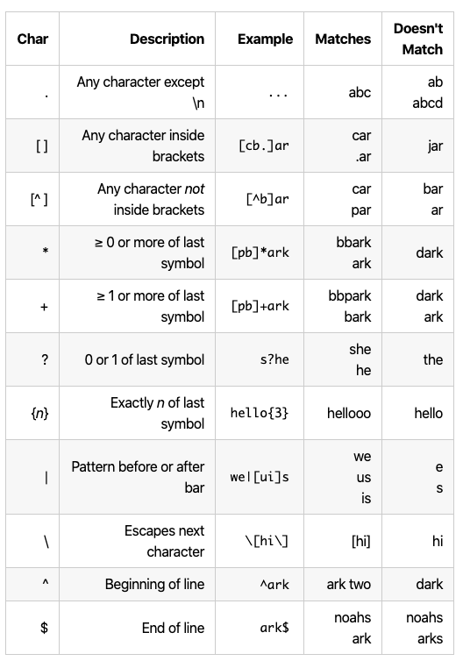
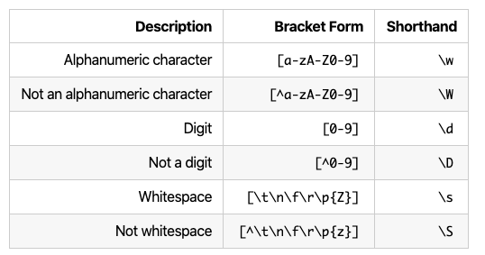
Learn Regex Features!
Good overview here: https://www.textbook.ds100.org/ch/08/text_regex.html#Reference-Tables
(screenshots here for convenience)
*?
+?
non-greedy equivalents:

Slide 10
Python re Module: findall and sub
import re
s = 'In CS 320, there are 10 quizzes, 7 projects, 39 lectures, and 1000 things to learn. CS 320 is awesome!'
re.findall(r"\d+", s)
re.sub(r"\d+", "###", s)
pattern
input str
pattern
replacement
input str

Slide 11
Python re Module: findall and sub
import re
s = 'In CS 320, there are 10 quizzes, 7 projects, 39 lectures, and 1000 things to learn. CS 320 is awesome!'
re.findall(r"\d+", s)
re.sub(r"\d+", "###", s)
pattern
input str
pattern
replacement
input str
['320', '10', '7', '39', '1000', '320']
'In CS ###, there are ### quizzes, ### projects, ### lectures, and ### things to learn. CS ### is awesome!'

Slide 12
Groups
import re
s = 'In CS 320, there are 10 quizzes, 7 projects, 39 lectures, and 1000 things to learn. CS 320 is awesome!'
re.findall(r"(\d+) (\w+)", s)
group 1
group 2

Slide 13
Groups
import re
s = 'In CS 320, there are 10 quizzes, 7 projects, 39 lectures, and 1000 things to learn. CS 320 is awesome!'
re.findall(r"(\d+) (\w+)", s)
group 1
group 2
[('10', 'quizzes'), ('7', 'projects'), ('39', 'lectures'),
('1000', 'things'), ('320', 'is')]

Slide 14
Groups
import re
s = 'In CS 320, there are 10 quizzes, 7 projects, 39 lectures, and 1000 things to learn. CS 320 is awesome!'
group 1
re.findall(r"((\d+) (\w+))", s)
group 2
group 3
[('10 quizzes', '10', 'quizzes'),
('7 projects', '7', 'projects'),
('39 lectures', '39', 'lectures'),
('1000 things', '1000', 'things'),
('320 is', '320', 'is')]

Slide 15
Python re Module: findall and sub
import re
s = """In CS 320, there are 10 quizzes, 7 projects,
41 lectures, and 1000 things to learn. CS 320 is awesome!"""
2 spaces
tab
newline
re.sub(r"\s+", " ", s)
pattern
replacement
input str
'In CS 320, there are 10 quizzes, 7 projects, 39 lectures, and 1000 things to learn. CS 320 is awesome!'
single space is only separator!

Slide 16
Python re Module: findall and sub
import re
s = """In CS 320, there are 10 quizzes, 7 projects,
41 lectures, and 1000 things to learn. CS 320 is awesome!"""
re.sub(r"(\d+)", "<b>\g<1></b>", s)
use \g<N> to refer to group N

Slide 17
Python re Module: findall and sub
import re
s = """In CS 320, there are 10 quizzes, 7 projects,
41 lectures, and 1000 things to learn. CS 320 is awesome!"""
re.sub(r"(\d+)", "<b>\g<1></b>", s)
In CS <b>320</b>, there are <b>10</b> quizzes, <b>7</b> projects, <b>39</b> lectures, and <b>1000</b> things to learn. CS <b>320</b> is awesome!
In CS 320, there are 10 quizzes, 7 projects, 39 lectures, and 1000 things to learn. CS 320 is awesome!

Slide 18
Review Regular Expressions
Which regex will NOT match "123"
r"\d\d\d"
r"\d{3}"
r"\D\D\D"
r"..."
Which string(s) will match r"^(ha)*$"
""
"hahah"
"that"
"HAHA"
What will r"^A" match?
"A"
"^A"
"BA"
"B"
"BB"
What is the type of the following?re.findall(r"(\d) (\w+)", some_str)[0]
list
tuple
string
Which one can match "HH"?
r"HA+H"
r"HA+?H"
r"H(A+)?H"
What will it do?
re.sub(r"(\d{3})-(\d{3}-\d{4})",
r"(\g<1>) \g<2>",
"608-123-4567")

Slide 19
Practice
finding emails, extracting function names, other examples...

