Slide 1
[220 / 319] Iteration 2
Meena Syamkumar
Andy Kuemmel
Exam I Friday
Consider finding a project partner

Slide 2
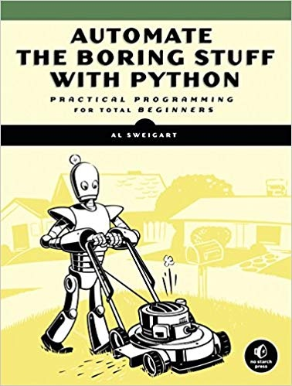
Learning Objectives Today
Understand break
Syntax
Control flow
Use cases
Understand continue
Syntax
Control flow
Use cases
Nested loops
Interaction with break/continue
Chapter 7 of Think Python
Chapter 2 of Sweigart
(great recap so far)
http://automatetheboringstuff.com/chapter2/

Slide 3
Today's Outline
Design Patterns
Worksheet
        Break
        Continue
        Nesting
Don’t get too excited,
only the loops get a break!

Slide 4
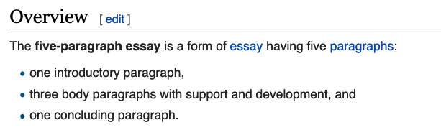
Design Patterns (outside Programming)
[wikipedia]

Slide 5
Design Patterns (outside Programming)
1st
3rd
2nd
[wikipedia]
somebody familiar with this structure might skip around
there are many similarities between reading/writing code and essays

Slide 6
Design Patterns
i = 1
while i <= 30:
    n = i * 2
    print(n)
    i += 1
When you ask a programmer what a piece of code
does, what do they look at, and in what order?
Way 1: walk through in order (never a bad option)

Slide 7
Design Patterns
i
1
i = 1
while i <= 30:
    n = i * 2
    print(n)
    i += 1
When you ask a programmer what a piece of code
does, what do they look at, and in what order?
Way 1: walk through in order (never a bad option)

Slide 8
Design Patterns
i
1
i = 1
while i <= 30:
    n = i * 2
    print(n)
    i += 1
When you ask a programmer what a piece of code
does, what do they look at, and in what order?
Way 1: walk through in order (never a bad option)

Slide 9
Design Patterns
i
1
n
2
i = 1
while i <= 30:
    n = i * 2
    print(n)
    i += 1
When you ask a programmer what a piece of code
does, what do they look at, and in what order?
Way 1: walk through in order (never a bad option)

Slide 10
Design Patterns
i
1
n
2
Output
2
i = 1
while i <= 30:
    n = i * 2
    print(n)
    i += 1
When you ask a programmer what a piece of code
does, what do they look at, and in what order?
Way 1: walk through in order (never a bad option)

Slide 11
Design Patterns
i
1 2
n
2
Output
2
i = 1
while i <= 30:
    n = i * 2
    print(n)
    i += 1
When you ask a programmer what a piece of code
does, what do they look at, and in what order?
Way 1: walk through in order (never a bad option)

Slide 12
Design Patterns
i
1 2
n
2
Output
2
i = 1
while i <= 30:
    n = i * 2
    print(n)
    i += 1
When you ask a programmer what a piece of code
does, what do they look at, and in what order?
Way 1: walk through in order (never a bad option)

Slide 13
Design Patterns
i
1 2
n
2 4
Output
2
i = 1
while i <= 30:
    n = i * 2
    print(n)
    i += 1
When you ask a programmer what a piece of code
does, what do they look at, and in what order?
Way 1: walk through in order (never a bad option)

Slide 14
Design Patterns
i
1 2
n
2 4
Output
2
4
i = 1
while i <= 30:
    n = i * 2
    print(n)
    i += 1
When you ask a programmer what a piece of code
does, what do they look at, and in what order?
Way 1: walk through in order (never a bad option)

Slide 15
Design Patterns
i
1 3
n
2 4
Output
2
4
…
i = 1
while i <= 30:
    n = i * 2
    print(n)
    i += 1
When you ask a programmer what a piece of code
does, what do they look at, and in what order?
Way 1: walk through in order (never a bad option)

Slide 16
Design Patterns
i = 1
while i <= 30:
    n = i * 2
    print(n)
    i += 1
When you ask a programmer what a piece of code
does, what do they look at, and in what order?
Way 2: knowing that certain code is written again
and again, look for common patterns to break it down

Slide 17
Design Patterns
experienced coders will focus in
on everything about “i” first
because that is in the loop condition
i = 1
while i <= 30:
    n = i * 2
    print(n)
    i += 1
When you ask a programmer what a piece of code
does, what do they look at, and in what order?
Observation: loop will run with values of i of: 1 to 30

Slide 18
Design Patterns
i = 1
while i <= 30:
    n = i * 2
    print(n)
    i += 1
When you ask a programmer what a piece of code
does, what do they look at, and in what order?
Observation: highlighted code runs 30 times, with i values of 1 through 30

Slide 19
Design Patterns
i = 1
while i <= 30:
    n = i * 2
    print(n)
    i += 1
n = 1 * 2
print(n)
n = 2 * 2
print(n)
n = 3 * 2
print(n)
...
n = 30 * 2
print(n)
When you ask a programmer what a piece of code
does, what do they look at, and in what order?
Observation: highlighted code runs 30 times, with i values of 1 through 30

Slide 20
Design Patterns
Output
2
4
6
8
…
56
58
60
i = 1
while i <= 30:
    n = i * 2
    print(n)
    i += 1
n = 1 * 2
print(n)
n = 2 * 2
print(n)
n = 3 * 2
print(n)
...
n = 30 * 2
print(n)
When you ask a programmer what a piece of code
does, what do they look at, and in what order?
Conclusion: the code prints 2, 4, 6, …, 58, 60

Slide 21
Design Pattern 1: do something N times
i = 1
while i <= N:
    i += 1
Option A
fill in with specifics here
Option B

Slide 22
Design Pattern 1: do something N times
i = 1
while i <= N:
    i += 1
Option A
fill in with specifics here
i = 0
while i < N:
    i += 1
fill in with specifics here
Option B

Slide 23
Design Pattern 1: do something N times
i = 1
while i <= N:
    i += 1
Option A
fill in with specifics here
1, 2, 3, …, N
i = 0
while i < N:
    i += 1
fill in with specifics here
Option B
0, 1, 2, …, N-1

Slide 24
Design Pattern 2: do something with all data
i = 0
while i < N:
    i += 1
fill in with specifics here
State | Population | Area
WI | 5.795 | …
CA | 39.54 | …
MN | 5.577 | …
… | … | …

Slide 25
Design Pattern 2: do something with all data
i = 0
while i < N:
    i += 1
fill in with specifics here
Functions:
count_rows()
get_population(index)
…
State | Population | Area
WI | 5.795 | …
CA | 39.54 | …
MN | 5.577 | …
… | … | …
index 0

Slide 26
Design Pattern 2: do something with all data
i = 0
while i < N:
    i += 1
fill in with specifics here
Functions:
count_rows()
get_population(index)
…
State | Population | Area
WI | 5.795 | …
CA | 39.54 | …
MN | 5.577 | …
… | … | …
index 1

Slide 27
Design Pattern 2: do something with all data
i = 0
while i < count_rows():
    pop = get_population(i)
    i += 1
fill in with specifics here
Functions:
count_rows()
get_population(index)
…
State | Population | Area
WI | 5.795 | …
CA | 39.54 | …
MN | 5.577 | …
… | … | …

Slide 28
Design Pattern 2: do something with all data
i = 0
while i < count_rows():
    pop = get_population(i)
    i += 1
fill in with specifics here
assumes we
use 0 for first row
Functions:
count_rows()
get_population(index)
…
State | Population | Area
WI | 5.795 | …
CA | 39.54 | …
MN | 5.577 | …
… | … | …

Slide 29
Design Pattern 3: do something until the end
while has_more():
    data = get_next()
fill in with specifics here
People creating functions/modules for other programmers
to use will often have functions for checking if there is more
data and for getting the data one piece at a time

Slide 30
Today's Outline
Design Patterns
Worksheet
Problem 1
Problem 2
        Break
        Continue
        Nesting

Slide 31
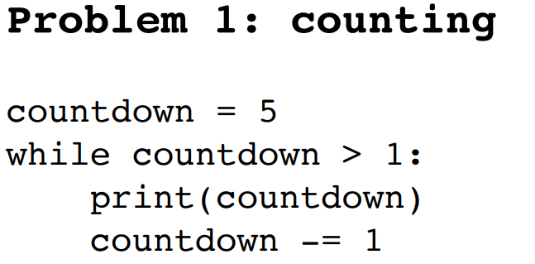

Slide 32
countdown
5
4
3
2

Slide 33
countdown
5
4
3
2
output
5
4
3
2

Slide 34
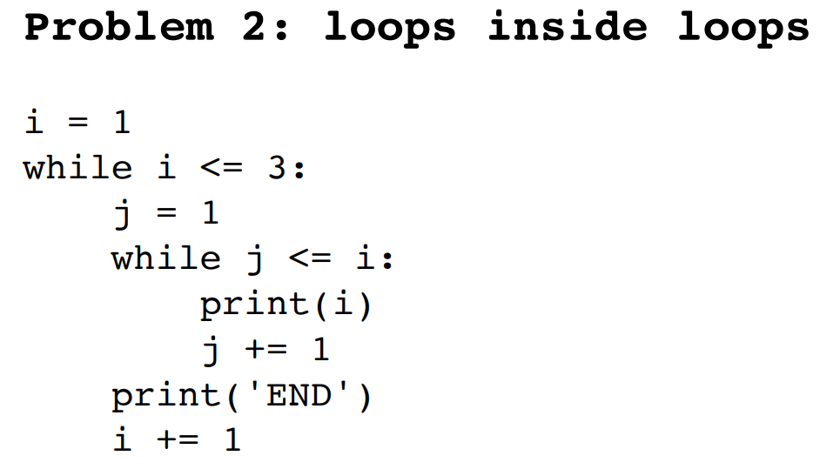

Slide 35
i
1
2
3

Slide 36
i j
1 1
2 1
2 2
1
3 2
3 3

Slide 37
i j
1 1
2 1
2 2
1
3 2
3 3
Output
1
END
2
2
END
3
3
3
END

Slide 38
Today's Outline
Design Patterns
Worksheet
        Break
        Continue
        Nesting

Slide 39
Basic Control Flow
at end, always go
back to condition check
  while CONDITION:
  code after the loop…
True
block of code…
maybe many lines…
False

Slide 40
Basic Control Flow
at end, always go
back to condition check
  while CONDITION:
  code after the loop…
True
code
…
if CONDITION:
break
…
more code
False
Just like return immediately exits a function,
break immediately exits a loop

Slide 41
Basic Control Flow
at end, always go
back to condition check
  while CONDITION:
  code after the loop…
True
code
…
if CONDITION:
break
…
more code
False
Usage: Commonly used when we’re searching through many things.
Allows us to stop as soon as we find what we want.

Slide 42
Demo: Prime Search Program
        Goal: answer whether a range of numbers contains a prime
        Input:
Start of range
End of range
        Output:
Yes or no
        Examples:
        14 to 16 => NO (because 14, 15, and 16 are all not prime)
        10 to 12 => YES (because 11 is prime)
10
11
12
13
14
15
16
17

Slide 43
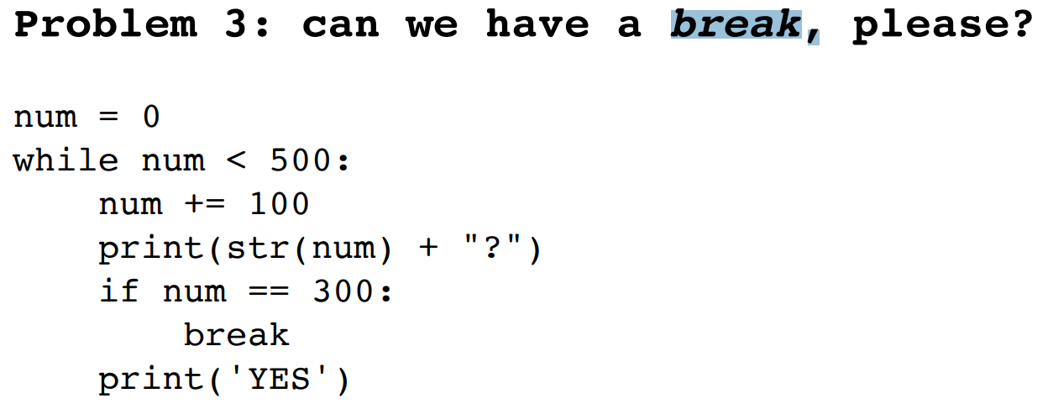

Slide 44
num
0
100
200
300
400

Slide 45
inside
sandwich
100
200
300
400
500
num
0
100
200
300
400

Slide 46
inside
sandwich
100
200
300
400
500
num
0
100
200
300
400
output
100?
YES
200?
YES
300?

Slide 47
Today's Outline
Design Patterns
Worksheet
        Break
        Continue
        Nesting

Slide 48
Basic Control Flow
at end, always go
back to condition check
  while CONDITION:
  code after the loop…
True
block of code…
maybe many lines…
False

Slide 49
Basic Control Flow
at end, always go
back to condition check
  while CONDITION:
  code after the loop…
True
code
…
if CONDITION:
continue
…
more code
False
continue immediately stops current iteration and
goes back to the condition, without executing the "more code part,
potentially to start another iteration

Slide 50
Basic Control Flow
at end, always go
back to condition check
  while CONDITION:
  code after the loop…
True
code
…
if CONDITION:
continue
…
more code
False
Usage: commonly used to skip over values we want to ignore

Slide 51
Demo: Average Score
        Goal: keep a running average of user-provided scores
        Input:
“q” for quit (keep running until this)
a score in the 0 to 100 range
        Output:
Recompute average and print after each new number
        Example:
        enter a score (or q for exit): 50
        avg is 50
        enter a score (or q for exit): 110
        bad input, skipping!
        enter a score (or q for exit): q
        exiting
Twist: use “continue” to skip over inputs not in the 0 to 100 range

Slide 52
Today's Outline
Design Patterns
Worksheet
        Break
        Continue
        Nesting

Slide 53
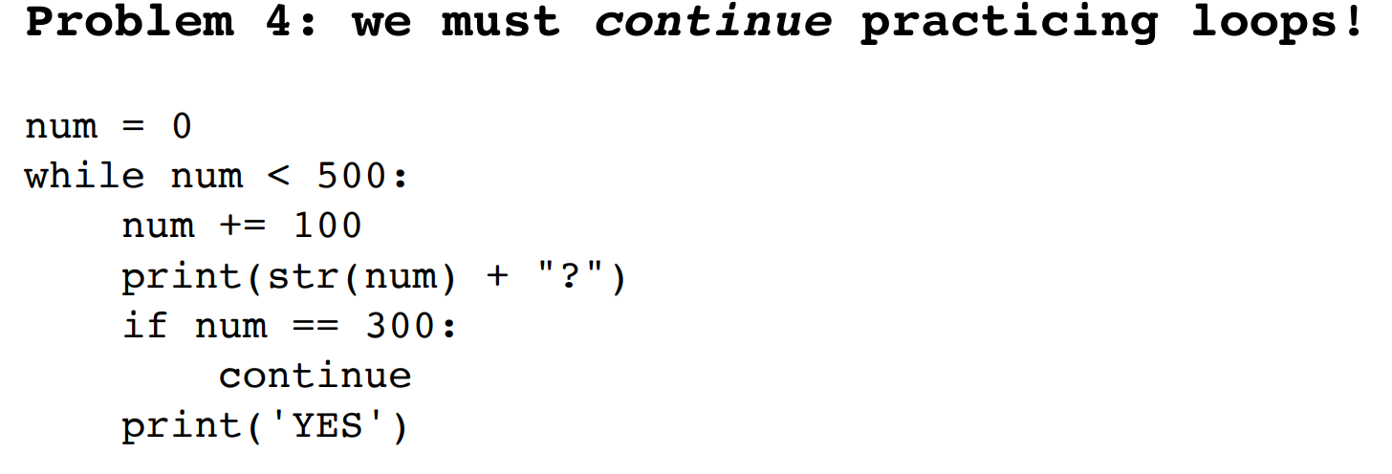

Slide 54
num
0
100
200
300
400

Slide 55
inside
sandwich
100
200
300
400
500
num
0
100
200
300
400

Slide 56
inside
sandwich
100
200
300
400
500
num
0
100
200
300
400
output
100?
YES
200?
YES
300?
400?
YES
500?
YES

Slide 57
Nested loops
while CONDITION_A:
# more code
while CONDITION_B:
# more code
if CONDITION_C:
continue
# more code
# more code
# code outside any loop
how many blocks are there?

Slide 58
Nested loops
while CONDITION_A:
# more code
while CONDITION_B:
# more code
if CONDITION_C:
continue
# more code
# more code
# code outside any loop

Slide 59
Nested loops
while CONDITION_A:
# more code
while CONDITION_B:
# more code
if CONDITION_C:
continue
# more code
# more code
# code outside any loop
where does this
jump back to?

Slide 60
Nested loops
while CONDITION_A:
# more code
while CONDITION_B:
# more code
if CONDITION_C:
continue
# more code
# more code
# code outside any loop
continue and break
always apply to the
inner loop in Python
https://www.python.org/dev/peps/pep-3136/

Slide 61
Nested loops
while CONDITION_A:
# more code
while CONDITION_B:
# more code
if CONDITION_C:
break
# more code
# more code
# code outside any loop
https://www.python.org/dev/peps/pep-3136/

Slide 62
Worksheet Problems

