Slide 1

The Big Picture
Jake Kelly and Yuankun Huang

Slide 2
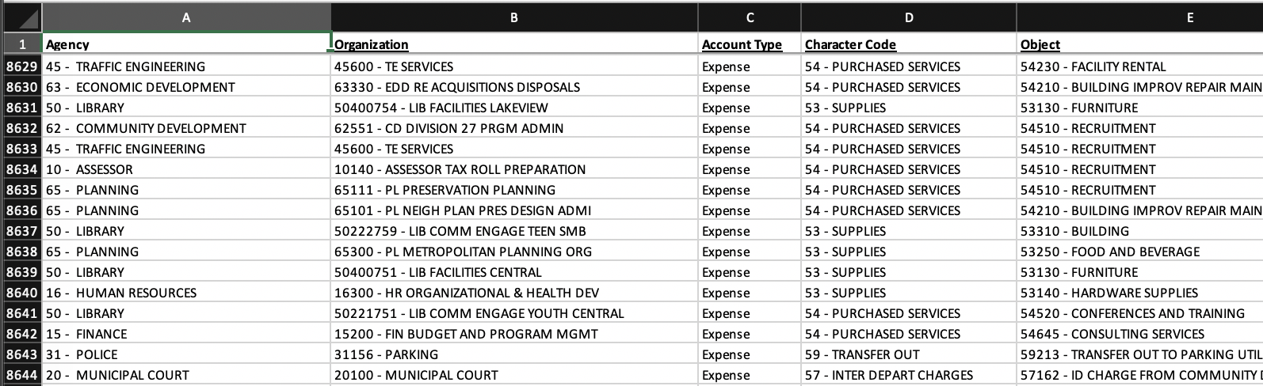
What our Data Looks Like?
8500+ budget entries
20+ agencies (departments)
80+ services
Across 4 years

Slide 3

Which Agencies to Pay Attention to?
Along Three Metrics:
Total Spending
Variability
Upward Trends

Slide 4
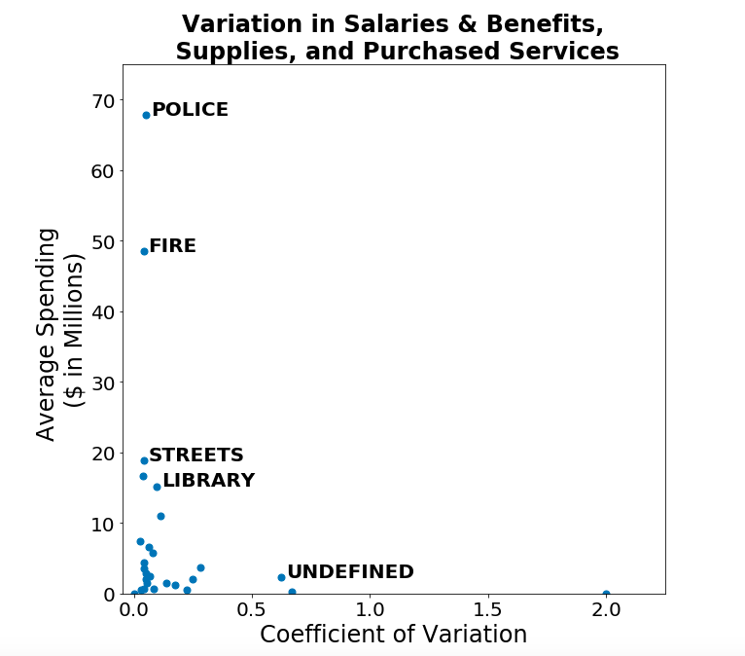
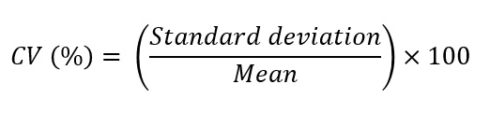
Which agencies have a non-negligible amount of total spending or variation in spending?
Focus on agencies with most spending and then look for variation within

Slide 5

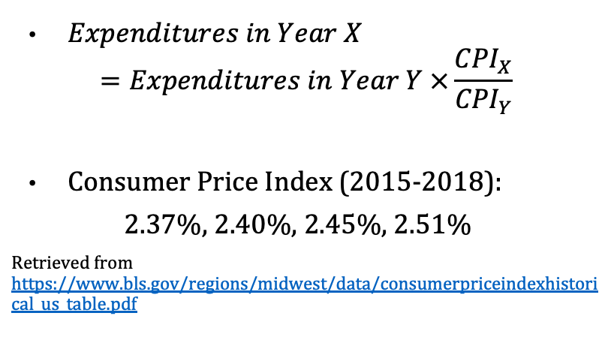
Inflation Adjustment Metrics
$Expenditures in Year X$
$$=Expenditures in Year Y ×\frac{{CPI}_{X}}{{CPI}_{Y}}$$
Consumer Price Index (2015-2018):
2.37%, 2.40%, 2.45%, 2.51%
Retrieved from https://www.bls.gov/regions/midwest/data/consumerpriceindexhistorical_us_table.pdf

Slide 6
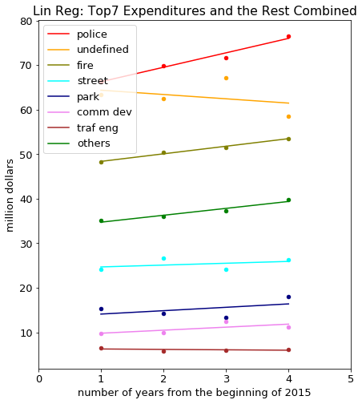
Linear Regression Lines
police
undefined
fire
others
street
Who is important?
park
traf eng
comm dev

Slide 7
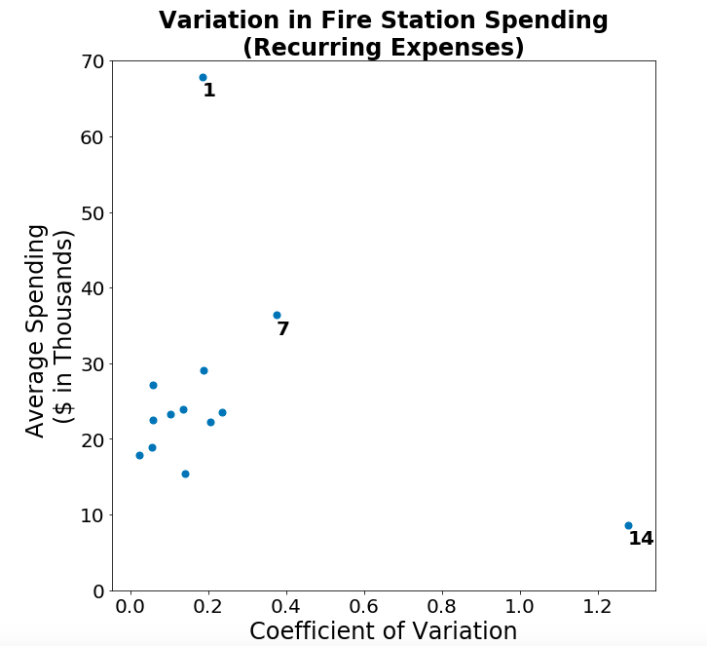
Which stations are worth investigating further?
Less variation = more predictive power
Can use to more confidently predict spending

Slide 8
Which stations are worth investigating further?
Less variation = more predictive power
Can use to more confidently predict spending
0.12

Slide 9

What happens within Police?
Complicated at a Glance:
Greatest total expenditures
40+ services within
Test:
Evenly distributed?
Skewed toward a few services?

Slide 10
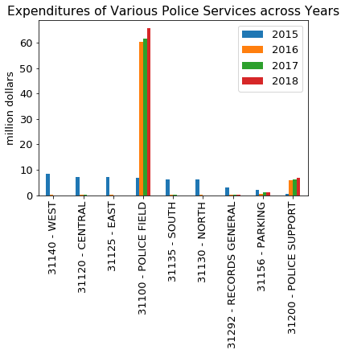
Single Leading Expenditure in Police Field

Slide 11

Questions?

