Slide 1


Going to Work
Jay Jin Woo Lee
Notes:
Hello, my name is Jin, and today, I will be exploring the bus transportation system especially the new rapid bus system’s effectiveness in getting commuters go to work.

Slide 2
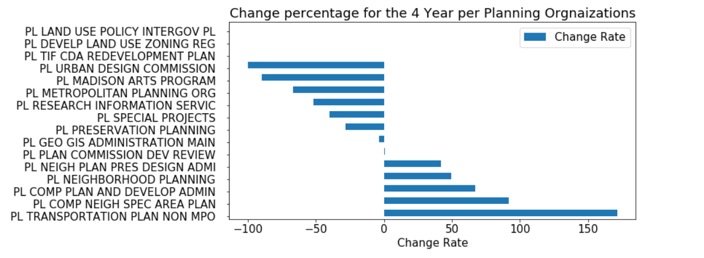
Which organizations within the planning agency have the greatest changes between 2015 and 2018?

Slide 3
Which organizations within the planning agency have the greatest changes between 2015 and 2018?

Slide 4
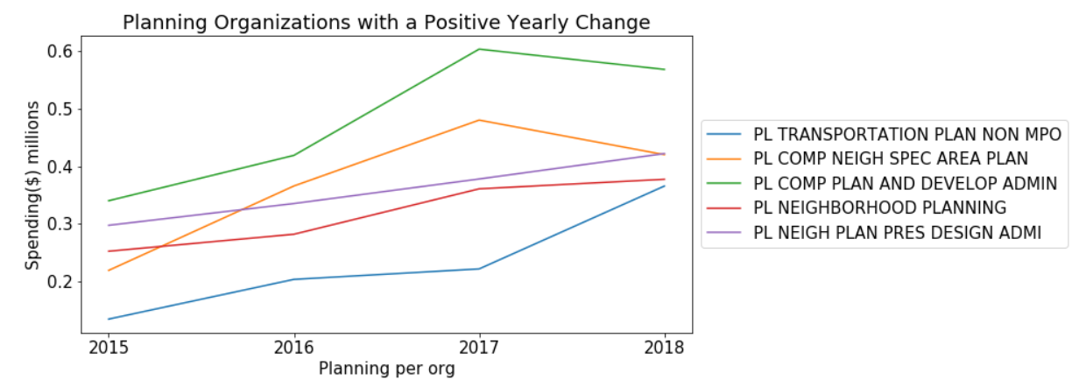
Transportation had the biggest difference between 2015 and 2018 expenditure…
But Why?
Notes:
I looked at whether the expenditures had increased over time and and found that the organizations had clear differences. The transportation had the biggest change between 2015 and 2018.

Slide 5
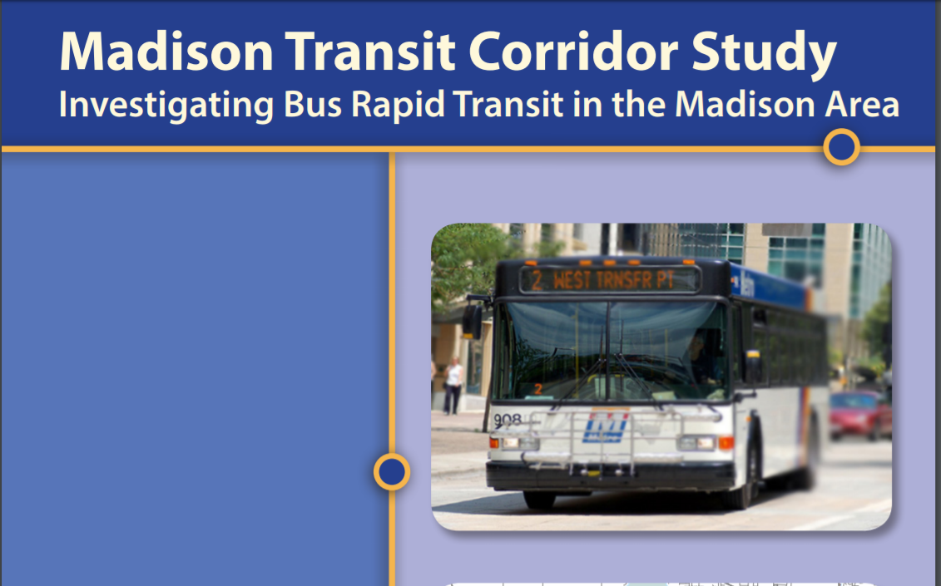

Slide 6
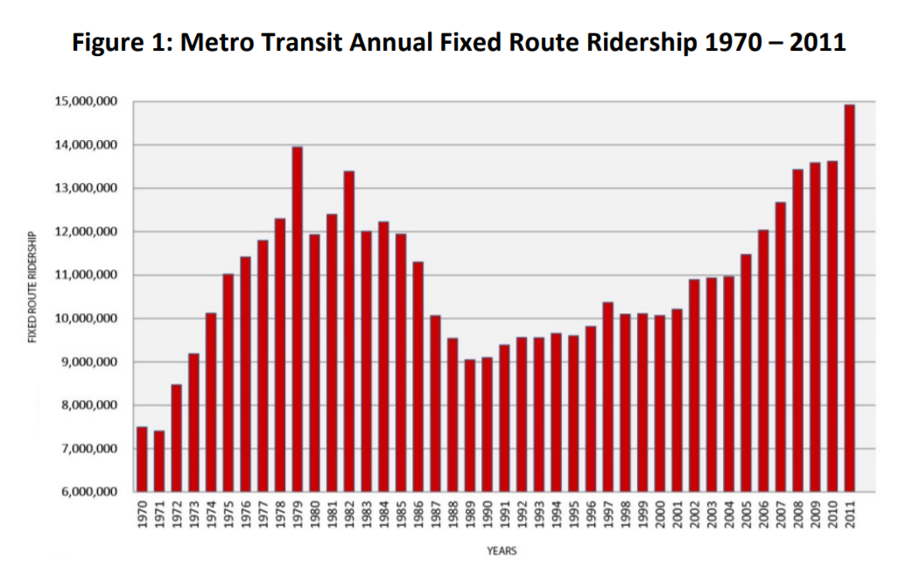
From 2001 to 2011, ridership increased a little less than 5 million.

Slide 7
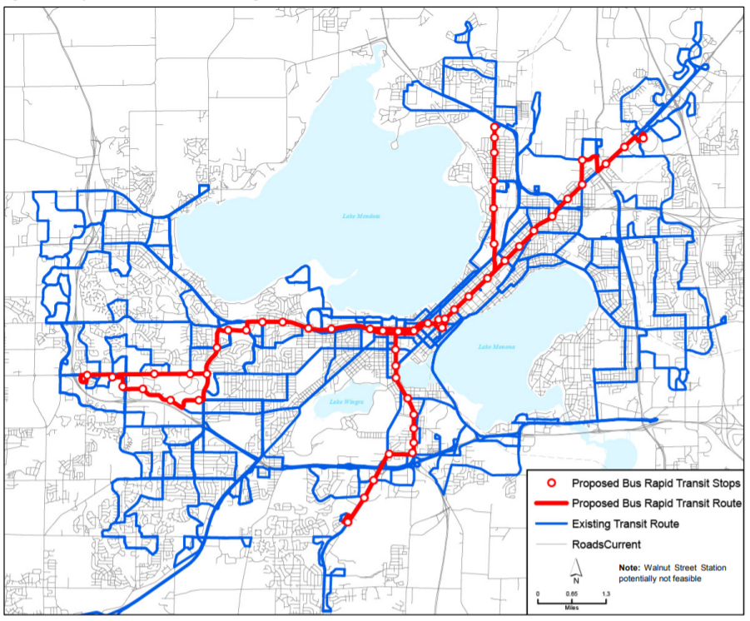
Madison Transit Corridor Study investigating bus rapid transit in Madison Area proposed in May 2013
Notes:
And so I looked at why this is and found that ridership in Madison metro has been increasing steadily for a decade til 2011. to support this, Conducted May 2013 Madison Corridor system did a study on implementing the rapid bus systems to increase ridership. The study focused on times, income areas, traffic and ridership. I wanted to look more into the effectiveness

Slide 8
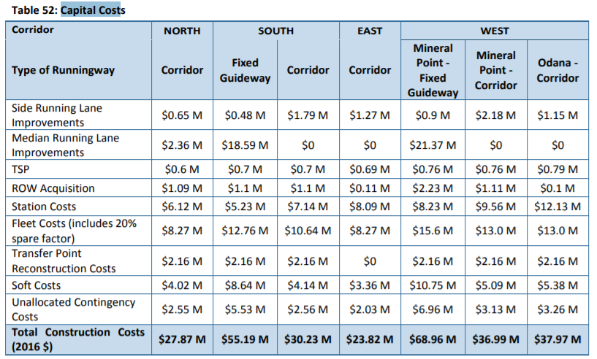
Total Capital cost over $276.03‬ Million

Slide 9
Ridership has increased by 5 million during 2001-2011
Transportation organization within planning agency expenditure has risen by 171% over the last 4 years
Currently spending $0.366 million
Projected capital cost of rapid bus systems is over $276.03‬ Million
Questions
Is the rapid bus system going to be effective investment?
How many people will use the rapid busses?

Slide 10
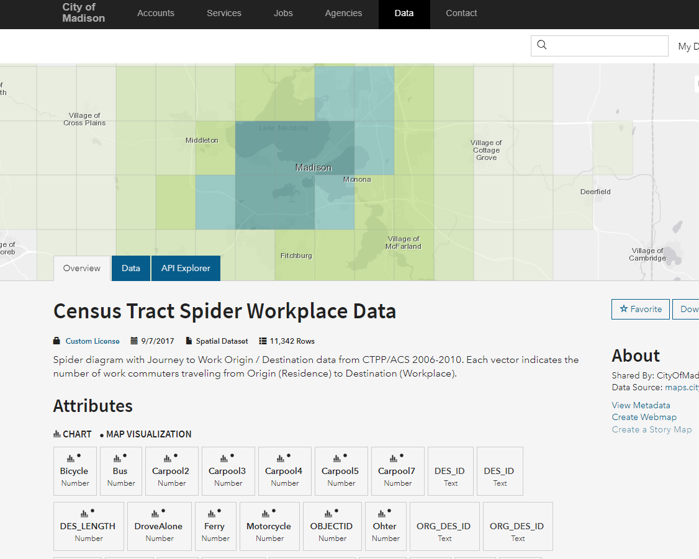
http://data-cityofmadison.opendata.arcgis.com/datasets/2bfd47ada14542c5969a6eb7e6f274dd_31?geometry=-89.925%2C42.981%2C-88.621%2C43.157 https://ctpp.transportation.org/ctpp-data-set-information/5-year-data/
The CTPP data product based on 2006 – 2010 5-year American Community Survey (ACS) Data is designed to help transportation analysts and planners understand where people are commuting to and from, and how they get there. The information is organized by where workers live, where they work, and by the flow between those places.
Notes:
I downloaded the census tract spider work place data from the city of Madison data base. This is based on the department of transportations ctpp data based on The CTPP data product based on 2006 – 2010 5-year American Community Survey (ACS) Data

Slide 11
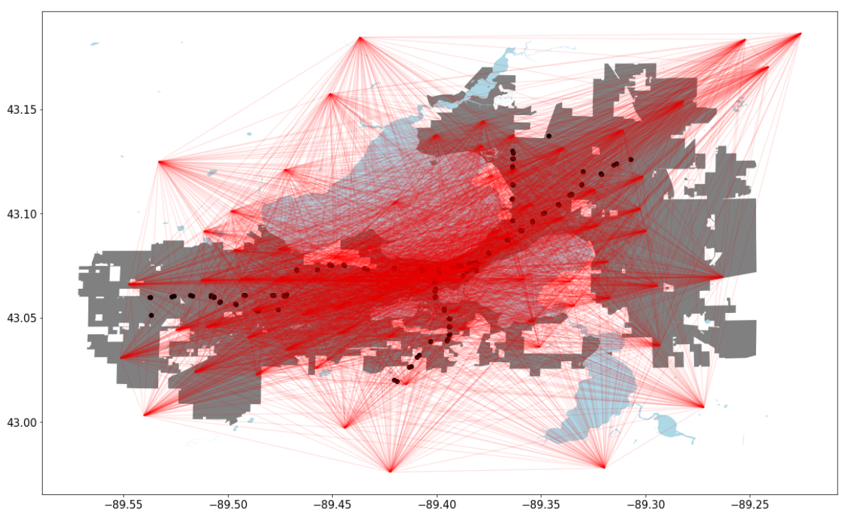
Notes:
This is the map of commuters directions and most of the commuters are headed towards the capital

Slide 12
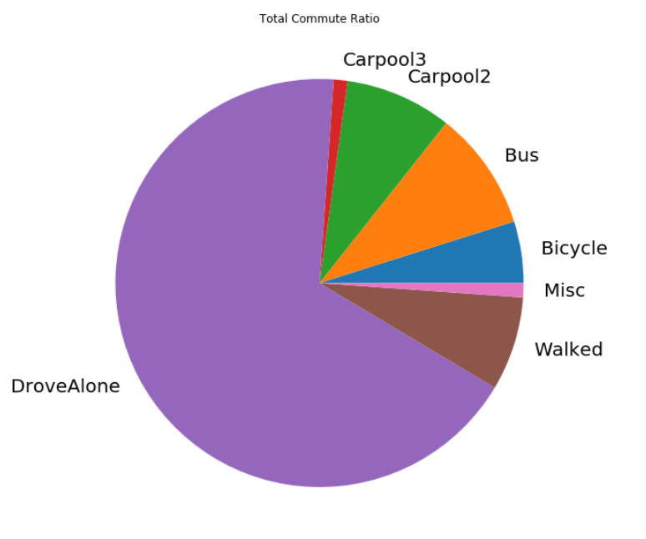
How do they get to work?
Many different ways: Walk, Drive, Carpool, Bus and Bike
67.5% of the people drive to work
9.4% of the people take the bus to work
7.4% of the people walk to work

Slide 13
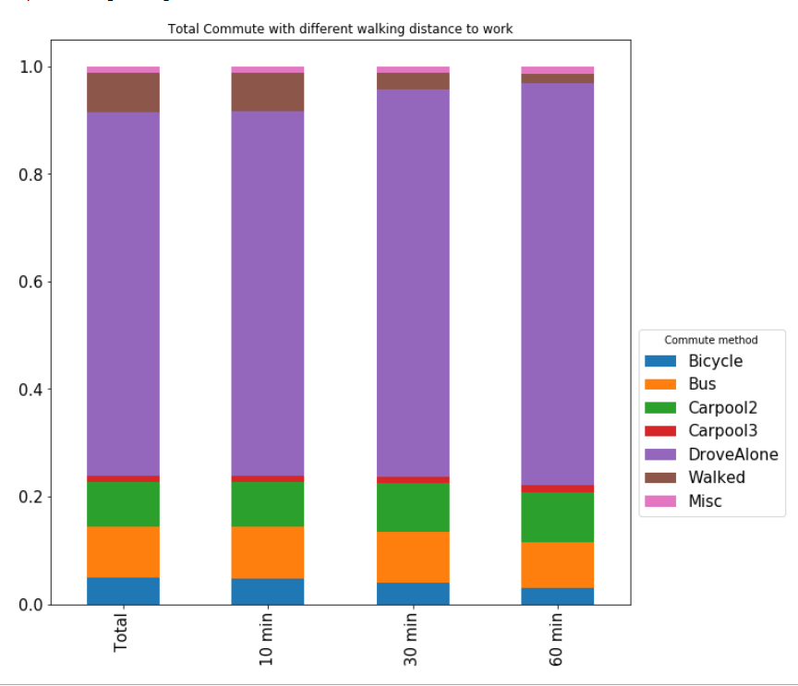
How does distance from their residence to work effect the commute?
When people are further away from work, they …
Walk to work noticeably less
Ride the bus but only slightly more
Drive to work noticeably more rather than taking the bus
Notes:
So I looked at how people got to their work and turns out most people drive. And I wanted to see if the distance between the residence and the bus stop had any effect on the bus ridership. In this example, it was hard to see a difference.

Slide 14
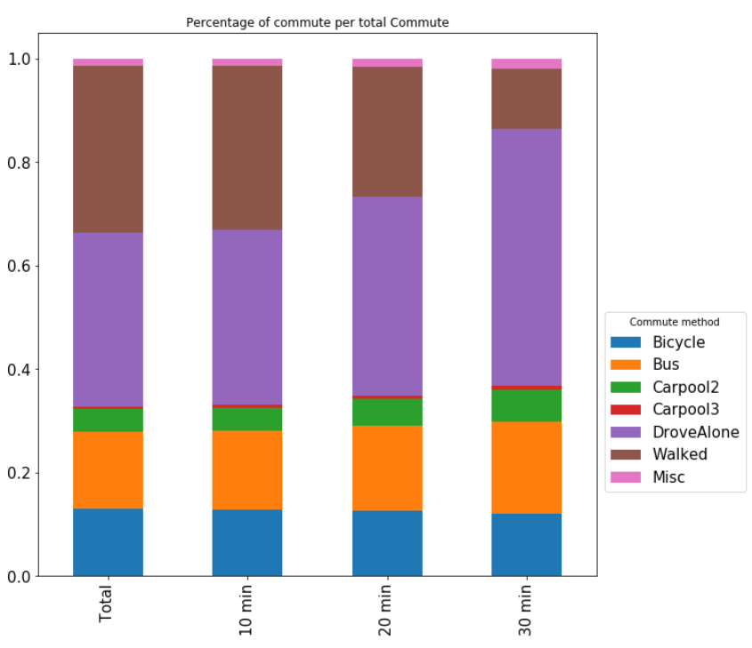
How does the distance from the residence to bus stops effect the ridership?
Bus Ridership percentage increased slightly
Walking to work percentage decreased drastically
Driving alone percentage increased drastically
The data becomes inaccurate because in campus, many people live close to bus stops but walk to work since they live close to work anyway

Slide 15
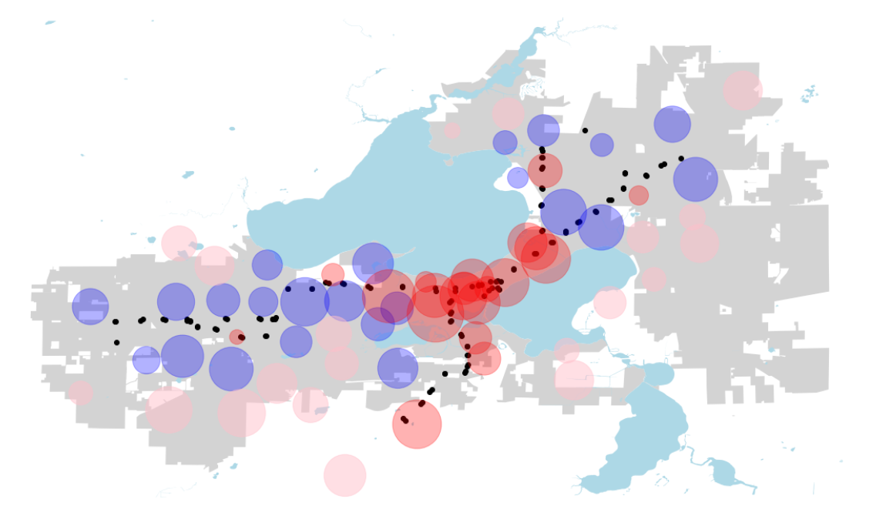
Where are they located?
Red = within 10 minute walking distance to bus stop
Blue = within 30 minutes walking distance to bus stop
Pink = more than 30 minutes walking distance to bus stop
Most people who are living in a 10 minute walking distance to bus stops are located near the capital
Notes:
So I decreased the sample to residences that are 4 miles or less away from the bus stop. The red are within 10 minute walking distance to the bus stop. The blue are within 30 minute walking distance to the bus stop and pink are the others. Get rid of the axis and add legend fill the scirlce

Slide 16
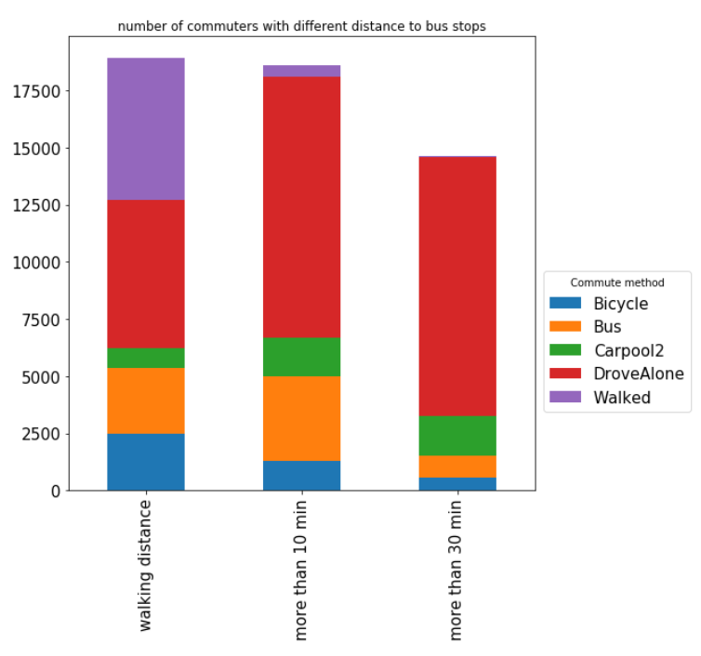
How does the different zones differ in ridership?
Red Zones
Most of the people walk due to them living on campus

Slide 17
How does the different zones differ in ridership?
The blue zones
Not many people walk to work anymore
More people are taking the bus to work
Most people choose to drive rather than taking the bus or walk

Slide 18
How does the different zones differ in ridership?
The Pink zones
People do not walk to work
Most people drive to work rather than talk the bus

Slide 19
Where are they located?
Red = within 10 minute walking distance to bus stop
Blue = within 30 minutes walking distance to bus stop
Pink = more than 30 minutes walking distance to bus stop
Notes:
So I decreased the sample to residences that are 4 miles or less away from the bus stop. The red are within 10 minute walking distance to the bus stop. The blue are within 30 minute walking distance to the bus stop and pink are the others. Get rid of the axis and add legend fill the scirlce

Slide 20
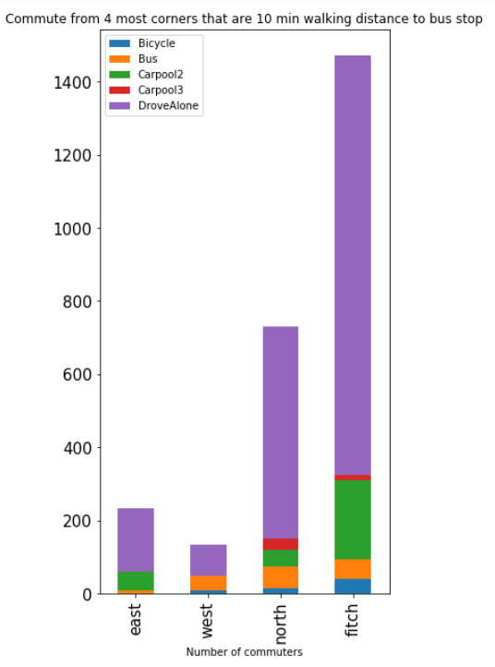
Which rapid bus stops are getting most ridership?
Focus only on the four most corners of the commute areas near the bus stops
North and Fitchburg has most ridership
North has most number of the ridership compared to others

Slide 21
In Conclusion…
Most effective
Fitchburg and North transfer point area are reaching the target ridership
Location
Bus stops needs to be closer to resident population
West side
Encourage people to take the bus rather than driving
Notes:
So I decreased the sample to residences that are 4 miles or less away from the bus stop. The red are within 10 minute walking distance to the bus stop. The blue are within 30 minute walking distance to the bus stop and pink are the others. Get rid of the axis and add legend fill the scirlce
In conclusion, I think to maximize ridership, the bus stops needs to be closer to the resident population. It is doing a well job in the north and Fitchburg area. However, the west side, where most people live, the bus stops could be closer which will make people less likely to drive their cars to work.

Slide 22
How to go forward…
Future work
Look in to which routes are going to be most effective
Issues encountered
Scope limitation
Reference
City of Madison

Slide 23
Thank you
Jay Jin Woo Lee

