Slide 1
Budget Simulation
By: Xi He, Sally Hu, Christopher Harte, Kyle Wiessinger

Slide 2
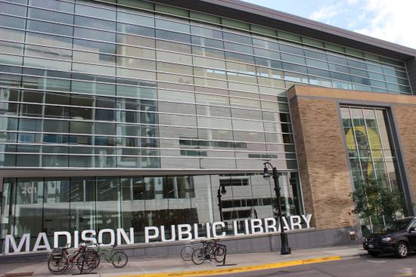
Libraries
10 years simulations starting from 2019 February to 2029 February
Salary Distribution
Trend of Salary
Spending

Slide 3
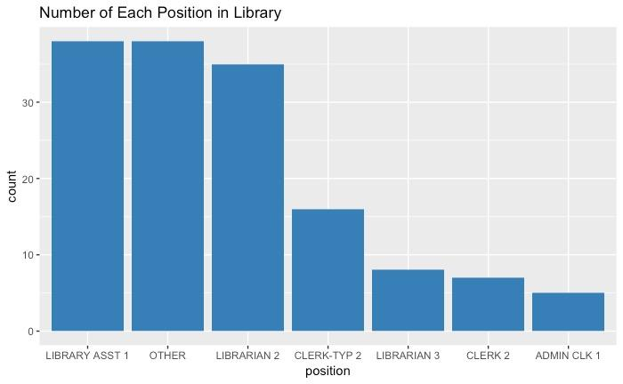
Number of People in Different Positions in Library

Slide 4
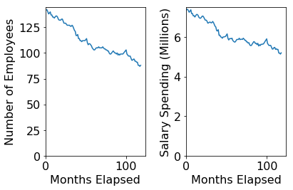
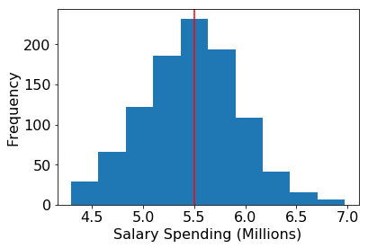
Simulation of Data for 10 years
Mean Salary Spending is $5.5 millions

Slide 5
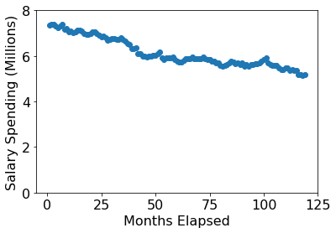
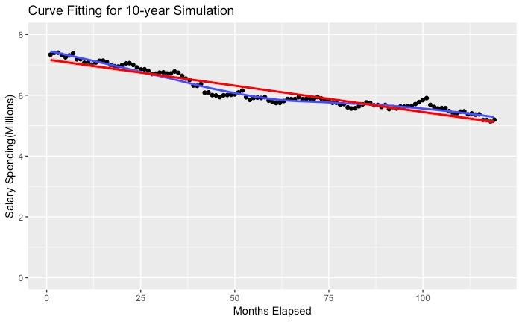
Curve Fitting for Salary Trending
Salary Spending=-0.017 * Months+7.178

Slide 6
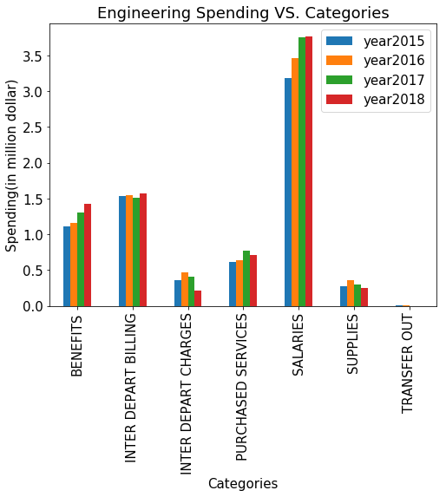
Engineering
Notes:
My project focus on Engineering Agency for city of Madison. The Engineering Agency is responsible for design, supervision and inspection of city construction for Madison. This histogram shows the budget spending from 2015 to 2018. You can see that About 50 percent of total Engineering Spending is on Salary Spending, which means that if we have good prediction for the Salary Spending, we will have good estimation of the total Budget. Therefore, I decide to build a Salary Simulation to predict future Salary Spending for Engineering Agency.

Slide 7
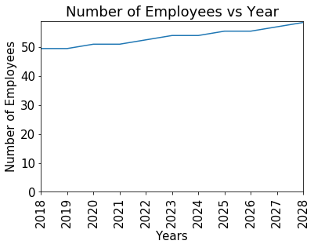
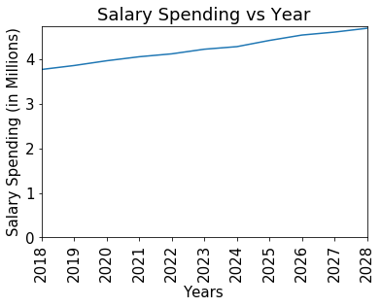
One single simulation
Number of Employees: Increasing
Salary Spending: Increasing
Notes:
Therefore, I generate simulation for next 10 years using 2018 as base year and this two plots are result from one single simulation. This graph shows the number of Employees vs Year. The graph on the right shows the Salary Spending vs Year. You can see that there is an upward trend for both number of employees and salary. Which means that in next 10 year, the total budget for Engineering will increase.

Slide 8
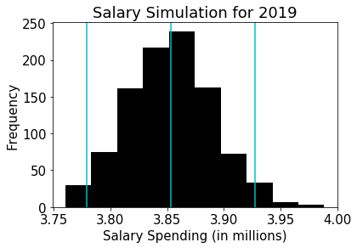
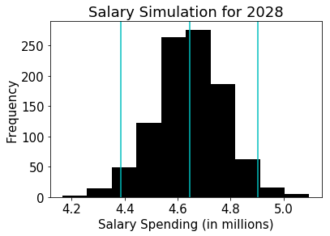
1000 Simulations
2019:
mean:$3.85M
lower:$3.78M
Upper: $3.93M
2028:
Mean:$4.6M
lower:$4.4M
Upper: $4.9M
Notes:
Then I did the simulation for 1000 times. These two plots shows the distribution of salary spending for 2019 and 2028. The blue line shows the mean and 95 confidence interval for the 1000 simulation. For example, for this year, it is very likely that the salary spending for Engineering Agency will be between 3.8M and 3.9Million. 10 years late, it is very likely that the salary spending for Engineering Agency will be between 4.6M and 4.9Million

Slide 9
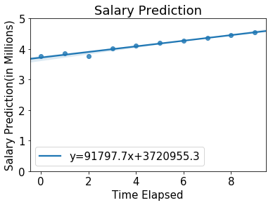
Regression
Y = 91797.7x + 3720955.3
Ex: 20 years later
Y = 83452.4*20 + 3382686.6
= $5.5M
Notes:
This is a linear regression analysis for 1000 simulation. You can see that this regression analysis shows that the salary spending will likely increase in the future. Therefore, Which means, in the future, the total budget for Engineering will increase.

Slide 10
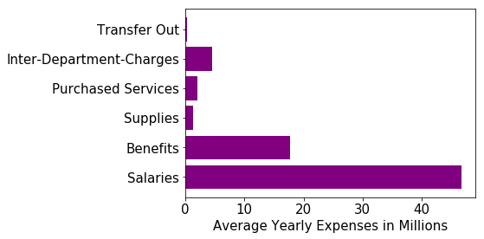

Madison Police
Police spending dominates the budget
Majority of the Police expenses stem from salaries
Notes:
Police spending (72.63 Million) on average accounts for 22% of the overall spending budget. Of that 22%, 65% of the total police expenses are their salaries.
What does this mean? The police agency is a huge part of the madisons government and make up a little over a 5th of the total budget. Their salaries make up 65% of their expenses. Clearly their salaries are an integral part of predicting the future budget.

Slide 11
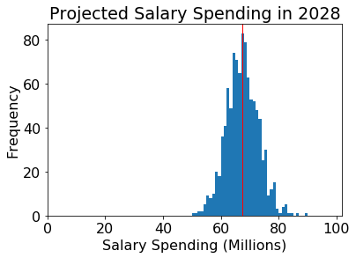
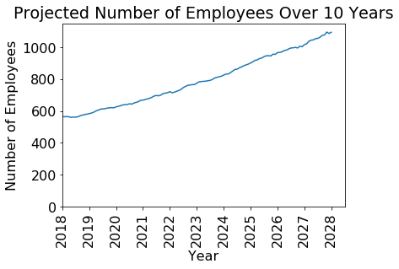
10 Year Simulation
Salary Spending in 2028 increased by 141% since 2018
Number of Employees increased by 128% since 2018
Notes:
Official Police Expense report in 2008 reported their benefits and wages to be 46 million, 84% of their total budget
Nine years later in 2017, wages and budget is 64 million dollars,86.7% of their total budget. Going off our data and previous data, salaries are around 75% of the total wages and benefits sum.
Our ten year projection of salaries which is around 68 million, making wages and benefits total around 90 MIllion, an increase of 26 million, is in line with the jump from 2007, to 2017 (18 million dollars). A 141% increase in Salary expenditures.
Analysis of number of employees over past 10 years shows an average increase of ~23 employees/year. *Actual* graph projects an increase of ~40 employees per year. This seems a bit high, however, this is due to the limitation of our small dataset. Ex. if there was a short hiring spike during our 24 month dataset, our parameters will be skewed and this affects our simulation numbers.

Slide 12
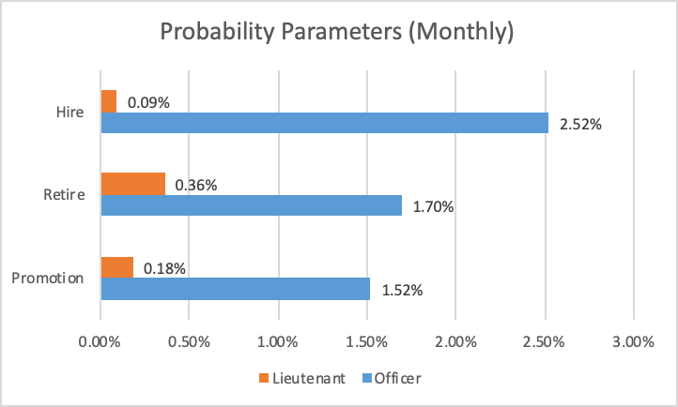
Analyzed monthly changes for each position
These numbers likely change over time
Other factors could be taken into account
Parameters
Notes:
Some positions had more mobility than others
Analyzed the trends in the 25 month period.
We found parameters to make the data as accurate as possible.

Slide 13
Main Takeaways
Police Salaries will continue to increase. The budget going forward should recognize this
Retiring in higher positions will increase, thus creating more promotions
Library Salary is increasing and decreasing among each months but overall is decreasing
Engineering Salary will continue to increase. The budget for 2020 is very likely to be increased
Notes:
Mention Problems we had, merging into one slide with takeaways!!
Only 25 months of data
Data format was problematic
Limited amount of time to build the simulation
Beginner knowledge of programming and dataset
Precision of simulation method(error)

Slide 14
Looking Forward
Treated parameters as independent of each other, but in reality they very much are not
Fix some of the bugs and errors
Try different simulation methods to be more precise
Not compatible enough with other datasets
Create better parameters from a more extensive dataset
Ex. Incorporate an employee’s age into the model
Notes:
Xi

