Slide 1
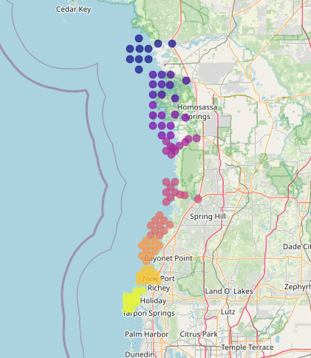
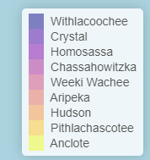
Nature Coast Aquatic Preserve
Nine estuarine / river systems:
Anclote
Aripeka
Chassahowitzka
Crystal River
Homosassa
Hudson
Pithlachascotee
Withlacoochee
Weeki Wachee
Notes:
Designated in 2020, 2nd largest aquatic preserve in the state
We wanted to determine any redundancies between sampling sites to determine long-term feasibility of continued sampling (regarding logistics of sample collection and budgeting)
Some systems are entirely estuarine, some have river and estuary components
Assumption is that river-based sampling will be maintained to capture gradients (esp. salinity)

Slide 2
Nature Coast Aquatic Preserve
Parameters measured
Water Temperature (*C)
Salinity (ppt)
Dissolved Oxygen (mg/L)
pH
Total Phosphorous (ug/L)
Total Nitrogen (ug/L)
Chlorophyll-a (ug/L)
Color (PTCO)
Kd (Light Attenuation Coefficient)
Monthly monitoring via Project COAST (UF) – 1998-2019
Long-term trend monitoring
Establishment of baseline water quality status
Re-established monitoring at all 90 stations in 2021 with establishment of NCAP
Notes:
Long-term trend monitoring
Establishing a baseline water quality status
Original experimental design appears to be designed to capture river, river mouth, and salinity zones within the estuary, with replication
Maybe some sampling sites are redundant now that regional baselines have been established
Quarterly sampling in some of the same areas done by SWFWMD (2015 - )

Slide 3
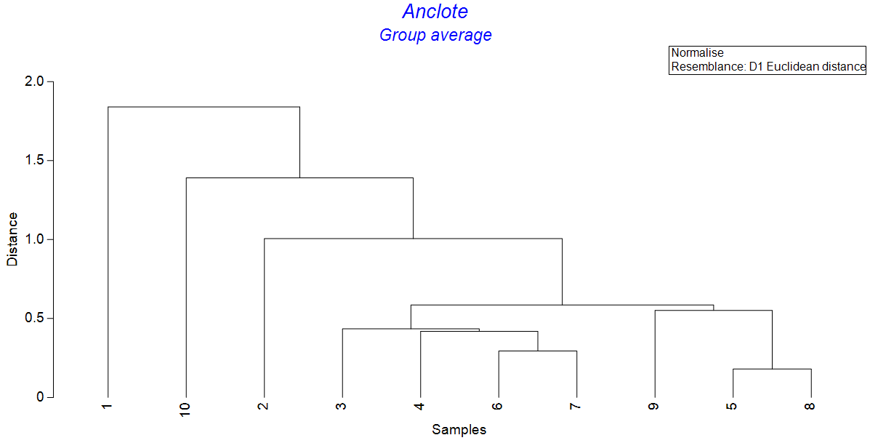
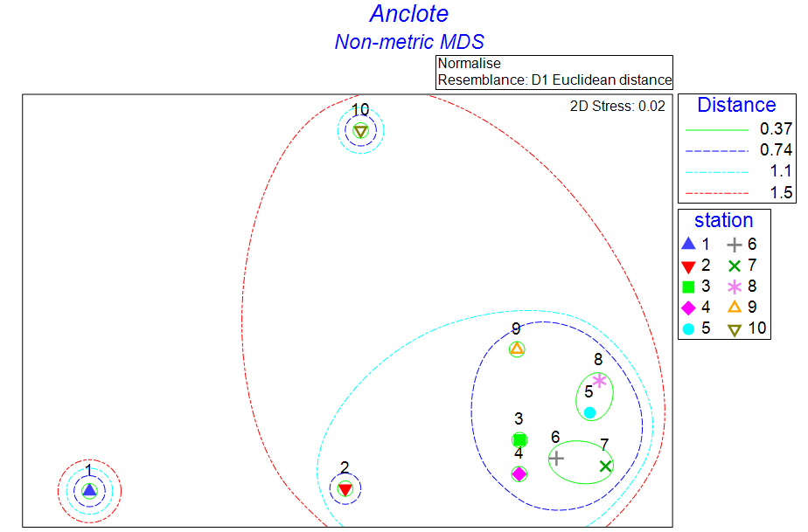
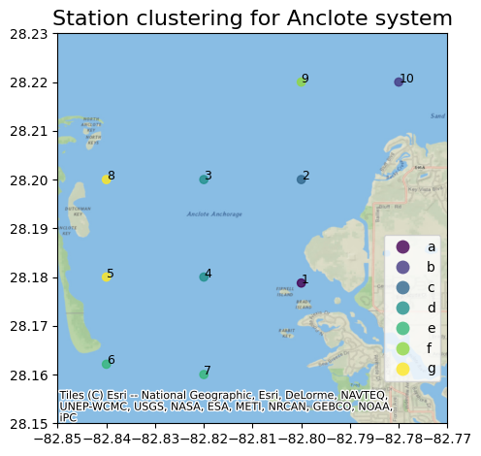
Notes:
Primer Permanova results, groups are pair-wise comparisons between each station
Low t-test values (typically under 1) and p-values greater than 0.95 could be classified as significantly similar
(Non-metric multidimensional scaling)
For nMDS, data must be normalized first. The dendrogram is obtained from station averages, then overlaid on the nMDS plots to produce the “lassos”
The “distance” lassos (red, blue, green) on the nMDS plots correspond to the y-axis deno
Green lassos implying a higher level of similarity between the stations in multidimensional space

Slide 4
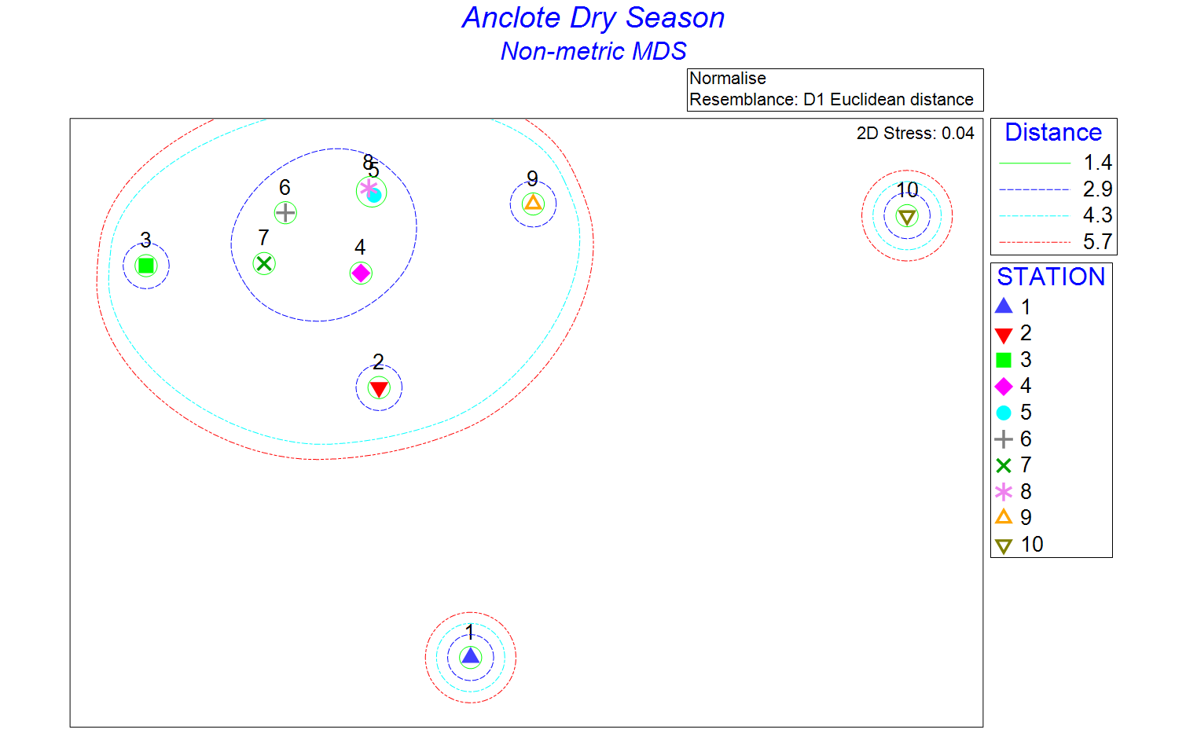
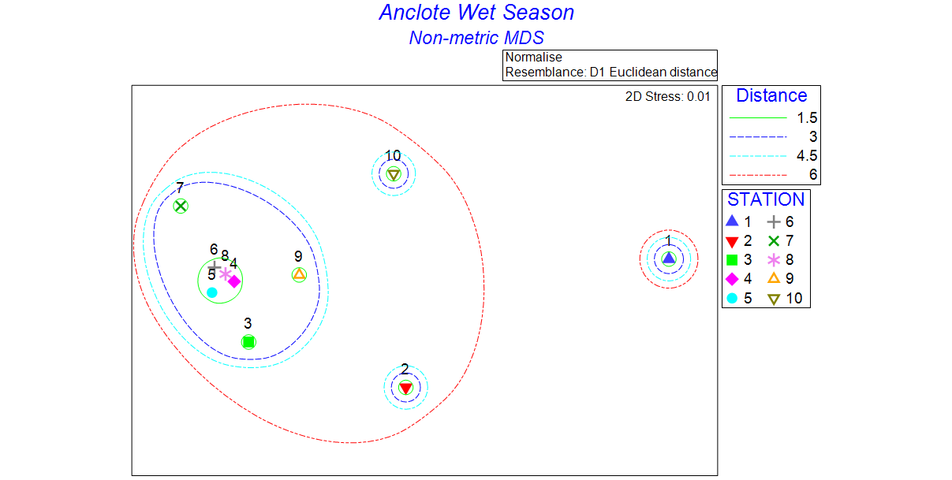

Notes:
Original approach was to compare dry and wet seasons to see the differences in groupings during rainy season and dry season
This is from the original analysis using only 3 years of recent data;
Using the Project Coast definition: wet season (may 15 to October 15), dry season (Jan 1st to May 14)
The groupings stayed mostly consistent, but with higher levels of clustering during Wet season.
The plots using all available data provided a good overall picture of the relatedness of sampling sites

Slide 5
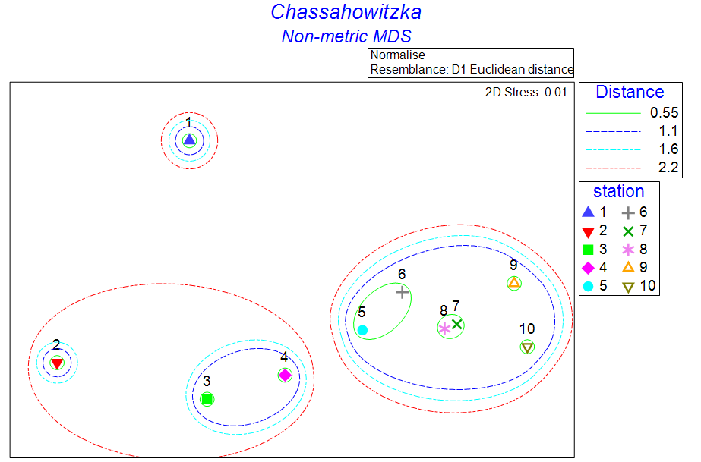
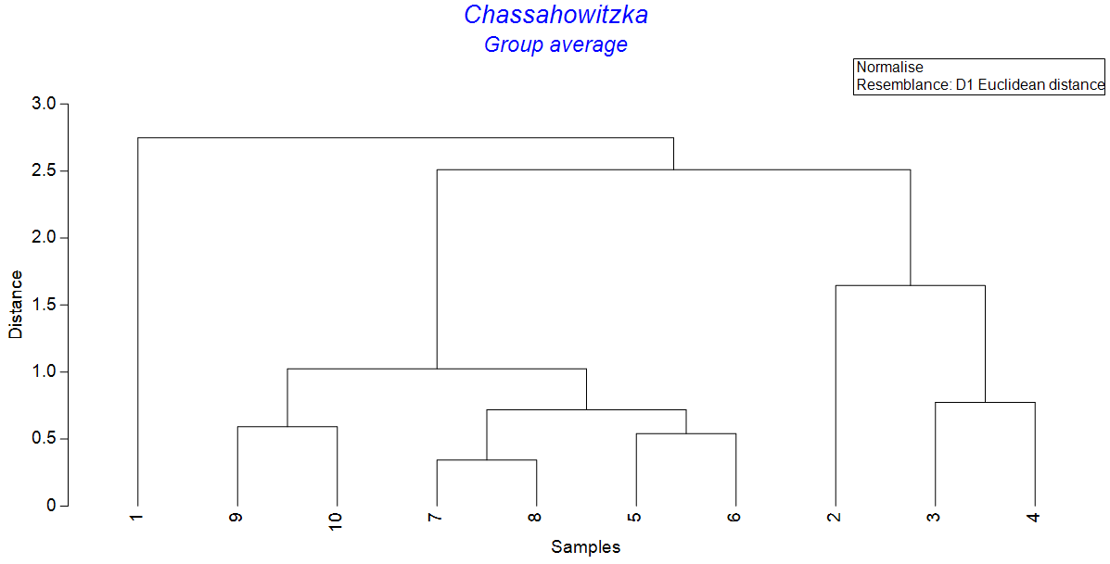
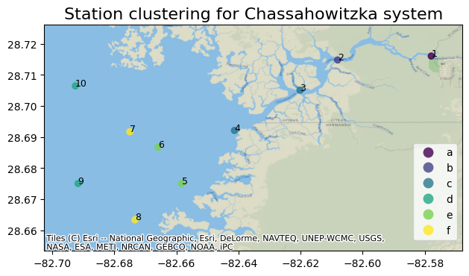
Notes:
Chassahowitzka is a good representation of river systems in Nature Coast
Here the river-to-estuary gradient is apparent, with salinity being the main driver. Temperature and dissolved oxygen to a lesser extent

Slide 6
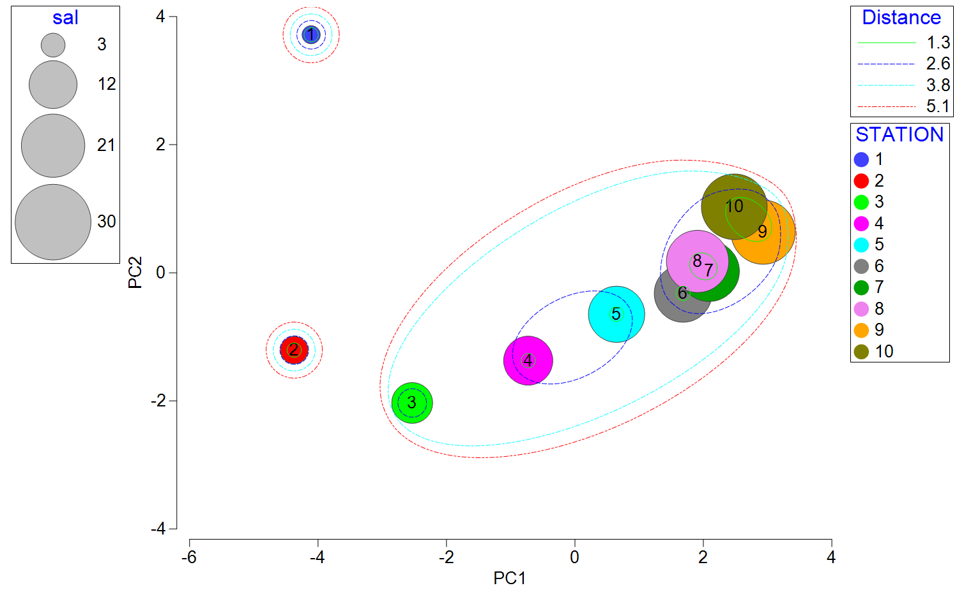
Chassahowitzka Dry Season – Salinity
Notes:
(from earlier analysis using 3 years of data)
Site 1 starting at the spring-fed source of the river heading out into estuary

Slide 7
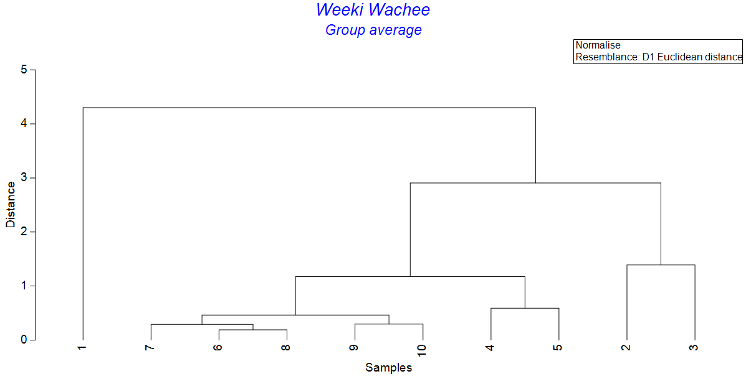
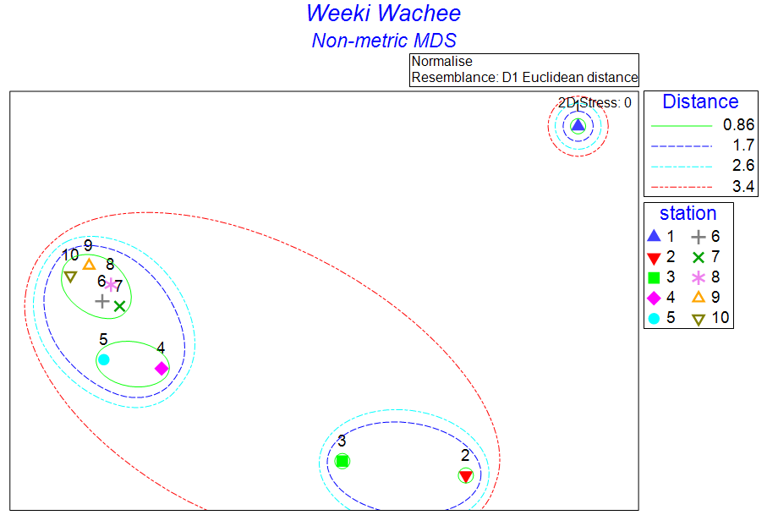
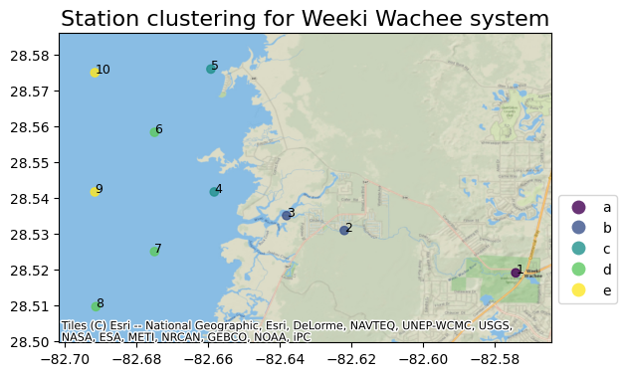
Notes:
1,2,3 are river sampling sites
4,5 group together as near-shore sites
6,7,8,9,10 are grouped together as estuarine

Slide 8
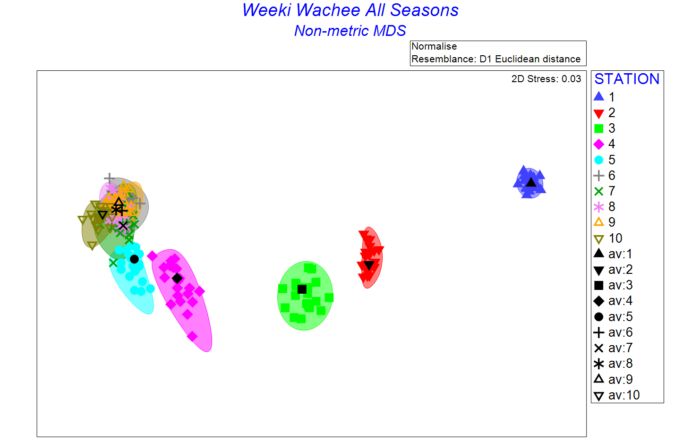
Bootstrap Averages
Bootstrapping techniques can be employed to assess the stability of clusters. By repeatedly resampling your data (with replacement) and re-clustering, you can see how often the same items cluster together.
Notes:
The more oblong stations (such as station 4 - pink) imply a higher level of seasonal variation at those stations (station 4 is estuarine but close to river mouth). Compared to station 1 where the averages cluster more tightly, implying less seasonal variation between samples

Slide 9
Further considerations
If long-term monitoring is the goal then the temporal frequency can be reduced
Quarterly / semi-annual rather than monthly
Logistical concerns (site accessibility)
Using airboat in open water resulting in greater maintenance costs

Slide 10
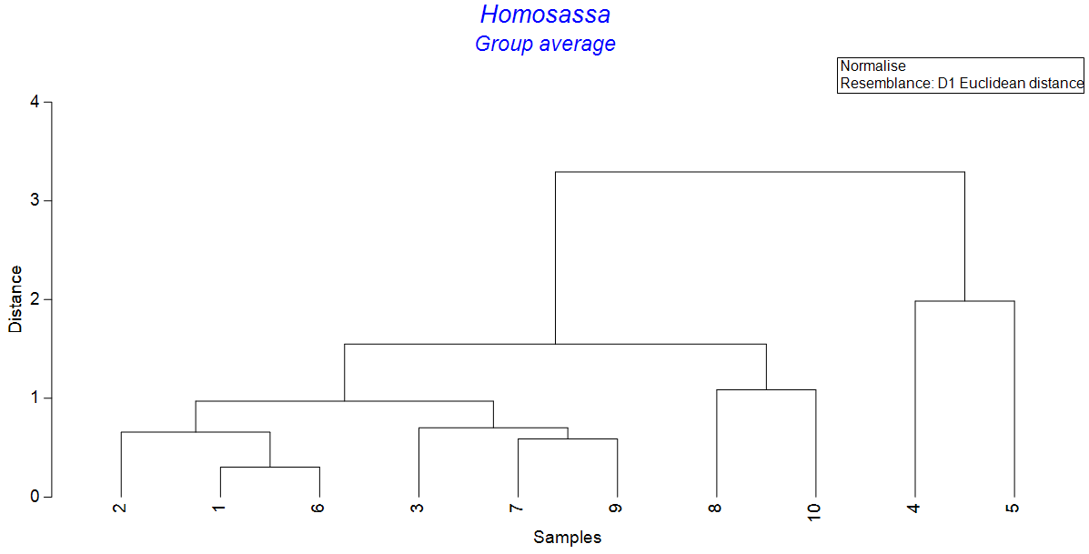
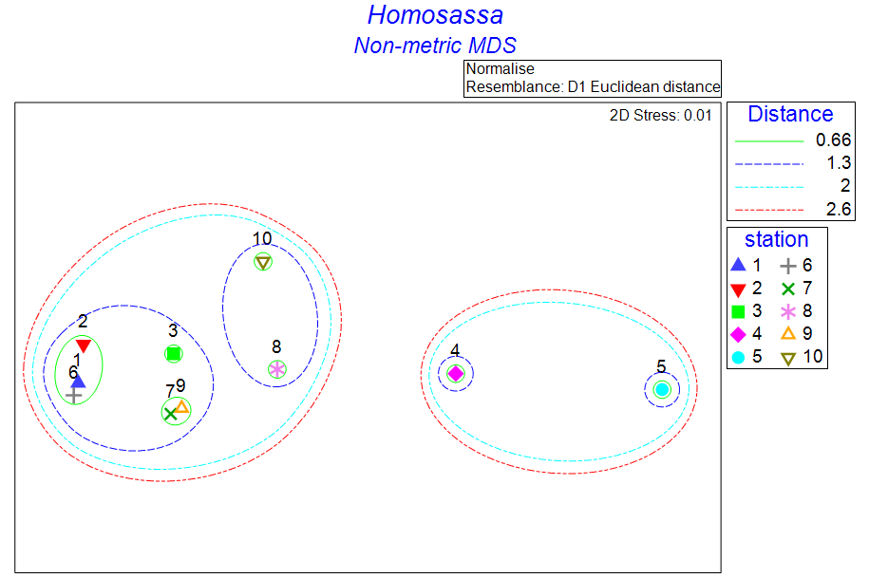
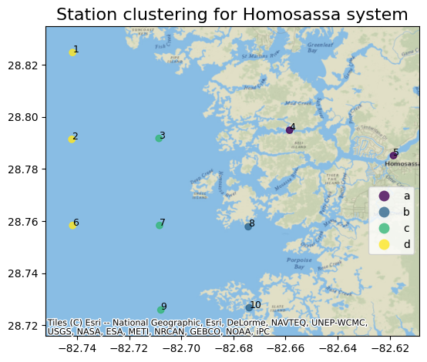

Slide 11
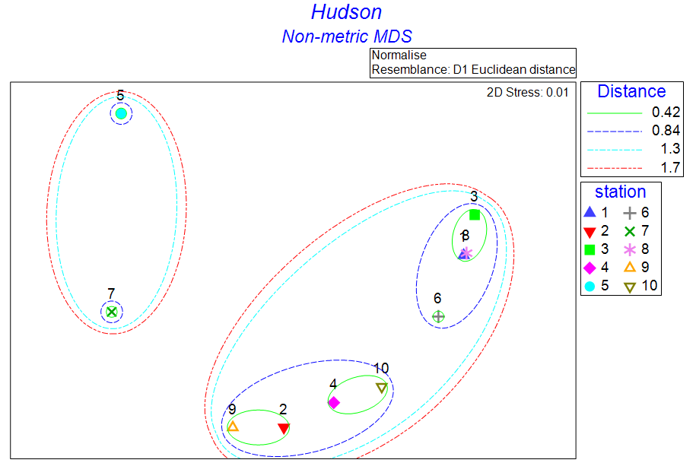
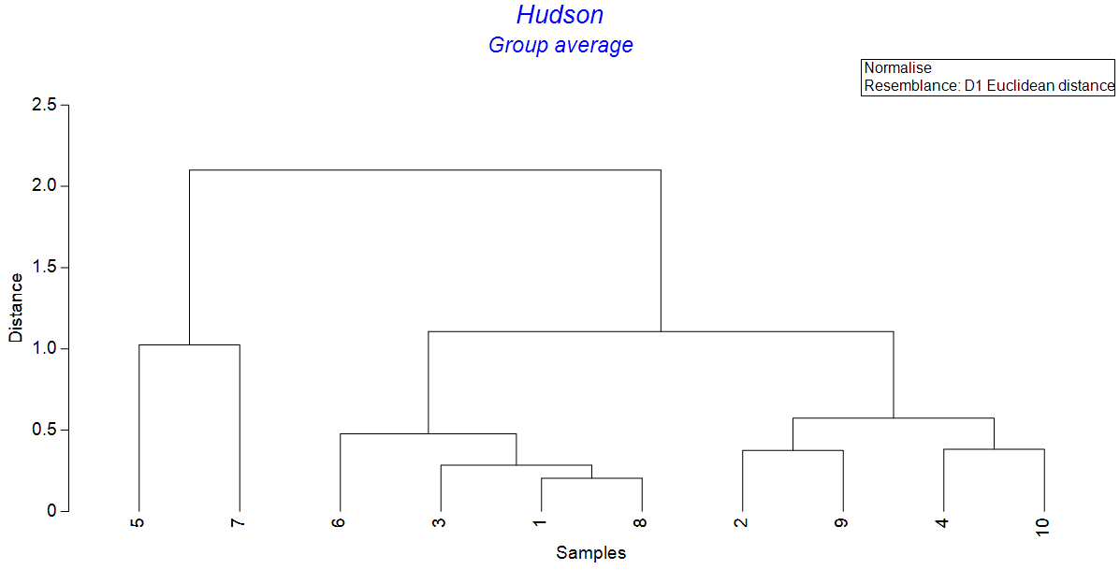
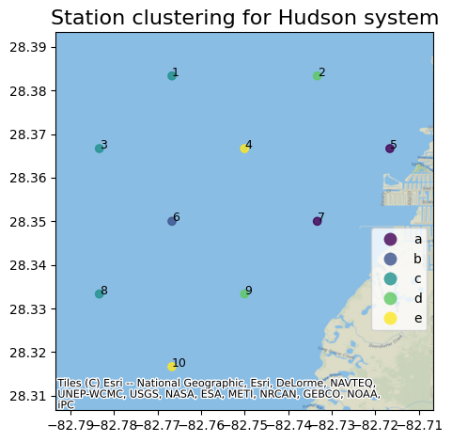

Slide 12
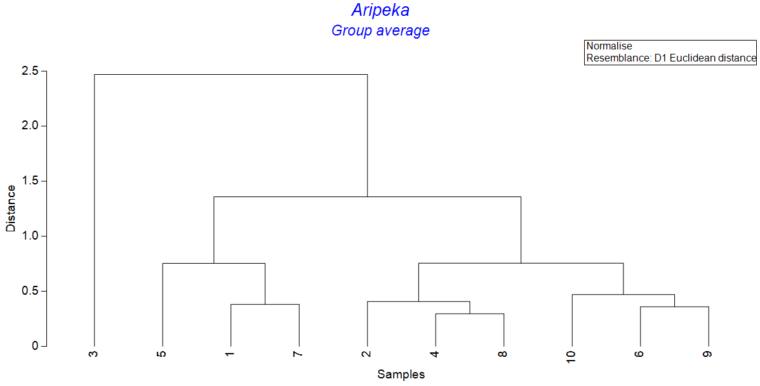
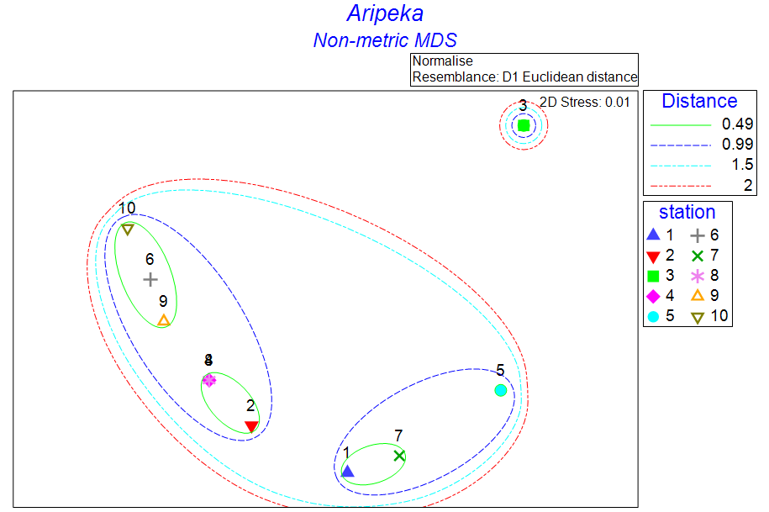
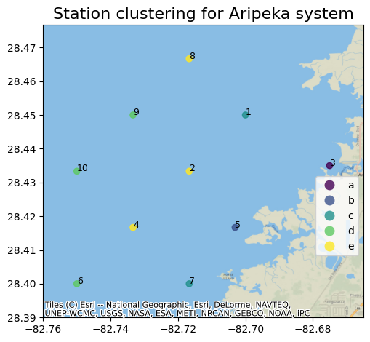

Slide 13
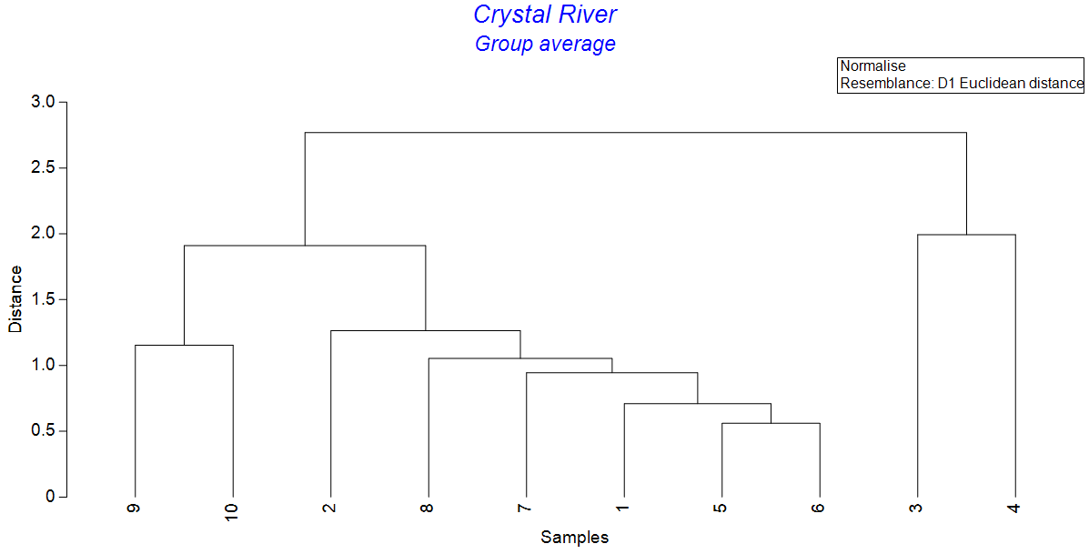
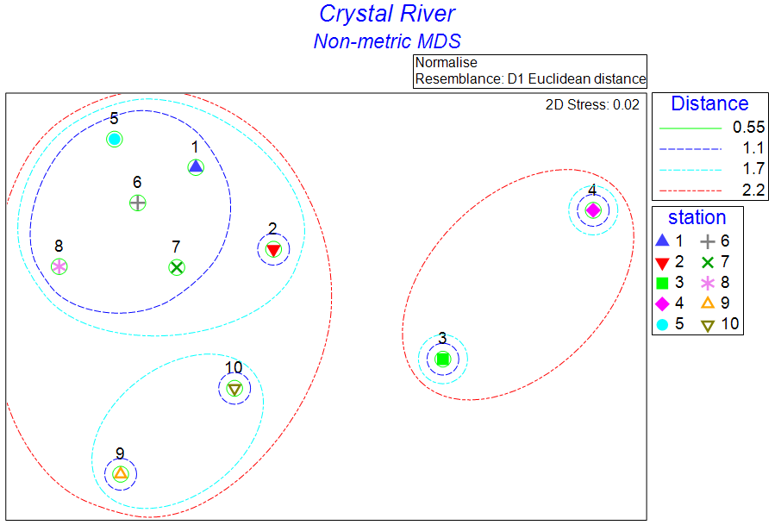
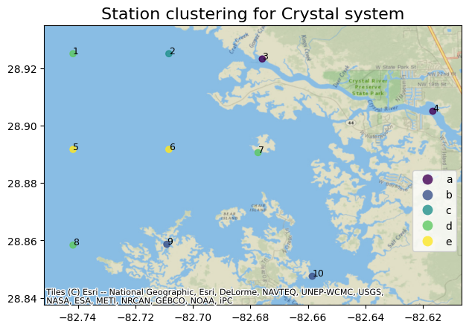

Slide 14
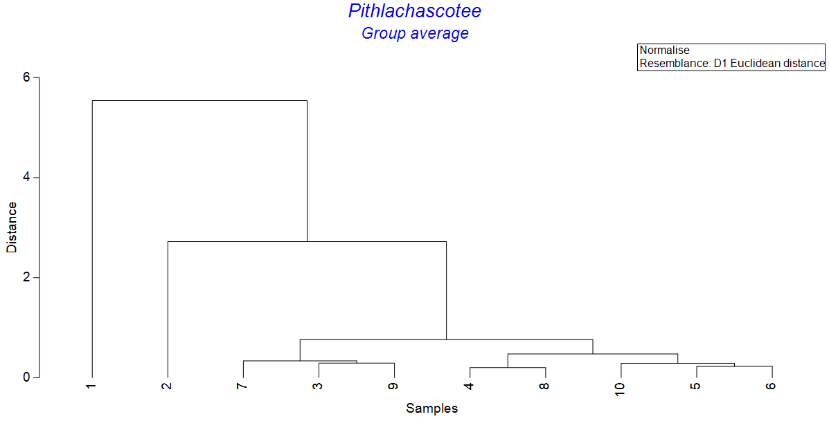
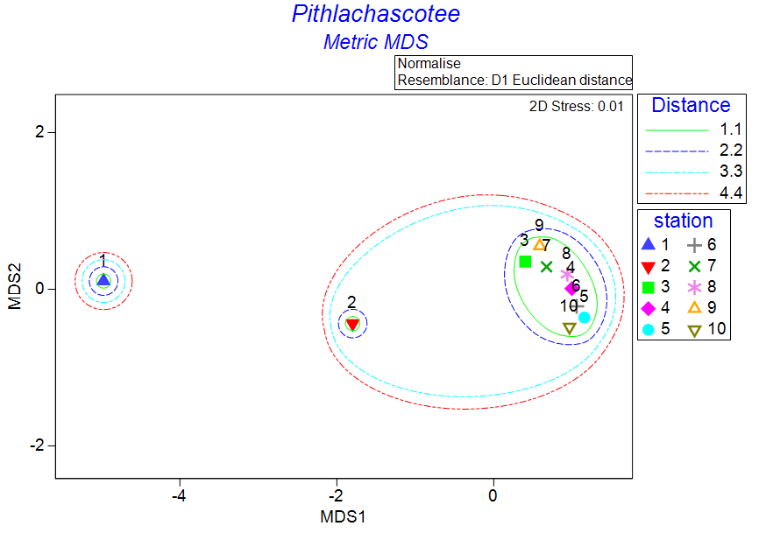
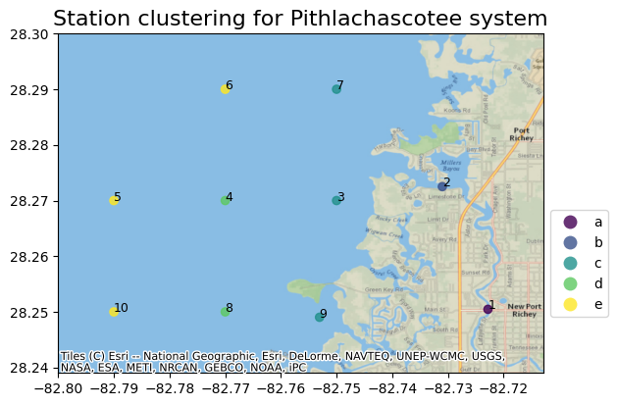

Slide 15
